Slide 1
Adoption of Climate Smart Agriculture by smallholder farmers in India
Key Pathways to Change
13th February 2023
Dr Srivalli Krishnan
Bill & Melinda Gates Foundation

Slide 2
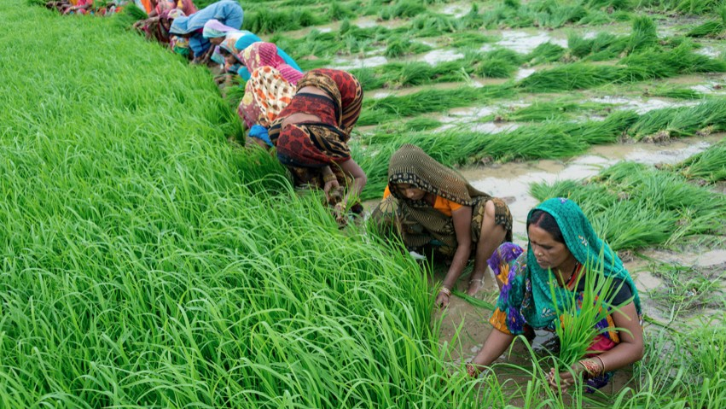
AGENDA
Climate Strategy
Key Learnings
Pathways for Success

Slide 3




Climate Strategy should address three key levers: institutional implementation, innovation, and inclusive markets
Areas of Investments
Partners
Outcomes
Impact
Support Institutional Implementation
Mainstream climate adaptation in national & state action plans, and institutional strengthening
CC policy design and prioritization (CSA) integration, social safety nets, performance analysis
Advancing climate-smart R&D policies & allocations
Institutional and implementation support
ICT & DIGITAL SOLUTIONS
GENDER
PRIVATE SECTOR
State partnerships with Uttar Pradesh, Bihar and Odisha
Federal partnerships with MoAFW, ICAR, DBT. CSIR
Universities e.g. TNAU, PAU, IARI, IISc
Industry associations e.g. CII, FICCI, GS1
International Financial Institutions e.g. ADB, World Bank, IFC
Private sector e.g. Reliance, ITC, Cargill, Corteva
Startups and incubators e.g. Social Alpha, Mivipro Technologies
Non-profit organizations e.g. Digital Green, Microsave, CINI
Strengthened public and private sector capacity to achieve SSP-centric climate adaptation goals
Increase agricultural productivity for SSPs
Promote Innovation
Support climate adaptation-centric R&D solutions, including resilience to biotic and abiotic stress
Building innovation pipeline in partnership with public and private sector
Digital climate advisory services
Shaping public investment priorities
Leveraging public/pvt financing
Varietal improvement and modernization of breeding systems
Interdisciplinary and translational research, including agronomy and livestock (public & private sector
Increase SSP household income
Inclusive agricultural transformation that increases rural incomes, empowers women, better nourishes families, and spurs economic growth
Leverage and promote Climate Smart Agriculture innovations in public & private sector, including emerging startup ecosystem
Increase equitable consumption of a safe, affordable, nutritious diet year-round
Shape Inclusive Markets
Supporting inclusive/resilient markets and risk mitigating innovations/solutions
Improving market resilience for Small Scale Producers (SSPs)
Risk mitigating innovations/solutions
Increase women’s empowerment in agriculture and livestock
Govt prioritization & resource allocation
Govt implementation capacity
Shaping inclusive markets
India for India / World evidence generation

Slide 4
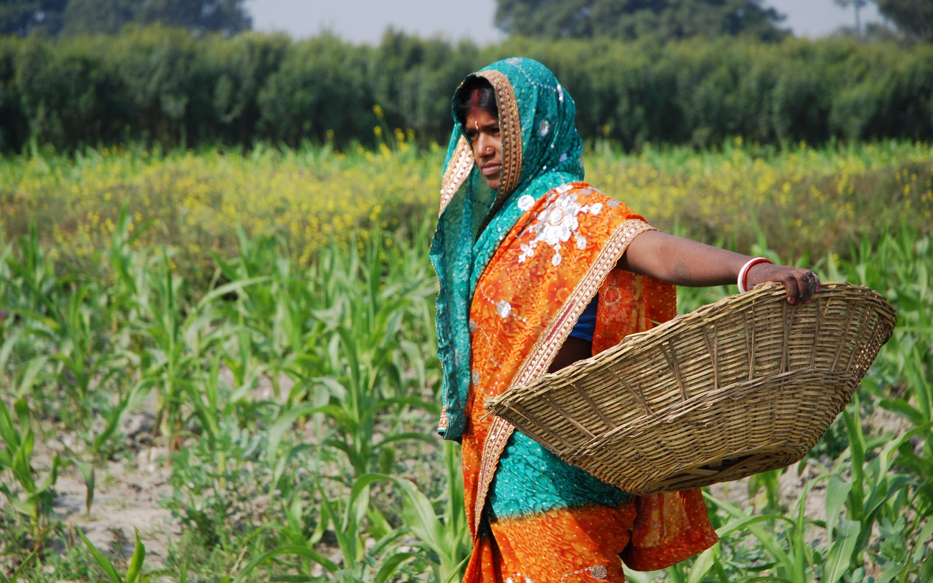
AGENDA
Climate Strategy
Key Learnings
Pathways for Success

Slide 5

A systems lens can prove useful in tackling the challenges in the way of mainstreaming climate adaptation in agriculture by smallholders in India
Key Actors
Government | Private sector | DFIs and Foundations
Potential Solutions
Technology Advancement
Build pipeline of scalable technologies, especially for population scale rollout
Support early stage innovation, and drive further innovations in the field
Demonstrate business cases for SSPs to adopt innovation
Drive capital investment in local production of climate smart technologies
Adoption Support
Introduce affordable pricing and payment models to enable SSP adoption
Build a distribution network for last-mile access to products and services
Provide on-call product support to familiarize SSPs on using products and services
Ecosystem Enablement
Institute regulations for safety, quality control and consumer protection
Introduce incentives to promote use of climate smart solutions and make them competitive with incumbent technologies
Current Scenario
Limited uptake of solutions at SSP level
Products and services see early levels of adoption, but few make it to large-scale adoption
Perceived risk in pushing new innovations
Governments perceive high risk in investing in untested technologies and promoting them among SSPs
High cost of business
Due to high costs of doing business i.e. high input, marketing and distribution costs, the private sector has been slow to make big moves

Slide 6
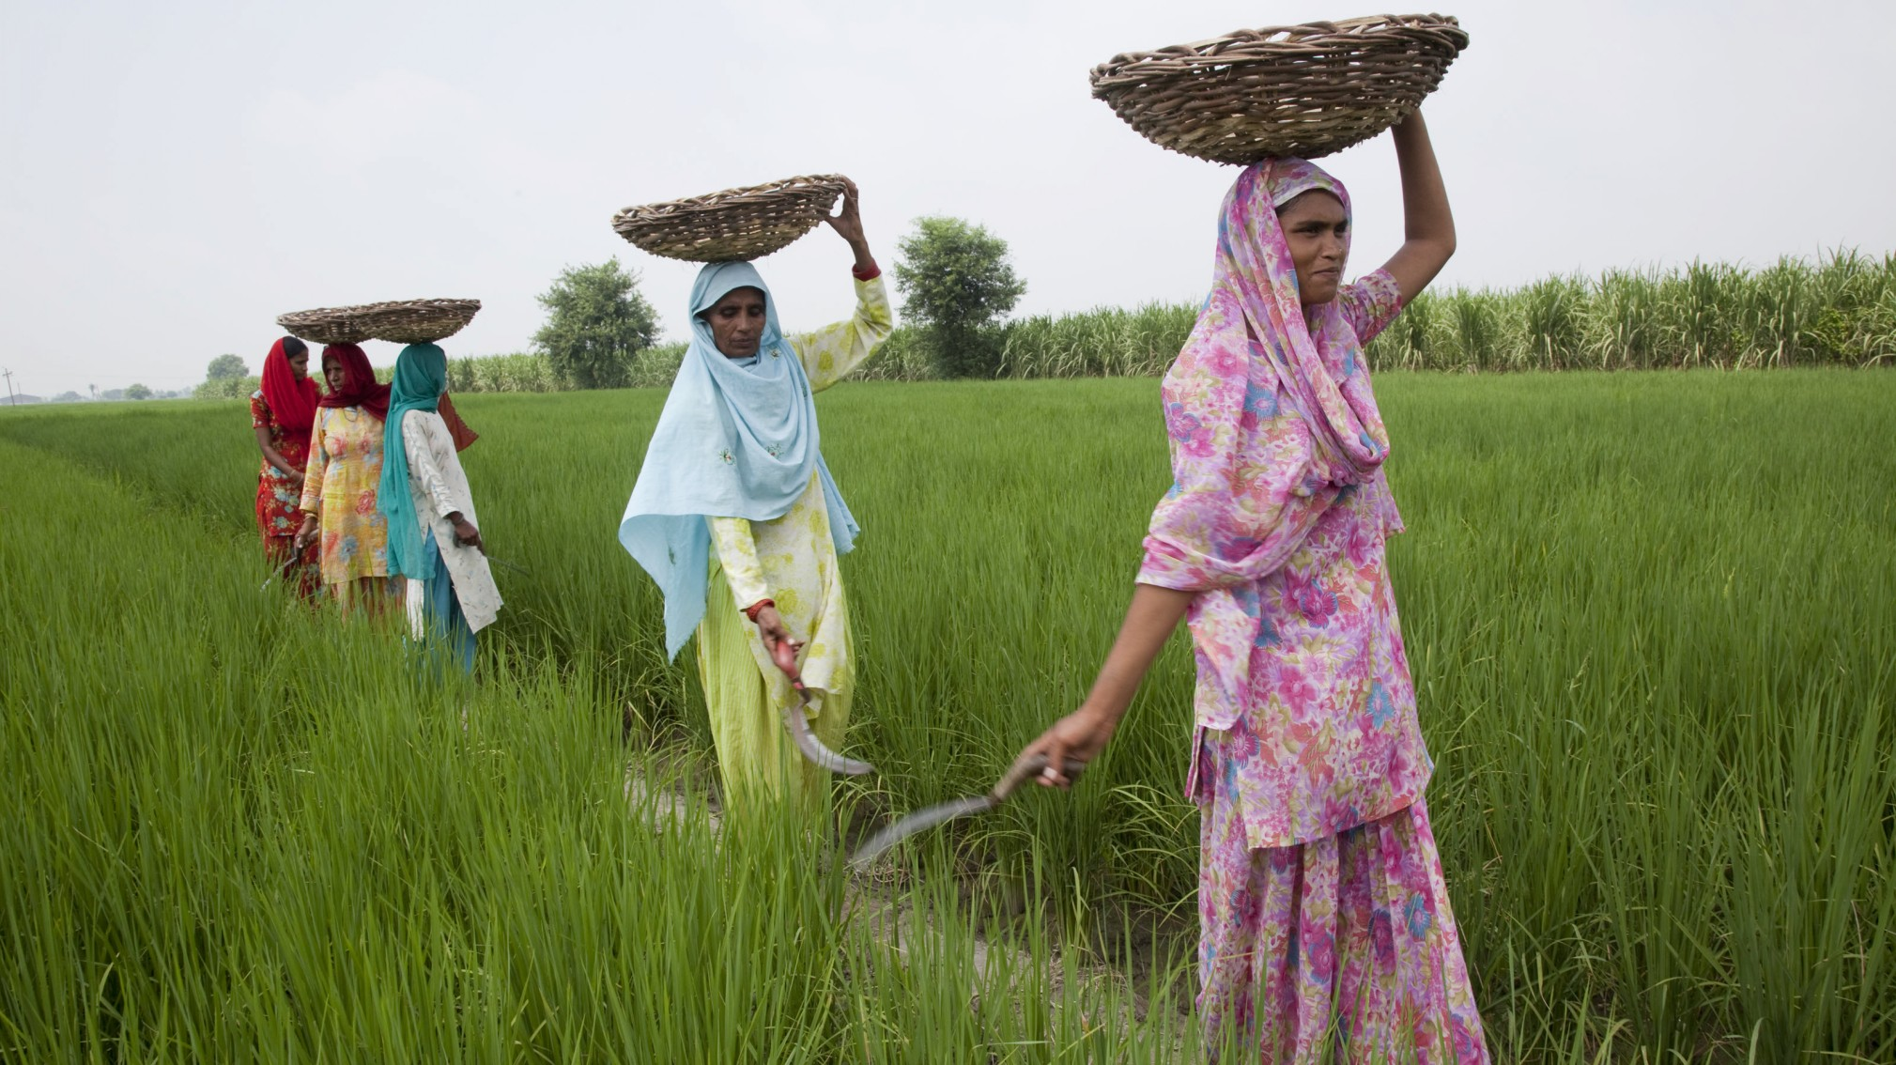
AGENDA
Climate Strategy
Key Learnings
Pathways for Success

Slide 7
Four pathways provide opportunity for success for CSA in India
1
2
3
4
Promoting emerging innovations
Pipeline development: Field new technologies based on technological maturity, technical feasibility and financial viability parameters Product support: Provide field testing sites, experimentation and product iteration support Enabling businesses to start early and start small: Provide support to test new business and operating models
Positioning tested innovations for success
Regulation: Develop quality and safety controls (through accreditations, customer safety redressal platforms) to regulate technologies Capital and financial leverage: Build capital and financial leverage through partnerships with private sector, DFIs, etc. Financial de-risking: Partner with financing institutions to promote affordable financing and payment options for products and services Set up distribution channels: Collaborate with community institutions etc. for rapid last-mile distribution and delivery of products and services
Leveraging community institutions for scale
Deep testing: Use FPOs, dairy cooperatives, etc. as microsites for testing products and services in specific commodities/ geographies Innovate new distribution models: Test new models of product and service distribution e.g. custom hiring, bundling with agri-inputs, Farming as a Service, etc. Diffuse innovations organically: Leverage progressive farmers in communities as champions of climate smart solutions.
Digital extension services for resilience
Leveraging existing extension infrastructure: Tap into the network on agricultural extension service providers and institutions, both public and private, e.g. Krishi Vigyan Kendras, ATMAs, agricultural entrepreneurs, etc. Maturing to precision agriculture: Develop integrated products and services providing SSPs microclimate-based advisory and inputs. Data as an enabler: Using data on climate, agricultural practices, crop production etc. for financial products e.g. insurance, carbon finance, etc. and value added services e.g. market alerts

Slide 8
