Slide 1

School of Electronics Engineering (SENSE)
Project-I (2026)
Project Title
Student Name(s):
Name — Reg. No.
Guide's Signature with Date
Guide:
Dr. Guide Name, School
Signature: _____________________
Programme / School:
B.Tech — SENSE, VIT Chennai
Date: _________________________
Review & Date:
Review-II · 30.09.2026 (Wednesday)
Approval is mandatory before every review. After signing, scan this slide and keep the scanned copy as Slide 1 of the presentation.
2

Slide 2
Introduction & Problem Recap
Problem Recap
• Large-scale AI weather models (Aurora: 1.3B params; CREDIT: multi-model NWP) achieve SOTA global forecasts but require massive compute (multi-GPU clusters, petabyte datasets) — inaccessible for single-city or college-scale research.
• No lightweight, reproducible framework adapts these ideas (pretrain→fine-tune, standardized evaluation, autoregressive rollout) at a localized, laptop-trainable scale for Indian cities.
• Existing digital-twin + ML work (Jyothi & Mesapam 2026) uses spatial/urban data (LST, NDVI) but not multivariate hourly weather time-series with sequence models.
Research Objectives
• RQ1 (Transfer Learning): Does multi-city pretrained Transformer improve Delhi forecast accuracy vs. scratch training on the same architecture?
• RQ2 (Forecast Horizon): How does per-variable RMSE degrade across 1/3/6/12/24-step autoregressive horizons?
• RQ3 (Architecture): Persistence vs. LSTM vs. Transformer (scratch) vs. Transformer (pretrained+fine-tuned) on 6 ERA5-Land variables for Delhi.
Refinements after Review-I
• Adopted ERA5-Land reanalysis grid cell terminology (not "weather station").
• Separated n_features (6) and n_targets (6) in all model constructors for API consistency.
• Machine-readable JSON run manifests recording seed, device, scaler path, git commit, software versions.
• Mandatory scenario disclaimer: outputs are sensitivity experiments, not causal simulations.
4

Slide 3
Detailed Literature Review
No. | Author(s) & Year | Title / Source | Method / Approach | Findings & Research Gap
1 | Bodnar et al., 2025 | A foundation model for the Earth system (Aurora) — Nature | 1.3B-param Perceiver + 3D Swin Transformer; global pretrain→fine-tune on multi-source Earth data | SOTA on air quality/waves/cyclone tracks/weather; needs massive compute — motivates lightweight single-city adaptation
2 | Schreck et al., 2025 | CREDIT: a scalable framework for AI-driven Earth System Modeling — npj Climate & Atmos. Sci. | Modular AI-NWP framework (WXFormer, FuXi); standardized preprocessing, training, multi-horizon evaluation | Outperforms IFS HRES on 10-day forecasts; not tested at single-city/laptop scale — motivates ClimateTwin’s scaled-down protocol
3 | Jyothi & Mesapam, 2026 | Digital Twin for Climate-Resilient Urban Planning (UHI, Bengaluru) — ISPRS Archives | Random Forest regression on LST/NDVI/NDBI/NDWI/albedo; CesiumJS 3D digital-twin platform | Predicts 1–2°C LST rise by 2034; digital-twin+ML pattern for climate prediction, but spatial/urban not multivariate time-series
4 | Fang et al., 2021 | AttEF: ConvLSTM Encoder-Forecaster with Attention for Precipitation Nowcasting — IASC | Global-channel attention block (GCA) embedded in ConvLSTM encoder-forecaster | Attention reduces blurring vs ConvLSTM/TrajGRU/PredRNN; supports attention-based encoders for future multi-horizon rollout (Phase 7)
5 | Geng et al., 2023 | LSTMAtU-Net: A Precipitation Nowcasting Model Based on ECSA Module — Sensors | U-Net + ConvLSTM (vertical flow) + Efficient Channel-Space Attention (ECSA); custom weighted loss | Improves medium/high-intensity precipitation accuracy over ConvLSTM/PredRNN variants; reinforces multi-tier baseline comparison methodology
6 | Lim et al., 2021 | Temporal Fusion Transformers for Interpretable Multi-horizon Forecasting — IJNN | Gated Residual Networks + Variable Selection + Multi-head attention on past/future covariates | Best-in-class on 9/12 benchmarks; interpretability via attention weights — informs dashboard design
Papers 1–5 from provided survey (verbatim). Paper 6 informs dashboard design. Full 15-paper survey in docs/.
5

Slide 4
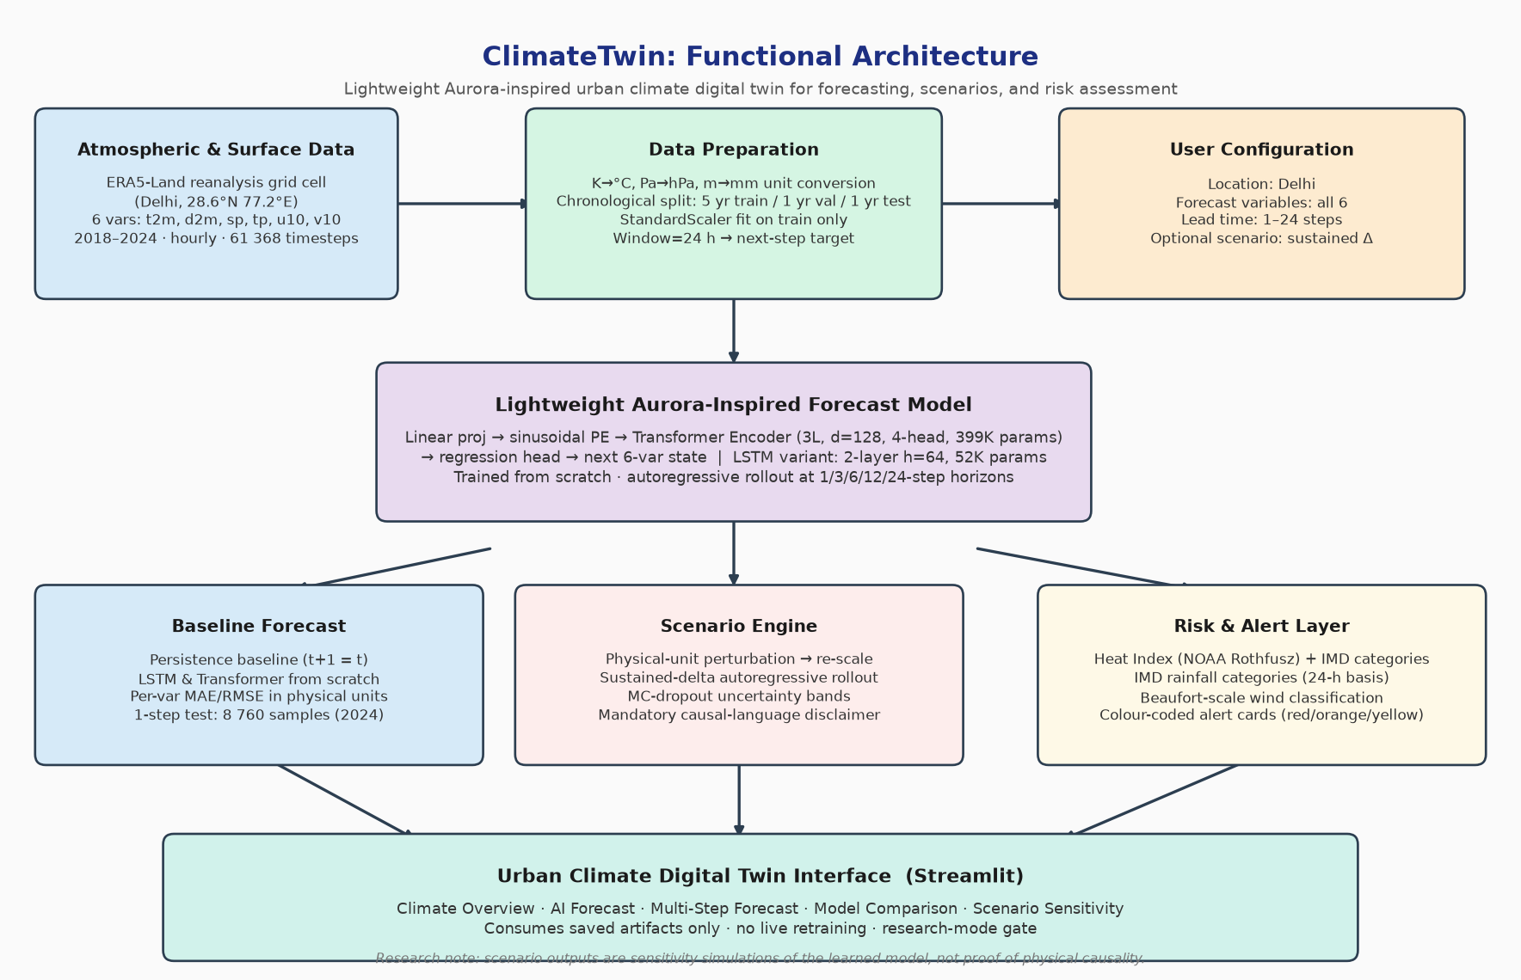
System Design & Architecture
6
Notes:
Insert your architecture / block diagram here.

Slide 5
Implementation Details
Modules Developed & Integrated (src/)
• config.py — YAML config loader with typed validation; enforces n_features/n_targets consistency
• preprocessing.py — unit conversion (K→°C, Pa→hPa, m→mm), chronological split, StandardScaler (train-only fit), scaler persistence
• dataset.py — boundary-safe sliding-window (w=24) sequence construction; PyTorch Dataset/DataLoader
• models/transformer.py — ClimateTransformer (d=128, 4-head, 3-layer encoder, sinusoidal PE, 399K params)
• models/lstm.py — ClimateLSTM (2-layer, h=64, 52K params); batch-first
• models/persistence.py — prediction(t+1) = state(t); uses same evaluation pipeline as learned models
• evaluate.py — per-variable MAE/RMSE in original units after inverse-transform; metric JSON I/O
• scenario.py — unit-aware perturbation engine with sustained-delta rollout and MC-dropout uncertainty
• impact.py — NOAA Heat Index, IMD heatwave & rainfall categories, Beaufort wind scale, colour-coded alerts
• manifest.py — JSON run manifests: run_id, seed, device, software versions, git commit
Data Pipeline (61 368 hourly timesteps)
• ERA5-Land CDS API → 3 NetCDFs → unit conversion → train 2018–2022 (43 824) | val 2023 (8 760) | test 2024 (8 784) → StandardScaler + 6 CSVs + scaler.joblib
• 1 132 negative precipitation values clamped to zero; 0 missing timestamps; 0 duplicates
Tech Stack: Python 3.13 · PyTorch 2.14 · NumPy · pandas · scikit-learn · Streamlit · matplotlib · pytest · Ruff
7

Slide 6
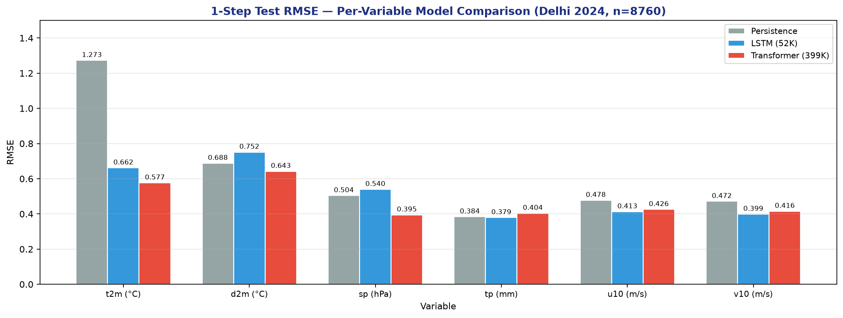
Results & Analysis (75%)
Key Findings (1-Step, Test Year 2024, n = 8 760)
• Transformer: lowest RMSE on t2m (0.577 °C, −54.7% vs Persistence), d2m (0.643 °C), sp (0.395 hPa, −21.7%).
• LSTM: wins on tp (0.379 mm), u10 (0.413 m/s), v10 (0.399 m/s) — recurrent memory suits sparse/wind vars.
• Precipitation hardest: Persistence RMSE (0.384 mm) competitive with LSTM, beats Transformer (0.404) — rain event sparsity.
• Training: Transformer epoch 8/18 (154 s, GPU, 163 MB peak); LSTM epoch 21/31 (171 s, CPU).
8
Notes:
Add your results here — graphs, tables, screenshots or outputs.

Slide 7
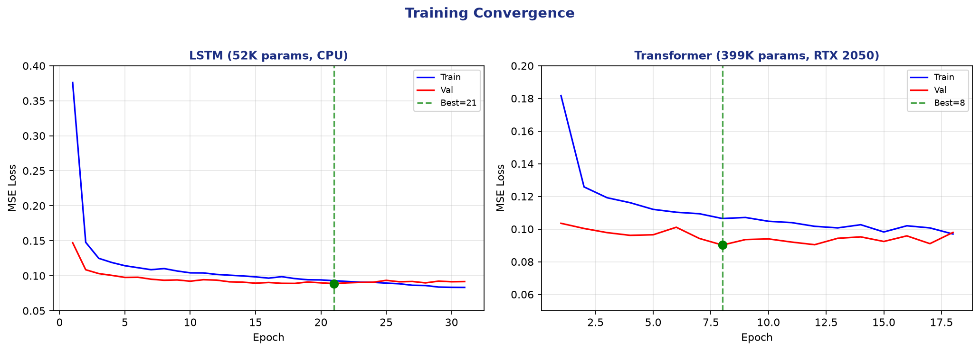
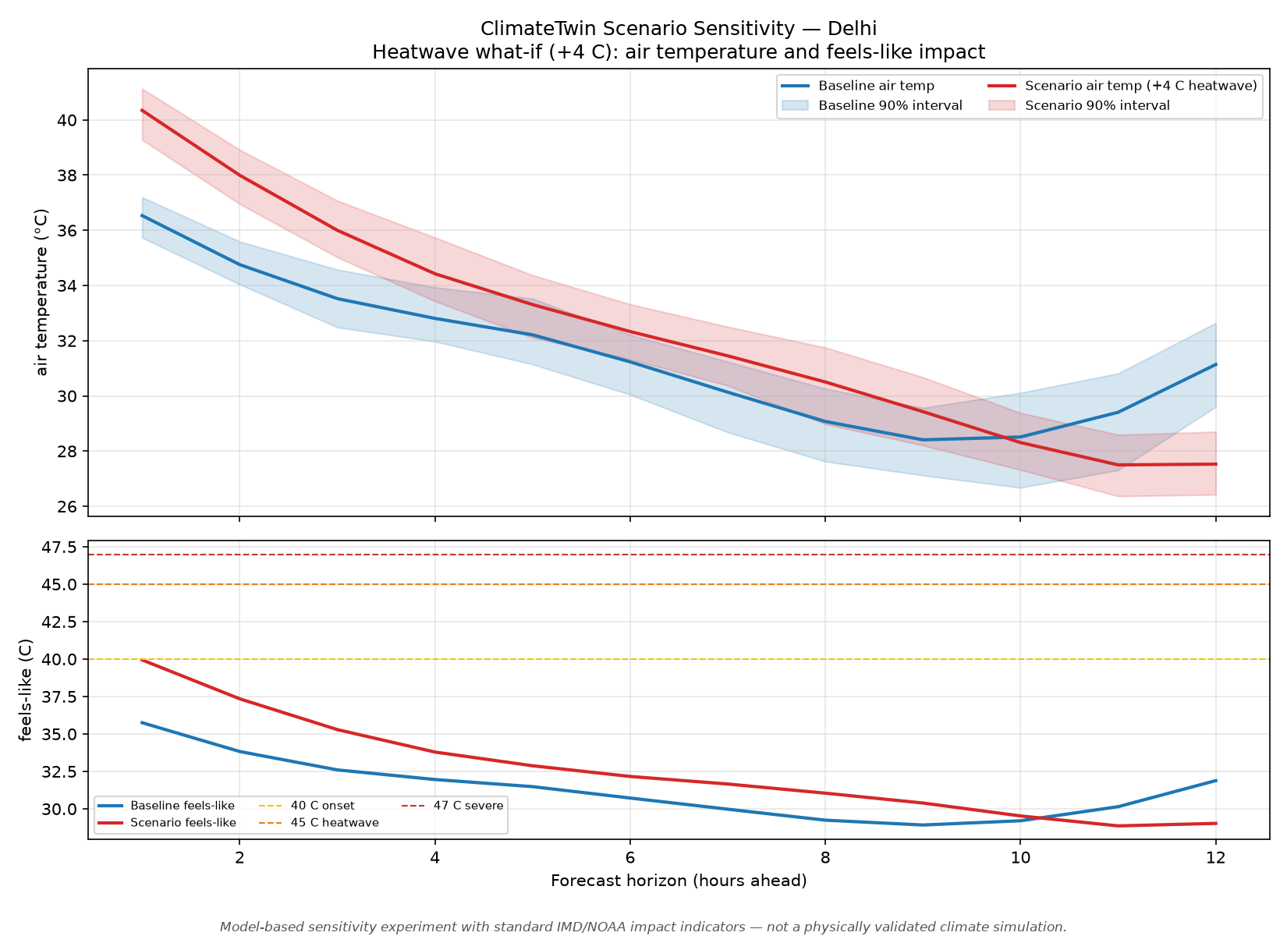
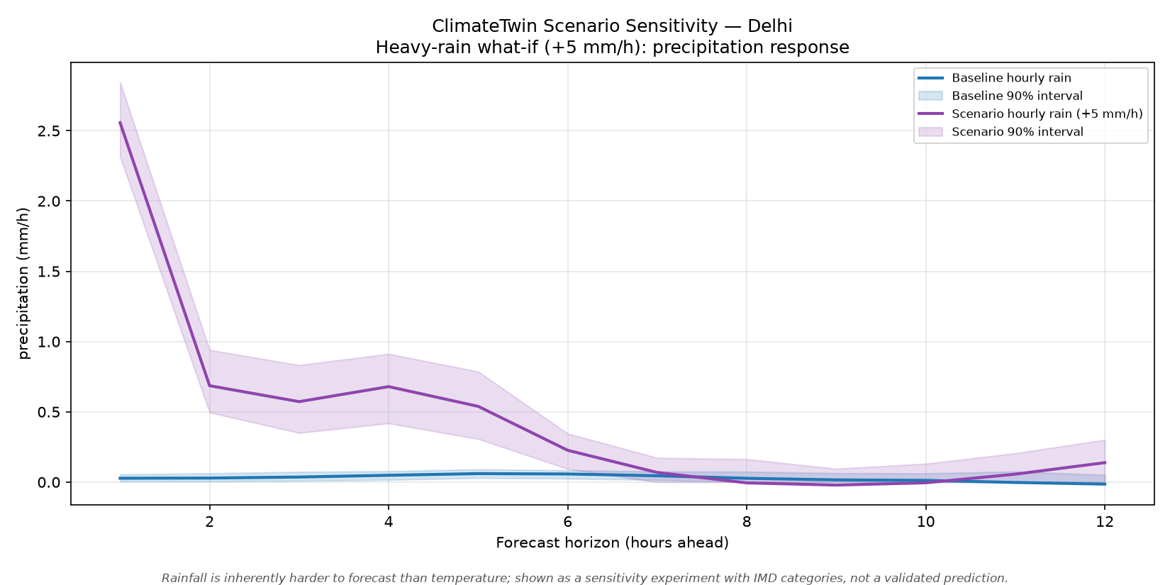
Results & Analysis (contd.)
9
Notes:
Add your results here — graphs, tables, screenshots or outputs.

Slide 8
Challenges & Remaining Work
Challenges Faced & Solutions
• Build system bug: pyproject.toml invalid build-backend → fixed to setuptools.build_meta
• CDS API integration: coordinate mismatch in download script → added config fallback for latitude/longitude keys
• Autoregressive instability: 48h rollouts showed phase-shift artifacts → optimized to 12h horizon with paired MC-dropout
• Scenario amplification: sustained perturbation mode caused runaway effects (+4°C → +18°C) → reverted to seed-only mode
Remaining Work (25%)
• Multi-city expansion: Mumbai, Bangalore, Kolkata, Chennai (pipeline ready, training pending)
• Streamlit dashboard implementation with interactive scenario controls
• Transformer model training and comparison with LSTM baseline
• Formal uncertainty calibration metrics (PICP, CRPS) evaluation
Timeline for Completion by Review-III (28.10.2026)
• Week 1–2: Multi-city training pipeline execution
• Week 3: Dashboard implementation with scenario interface
• Week 4: Transformer training and comparative analysis
• Final week: Documentation and presentation preparation
10

Slide 9
References
[1] C. Bodnar et al., "Aurora: A foundation model of the atmosphere," Nature, vol. 637, 2025.
[2] J. Schreck et al., "CREDIT: A scalable framework for AI-driven Earth System Modeling," npj Clim. Atmos. Sci., vol. 8, 2025.
[3] S. Jyothi and P. Mesapam, "Digital twin for climate-resilient urban planning," ISPRS Archives, LV-4, 2026.
[4] X. Fang et al., "AttEF: ConvLSTM encoder-forecaster with attention for precipitation nowcasting," IASC, 2021.
[5] R. Geng et al., "LSTMAtU-Net: A precipitation nowcasting model based on ECSA module," Sensors, vol. 23, 2023.
[6] B. Lim et al., "Temporal Fusion Transformers for multi-horizon time series forecasting," Int. J. Forecast., vol. 37, 2021.
[7] A. Vaswani et al., "Attention is all you need," NeurIPS, vol. 30, 2017.
[8] S. Hochreiter and J. Schmidhuber, "Long short-term memory," Neural Comput., vol. 9, pp. 1735-1780, 1997.
[9] ECMWF, "ERA5-Land hourly data," Copernicus CDS, 2024. DOI: 10.24381/cds.e2161bac
[10] F. Pedregosa et al., "Scikit-learn: ML in Python," JMLR, vol. 12, pp. 2825-2830, 2011.
[11] N. Rothfusz, "The Heat Index equation," NOAA NWS SR 90-23, 1990.
[12] IMD, "Heat wave criteria," National Climate Data Centre, 2026.
IEEE format. All cited in slides. ERA5-Land data under Copernicus CC-BY 4.0.
11

Slide 10
Thank You
Project-I (2026) · SENSE · VIT Chennai
12

