Slide 1
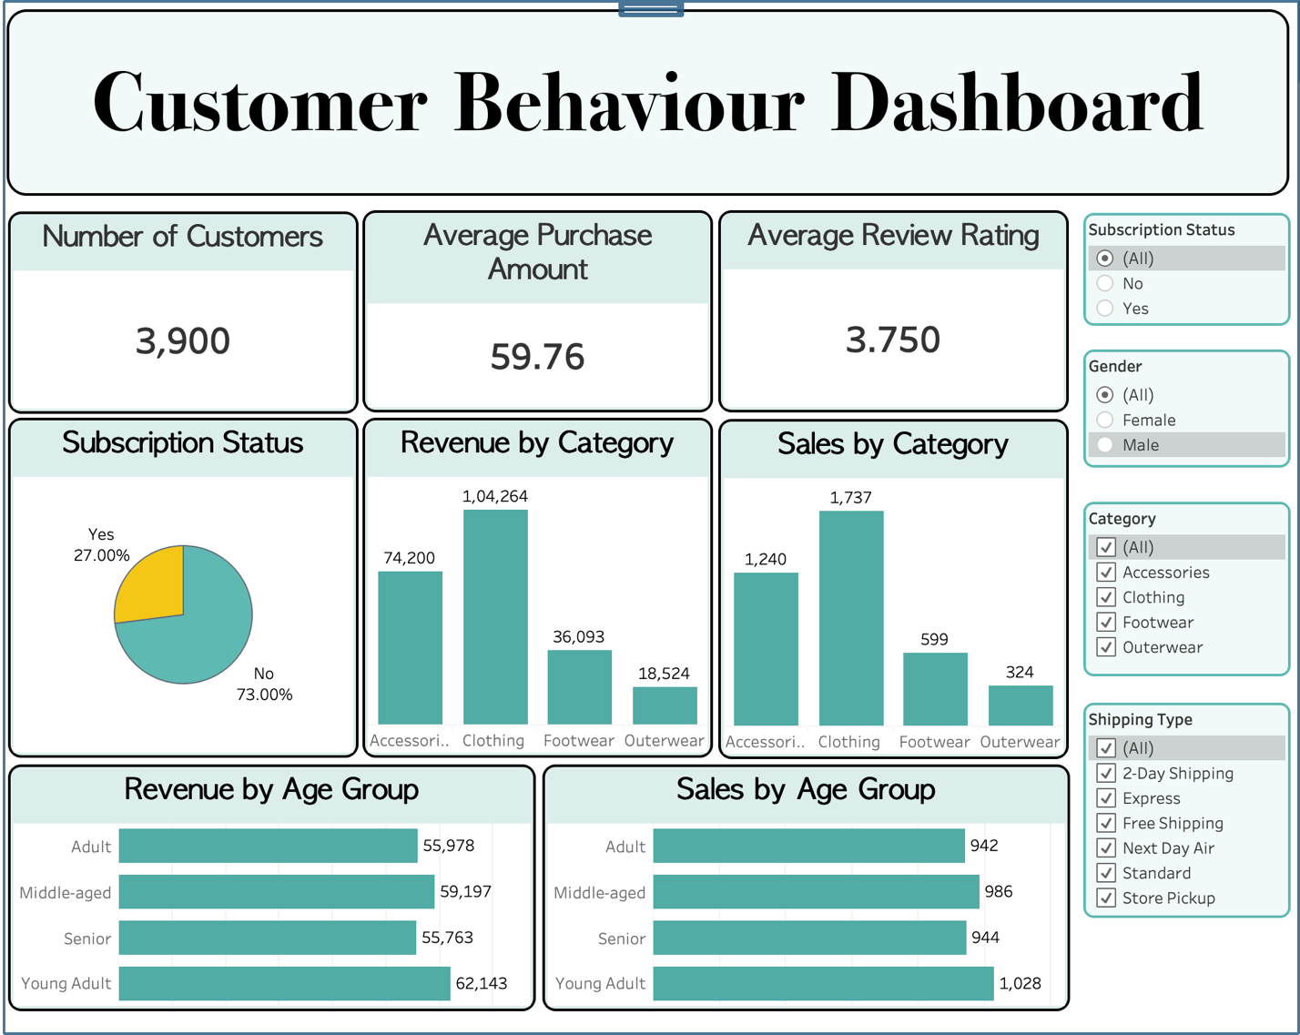
Customer Shopping Behavior Analysis
An end-to-end data analytics project
Python → PostgreSQL → Tableau
Prepared by Manas Jaiswal · August 2026

Slide 2
Business Problem
Objective
THE KEY QUESTION
Understand customer shopping behavior to lift sales, engagement, and long-term loyalty.
How can shopping data reveal trends to optimize marketing and product strategy?
Focus Areas
Discounts
Reviews
Seasonality
Payment preferences
Demographics

Slide 3
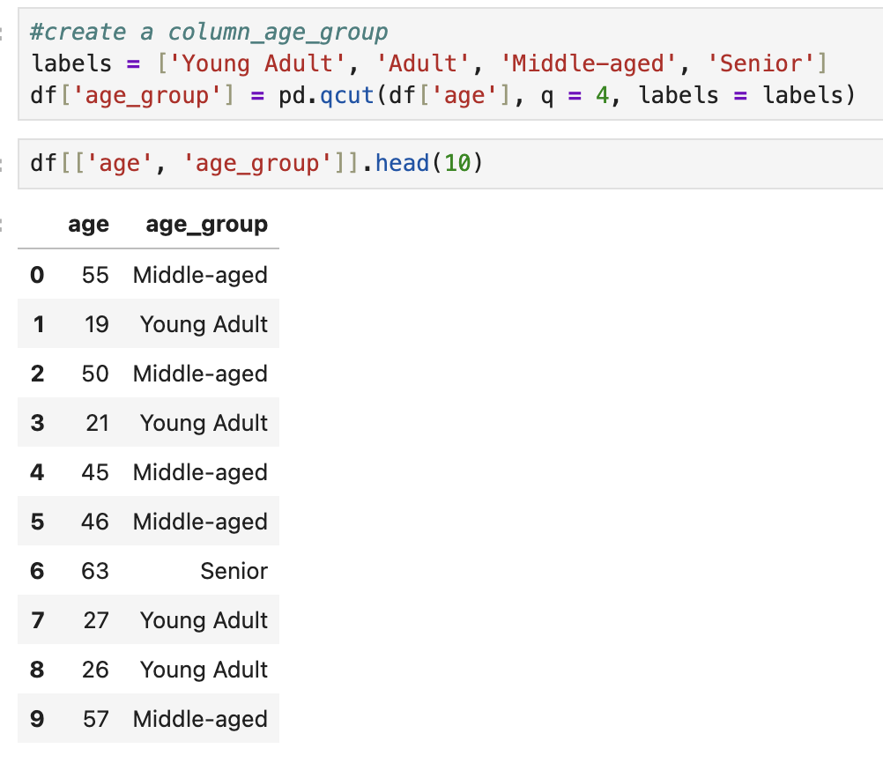
Approach
1
Python (pandas)
Cleaned data, imputed missing review ratings by category median, and engineered age_group and purchase-frequency features.
2
PostgreSQL
Loaded the data and answered 10 business questions using aggregates, subqueries, CASE, CTEs and window functions.
3
Tableau
Built a live-connected interactive dashboard with KPIs, category & age breakdowns, and cross-filters.

Slide 4
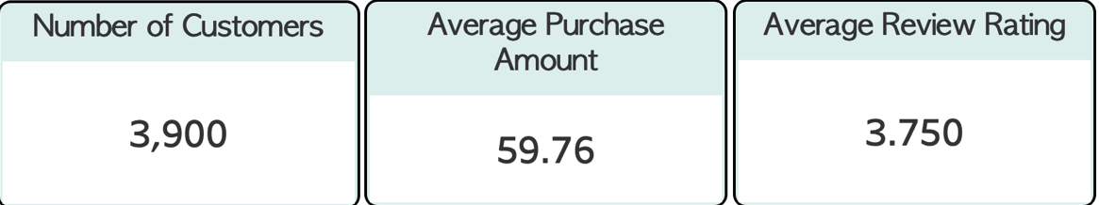
KPIs at a Glance
3,900
$59.76
3.75 / 5
27%
Total Customers
Avg Purchase Amount
Avg Review Rating
Subscribed (1,053)
As shown on the live Tableau dashboard
73% not subscribed
2,847 of 3,900 customers — the biggest growth opportunity.

Slide 5
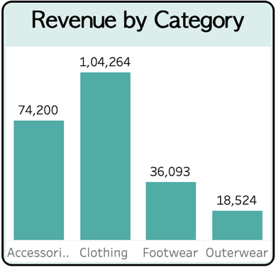
Where the Revenue Comes From
Revenue by Category
Clothing — $104,264 (1,737 orders)
Accessories — $74,200 (1,240 orders)
Footwear — $36,093 (599 orders)
Outerwear — $18,524 (324 orders)
Revenue by Age Group
Young Adult $62,143 · Middle-aged $59,197 · Adult $55,978 · Senior $55,763
Insight Clothing is the core category (~45% of revenue and orders); revenue is spread evenly across all age groups.

Slide 6
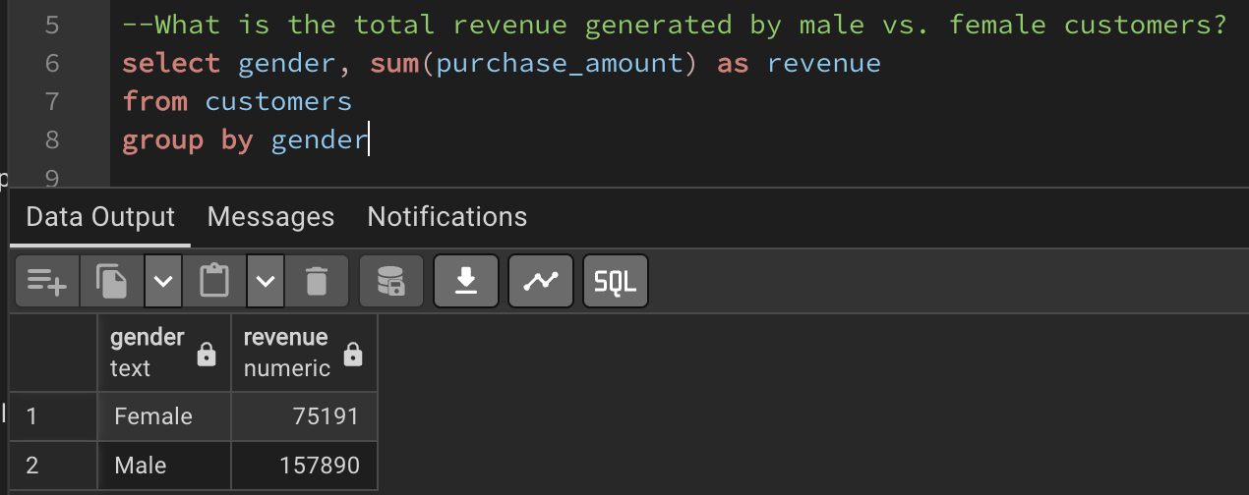
The Demographics Story
Revenue by Gender
Male $157,890 (68%) vs Female $75,191 (32%)
Per-Customer Spend
Male ≈ $59.5 · Female ≈ $60.2
Insight The male lead is driven by a larger customer count — women actually spend marginally more per head. Acquiring more female customers is an untapped lever.
SQL result — revenue by gender

Slide 7
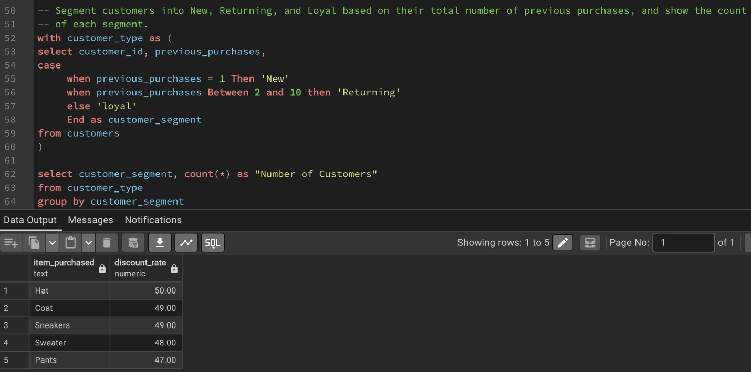
Subscription & Loyalty — Biggest Opportunity
Key Figures
Subscriber vs non-subscriber spend: $59.49 vs $59.87
Segments: Loyal 3,116 · Returning 701 · New 83
Repeat buyers (5+): 958 subscribe vs 2,518 don't (~28%)
Insight 80% of customers are loyal repeat buyers, yet only ~27% subscribe — and subscription doesn't lift spend. Converting loyal non-subscribers is the win.
SQL result — customer segmentation

Slide 8
Products, Discounts & Shipping
Top-Rated Products
Best-Sellers by Category
Most Discount-Reliant
Shipping
Gloves 3.86
Sandals 3.84
Boots 3.82
Hat 3.80
Skirt 3.78
Jewelry (Accessories)
Pants & Blouse (Clothing)
Sandals (Footwear)
Jacket (Outerwear)
Hat 50%
Coat 49%
Sneakers 49%
Sweater 48%
Pants 47%
Express $60.48 vs Standard $58.46
839 customers spent above average while using a discount
Insight Some products only sell with heavy discounts (margin review advised); faster shipping correlates with modestly higher spend.

Slide 9
Recommendations
1
Grow subscriptions
2
Convert loyal non-subscribers
3
Acquire more female customers
4
Audit discount-reliant items
73% aren't subscribed and it doesn't lift spend — redesign the offer with real value.
Target repeat buyers (80% of base) who don't subscribe.
Women are 32% of base but spend slightly more per order.
Review margins on Hat, Coat, Sneakers (~49–50% discounted).
5
Reinforce Clothing
6
Feature top-rated products
7
Invest in faster delivery
The core category (~45%); investigate Outerwear's low share.
Promote best-rated & best-sellers; consider premium pricing.
Express buyers spend modestly more.

Slide 10
Tools & Links
Tech Stack
Python — pandas, Jupyter Notebook
PostgreSQL — pgAdmin, SQLAlchemy + psycopg2
Tableau — live database connection
Links
GitHub repository: github.com/Manas463/customer-shopping-behavior-analysis
Live dashboard: View the interactive dashboard on Tableau Public →

