Slide 1
CheXNet : Radiologist-Level Pneumonia Detection on Chest X-Rays with Deep Learning
Name : Manas Abhinay Gajula
Student id #: 700757201

Slide 2
introduction
Pneumonia is a major global health concern, contributing significantly to illness and death.
Chest X-rays are the most common imaging tool for diagnosing pneumonia and other thoracic diseases.
Challenges:
Two-thirds of the global population lacks access to radiology diagnostics.
There is a shortage of radiologists, leading to increased mortality from treatable diseases.
Existing Methods:
Reliant on expert radiologists for interpretation.
High variability and subjectivity in diagnosis.

Slide 3
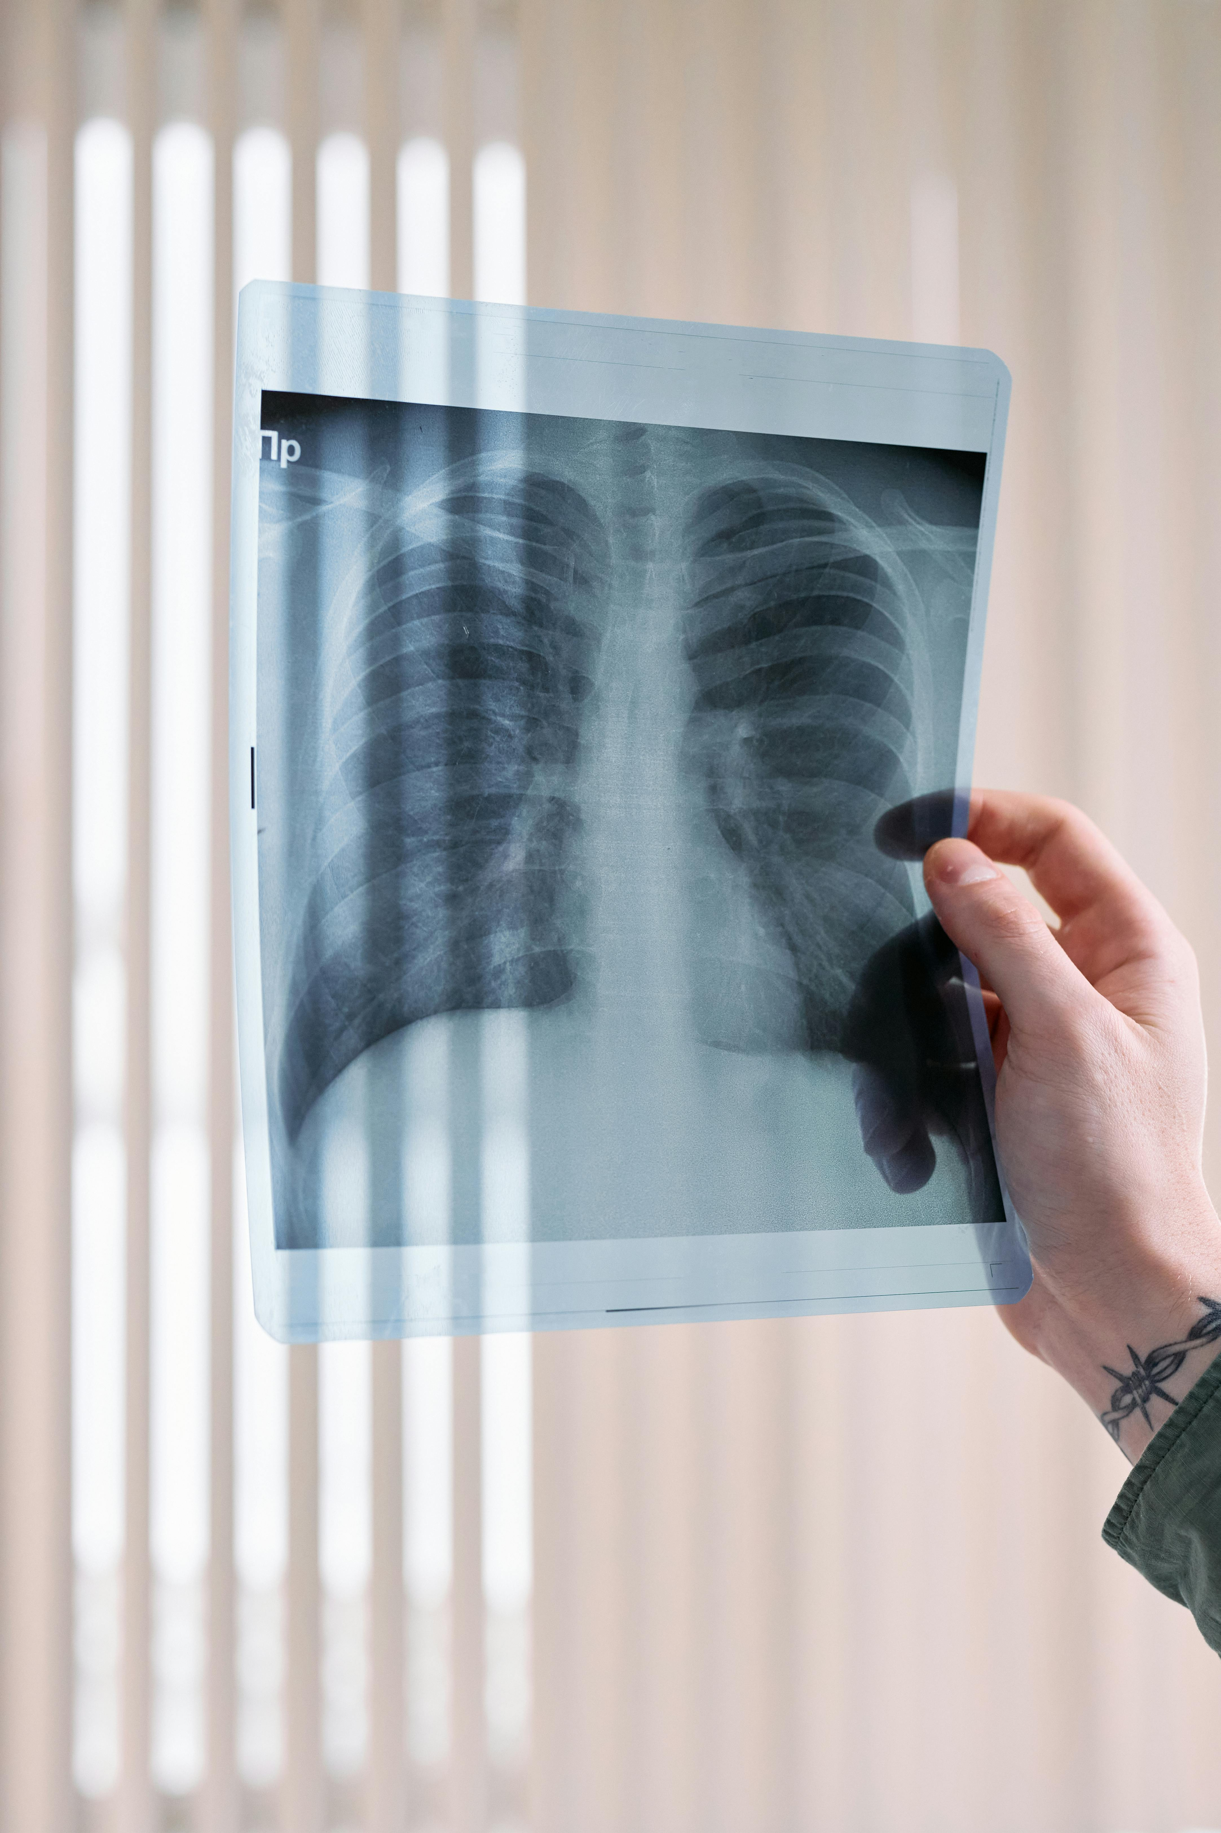
Objective:
To develop a deep learning model, CheXNet, for pneumonia detection that exceeds the performance of practicing radiologists

Slide 4
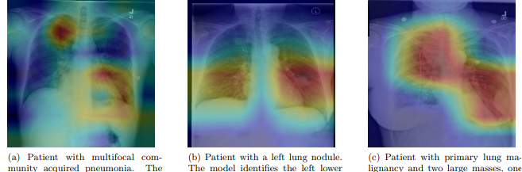
motivation
Difficulties on Pneumonia Detection:
The appearance of pneumonia in X-ray images is often vague can overlap with other diagnoses can mimic many other benign abnormalities.
Traditional diagnostic methods rely heavily on radiologist expertise, which can vary significantly. Additionally, access to skilled radiologists is limited in many regions, leading to missed or delayed diagnoses

Slide 5
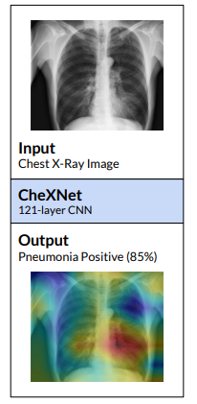
Convolutional Neural Networks go deeper:
The path for information from the input layer until the output layer (and for the gradient in the opposite direction) becomes so big, that they can get vanished before reaching the other side
Potential of AI Technology:
Leveraging deep learning and artificial intelligence (AI) can enhance the accuracy and efficiency of pneumonia detection from chest X-rays. AI systems can process large volumes of data quickly, providing reliable results and supporting healthcare professionals in their diagnostic processes.
CheXNet:
This a type of image analysing AI called a DenseNet (a variant of a ConvNet, similar to a ResNet) that was trained to detect abnormalities on chest x-rays, using the ChestXray14 dataset.

Slide 6
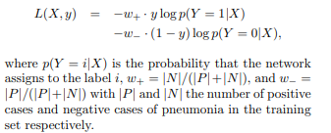
CheXNet: Advanced Pneumonia Detection
Architecture:
121-layer Dense Convolutional Network (DenseNet)
Enhances information flow and gradient propagation
Input:
Chest X-ray images
Output:
Probability of pneumonia
Heatmap for localization of affected areas
Key Techniques:
Dense Connections: Improves feature reuse and gradient flow
Batch Normalization: Stabilizes and speeds up training
Loss Function:
Weighted Binary Cross-Entropy:

Slide 7
CheXNet: Data and Training
Dataset: ChestX-ray14 by Wang et al. (2017)
112,120 frontal-view X-ray images
30,805 unique patients
Annotated with up to 14 thoracic pathologies
Label images that have pneumonia as one of the annotated pathologies as positive examples and label all other images as negative examples.
Dataset Split:
Training Set: 28,744 patients, 98,637 images
Validation Set: 1,672 patients, 6,351 images
Test Set: 389 patients, 420 images
Downscale the images to 224*224, and normalized based on mean and standard deviation
Augmented the training data with random horizontal flipping

Slide 8
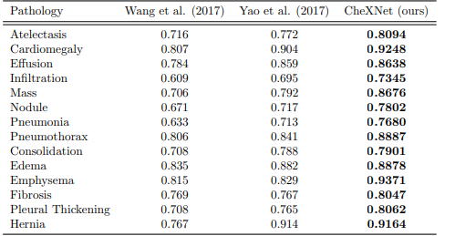
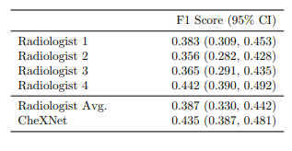
comparison
Comparison with Radiologist:
Computed the F1 score (harmonic avg.)
Used the bootstrap to construct 95% confidence intervals (CIs) on 10,000 bootstrap samples
The difference in F1 scores, the 95% CI on the difference does not contain 0, CheXNet is statistically significantly higher
Comparison with Previous CNNs on ChestX-ray14:
CheXNet outperforms the best published results on all 14 pathologies in the ChestX-ray14 dataset. Especially on Mass, Nodule, Pneumonia, and Emphysema, CheXNet has a margin of >0.05 AUROC over previous state of the art results.

Slide 9
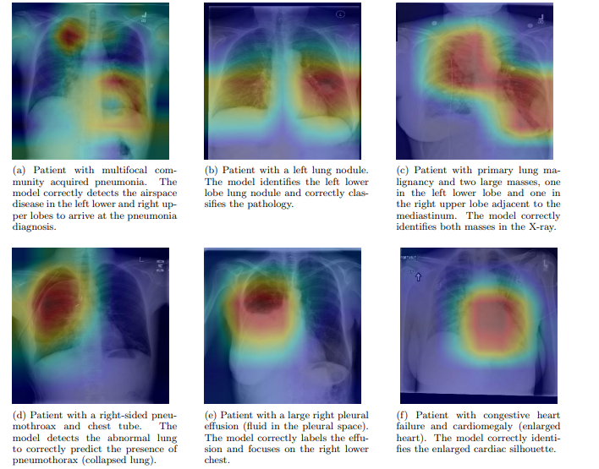
conclusion
Summary of Findings:
CheXNet is highly effective in detecting pneumonia from chest X-rays.
The model achieved radiologist-level performance on the ChestX-ray14 dataset.
Achievements:
Surpassed previous models on all 14 pathologies.
Significant improvement in detecting Mass, Nodule, Pneumonia, and Emphysema.
Localizes Pathologies: Uses Class Activation Maps (CAMs) to highlight the regions of X-rays most critical for making specific pathology classifications, which improves the interpretability of model predictions.

Slide 10
Limitations:
Limited View: Only frontal radiographs were used, but up to 15% of accurate diagnoses require lateral views
Lack of Patient History: Neither the model nor radiologists had access to patient history, which can impact diagnostic performance.
Generalization Challenges: Requires large annotated datasets for effective training and may face difficulties generalizing to different clinical settings and populations.

Slide 11
references
Wang, X., Peng, Y., Lu, L., et al. (2017). ChestX-ray8: Hospital-scale chest x-ray database and benchmarks on weakly-supervised classification and localization of common thorax diseases. arXiv preprint arXiv:1705.02315.
Rajpurkar, P., Hannun, A. Y., Haghpanahi, M., et al. (2017). Cardiologist-level arrhythmia detection with convolutional neural networks. arXiv preprint arXiv:1707.01836.
Kingma, D., & Ba, J. (2014). Adam: A method for stochastic optimization. arXiv preprint arXiv:1412.6980.
Huang, G., Liu, Z., Van Der Maaten, L., & Weinberger, K. Q. (2016). Densely connected convolutional networks. In Proceedings of the IEEE Conference on Computer Vision and Pattern Recognition (CVPR), pp. 4700–4708.
Ioffe, S., & Szegedy, C. (2015). Batch normalization: Accelerating deep network training by reducing internal covariate shift. In Proceedings of the 32nd International Conference on Machine Learning (ICML), pp. 448–456.

