Slide 1

Diabetes and heart disease Prediction Using
Machine Learning
A Futuristic Approach to Healthcare

Slide 2

PRESENTED BY -
Manas Bhunia -10300224222
Nibedita Maji -10300224227
Irfana Khatun -10300224220
GUIDED BY -
Mr. Debasis Sahoo
(Industrial Trainer)

Slide 3

Introduction
Diabetes and Heart disease are major health problems worldwide.
Early prediction helps in timely treatment and prevention.
Machine Learning (ML) can analyze medical data and predict disease accurately.

Slide 4
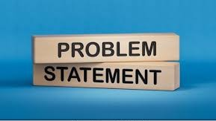
PROBLEM STATEMENT
Difficulty in early detection using traditional methods
Need for an automated and accurate prediction system
Predict wheather a person is likely to have:
  Diabetes
  Heart Disease

Slide 5
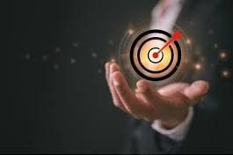
OBJECTIVES
To build a prediction model using ML
To analyze patient health parameters
To improve early diagnosis and reduce heath risks

Slide 6

Aim of the Project
Our primary aim is to predict diabetes accurately, with a specific focus on diabetes.
In the future we will add more different types of diseases here for the improvement of health care.

Slide 7

DATASETS USED
Diabetes dataset(PIMA Indian Dataset):
Glucose level
Blood pressure
BMI
Age
Insulin
Heart Disease Dataset(UCI DataSet):
Age, Gender
Cholesterol
Blood pressure
Chest pain type
ECG results

Slide 8

METHODOLOGY
DATA COLLECTION
DATA PREPROCESSING
FEATURE SELECTION
MODEL TRAINING
PREDICTION AND EVOLUTION

Slide 9
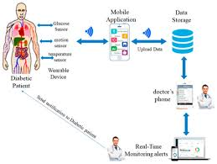
SYSTEM ARCHITECTURE
User inputs health data
ML model processes the data
System predicts:
  Diabetes/Non-diabetes
  Heart Disease/Non- Heart Disease

Slide 10

Why Machine Learning?
Machine learning enhances our ability to analyze complex health data, leading to more accurate and efficient predictions by using
Logistic regression
Decision tree
Random forest
Support vector machine (SVM)

Slide 11
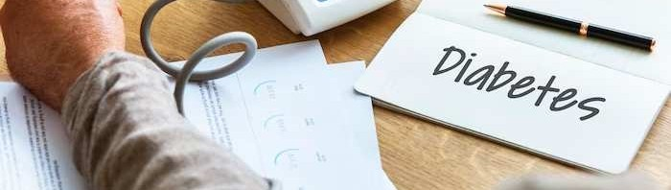
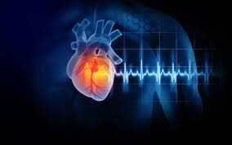
Understanding
Disease
Before delving into machine learning applications, let’s
understand
the complexities of diabetes and heart . We'll explore the
impact of
lifestyle, genetics, and environmental factors on diabetes
development.

Slide 12

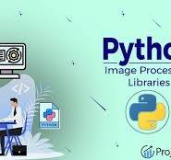



USEFUL TOOLS

Slide 13

We are collecting our data from git hub repository.
Predictive Modeling for Diabetes
https://multiple-disease-prediction-4jkmvztsmchdtdgbcro9mu.streamlit.app/

Slide 14
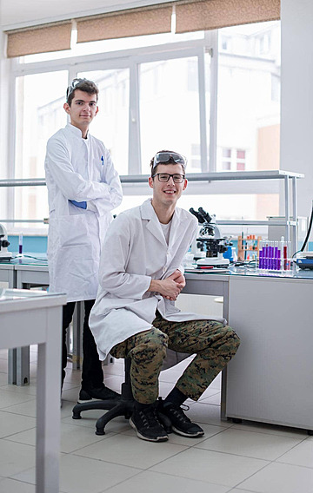
Contributions to Healthcare
Emphasize the impact of the project on healthcare.
Discuss how the project contributes to advancements in disease prediction and healthcare innovation.

Slide 15
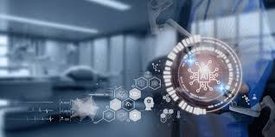
Future Scope
Use of deep learning
Integration with IOT devices
More accurate model with larger dataset
Mobile health application

Slide 16
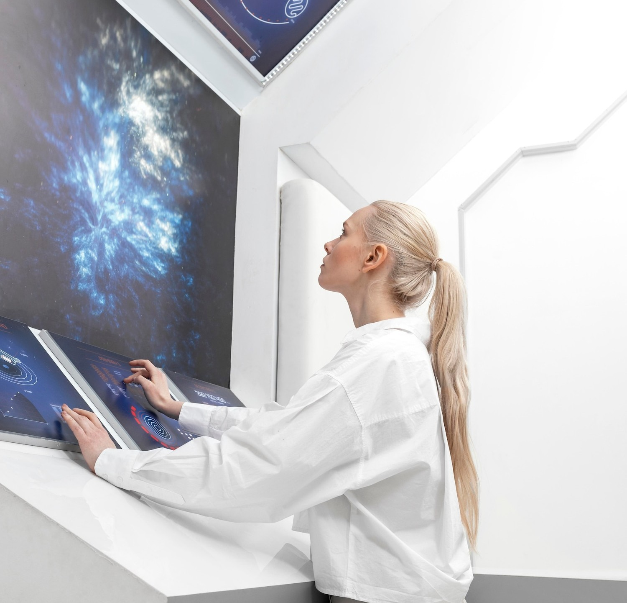
Conclusion
ML plays an important role in healthcare prediction
Diabetes and heart disease can be predicted efficiently
Future scope includes real-time monitoring and deep learning

Slide 17

Thank You!

