Slide 1

NATIONAL INSTITUTE OF TECHNOLOGY, RAIPUR
MAJOR PROJECT
Plant Disease detection via AI
GUIDED BY
Dr. D. Vasanth
(ASST PROFESSOR. DEPT OF BIOTECHNOLOGY)
BRANCH : BIOTECHNOLOGY
SEMESTER: 8th

Slide 2
Presented by :
Banothu Sathish , 18112012
Bansuri Rajwade, 18112013
Bhavesh Wadhwani, 18112014
Maanas, 18112026
Rishabh Siddharth, 18112043

Slide 3
Objective
To detect the diseased part of plant leaf using AI by finding the optimum way with minimum cost.
Plant diseases and pests disrupt normal plant growth and even result in plant mortality during the whole developmental phase of plants, from seed formation to seedling development and seedling growth.

Slide 4
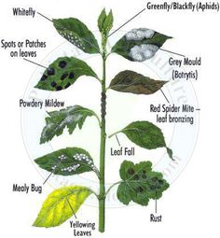
Introduction
A plant becomes diseased when it is continuously disturbed by some causal agent that results in an abnormal physiological process that disrupts the plant’s normal structure, growth, function, or other activities. This interference with one or more of a plant’s essential physiological or biochemical systems elicits characteristic pathological conditions or symptoms.
The study and detection of plant diseases is important as they cause loss to the plant as well as plant produce.

Slide 5
Steps to detect:
1.Classification
Image of a diseased plant
Deep learning
2.Detection
3.Segmentation

Slide 6
Image recognition based on deep learning
In comparison to other image recognition methods, deep learning-based image recognition technology does not require the extraction of specific features, and can instead find appropriate features through iterative learning. It can acquire global and contextual features of images, and has strong robustness and recognition accuracy.

Slide 7
Deep learning theory
The basic idea of deep learning is that data features are extracted by multiple hidden layers, each hidden layer can be regarded as a perceptron, the perceptron is used to extract low-level features, and then low-level features are combined to obtain abstract high-level features, which can significantly alleviate the problem of local minimum when using neural networks for data analysis and feature learning
Many well-known deep neural network models have been constructed using deep learning approaches, including the deep belief network (DBN), deep Boltzmann machine (DBM), stack de-noising autoencoder (SDAE), and deep convolutional neural network (DCNN) (CNN).

Slide 8
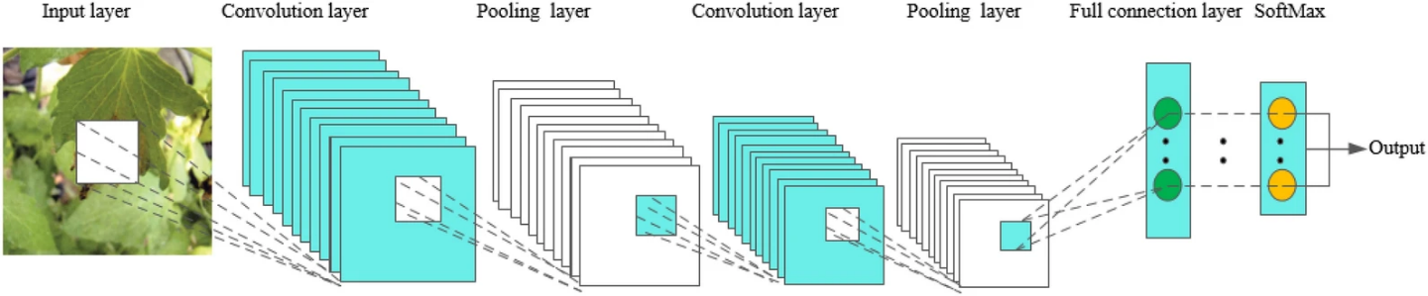
Convolutional Neural Network (CNN)
In the realm of deep learning, CNN is a prominent model. The reason for this is due to the large model capacity and complicated information provided by CNN's core structural properties, which allows CNN to excel in picture identification.

Slide 9
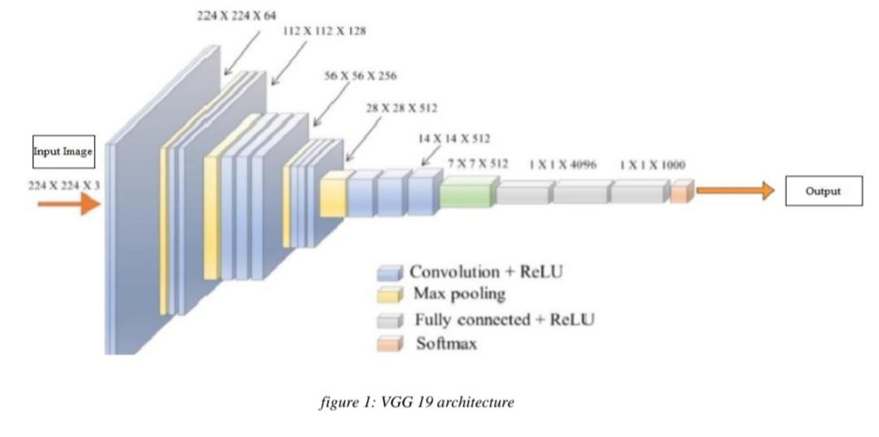
VGG19
VGG-19 is a 19-layer deep convolutional neural network. You may use the ImageNet database to load a pretrained version of the network that has been trained on over a million photos. The network can categorize photos into 1000 different object categories, including keyboards, mice, pencils, and a variety of animals. As a result, the network has learnt a variety of rich feature representations for variety of pictures. The network's picture input size is 224 × 224 pixels.

Slide 10

Work Flow

Slide 11
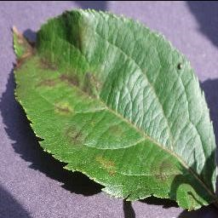
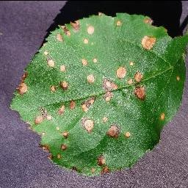
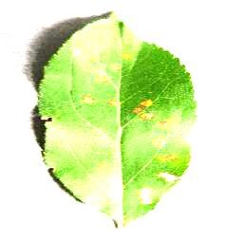
Diseases that were used to train the model: Tomato
Apple Scab
Pathogen - Venturia inaequalis
Symptoms - Scabby spots are sunken and brown, and the centre may contain velvety spores. Fruit that has been infected gets deformed and may crack, allowing secondary pathogens to enter. Fruit that has been severely harmed may drop, especially if it is young
Black Rot
Pathogen - Botryosphaeria obtusa
Symptom - small purple fleck on the leaf, then grows into a circular lesion around 4-5 mm in diameter. 1-3 weeks following petal fall, the illness usually appears. The edge of the lesion remains purple as it becomes larger, while the centre turns tan or brown with a light centre, giving it a “frog-eye” appearance.
Cedar-Apple Rust
Pathogen - Gymnosporangium juniperi-virginianae
Symptoms - Early in June, lesions emerge as greenish-yellow patches that grow in size. Depending on the apple or crab apple variety, they develop into vividly coloured dots that range in hue from yellowish-orange to red.

Slide 12
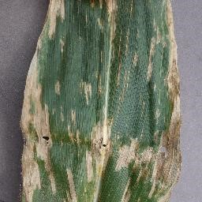
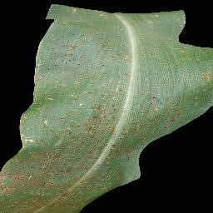
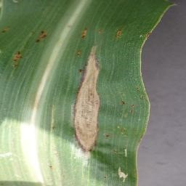
Corn
Cercospora zeaemaydis/Grey Leaf
Pathogen - Cercospora zeaemaydis
Symptoms - On the leaves, early grey leaf spot symptoms appear as minute, pinpoint lesions surrounded by yellow halos
Common Rust
Pathogen - Puccinia sorghi
Symptoms - Chlorotic specks on the leaf surface. As the spores burst through the leaf surface, these turn into powdery, brick-red pustules. Pustules are oval or elongated, about 1/8 inch long, and can be seen infrequently or in clusters. The leaf tissue surrounding the pustules may become yellow or die, creating dead tissue lesions. The lesions can sometimes form a band across the leaf, and if the infection is serious enough, the entire leaf can die.The red spores in the pustules turn black as they age, making the pustules seem black and continuing to erupt through the leaf surface. Infected husks, leaf sheaths, and stalks are also possible.
Northern leaf blight
Pathogen - Exserohilum turcicum
Symptoms - long, narrow tan lesions that form parallel to the leaf margins.

Slide 13
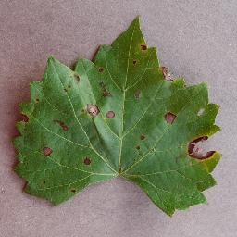
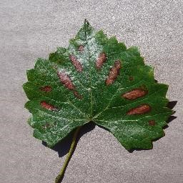
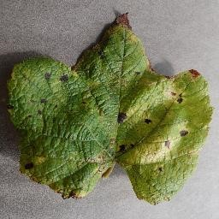
Grapes
Black Rot
Pathogen - Guignardia bidwellii
Symptoms - On the leaves, round, tan lesions with dark purple to brown margins can be seen. On the lesions, small, spherical, black fruiting bodies (pycnidia) are developed, which can be seen with a hand lens. Leaf deformation might occur if the infection is severe
Esca(Black measles)
Pathogen - fungus Phaeoacremonium aleophilum, Phaeomoniella chlamydospora, and Fomitiporia mediterranea
Symptoms - Red cultivars will have red regions followed by necrosis, whilst white cultivars will have chlorosis followed by necrosis. Early spring signs include shoot tip dieback, leaf yellowing, and, in severe cases, complete defoliation.
Leaf blight (Isariopsis leaf spot)
Pathogen - Pseudocercospora vitis
Symptoms - symptom similar to black rot but the entire clusters will collapse.

Slide 14
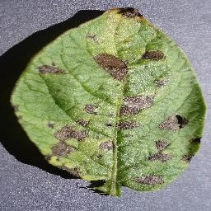
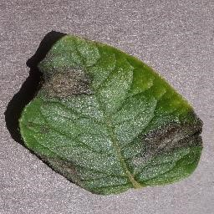
Potato
Early blight
Pathogen= Alternaria solani
Symptoms= Tuber symptoms of early blight include circular to irregular lesions that are slightly sunken and often surrounded by a raised purple to dark brown border. These lesions reduce the quality and marketability of fresh market tubers
Late blight
Pathogen= Phytophthora infestans
Symptons= small light to dark green circular to irregular-shaped water-soaked lesions on the potato plant’s leaves

Slide 15
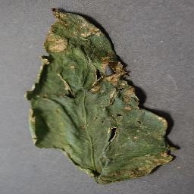
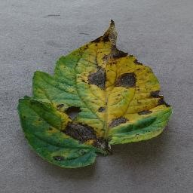
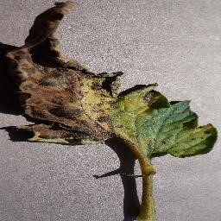
Tomato
Bacterial spot
Pathogen - Xanthomonas vesicatoria, Xanthomonas euvesicatoria, Xanthomonas gardneri, and Xanthomonas perforans
Symproms - circular spots that are sometimes water-soaked (i.e., wet-looking). Spots may appear yellow-green at first, but as they age, they darken to a brownish-red colour.
Early blight
Pathogen - Alternaria linariae
Symptoms - Lesions appear as little brownish-black spots on lower leaves that can grow to be 1/4 to 1/2 inches in diameter with typical concentric rings in the darkened area. The area around the lesions may turn yellow, and the entire leaf may turn yellow as the disease spreads. Lesions on the upper leaves and defoliation in the bottom half of the plant may arise later, leaving the fruit vulnerable to sunscald.
Late blight
Pathogen - Phytophthora infestans
Symptoms - During periods of high humidity, white cottony growth on the underside of the leaf, where sporangia form, may be evident. On both sides of the leaves, there are spots.

Slide 16
Result
We performed the test on various leaf images with deep learning-based image recognition technology using deep convolutional neural networks, the most common deep learning framework, and successfully detected the diseases.
The website can be accessed using this link:- http://predict2105.herokuapp.com/

Slide 17
Thank you

