Slide 1
Recommender System
Manas pant 2018916 sec. b 5th semester class roll no. 38
Made under the mentorship of
Mrs. Vishu Tyagi
(Assistant professor)

Slide 2
Introduction
Recommender systems, also known as recommendation systems or engines, are a type of software application that provides personalized suggestions to users. Usually, these recommendations are for goods, services, articles, or other things that the user would find interesting.
Many online platforms, such as social networking, streaming services, e-commerce websites, and more, employ recommender systems extensively. While there are various ways to create recommender systems, the most popular ones include content-based filtering, collaborative filtering, and hybrid approaches.

Slide 3
The various types of recommender systems are:-
Collaborative Filtering: The premise behind collaborative filtering is that users who have previously agreed are more likely to do so in the future. It is dependent upon user-item interaction data, including past purchases or user ratings.
Content-Based Filtering: Items are recommended using content-based filtering according to user preferences and feature sets. When making suggestions, it considers both the attributes of the objects and the past preferences of the users.
Popularity-Based: Popularity-based recommendation systems offer a straightforward and natural way to make suggestions by recommending content that users like or use frequently.
Hybrid Recommender Systems: Hybrid recommender systems take advantage of the advantages of both content-based and collaborative filtering.

Slide 4
Methodology
The project is implemented using python due to the wide variety of libraries provided by python for Machine Learning needs which are essential to the project.
The necessities or the requirements that I had for this project are as follows :-
1) Visual Studio Code
2) Python 3.10.9
3) Dataset (from Kaggle)

Slide 5
Visual Studio Code is a free to all code editor by Microsoft. I chose it due to the interactive and easy interface it has.
Python is a high-level programming language. I chose the 3.10.9 version due to its support for almost all of the libraries (unlike 3.11.x).
The dataset that I took was downloaded from a site called Kaggle and has a number of books and related information. There are datasets named users and rating as well which further help in the building of the system.
The next step in the process of building the recommendation system is data cleaning. It is a crucial step in the machine learning data preprocessing. It entails locating and fixing problems such irrelevant features, inconsistent formatting, duplicate entries, outliers, and missing values

Slide 6
Next, we create a popularity-based recommendation system by finding out the top 50 rated books in this dataset. The criteria used is highest average rating and rated by at least 250 users.
Next, we make the collaborative-filtering based recommendation system by finding the similarities between books. This is done using the cosine similarity provided by python and calculating the similarity sores between books.
Finally, we create a website for the final system to work as an interface for ease of use and pleasure of sight.

Slide 7
Result and Discussion
We are successful in building a Book Recommendation System which is primarily based on finding Cosine-Similarity between the books and then recommending the books which are of same genre.
The resulting project is a system capable of generating recommendations of 2 types :-
Popularity based recommendations.
Collaborative filtering-based recommendations.
The project is now capable of recommending books present in the database accurately based on the genre and the user ratings present in the database. This system is now complete and can be used for generating recommendations for similar books.

Slide 8
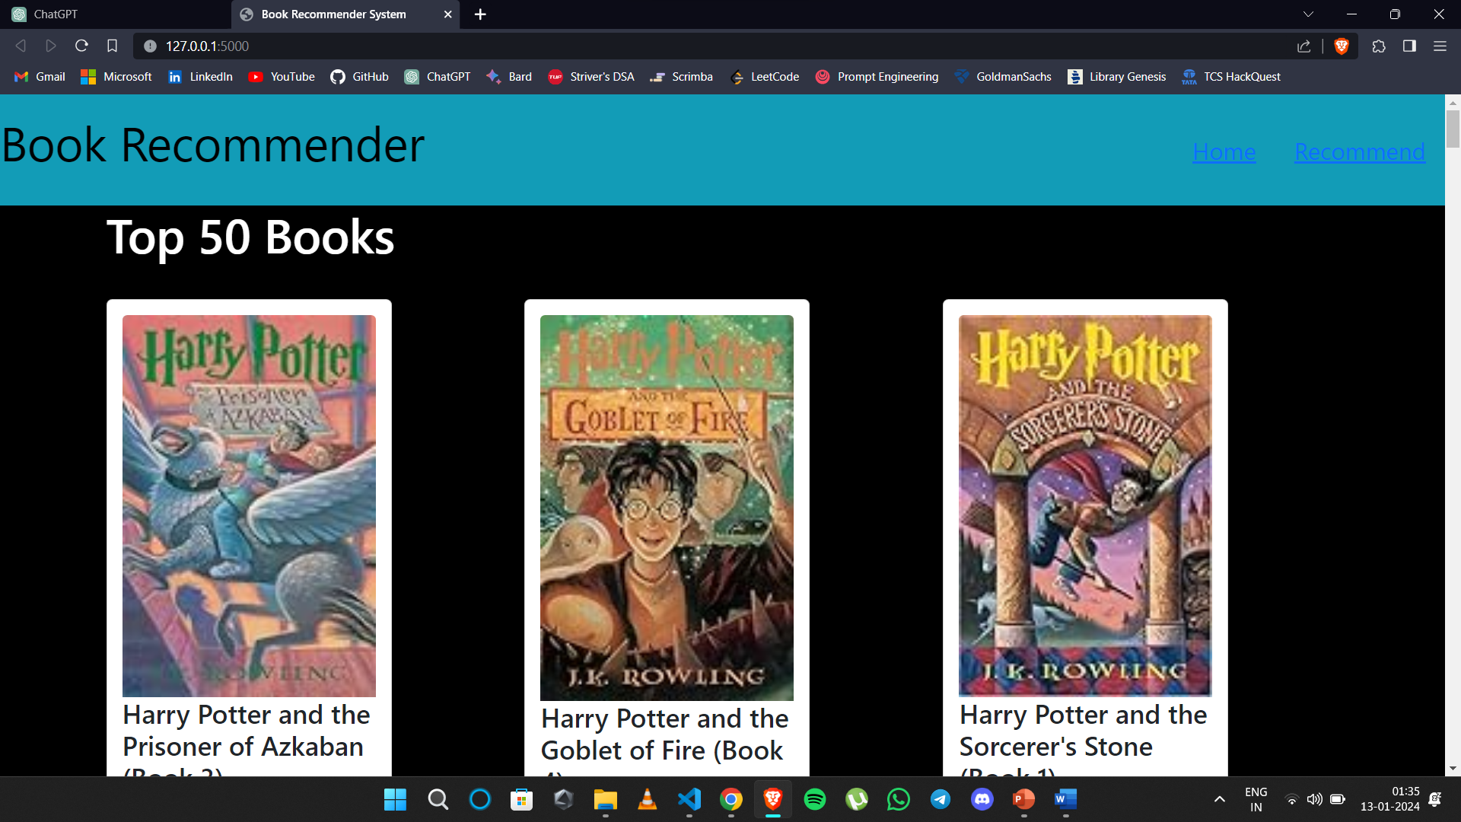
The resulting website has 2 pages:-
Top 50 Popular Books on Home Page

Slide 9

Recommendation Page

Slide 10
Conclusion and Future Work
This project helps us in recommending books based on popularity or similarity accordingly and is now fully functional given the dataset and the code.
The resulting system accurately recommends books as it is evident that the recommended books are of the same genre and writing style as the book given as a reference.
The project covers just the basics of recommendation systems and is not very complex of sorts, but this can surely lay a good understanding of how recommendation systems work and help in developing more complex codes.

