Slide 1
Traffic Sign Classification
Manas pant 2018916 sec. b 4th semester class roll no. 38
Made under the mentorship of
Mr. Ashwini Kumar
(Assistant professor)

Slide 2
Introduction
The invention of the wheel is said to be a historic moment in the evolution of humanity. The domino effect that started from the invention of wheels led us to the modern-day drivable motor cars. The next step in the same direction is making these cars self-drivable. But there exists a trivial obstacle to achieving this goal.
The first thing that’s important while driving a car is the need to understand and follow the traffic rules to ensure the safety of self and of others on the road. That’s why the first step in teaching someone to drive is to make them learn the rules and the traffic signs.
So, in the same manner, to teach a vehicle to drive on its own, it is essential for it to learn, understand and implement the traffic rules and the traffic signs. Without this trivial detail, this next step in the evolution of cars will just be a dream and nothing more than that.

Slide 3
In order to reach level 5 automation, a vehicle needs to classify the traffic signs quiet efficiently.
We are going to build a deep learning model using CNN and Keras for the same purpose.

Slide 4
Methodology
The project is implemented using python due to the wide variety of libraries provided by python for Machine Learning needs which are essential to the project.
The necessities or the requirements that I had for this project are as follows :-
1) Visual Studio Code
2) Python 3.10.9
3) Dataset (GTSRB - German Traffic Sign Recognition Benchmark)
from Kaggle
4) CNN and Keras

Slide 5
Visual Studio Code is a free to all code editor by Microsoft. I chose it due to the interactive and easy interface it has.
Python is a high-level programming language. I chose the 3.10.9 version due to its support for almost all of the libraries (unlike 3.11.x).
The dataset that I took was downloaded from a site called Kaggle namely GTSRB - German Traffic Sign Recognition Benchmark. It is a public domain dataset with over 50,000 images segregated into 43 classes.
A Convolutional Neural Network (CNN) is a specialized type of deep learning neural network designed to process and analyze visual data, such as images and videos.
Keras is an open-source high-level neural networks API written in Python. It is designed to provide a user-friendly, modular, and intuitive interface for building and experimenting with deep learning models.

Slide 6
After setting up of the code editor, the interpreter and installation of the libraries, the main processes involved in the project are as follows :-
1) The dataset is explored and all the 43 classes are iterated over to
append the images and their respective labels in the data and
labels list.
2) A CNN model is built to classify the images into their respective
categories.
3) The model is then trained using model.fit().
4) The model is then tested with test dataset and is finally saved
using the model.save() function.
Finally, a GUI (Graphical User Interface) is built for the traffic signs classifier with Tkinter. Tkinter is a GUI toolkit in the standard python library.

Slide 7
Result and Discussion
The resulting classifier model can now be used to classify any input image of a traffic sign into its respective type ranging from speed limit signs to road work ahead and many more.
This final model has shown an accuracy of 95% and has also visualized how our accuracy and loss changes with time, which is quite good for a simple CNN model.
The resulting interface is shown in the next slide :-

Slide 8
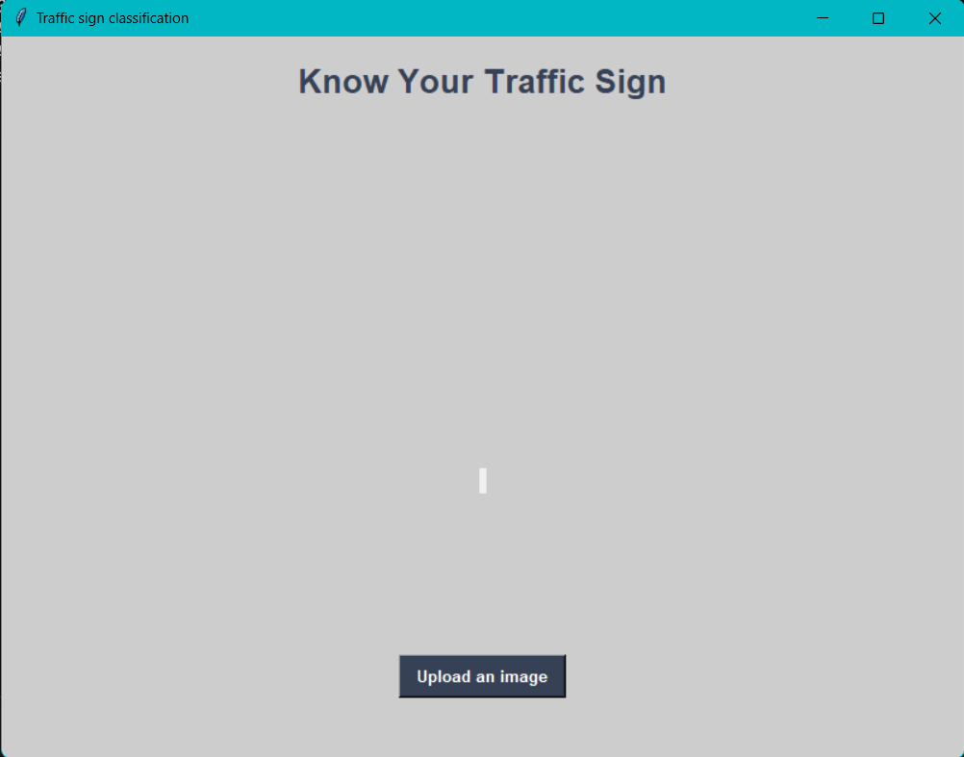

Slide 9
Conclusion and Future Work
The model so made is the simplest of models in the fields and it still shows an accuracy of 95%.
Few sectors where the future work may be possible are :-
1) Model Interpretability: Explore methods for interpreting the
model's decisions, such as class activation maps or gradient-
based visualization.
2) Real-World Testing: Evaluate the model's performance on real-
world traffic sign images or videos collected in different conditions,
such as varying lighting, weather, and camera angles.
3) Deployment: Consider deploying the trained model on
embedded devices or in real-time applications.

