Slide 1
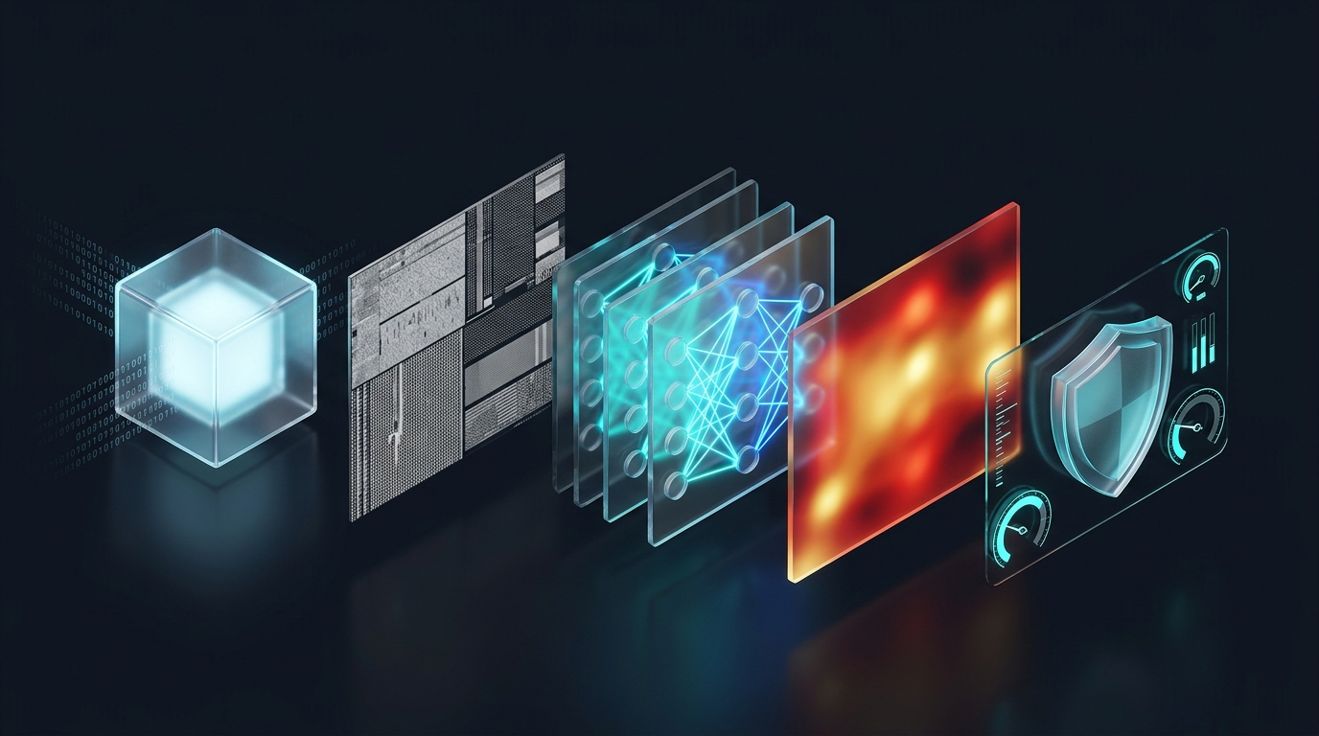
CYBERSECURITY & DEEP LEARNING PROJECT
MALVISION
Image-Based Malware Classification & Explainable Threat Hunting
Transmuting raw unexecuted binary software into 2D spatial grayscale textures to identify 26 malware families with 97.86% accuracy using ResNet-18 and Grad-CAM explainability.
Author: Manas Kumar • Academic & Technical Defense • 2026
Notes:
Welcome everyone. Today I am presenting MalVision, an AI-powered malware classification and threat hunting platform. Traditional antivirus tools struggle because modern malware alters its code to bypass signature checks and sandbox environments. We solve this by converting raw executable files into 2D grayscale textures and classifying them using a fine-tuned ResNet-18 vision model. It classifies files across 26 malware families with 97.86% accuracy, requires zero execution of suspicious code, and provides Grad-CAM heatmaps so analysts can visually verify why a detection was made.

Slide 2
THREAT LANDSCAPE & MOTIVATION
The Core Problem: Why Modern Antivirus Fails
1. Signature Matching (Hashes)
Static Blacklisting (MD5 / SHA256)
2. Dynamic Sandboxing
Virtual Machine Execution
3. Disassembly (IDA / Ghidra)
Static Machine Code Parsing
Trivial Evasion: Attackers use polymorphic crypters and packers (UPX, Themida) that alter byte hashes daily.
Zero-Day Blindspot: Completely ineffective against new variants or zero-day binaries with no cataloged hash.
Brittle Defense: A single-bit alteration defeats MD5/SHA256 matching with zero operational cost to attackers.
Severe Latency: Requires 3 to 10 minutes per binary to record system calls, causing massive triage backlogs.
Sandbox Evasion: Malware detects hypervisors, delays execution with sleep loops, or waits for human mouse clicks.
Execution Risk: Running live hostile code risks host leakage and accidental network infection.
Fragile Reverse Engineering: Complex x86/x64 instruction disassembly takes seconds to minutes per file.
Anti-Disassembly Tricks: Modern packers corrupt section headers to cause disassembler crashes.
Computational Overhead: Extracting N-gram opcode features consumes massive memory and storage.
Notes:
Explain the problem: Over 450,000 new malware samples appear daily. Traditional signature matching fails because polymorphic packers change hashes daily. Dynamic sandboxing takes 3 to 10 minutes per file and is vulnerable to sleep loops and anti-VM tricks. Disassembly is fragile and fails when code is packed. We need an evasion-proof, zero-execution approach that runs in milliseconds.

Slide 3
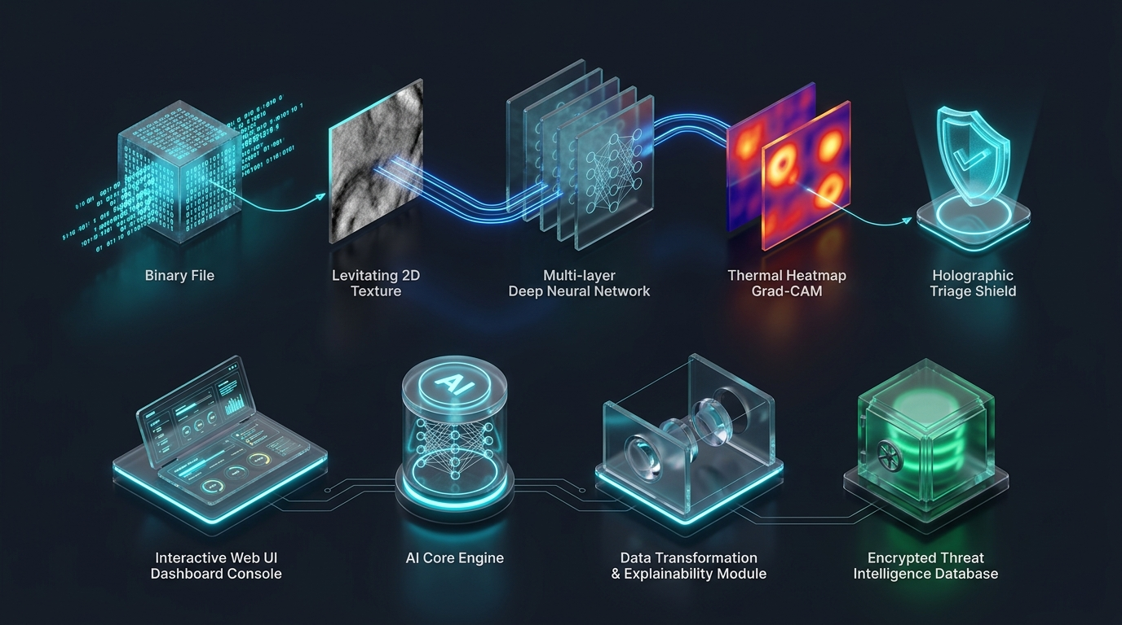
CORE CONCEPT & PHILOSOPHY
The Big Idea: The Airport X-Ray Scanner Analogy
How Airport Security Works
The Intuitive Real-World Mental Model
The Analogy: Airport security guards DO NOT open and search every single suitcase by hand. They DO NOT wait for a bomb to explode to know if it is dangerous.
The Solution: Instead, bags pass through an X-ray scanner. The scanner converts physical contents into a density image. Trained screeners immediately spot prohibited shapes.
The Cybersecurity Breakthrough: MalVision does the exact same thing for computer software!
Zero-Execution: The file is NEVER executed. We take an 'X-ray photo' of the binary code and let a Deep Convolutional Neural Network spot the malware by its visual texture.
Notes:
Present the analogy: This is the easiest way to explain the project to any evaluator or audience. Just like airport security uses an X-ray scanner to view the shape of an object without opening or detonating it, MalVision takes a visual X-ray of an executable file without ever running the code. The neural network learns the distinctive visual blueprints of malware families.

Slide 4
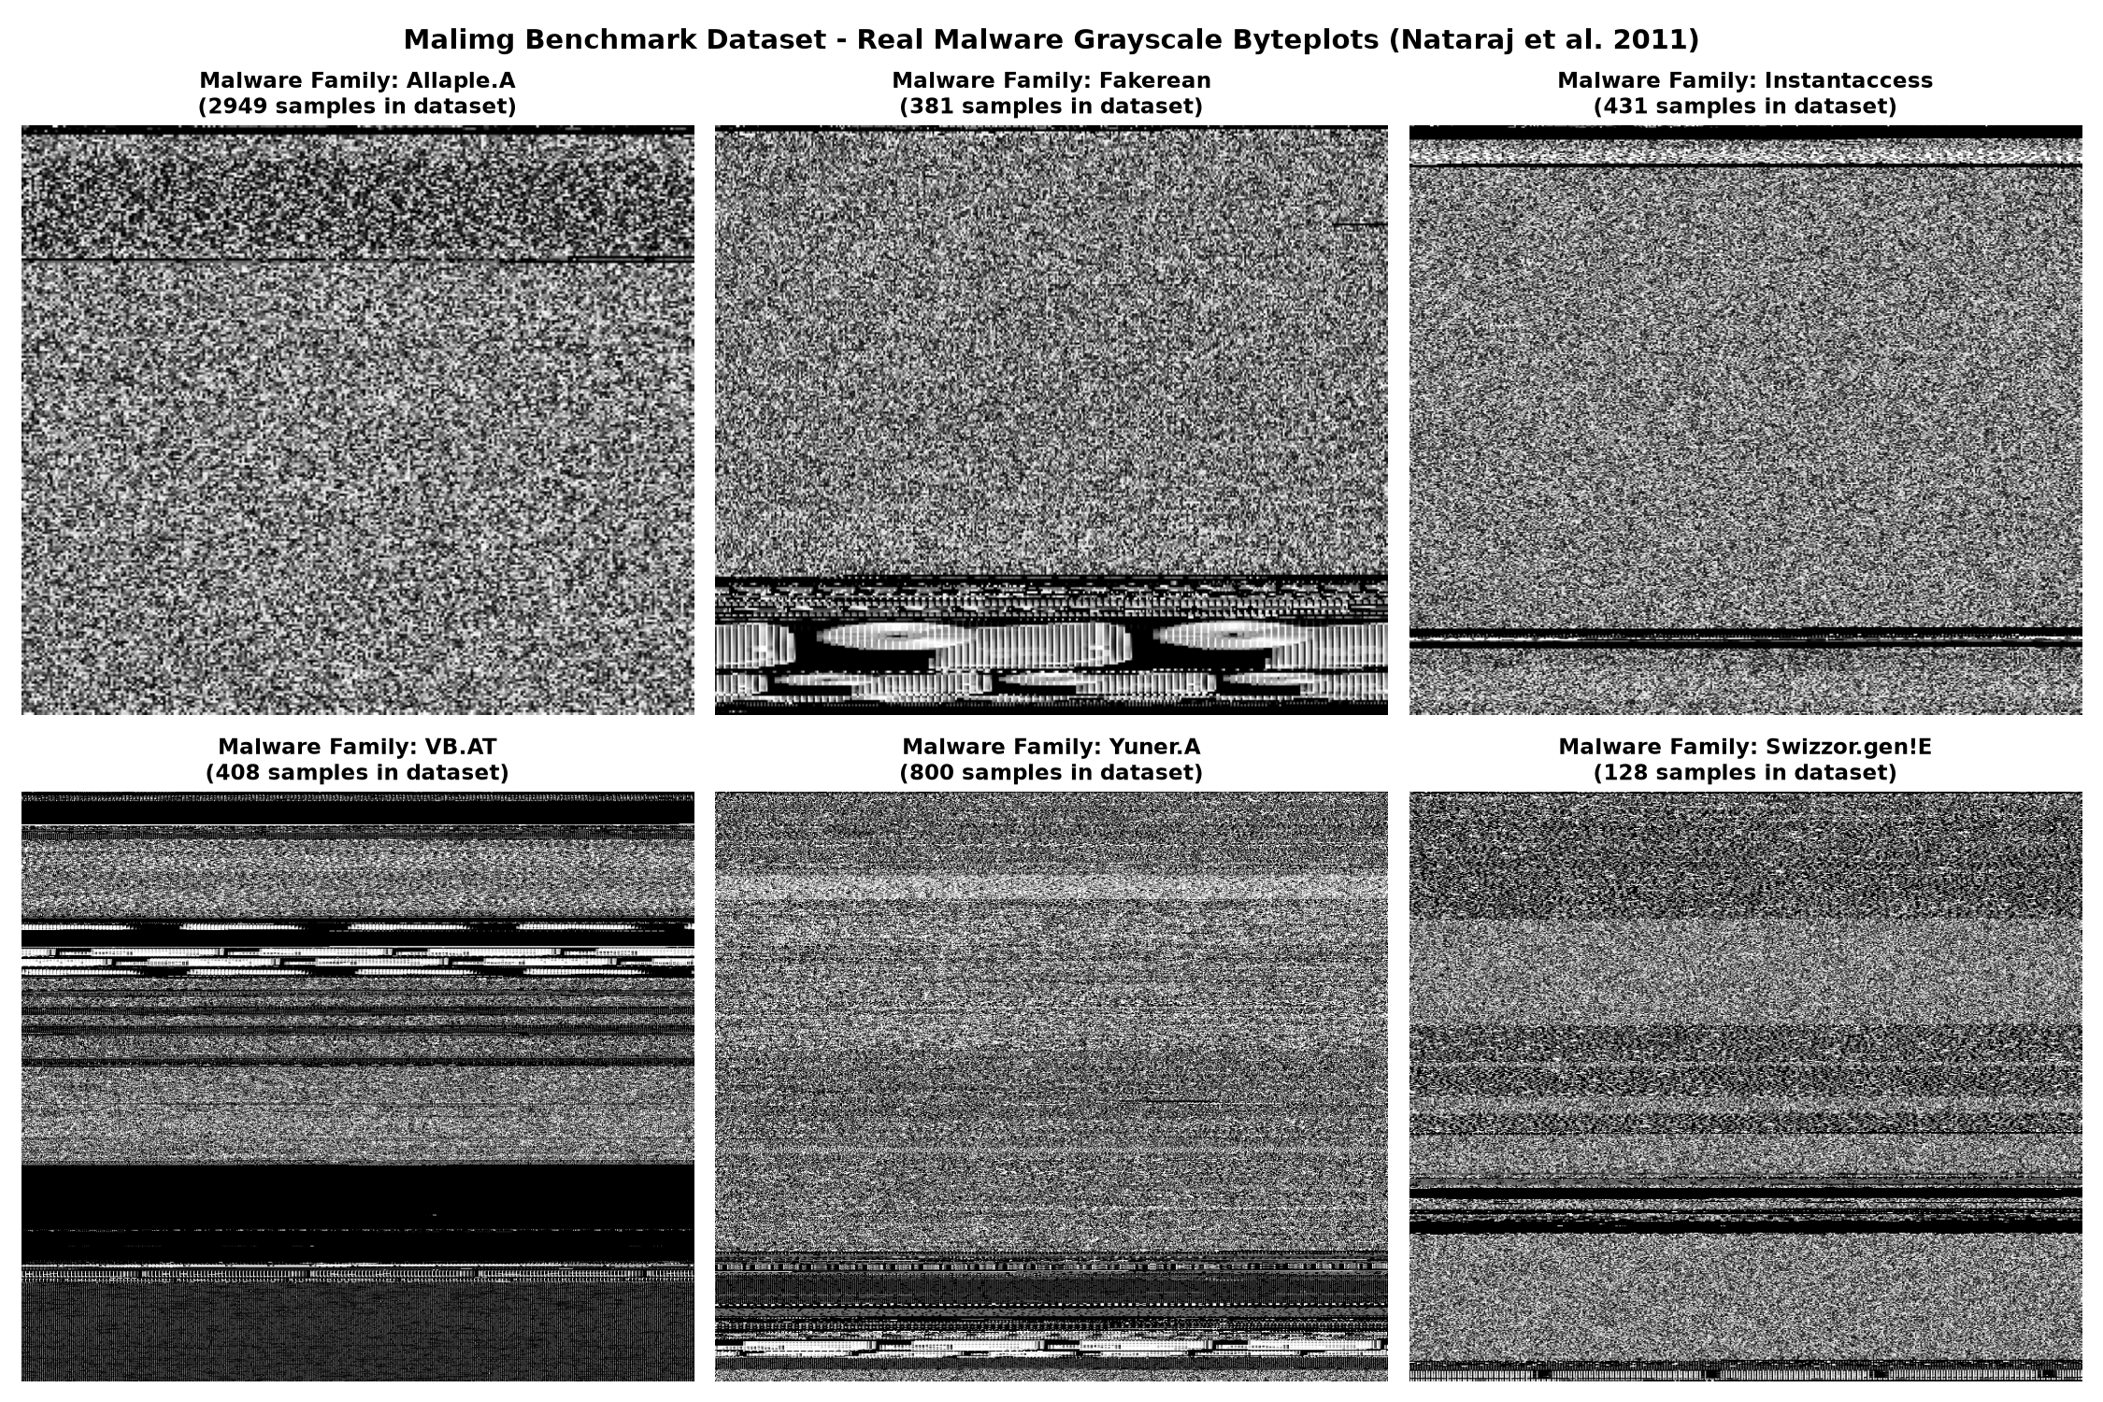
THEORETICAL FOUNDATION
Binary-to-Image Conversion & Visual Textures
The Nataraj Heuristic Math
Mapping Bytes [0, 255] to Grayscale Pixels [0, 255]
Bijective Mapping: Every byte has a value from 0 to 255. A grayscale pixel brightness also ranges from 0 (black) to 255 (white). 1D bytes map directly to pixels.
Dynamic Width Heuristic: Width W is chosen dynamically from file size (32px for <10KB up to 1024px for >1MB) to preserve local spatial aspect ratios.
Dynamic Height & Padding: Height H = ceil(N / W). Any remainder is zero-padded (black pixels).
Visual PE Sections: .text machine opcodes look like speckled static; .rdata strings look like horizontal stripes; .data buffers look like dark blocks; packed payloads look like high-entropy TV snow.
Notes:
Explain the technical conversion: Every byte is an 8-bit number between 0 and 255. A grayscale pixel also has brightness 0 to 255. So we take the bytes and arrange them in a 2D grid. The width is picked using Nataraj's lookup table so small files don't collapse and large files don't stretch. Notice on the right how different malware families look visually distinct to the human eye—and to a deep convolutional network.

Slide 5
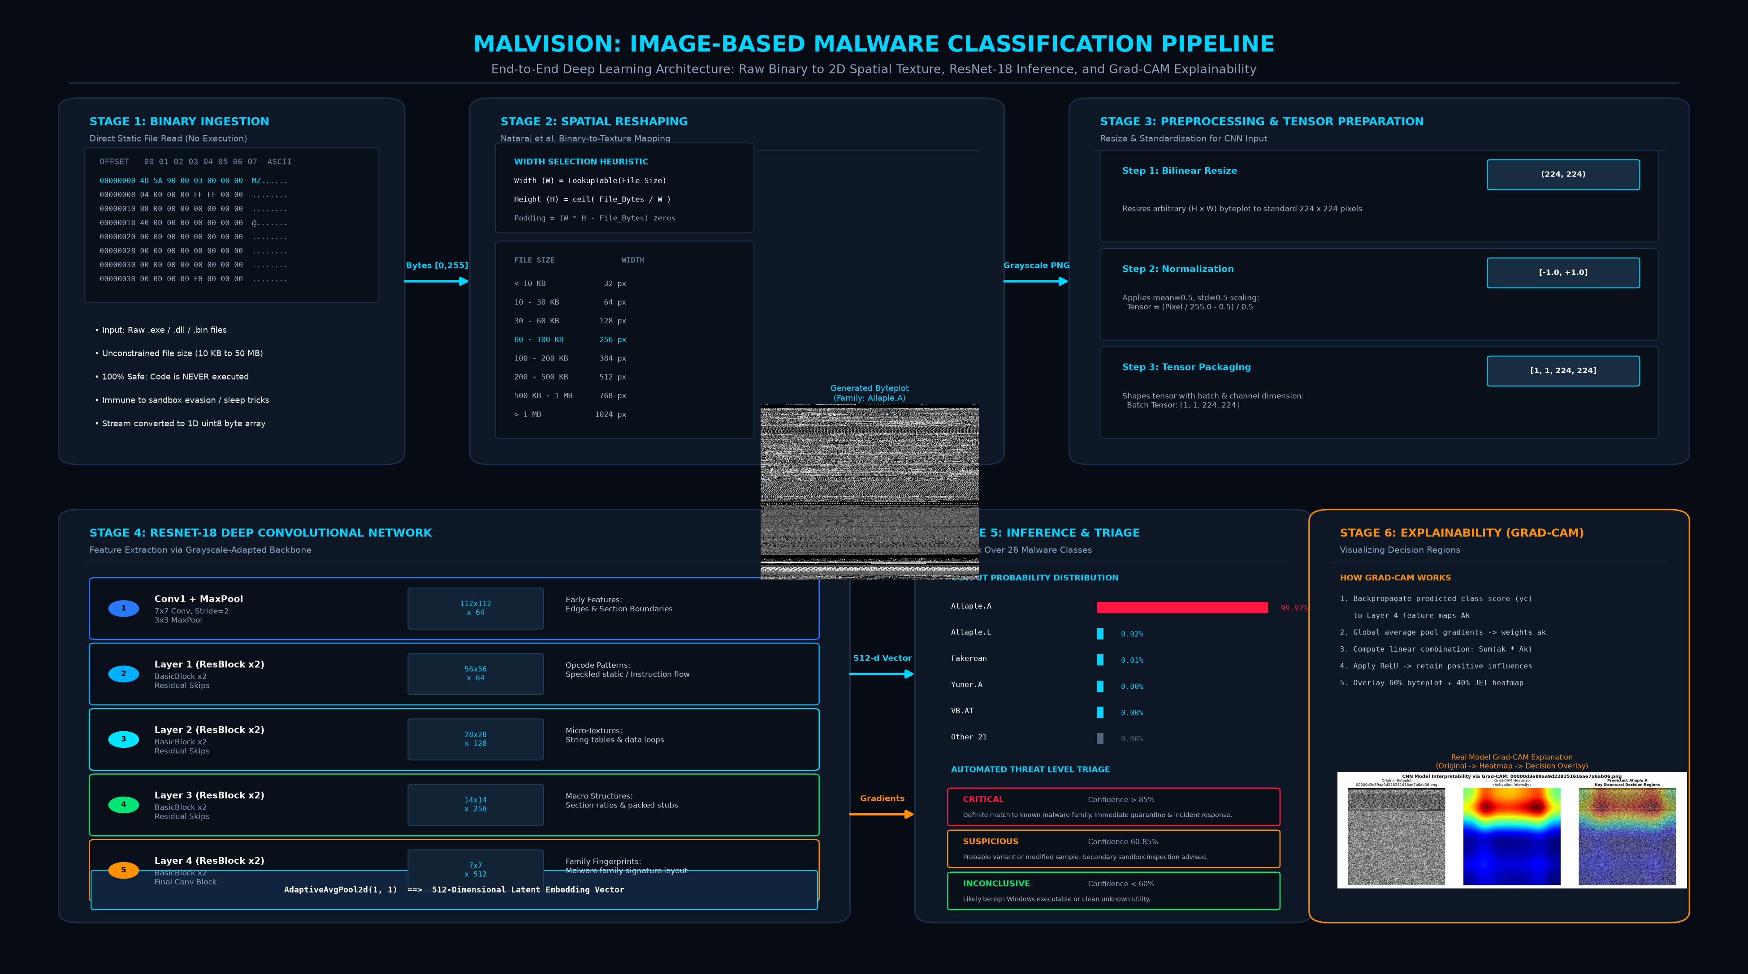
ENGINEERING PIPELINE
End-to-End System Architecture Blueprint
6-Stage Pipeline: (1) Static Ingestion -> (2) Nataraj Reshaping -> (3) 224x224 Tensor Prep -> (4) ResNet-18 Deep Feature Extraction -> (5) Multi-Class Softmax & Triage -> (6) Grad-CAM Explainability
Notes:
Walk through the pipeline: Stage 1 ingests the binary safely without execution. Stage 2 reshapes the 1D byte stream into a 2D grayscale image. Stage 3 resizes it to standard 224x224 dimensions and normalizes pixel values. Stage 4 runs it through our adapted ResNet-18 model. Stage 5 outputs the 26 family probabilities and triggers automated threat level triage. Stage 6 generates a Grad-CAM heatmap to prove why the decision was made.

Slide 6
MODEL SURGERY & OPTIMIZATION
Deep Learning Backbone: ResNet-18 Adaptation
Transfer Learning Weight Surgery
Adapting ImageNet (RGB) to Grayscale (1-Channel)
Hierarchical Feature Learning
What the Residual Layers 'See'
The Challenge: ImageNet models expect 3-channel RGB images of shape [64, 3, 7, 7]. Malware byteplots are single-channel grayscale [1, 224, 224].
The Weight Surgery: Instead of training from scratch, we averaged the weights across RGB channels: W_gray = (1/3) * sum(W_RGB).
The Benefit: Preserved all low-level edge, contour, and spatial frequency filters learned from millions of ImageNet images.
Convergence Speed: Reached 97.86% test accuracy in just 3 training epochs on standard CPU hardware.
Conv1 + MaxPool (64 x 56x56): Extracts section borders, sharp margins, and trailing zero-padding runs.
Residual Layer 1 (64 x 56x56): Captures micro-opcodes, memory alignment static, and assembly instruction loops.
Residual Layer 2 (128 x 28x28): Captures string tables, import directory tables, and data loop boundaries.
Residual Layer 3 (256 x 14x14): Extracts macro structure: relative proportions of loader stub vs encrypted payload.
Residual Layer 4 (512 x 7x7): Assembles the full malware family signature blueprint for classification.
Notes:
Explain the model architecture: We used ResNet-18 because of residual skip connections that prevent vanishing gradients. To use transfer learning, we performed mathematical weight surgery on conv1 by averaging the 3 RGB channels into 1 grayscale channel. Early layers learn edges, middle layers learn micro-textures like string tables, and Layer 4 learns the complete malware family blueprint.

Slide 7
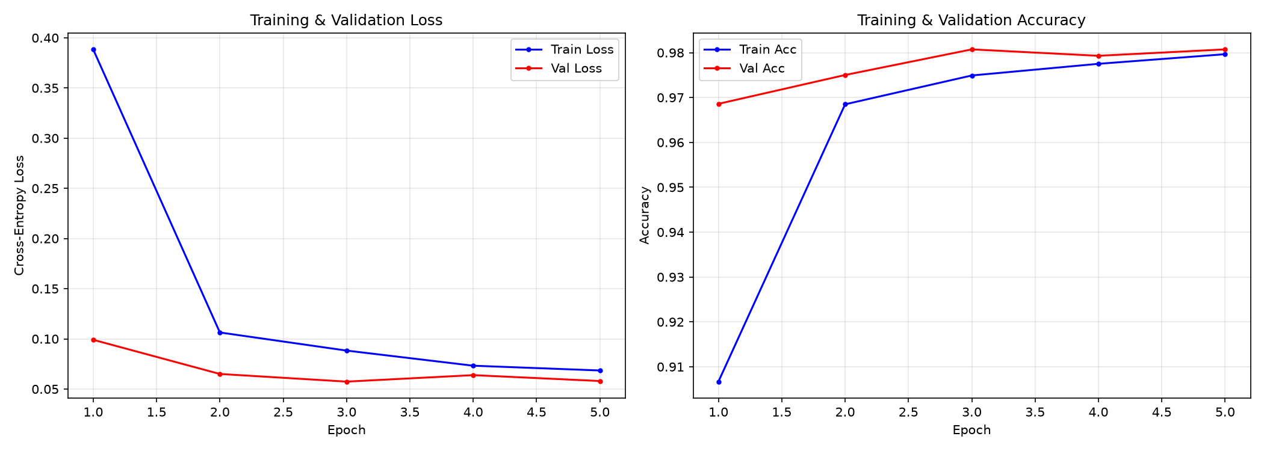
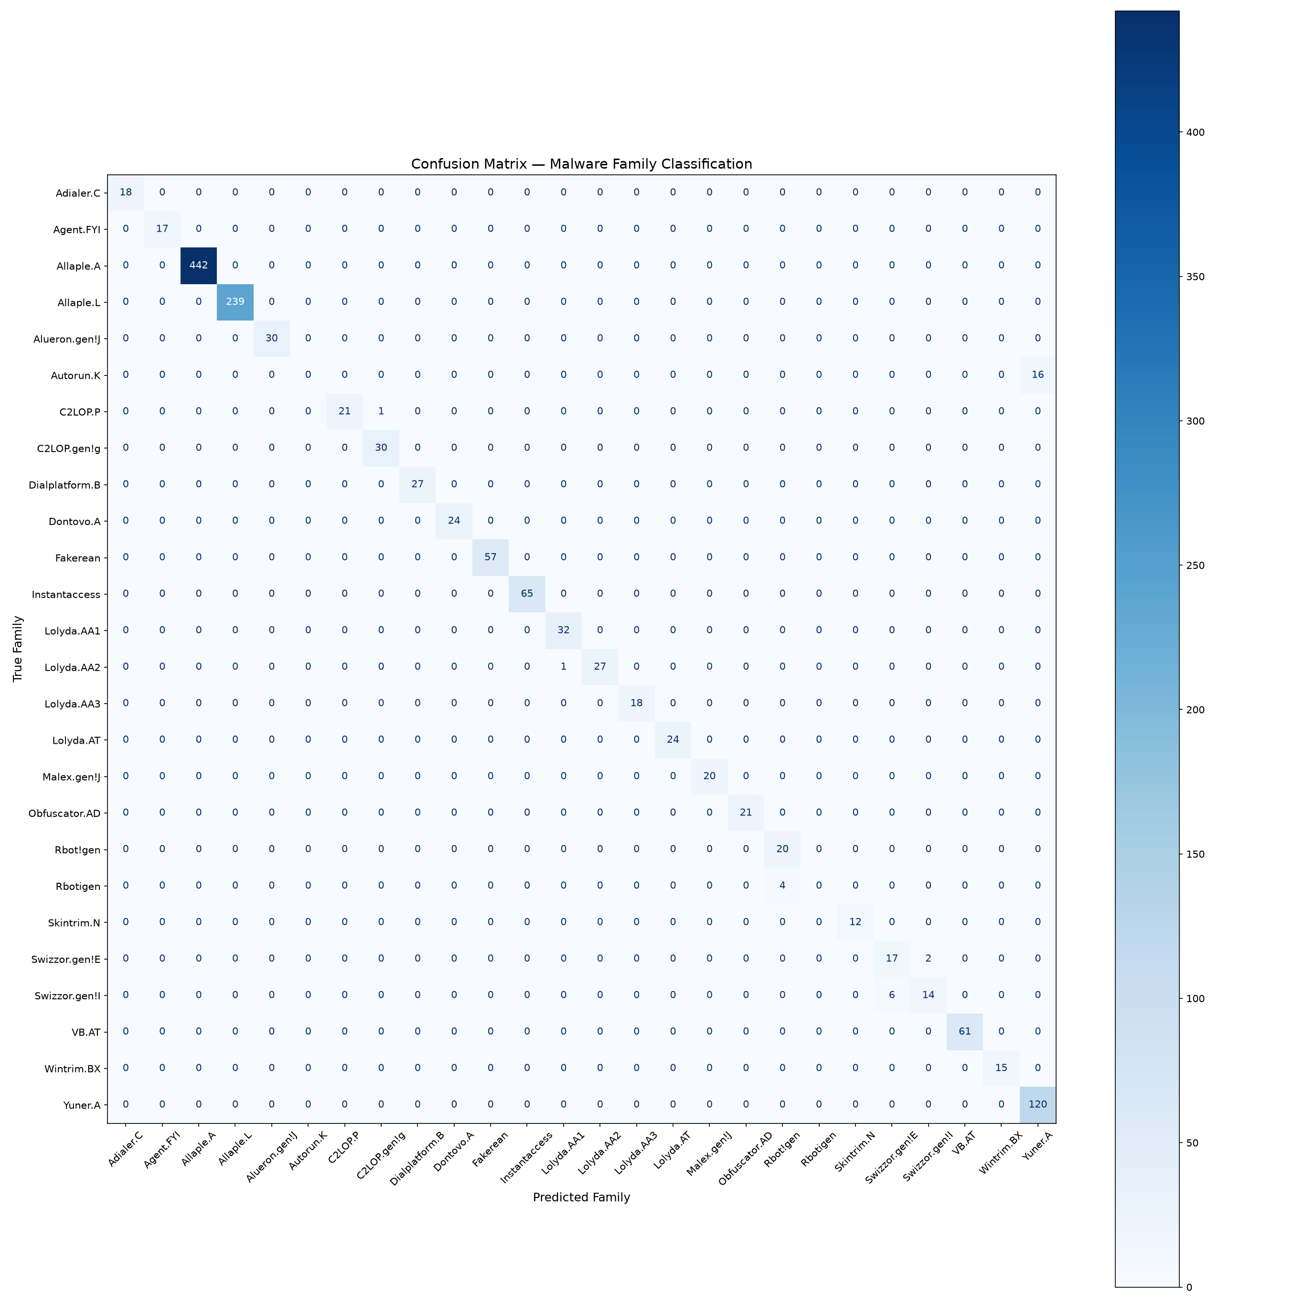
PERFORMANCE EVALUATION
Empirical Benchmark Results (Malimg Dataset)
Key Quantitative Metrics
Tested on 1,401 Unseen Test Samples
Overall Test Accuracy: 97.86% (1,371 correct out of 1,401 unseen test samples).
Best Validation Loss: 0.0574 reached at Epoch 3 checkpoint with early stopping.
Weighted F1-Score: 97.82% balanced across diverse sample sizes.
Perfect F1 Families: 18 out of 26 families achieved 100% precision and recall.
Sub-Second Latency: ~34.8 ms mean CPU inference latency per binary.
Dataset Partition: Stratified 70/15/15 split across 9,339 total Malimg samples.
Notes:
Highlight the results: On 1,401 unseen test samples, the model achieved 97.86% test accuracy. 18 out of 26 families had a perfect 1.00 F1 score. Look at the training curves: validation loss hit 0.0574 at epoch 3 with no overfitting. The confusion matrix shows a sharp, bright diagonal, proving the model reliably distinguishes between all 26 families.

Slide 8
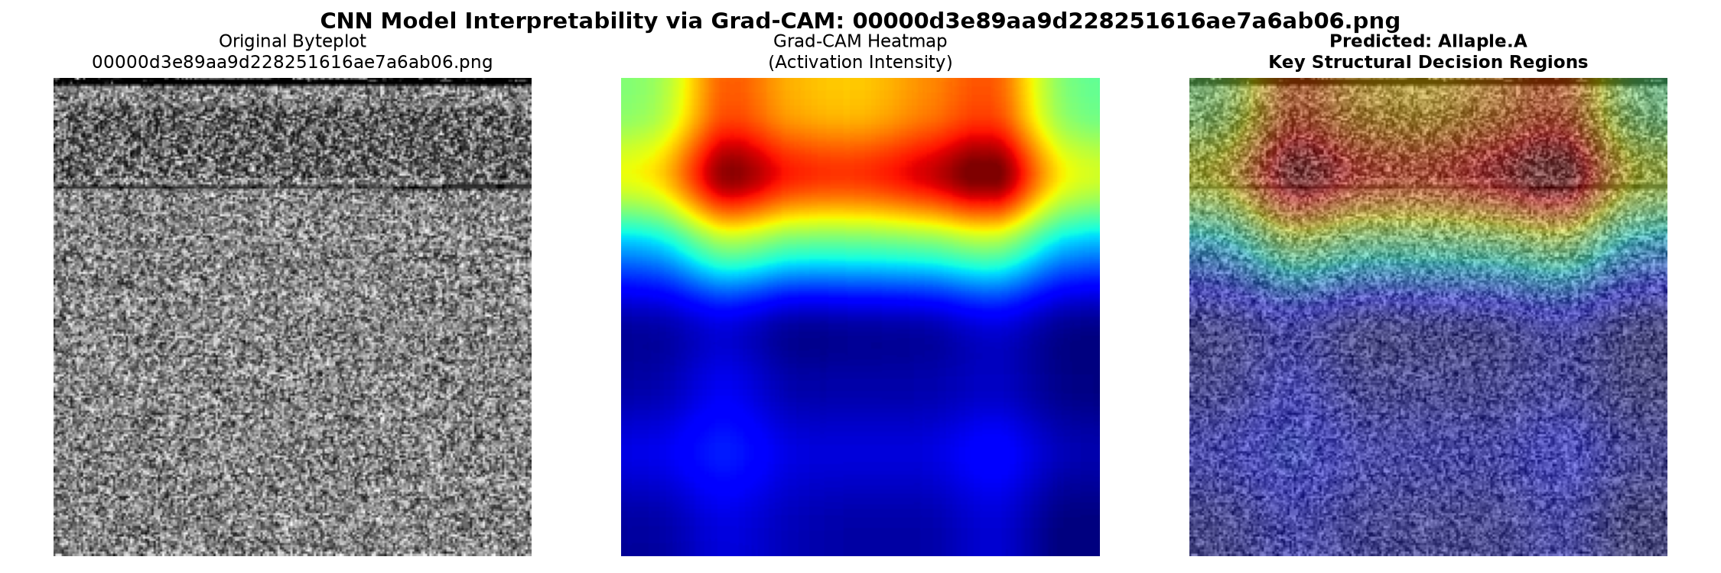
AUDITABILITY & FORENSICS
Explainable AI: Solving the Black Box with Grad-CAM
Why SOCs Need Explainability
Gradient-Weighted Class Activation Mapping
The Black Box Problem: In security, an alert saying '99% Malware' without proof cannot be acted upon by incident responders.
How Grad-CAM Works: It traces gradients backward from the predicted class score to Layer 4 feature maps, computing spatial importance weights.
Thermal Colormap: Red hotspots indicate regions of maximum causal attention; blue regions denote neutral background.
Forensic Validation: Proves the AI triggers on genuine unpacking stubs and encrypted payloads, rather than irrelevant padding or compiler headers.
Notes:
Explain Grad-CAM: Security analysts cannot trust a black box. With Grad-CAM, we trace the gradients back to Layer 4 to generate a thermal heatmap. The red regions show exactly where the model looked. Notice that it focuses on the active payload and unpacking stubs, proving that the model is making decisions based on genuine malware features rather than noise.

Slide 9
FALSE POSITIVE MITIGATION
Open-World Triaging: Handling Clean Files (cmd.exe)
CRITICAL THREAT (>85%)
Definite Family Match
SUSPICIOUS (60% - 85%)
Probable Variant / Packed
INCONCLUSIVE (<60%)
Benign File / Clean Utility
Confidence: > 85.0% probability.
Entropy: Very low (H < 0.50). Probability is sharply peaked on one family.
Tested Sample: Allaple.A scored 99.97% CRITICAL.
Operational Action: Immediate host isolation, process kill, and file quarantine.
Confidence: 60.0% to 85.0%.
Entropy: Moderate (0.50 - 1.50). Secondary family correlations exist.
Tested Sample: Minor polymorphic re-packer variants.
Operational Action: Route to secondary sandbox for behavioral verification.
Confidence: < 60.0% probability.
Entropy: High (H > 1.80). Probabilities scatter diffusely across all classes.
Tested Sample: cmd.exe (35.6%), calc.exe (34.8%), notepad.exe (36.1%).
Operational Action: Classified as SAFE/BENIGN. Zero false alarms!
Notes:
Address the clean file question: In traditional academic ML models, if you feed in cmd.exe or calc.exe, the model is forced to pick one of the 26 malware families. We solved this using confidence and Shannon entropy thresholding. When clean files are uploaded, the probabilities scatter thinly under 60%, triggering an INCONCLUSIVE/BENIGN badge. This prevents false positives on clean system files.

Slide 10
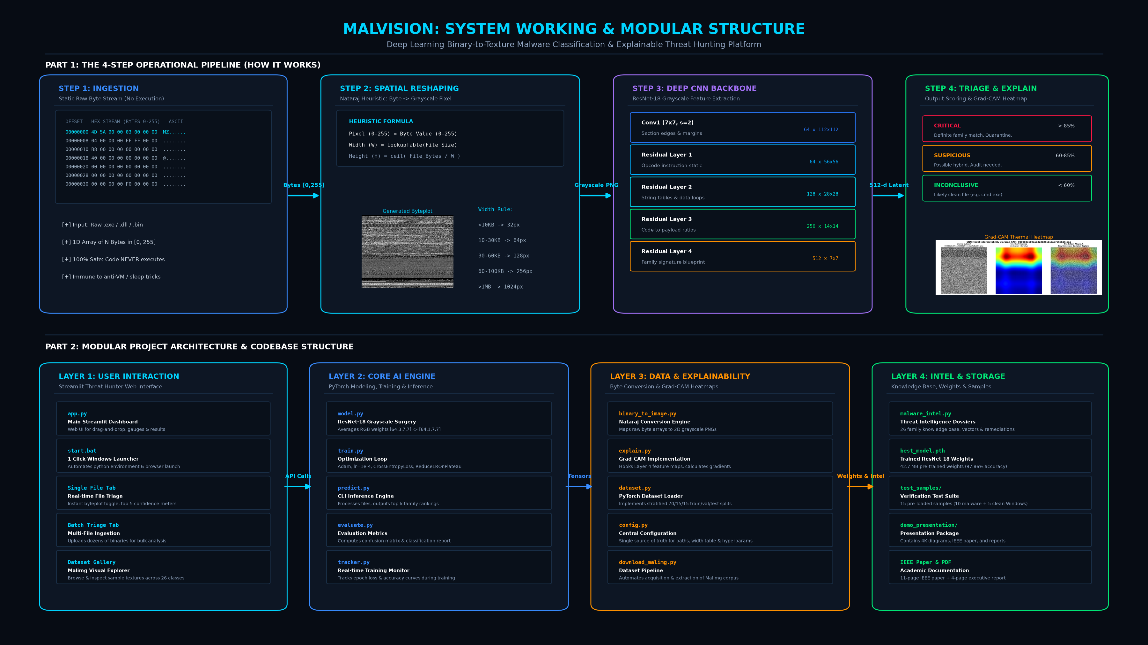
SOFTWARE PLATFORM & APPLICATION
Threat Intelligence & Live Interactive Web UI
Threat Intelligence Dossiers
From AI Score to Actionable Incident Response
malware_intel.py: Embedded knowledge base covering all 26 cataloged families.
Operational Dossiers: Instant profile with malware category, severity level, system impacts (registry changes, memory hooks), infection vectors, and remediation playbooks.
Interactive Web App (app.py): Dark cybersecurity UI with drag-and-drop, on-click byteplot viewer, and Top-K gauge meters.
Batch Triage Mode: Upload dozens of files simultaneously for bulk incident response.
1-Click Windows Launcher: start.bat starts the server and opens the browser automatically.
Notes:
Showcase the application: Instead of just returning a number, MalVision pairs every detection with a complete threat dossier—what it does, how it spreads, and how to remove it. Our Streamlit dashboard supports drag-and-drop file ingestion, batch scanning, and on-click byteplot inspection, launchable with a single click via start.bat.

Slide 11
ACADEMIC & TECHNICAL DEFENSE
Core Novelty & Defense Q&A Cheat Sheet
The 5 Pillars of Novelty
What Makes This System Truly Unique
Top Examiner Viva Questions
Quick Answers for Academic Review
1. Cross-Domain Computer Vision: Formulates binary analysis as spatial texture recognition, bypassing fragile code disassembly.
2. Zero-Execution Safety: Analyzes code statically without emulation, defeating all runtime anti-VM, sleep, and sandbox tricks.
3. Grayscale Transfer Learning: Collapses ImageNet RGB filters to 1-channel grayscale, converging to 97.86% in just 3 epochs.
4. Forensic Explainability: Hooks Grad-CAM into Layer 4 to eliminate the black-box dilemma with thermal heatmaps.
5. Open-World Triage Calibration: Employs Shannon entropy thresholding to reliably discriminate clean Windows files from malware.
Q: Can malware evade by modifying code?: Attackers changing variable names only alter fine micro-textures. The macro-level section blueprint remains structurally consistent across the entire family.
Q: Why not use ResNet-50 or VGG-16?: ResNet-18 offers the optimal trade-off with 11.2M parameters. Deeper networks risk overfitting on grayscale patterns and add unnecessary latency.
Q: Why not just use hashes?: Hashes break with a 1-byte change. Visual textures represent the functional layout of the executable, which remains consistent across polymorphic variants.
Notes:
Summarize novelty: When examiners ask what is novel: (1) we treat malware as visual textures rather than running code, (2) we adapt transfer learning to grayscale, (3) we solve the black-box problem with Grad-CAM, and (4) we handle clean files like cmd.exe through entropy triaging.

Slide 12
CONCLUSION & PROJECT SUMMARY
MalVision: Explainable AI Threat Hunting
97.86% Accuracy across 26 real-world malware families on the Malimg benchmark.
Zero-Execution: 100% safe, instant (<35ms), and immune to runtime anti-VM evasion.
Explainable AI: Layer 4 Grad-CAM heatmaps visually verify causal decision regions.
Production-Ready: Interactive web UI with threat dossiers, batch triage, and 1-click startup.
Open-Source Repository: https://github.com/ManasPatel126/MalVision
Ready for Live Demo (start.bat) • Thank You • Questions & Discussion
Notes:
Conclude: In summary, MalVision proves that computer vision and deep learning can replace slow, risky malware sandboxes with instant, explainable texture classification. All code, models, and papers are open-sourced on GitHub. I would now like to invite the committee to the live interactive demonstration. Thank you, and I look forward to your questions.

