Slide 1

Olist Store Data Analysis
E-commerce Domain
Presented by -
Allam Pravalika
Ponnapureddy Vyshnavi
P.Durga prasad
Manas Sugandh Potdar
Machani Tejasree
Sirvuri Rishi Verma
GROUP - 6

Slide 2
Project Overview
Introduction: The Olist Store Data Analysis project focuses on examining e-commerce transactions from the Olist platform, a popular online marketplace. By analyzing a rich dataset of customer orders, we aim to gain valuable insights into purchasing behaviors, payment preferences, delivery times, and overall customer satisfaction. This analysis is crucial for understanding trends and patterns that can drive strategic decisions to enhance the platform's performance and customer experience.
Objectives:
Analyze Payment Statistics: Examine how payment methods vary between weekdays and weekends to identify trends and preferences in customer payment behavior.
Evaluate Review Scores and Payment Types: Investigate the relationship between high review scores and payment methods to understand customer satisfaction and payment preferences.
Assess Delivery Times for Pet Shop Orders: Determine the average delivery time for pet shop orders to identify potential areas for improvement in logistics and customer service.
Analyze Customer Spending in São Paulo: Explore spending patterns and payment values of customers from São Paulo to tailor marketing and sales strategies effectively.
Investigate Shipping Days vs. Review Scores: Explore the correlation between shipping duration and review scores to assess the impact of delivery times on customer satisfaction.
Importance: Understanding these aspects is vital for optimizing various facets of the e-commerce platform. By identifying key trends and patterns, Olist Store can enhance its operational efficiency, improve customer satisfaction, and tailor its strategies to better meet the needs of its diverse customer base. The insights gained from this analysis will not only inform business decisions but also contribute to a more effective and customer-centric approach in the competitive e-commerce landscape.

Slide 3

Dataset Details
The dataset used in this analysis is a comprehensive collection of e-commerce transactions from the Olist Store. It is provided in CSV format and includes various details related to customer orders.
Key Attributes:
Order ID: Unique identifier for each order.
Order Purchase Timestamp: Date and time when the order was placed.
Payment Type: Method used for payment (e.g., credit card, boleto).
Review Score: Rating given by customers (from 1 to 5).
Order Delivery Date: Date when the order was delivered.
Product Category: Category of the product purchased (e.g., electronics, home goods).
Customer City: City where the customer is located.
Shipping Days: Number of days taken for delivery from the order date.
This dataset provides a detailed view of various aspects of customer transactions, which is essential for performing in-depth analysis and deriving meaningful insights into customer behavior and platform performance.

Slide 4

DATASET SCHEMA

Slide 5
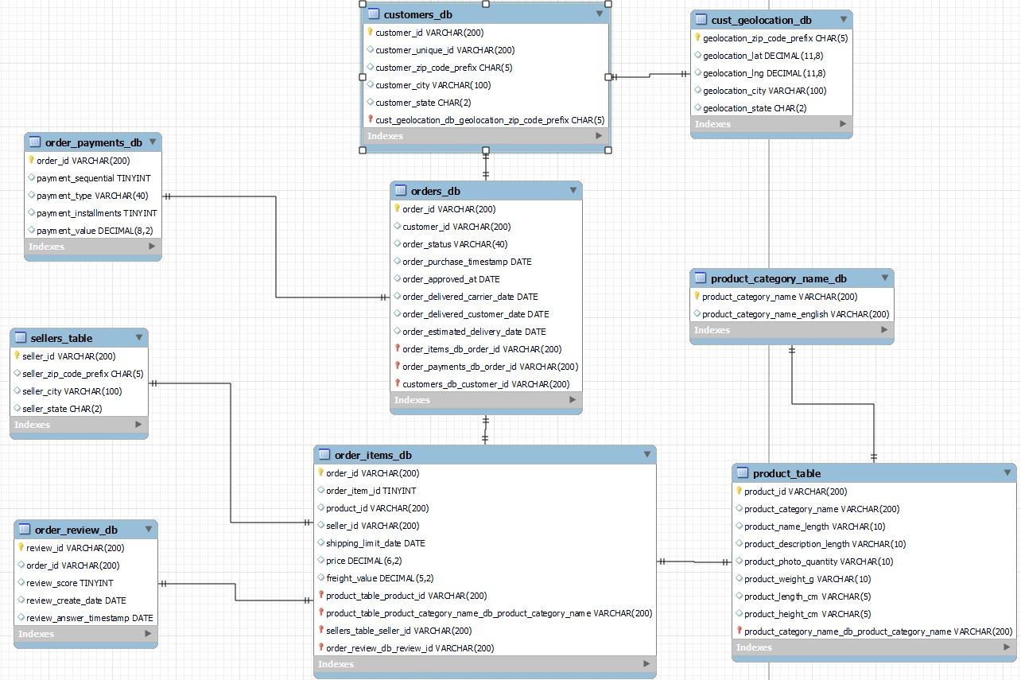
DATA MODEL AND DATA TYPES DEFINED

Slide 6
PROJECT METHODOLOGY
EXTRACT DATA
TRANSFORMATION
LOAD & USING TOOLS
DASH BOARDS
KPI’s & VISUALIZATION

Slide 7
PROJECT ANALYSIS RAW DATA
Data storage through multiple CSV flies
Insufficient information
Lacks of analytics insights to make business decisions
Data Normalization
Create a normalized relation as a central data to collect files in a workbook
ETL Process Optimization
Conduct data manipulation and data cleaning with Excel and MySQL
Analytics Insights
Generate analytical insights through an interactive dashboard via Power BI, Tableau
CLEAN DATA
Reduce data storage
Create efficient Query and analysis
Empower data driven decision making capability

Slide 8
Tools Used and Their Roles
Excel:
Role: The initial step involved importing the CSV files into Excel for data cleaning and preliminary exploration. Excel was used to handle missing values, correct data inconsistencies, and organize the dataset. It also facilitated basic calculations and the creation of preliminary charts to understand the data better before further analysis.
MySQL:
Role: After cleaning the data in Excel, it was imported into MySQL for creating a structured database. MySQL was used to perform complex queries and aggregations to generate key performance indicators (KPIs). The relational database allowed for efficient data management and querying, which was crucial for detailed analysis.
Power BI:
Role: With the database set up in MySQL, data was imported into Power BI via a MySQL database connection. Power BI was used to create interactive and dynamic dashboards. It enabled the visualization of KPIs and trends through various charts and graphs, providing insights into payment statistics, delivery times, and other key metrics.
Tableau:
Role: Similarly, data was imported into Tableau using the MySQL database connection. Tableau was employed for advanced data visualization, allowing for the creation of detailed and visually appealing charts. It helped in exploring complex relationships and patterns in the data, facilitating an engaging presentation of the insights derived from the analysis.

Slide 9
Key Performance Indicators (KPIs)
Weekday vs. Weekend (order_purchase_timestamp) Payment Statistics
Number of Orders with review score 5 and payment type as credit card
Average number of days taken for order_delivered_customer_date for pet_shop
Average price and payment values from customers of São Paulo city
Relationship between shipping days vs. review scores

Slide 10
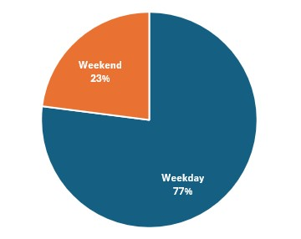
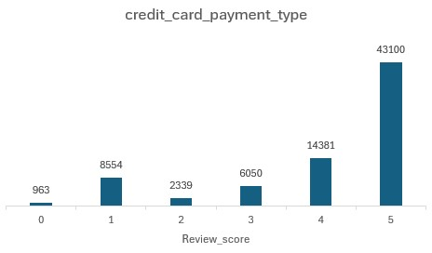
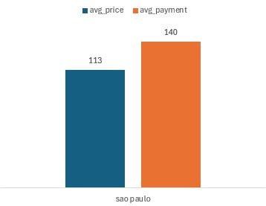
1) Weekday vs. Weekend Payment Statistics:
Explanation: This KPI was chosen to analyze payment behaviors based on the day of the week. Understanding whether customers prefer to make purchases on weekdays or weekends can reveal patterns in consumer activity and help optimize marketing strategies and promotional timing.
Relevance: Insights into payment trends can guide targeted marketing efforts, adjust inventory management, and align promotional campaigns with peak purchasing times, ultimately enhancing sales performance.
2) Number of Orders with Review Score 5 and Payment Type as Credit Card:
Explanation: This KPI focuses on identifying the number of orders that received the highest review score (5) and were paid for using a credit card. It helps to understand customer satisfaction levels and preferences related to payment methods.
Relevance: High review scores combined with credit card payments indicate a high level of customer satisfaction and preference for a specific payment method. This information can be used to tailor customer service approaches and payment options to improve overall customer experience.
3)Average Price and Payment Values from Customers of São Paulo City:
Explanation: This KPI examines the average price of orders and payment values from customers in São Paulo. It helps understand the spending behavior and purchasing power of customers from this key city.
Relevance: Insights into customer spending patterns in São Paulo can inform targeted marketing strategies, pricing adjustments, and promotional offers tailored to this geographic segment, potentially increasing sales and customer engagement.

Slide 11
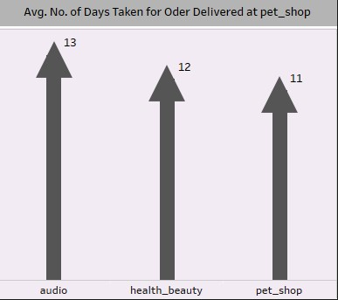
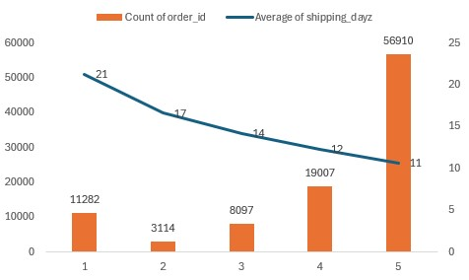
4) Average Number of Days Taken for Order Delivery (Pet Shop):
Explanation: This KPI measures the average delivery time for orders specifically from the pet shop category. It provides insights into the efficiency of the delivery process for this product category.
Relevance: Analyzing delivery times for pet shop orders helps identify any delays or inefficiencies in the supply chain. Improving delivery times can enhance customer satisfaction and reduce the likelihood of negative reviews related to shipping delays.
5) Relationship Between Shipping Days and Review Scores:
Explanation: This KPI explores the correlation between the number of days taken for shipping and the review scores given by customers. It aims to assess how shipping times impact customer satisfaction.
Relevance: Understanding this relationship is crucial for improving delivery processes and customer service. Faster shipping times generally lead to higher review scores, which can enhance the platform’s reputation and customer loyalty.

Slide 12
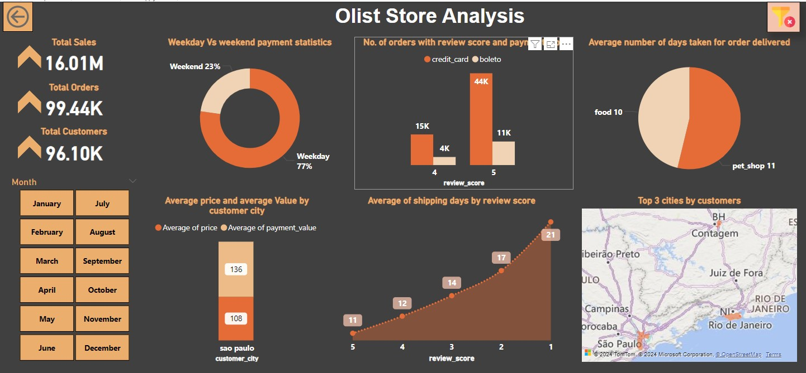
POWER BI
DASHBOARD

Slide 13
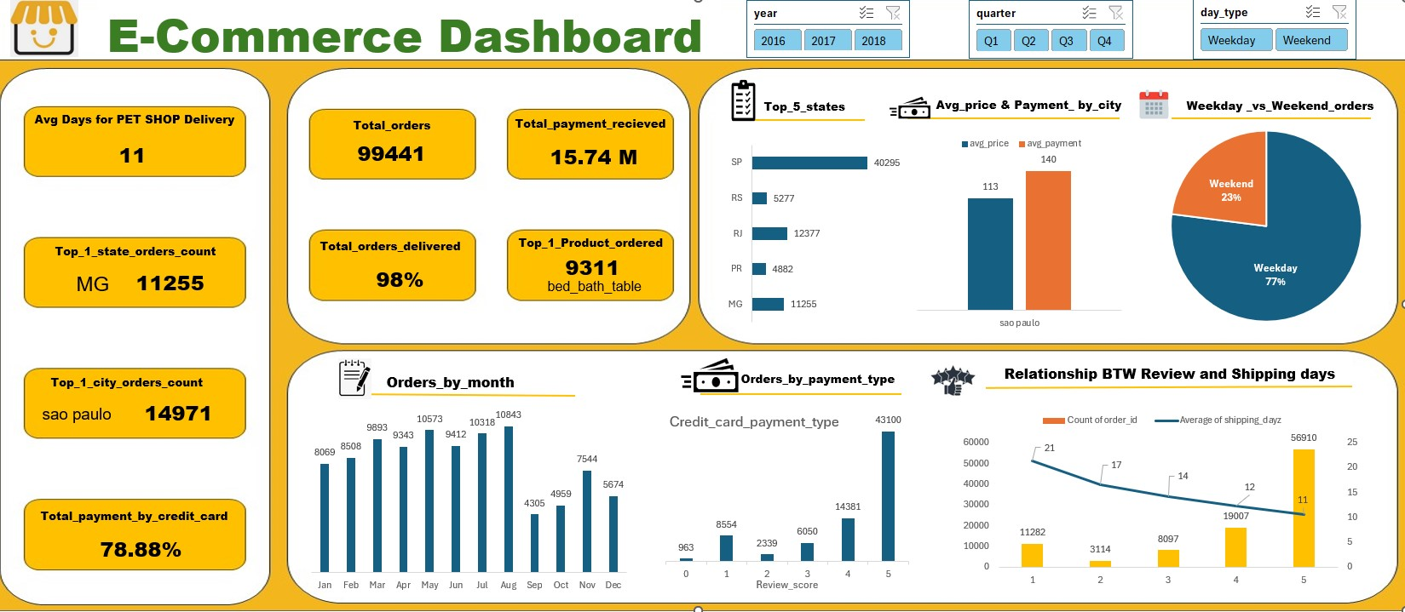
EXCEL
DASHBOARD

Slide 14
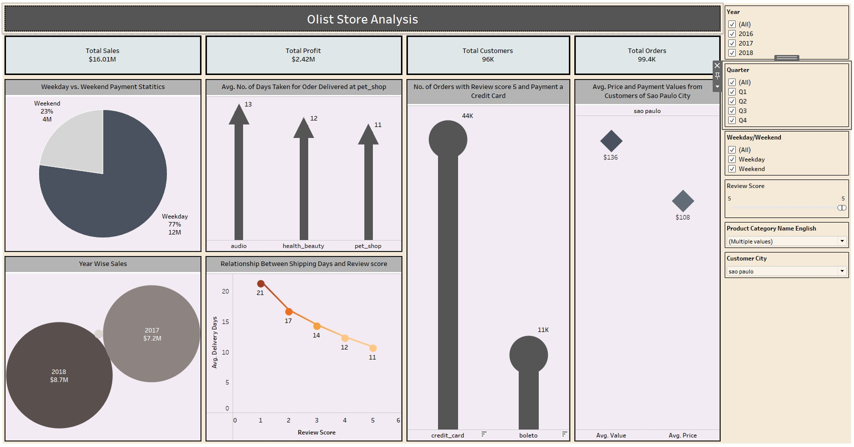
TABLEAU
DASHBOARD

Slide 15

Insights and Suggestions
Insight: Relationship Between Shipping Days and Review Scores
Suggestion: Improve shipping efficiency by optimizing logistics and reducing delivery times. Implement measures such as better route planning, faster processing times, and partnerships with reliable courier services.
Impact: Enhancing delivery speed will likely lead to higher customer satisfaction, improved review scores, and increased repeat business. Faster deliveries can also reduce negative feedback and bolster the platform's reputation.
Insight: Number of Orders with Review Score 5 and Payment Type as Credit Card
Suggestion: Promote credit card payments through incentives and streamlined checkout processes. Focus on enhancing customer service for high-rated transactions to encourage positive reviews.
Impact: By leveraging customer satisfaction and preferred payment methods, the platform can increase conversion rates, encourage higher spending, and build stronger customer relationships.
Insight: Weekday vs. Weekend Payment Statistics
Suggestion: Align marketing campaigns, sales promotions, and inventory management with peak purchasing times identified in the data. Tailor promotions to maximize engagement during high-activity periods.
Impact: Targeted marketing and strategic inventory planning can drive sales during peak times and optimize resource allocation, leading to increased revenue and improved operational efficiency.
Insight: Average Price and Payment Values from Customers of São Paulo City
Suggestion: Develop customized marketing strategies and promotional offers for São Paulo customers. Adjust pricing strategies to align with the spending patterns of this key demographic.
Impact: Tailoring approaches for high-value customers in São Paulo can enhance engagement, drive higher sales in this important market, and improve overall profitability.
Insight: Average Number of Days Taken for Order Delivery (Pet Shop)
Suggestion: Investigate and address any inefficiencies in the delivery process for pet shop orders. Explore options for expedited shipping or improved inventory management.
Impact: Reducing delivery times for pet shop products can lead to higher customer satisfaction and fewer complaints, potentially increasing customer retention and positive reviews.

Slide 16


