Slide 1

A Novel Approach to develop Energy Prediction Model for Large Industries using Artificial Intelligence

Slide 2
Introduction
Energy is the major concern of the development of any nation. India, the second largest population of the world has major challenges to meet its growing demand of energy with limited fossil fuel.
The sun, which is abundant source of energy can be an alternative to meet this growing demand without any ecological concerns.
Accurate estimation of solar energy is necessary as demand and dependency of solar energy in total power is increasing worldwide. Moreover, accurate estimation is required by energy planners and electric utilities to have a right balance of renewable and fossil fuels based generation.

Slide 3
About the project
Increased competitiveness of solar panels as a renewable energy source has increase the number of PV panel installation in recent year. In the meantime, higher availability of data and computational power have enabled machine learning algorithm to perform improved prediction.
As the need to predict solar energy output is essential for the energy industry,Machine learning models can be employed to create more accurate predictions.

Slide 4

Project Goals
To predict the power generation for next couple days.
To identify the need for panel cleaning or maintenance.
To identify faulty or sub-optimally performing panel.

Slide 5
Tools and Technologies
Data analytics techniques and machine learning algorithm along with Python background to achieve maximum accurate results.
A platform of high-performance computing, to run and test machine learning models. For example Google colab
Appropriate medium to represent data interpretation and analysis to highlight differences between expected and achieved results.

Slide 6
Development methodology
Planning out the development lifecycle
Collection and analysis of data available in open source datasets
Data cleaning and generation of necessary data
Identification & development of ML models
Fine tuning models to achieve maximum accuracy
Try to catalog data by identifying patterns using data analysis

Slide 7
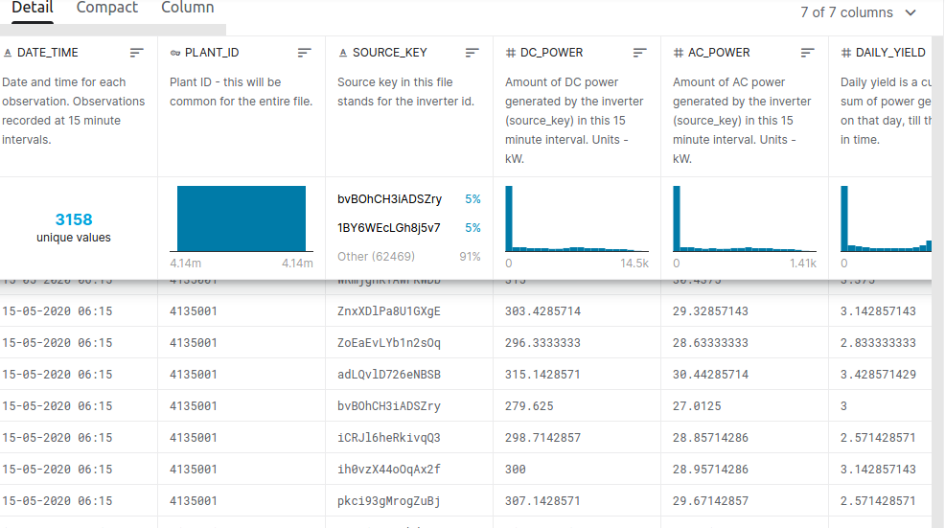
The Solar Power Generation Dataset
Fig 1.1 A few rows of the solar generation dataset obtained from Kaggle.
Notes:
Static and dynamic yield analysis (future scope)

Slide 8
Final Results
At the end of this project, we
Have developed a machine learning tool to predict solar energy generation and related parameters.
Have been able to catalog and present forecasted given data in a human readable syntax
Have constructed a tool that will be able to provide meaningful insights into energy consumption of specific facilities using data analysis techniques.

Slide 9
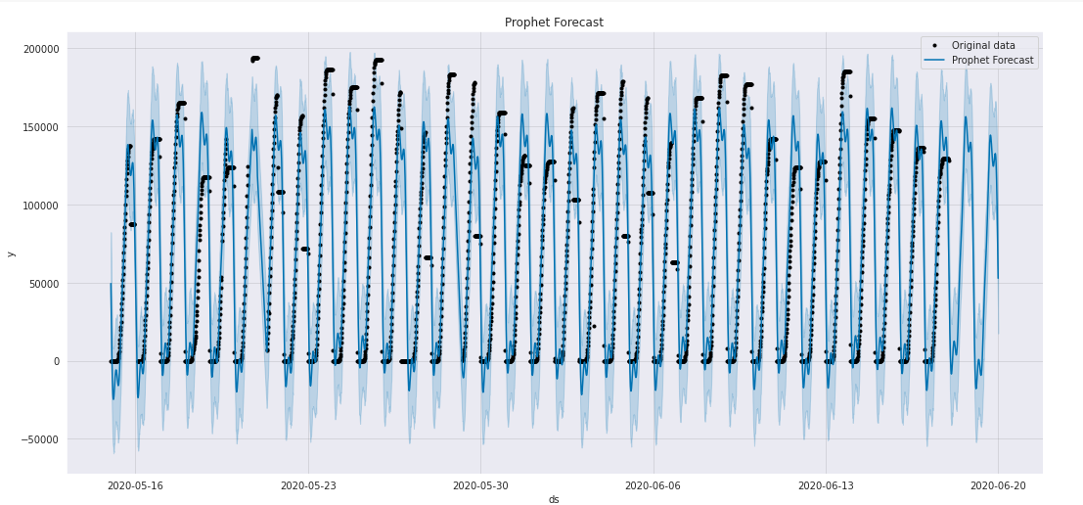
Prophet model forecast output
Fig 1.2 The output of the Prophet model when used to forecast using the values in the solar generation dataset with energy generation plotted against time

Slide 10
Time & Cost Analysis
Timeline
Cost
Data collecton, cleaning and preparation
Development of models & accuracy enhancement
Additional documentation & data analysis
Tool | Price
Google Colaboratory | N/A
Open Source Datasets | N/A
Github Project Hosting | N/A

Slide 11
Project Applications
With the growing need for conventional energy methods, there is an even critical need for monitoring these techniques to get maximum efficiency.
It will also help examine, control and eliminate wasteful practices.
Data analysis opens doors to research and innovation in these methods.

Slide 12
Conclusion & Future Work
Conclusion
Future Work
We aim to implement a tool to help conventional energy generation and prevent wasteful practices.
Port the application to a web app, for easy access to users.
Generalize energy prediction tool for many other forms of conventional energy.

Slide 13
References
KTH RITSES, Solar Power Forecasting with Machine Learning Techniques in 2018, by EMIL ISAKSSON and MIKAEL KARPE CONDE.
IRENA. Renewable power generation costs in 2017. Technical report, International Renewable Energy Agency, Abu Dhabi, January 2018
Jose R. Andrade and Ricardo J. Bessa. Improving renewable energy forecasting with a grid of numerical weather predictions. IEEE Transactions on Sustainable Energy, 8(4):1571–1580, October 2017.
Rich H. Inman, Hugo T.C. Pedro, and Carlos F.M. Coimbra. Solar forecasting methods for renewable energy integration. Progress in Energy and Combustion Science, 39(6):535 – 576, 2013.
J. Antonanzas, N. Osorio, R. Escobar, R. Urraca, F.J. Martinez-de Pison, and F. Antonanzas-Torres. Review of photovoltaic power forecasting. Solar Energy, 136:78–111, October 2016.

Slide 14
THANK YOU

