Slide 1
TourPlan AI: Smart Travel & Trip Planning System
• Software Engineering Lab project, MBA Tech Computer Engineering
• Presented by: [Student name(s)] ([Roll no(s)])
• Faculty mentor: [Faculty mentor]
• [Institute / department name] | [Submission date]
• Placeholders in square brackets must be filled in by the student.
Notes:
Introduce yourself, the project name and mentor. Say in one sentence: it plans trips and is honest about estimates.

Slide 2
Problem and motivation
• Choosing where to go within a budget is hard
• Costs are scattered across sites and spreadsheets
• Generic chatbots can invent prices and places
• Need: transparent, reproducible, editable plans
Notes:
Viva: Why not just use a chatbot? Because numbers must be reproducible and testable; LLMs may hallucinate.

Slide 3
Objectives and scope
• Transparent 100-point destination ranking
• Itinerary, budget, map, packing list, PDF
• AI assistant with honest fallback
• Security: hashing, JWT, per-user access, no keys in browser
• Out of scope: booking, live prices, payments
Notes:
State clearly the app does not book anything and prices are indicative estimates.

Slide 4
Existing vs proposed system
• Existing: booking portals (live prices, no planning), spreadsheets (manual), chatbots (may hallucinate)
• Proposed: one app combining discovery, planning, budgeting, map and assistant
• LLM optional and limited to explanation; labelled fallback
Notes:
Emphasise the design choice: engine decides, LLM explains.

Slide 5
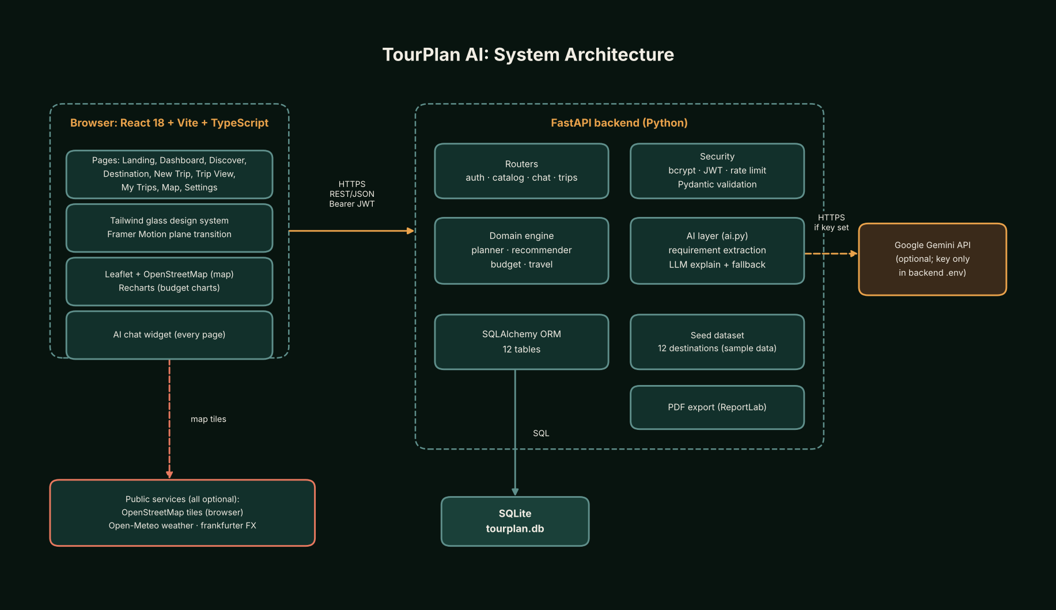
System architecture
• React SPA
• FastAPI REST + JWT
• SQLAlchemy + SQLite
• Deterministic engine
• Optional Gemini, Open-Meteo, Frankfurter
Notes:
Walk the diagram left to right. The key is only in the backend environment.

Slide 6
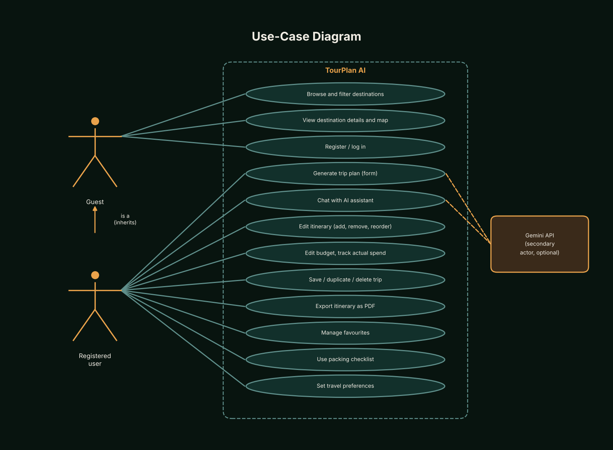
Use cases
Notes:
Actors: guest and registered user. Highlight Generate trip plan and Chat with assistant.

Slide 7
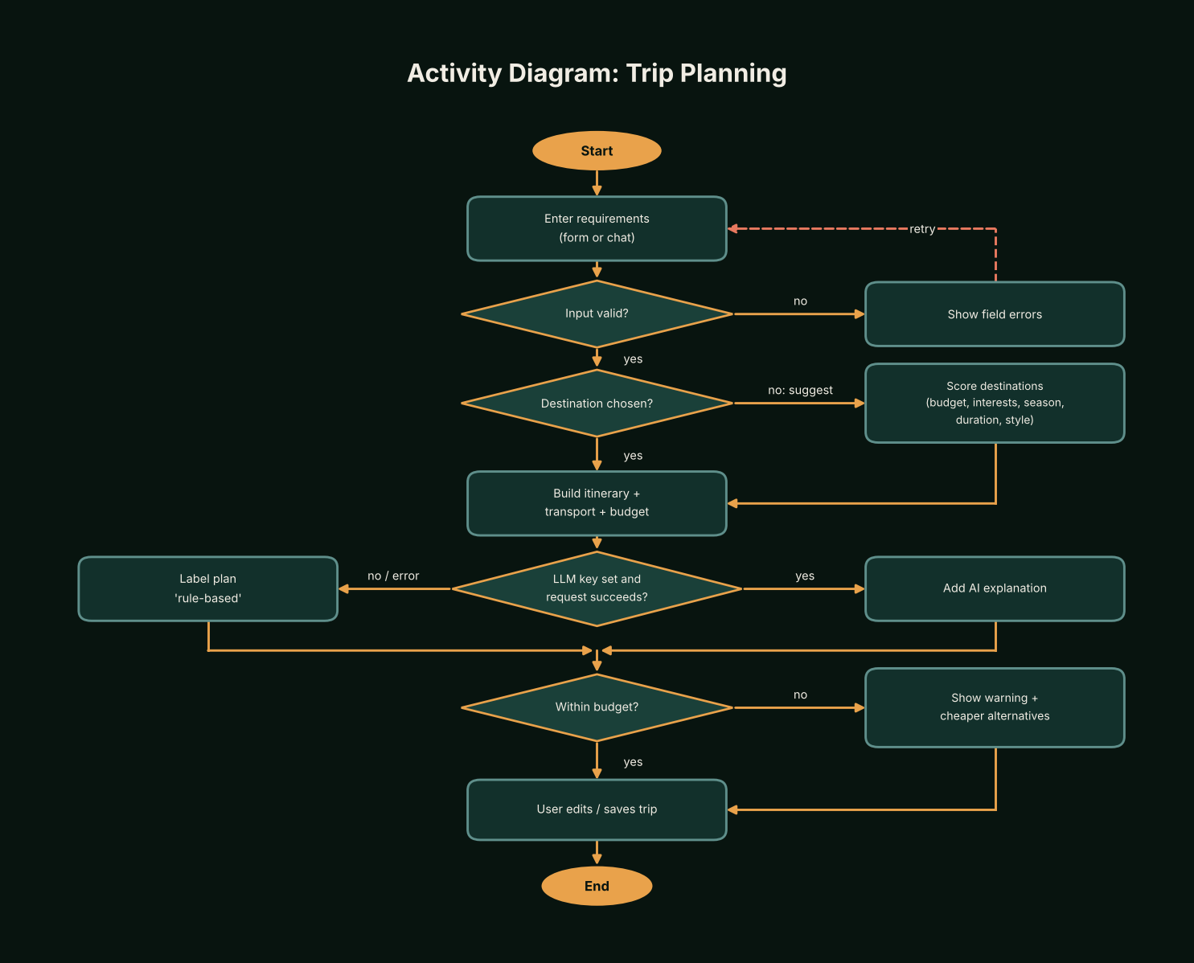
Data flow and activity
Notes:
Show validation, scoring, budget check and the over-budget branch that suggests cheaper alternatives.

Slide 8
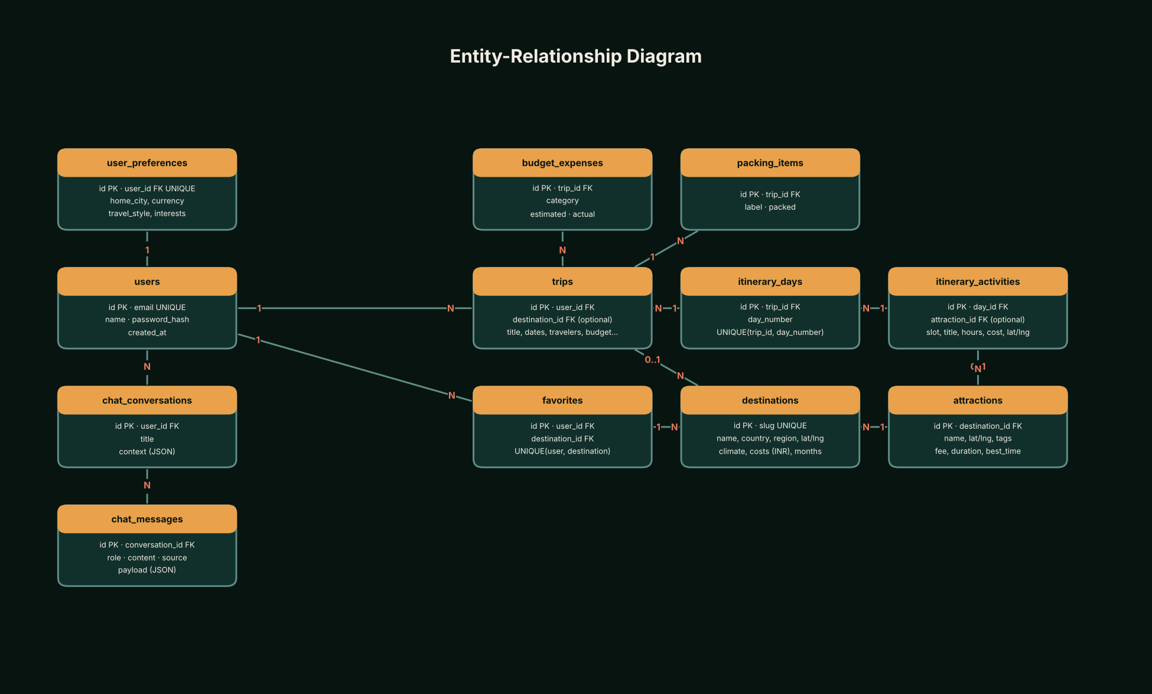
Database design
• 12 destinations, 54 attractions (sample data)
• Trips own days, activities, expenses, packing items
• Unique constraints: trip/day and user/destination
• Foreign keys enabled in SQLite
Notes:
Explain one-to-many relationships. Seed data is hand-written sample data.

Slide 9
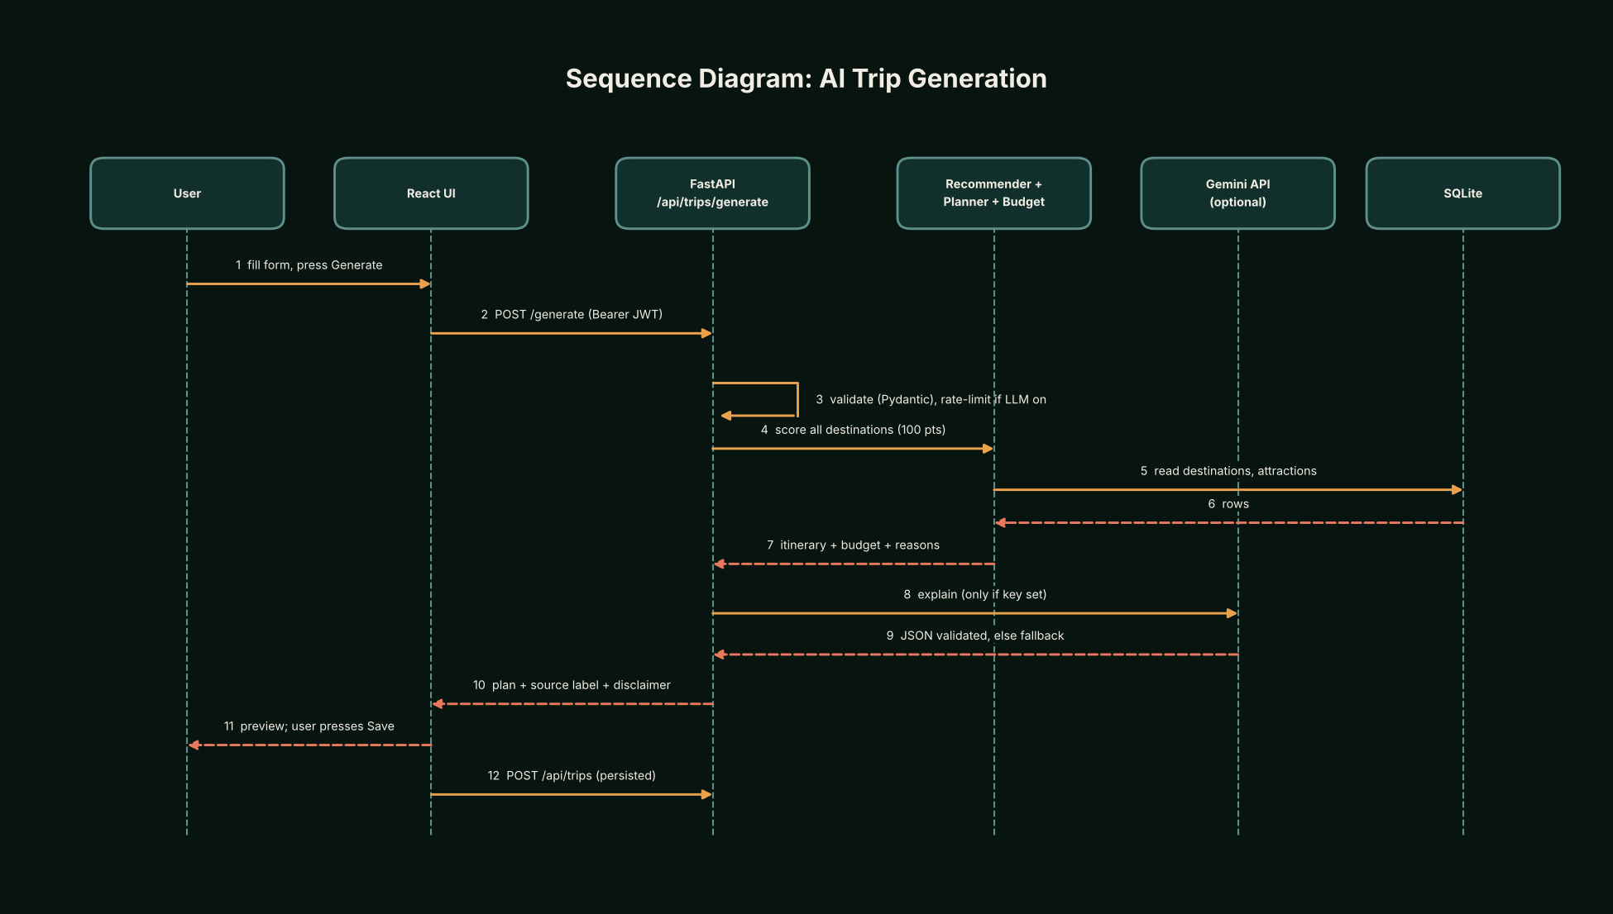
AI architecture
• 1 Rule-based requirement extraction
• 2 Deterministic recommender, planner, budget
• 3 Optional Gemini explanation as validated JSON
• 4 Fallback labelled rule_based
• LLM never supplies prices or coordinates
Notes:
Viva: what if there is no key? Rule-based text, labelled honestly. Rate limit 10 per minute by default.

Slide 10
Recommendation score
• budget fit: 35 points
• interest match: 30 points
• season fit: 15 points
• duration fit: 10 points
• style fit: 10 points
• + up to 8 bonus for place-type hints
• In-budget destinations rank first; every component shows a reason
Notes:
Total is 100 points. Show the breakdown in the UI during the demo.

Slide 11
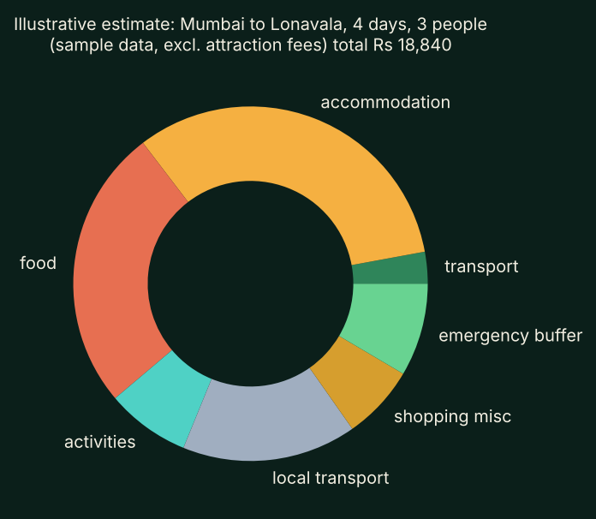
Budget estimation
• Worked example total Rs 21,240 (matches unit test)
• Categories incl. 8% misc and 10% emergency buffer
• Rooms = ceil(travellers / 2)
• All figures are estimates from sample data
Notes:
The chart is computed by the real budget module for Mumbai to Lonavala, 3 people, 4 days, train, excluding attraction fees. It is illustrative.

Slide 12
User interface
• Dark forest glassmorphism; featured card, stat rings, map panel
• Responsive; keyboard focus; aria roles; reduced motion
• Airplane transition with a settings toggle
• [Insert real screenshots here after running the app]
Notes:
Replace the last bullet with screenshots captured from the running application. None were faked.

Slide 13
Security
• bcrypt password hashing
• JWT with expiry; protected routes
• Other users' trips return 404
• Input validation, CORS allow-list, AI rate limit
• Limitation: token in localStorage
Notes:
Viva: XSS risk of localStorage; cookies with CSRF protection are future work.

Slide 14
Testing
• 45 pytest functions in the repository
• Budget and travel as pure functions with hand-calculated values
• API tests with temp DB, LLM disabled
• Results NOT yet recorded: run pytest and npm test, then insert real output here
Notes:
Be honest: do not claim a pass count until you have run the tests. Paste real output in report section 25.

Slide 15
Demo, limitations and future work
• Demo: Mumbai, 3 people, 4 days, Rs 20,000; ranking, itinerary edit, budget, map, chat, PDF
• Limits: sample data, 10 start cities, rule-based extraction, in-memory rate limit
• Future: migrations, live pricing, cookie sessions, larger dataset
• Thank you. Questions?
Notes:
DEMO STEPS: 1 Discover and filter. 2 Log in demo@tourplan.ai / demo12345. 3 New trip. 4 Score breakdown. 5 Edit and save itinerary. 6 Budget warning and alternatives. 7 Map route. 8 Assistant: 'Plan 3 days in Lonavala for 3 people under 15k' then 'make it cheaper'. 9 PDF export. 10 Turn transition off in Settings. VIVA: see docs/VIVA_AND_DEMO.md for 20 prepared questions.

