Slide 1

Customer Shopping Behavior Analysis
Uncovering insights from 3,900 transactions across product categories to guide strategic business decisions on spending patterns, customer segments, and subscription behavior.
Notes:
1

Slide 2
Dataset at a Glance
3,900
18
Transactions
Columns
Rows in the dataset
Features tracked
$59.76
37
Avg Purchase
Missing Values
Average spend per order
In Review Rating column
Key features include customer demographics (Age, Gender, Location, Subscription Status), purchase details (Item, Category, Amount, Season), and shopping behavior (Discount, Promo Code, Frequency, Review Rating).
Notes:
2

Slide 3




Data Preparation in Python
Cleaning
Imputed missing Review Rating values using median by product category. Renamed columns to snake_case for consistency.
Feature Engineering
Created age_group by binning customer ages and purchase_frequency_days from purchase data. Dropped redundant promo_code_used column.
Database Integration
Connected Python to PostgreSQL and loaded the cleaned DataFrame for SQL-based analysis.
Notes:
3

Slide 4
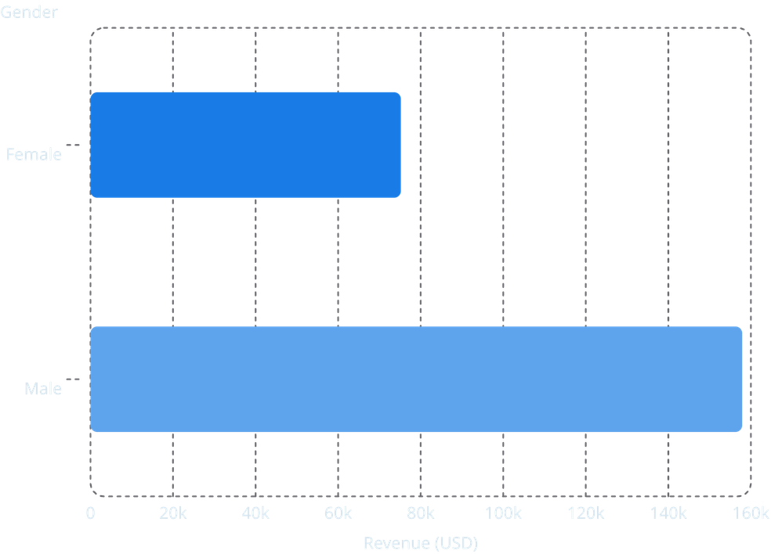
Revenue by Gender & Discount Users
Key Findings
Male customers generated more than double the revenue of female customers ($157,890 vs. $75,191).
839 customers used discounts and still spent above the average purchase amount — indicating strong deal-seeker conversion potential.
Notes:
4

Slide 5

Top Products & Shipping Insights
Top 5 Products by Rating
Shipping Type Comparison
Express shipping customers spend slightly more on average ($60.48) vs. Standard ($58.46).
Product
Avg Rating
Gloves
3.86
Discount-Dependent Products
Sandals
3.84
Hat (50%), Sneakers (49.66%), Coat (49.07%), Sweater (48.17%), and Pants (47.37%) have the highest discount rates — review policy to balance sales with margins.
Boots
3.82
Hat
3.80
Skirt
3.78
Notes:
5

Slide 6

Customer Segmentation
Loyal
Returning
3,116 customers — the dominant segment with repeat purchase history.
701 customers — have purchased before but not yet in the loyal tier.
New
83 customers — first-time buyers with growth potential.
Of customers with more than 5 purchases, 958 are subscribers vs. 2,518 non-subscribers — repeat buyers show meaningful subscription affinity.
Notes:
6

Slide 7
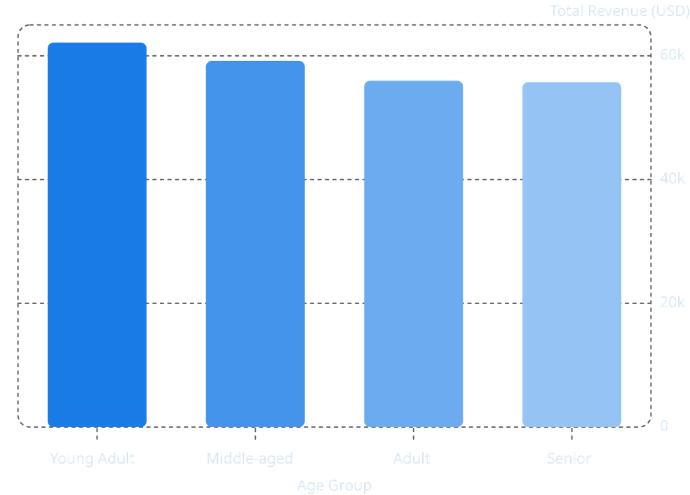
Revenue by Age Group
Age Group Insights
Young Adults lead in revenue contribution at $62,143, followed closely by Middle-aged ($59,197), Adult ($55,978), and Senior ($55,763).
Revenue is relatively evenly distributed across age groups, suggesting broad market appeal. Targeted marketing should focus on high-revenue age groups and express-shipping users.
Notes:
7

Slide 8
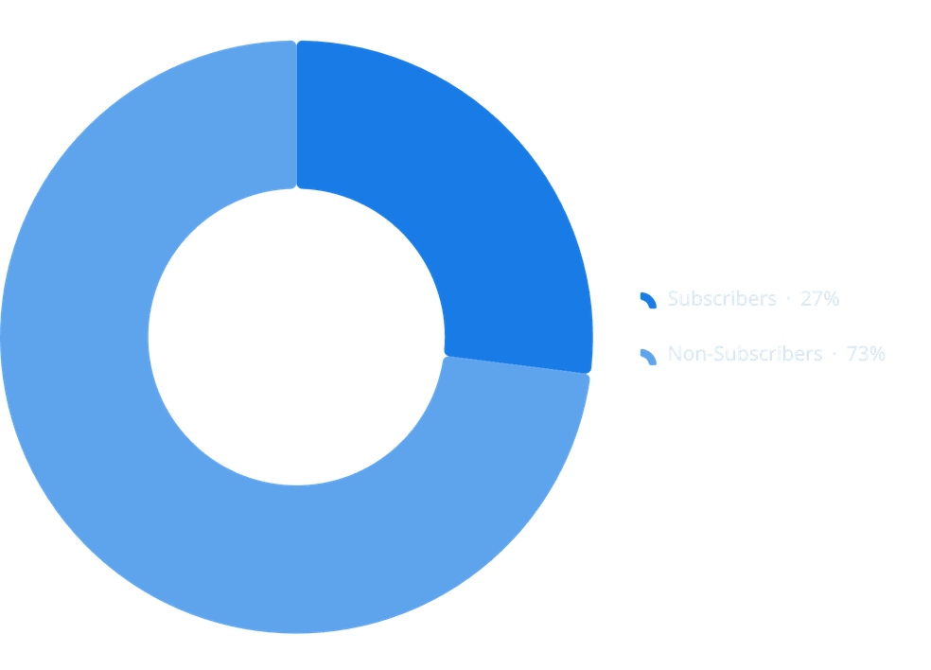
Subscription Behavior
Subscribers vs. Non-Subscribers
Status
Customers
Avg Spend
Total Revenue
Yes
1,053
$59.49
$62,645
No
2,847
$59.87
$170,436
Subscribers make up only 27% of customers but represent a high-value segment. Promoting exclusive subscriber benefits could grow this base significantly.
Notes:
8

Slide 9
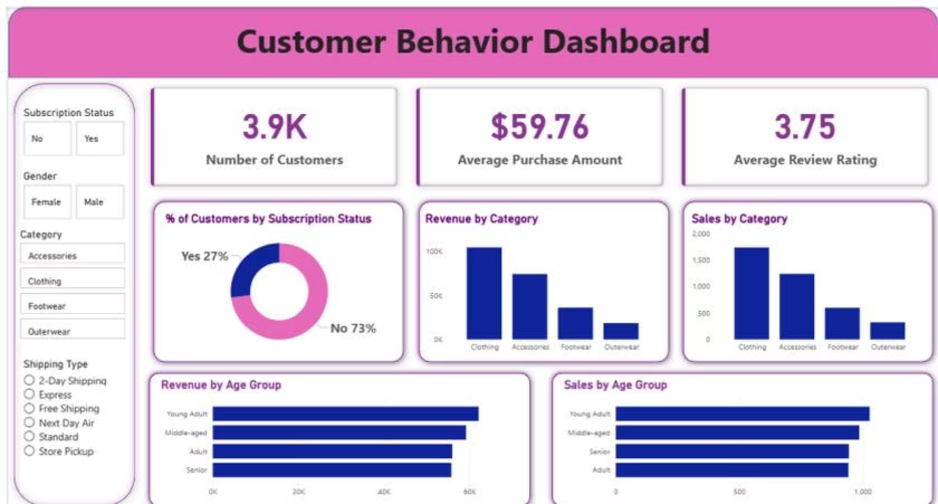
Power BI Dashboard
Key Metrics
Visualizations
3.9K Customers · $59.76 Avg Purchase · 3.75 Avg Rating
Revenue & Sales by Category and Age Group, Subscription donut chart, interactive filters for Gender, Category, and Shipping Type
Notes:
9

Slide 10


Business Recommendations
Boost Subscriptions
Promote exclusive benefits to convert non-subscribers and grow the 27% subscriber base.
Loyalty Programs
Reward repeat buyers to move Returning customers (701) into the Loyal segment (3,116).
Review Discount Policy
Balance sales boosts with margin control, especially for high-discount products like Hat and Sneakers.
Targeted Marketing
Focus campaigns on high-revenue age groups, express-shipping users, and top-rated products.
Notes:
10

