Slide 1

Project Title -Seasonal Agriculture Performance Analysis
[Student Name:Manas Atul Thakre
College Name- G. H. Raisoni College of Engineering]
AICTE STU ID : STU6a1bc6d73de001780205271

Slide 2

PROBLEM STATEMENT
To analyze and compare agricultural performance across different seasons by studying yield, production, environmental conditions, resource usage, economic outcomes, and regional patterns, and to derive insights for better seasonal agricultural planning.

Slide 3
Project Description Seasonal Agriculture Performance Analysis is a data analytics project that analyzes agricultural performance across Kharif, Rabi, and Zaid seasons. The project uses agricultural data containing information about crops, regions, environmental conditions, farming practices, resource usage, production, yield, and economic outcomes. The analysis involves data cleaning, exploratory data analysis, statistical analysis, and data visualization using Python. The project compares seasonal differences in yield, production, revenue, cost, profit, rainfall, temperature, water usage, fertilizer and pesticide usage, and irrigation methods. It also examines relationships between environmental conditions and agricultural yield, compares seasonal performance across different states, and identifies unusual patterns and variations in the data. The findings are used to identify the best-performing seasons, resource-efficiency patterns, economic differences, and regional variations, and to provide insights that can support better seasonal agricultural planning and decision-making.

Slide 4

WHO ARE THE END USERS?
The main end users of this project are:
Farmers – to understand seasonal crop performance, resource usage, and profitability.
Agricultural Planners – to support better seasonal crop and resource planning.
Government & Agricultural Departments – to understand regional and seasonal agricultural patterns for planning and decision-making.
Data Analysts & Researchers – to analyze agricultural trends, relationships, and performance.
Agribusiness & Farming Organizations – to evaluate production, costs, revenue, and profit across seasons.

Slide 5

Technology Used
Python – Data analysis and processing
Pandas – Data cleaning, manipulation, and analysis
NumPy – Numerical calculations
Matplotlib – Data visualization
Seaborn – Statistical graphs and visualizations
Jupyter Notebook / Google Colab – Developing and documenting the analysis
Microsoft Excel (.xlsx) – Dataset storage and input
GitHub – Project version control and hosting

Slide 6
RESULTS
The analysis of agricultural data across Kharif, Rabi, and Zaid seasons produced the following key results:
Kharif showed the highest average yield (5.64 tonnes/ha), production (46.31 tonnes), revenue (₹7.11 lakh), and profit (₹1.79 lakh).
Rabi showed moderate performance with an average yield of 5.08 tonnes/ha and profit of ₹87,689.
Zaid had the lowest average yield (4.67 tonnes/ha) and recorded an average loss of ₹24,805.
Kharif received the highest average rainfall (852.08 mm) and humidity (71.81%).
Zaid had the highest average temperature (31.04°C), sunlight (8.18 hours/day), and water usage (6,419.89 m³).
Kharif had the highest water efficiency (5.89 tonnes/1,000 m³), while Zaid had the lowest (4.41).
Environmental variables individually showed very weak linear correlation with yield in this dataset.
Seasonal performance varied across states; there was no single season that performed best in every state.
Some unusual high-yield observations/outliers were found, particularly in Kharif and Rabi.

Slide 7
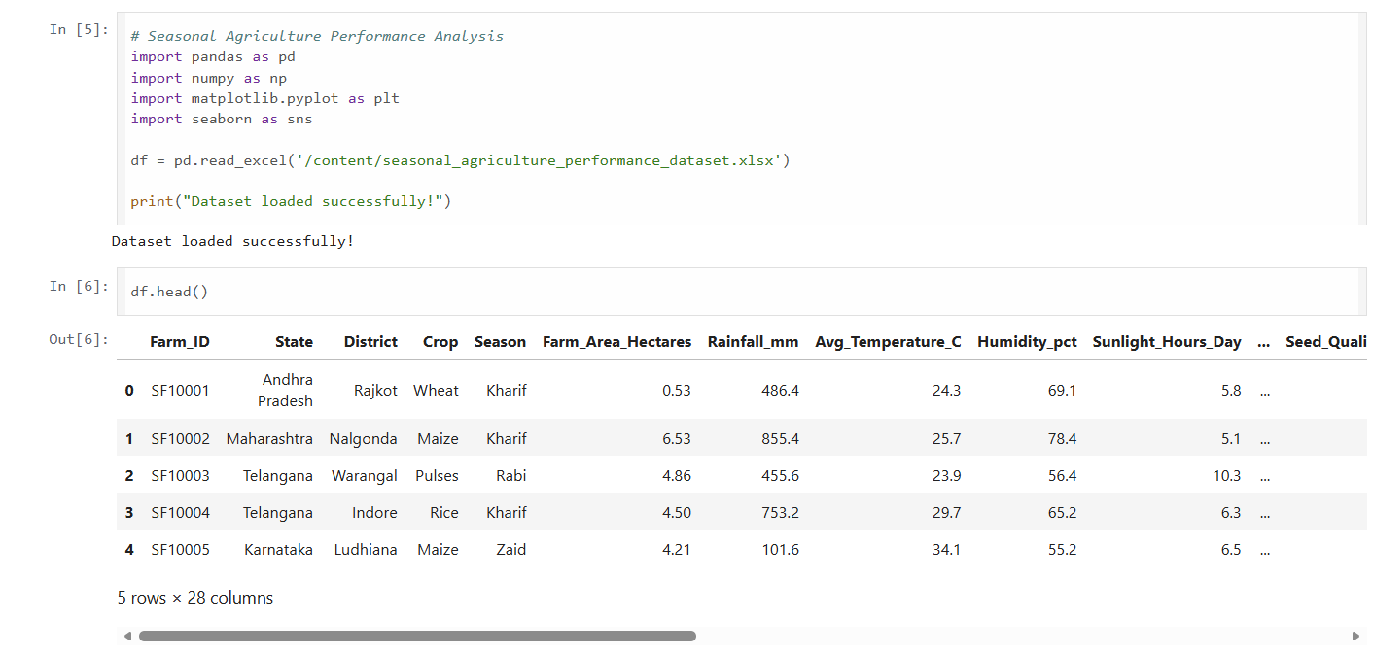
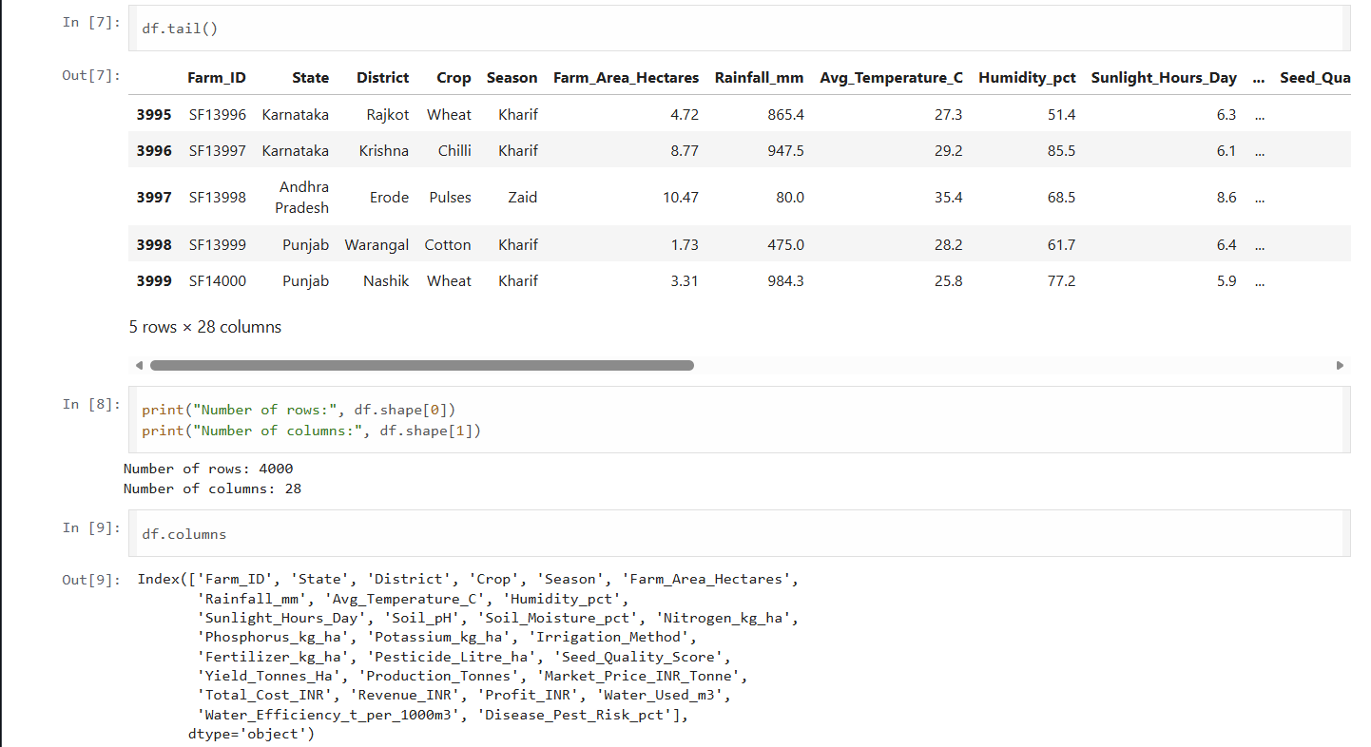
RESULTS
[Add screen shots of your code ]

Slide 8
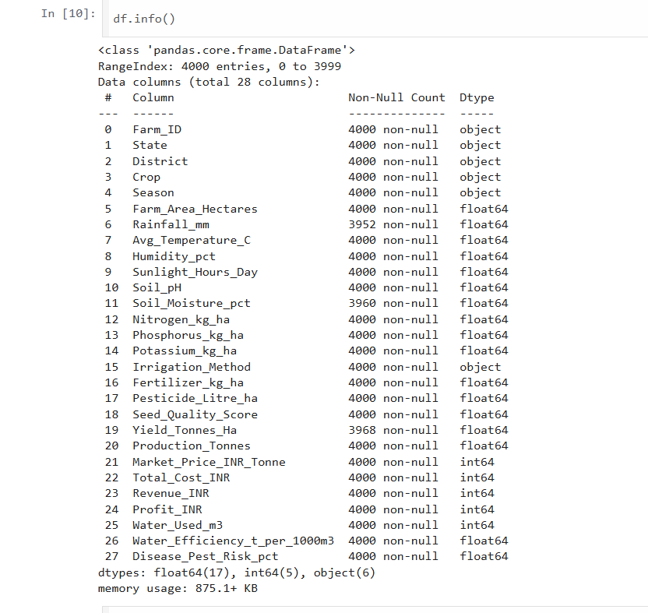
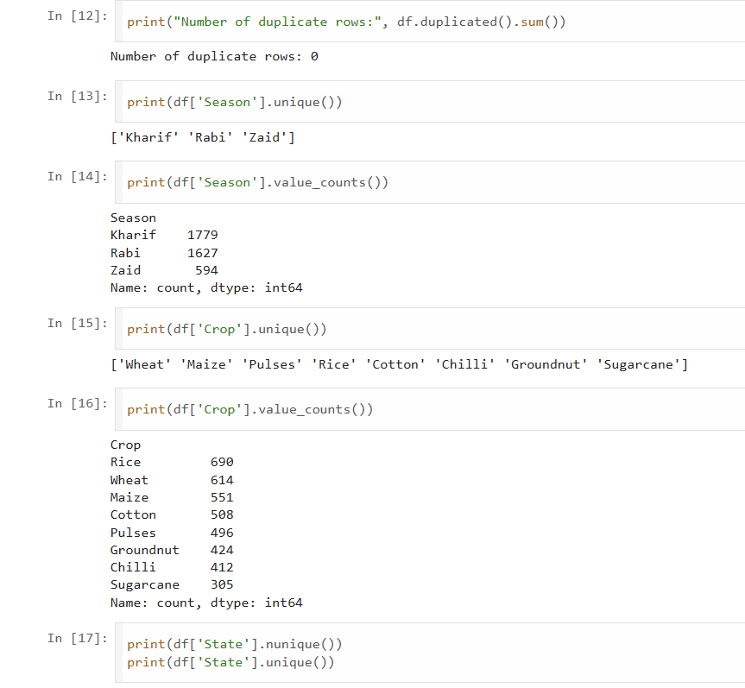
RESULTS
[Add screen shots of your code ]

Slide 9
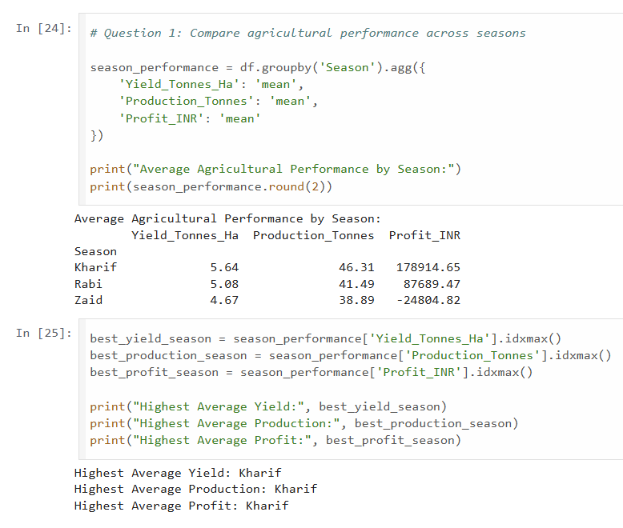
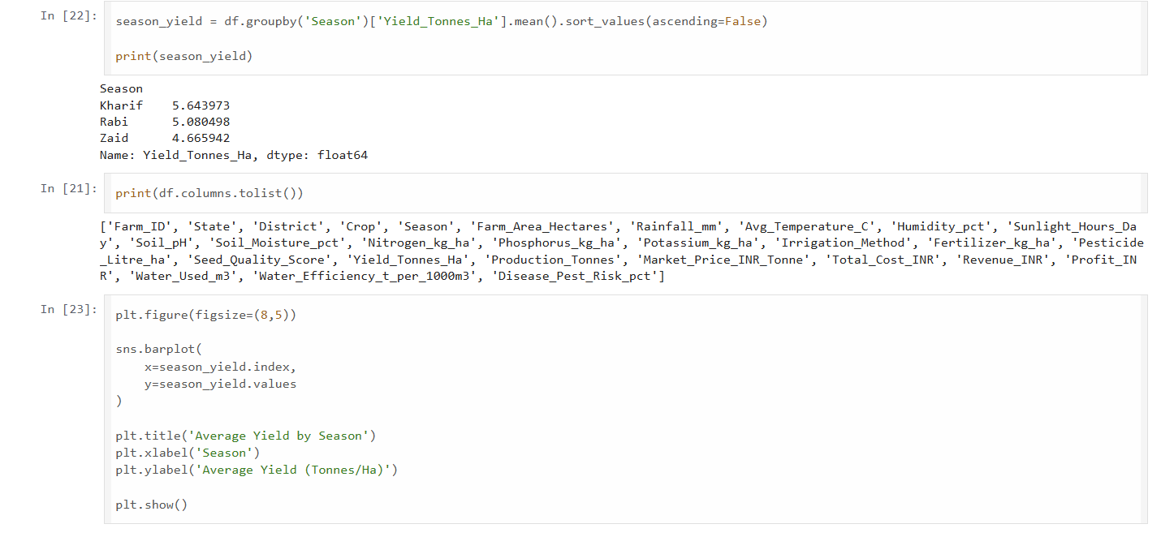
RESULTS
[Add screen shots of your code ]

Slide 10
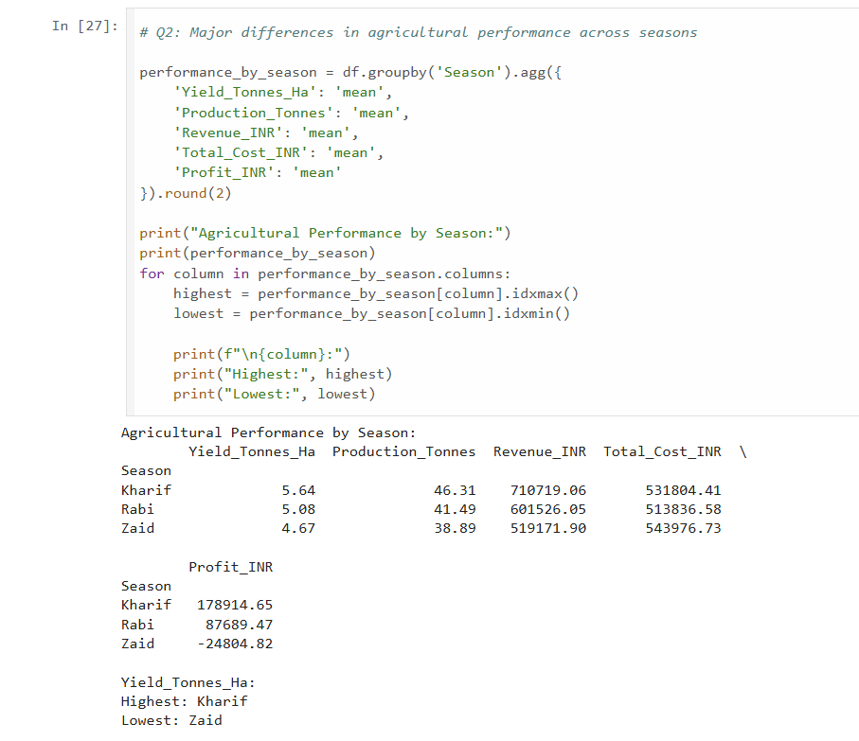
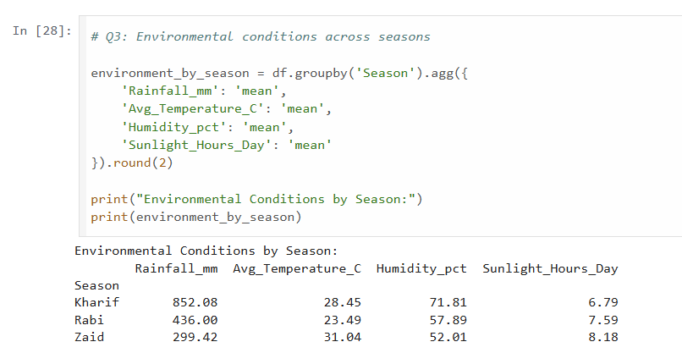
RESULTS
[Add screen shots of your code ]

Slide 11
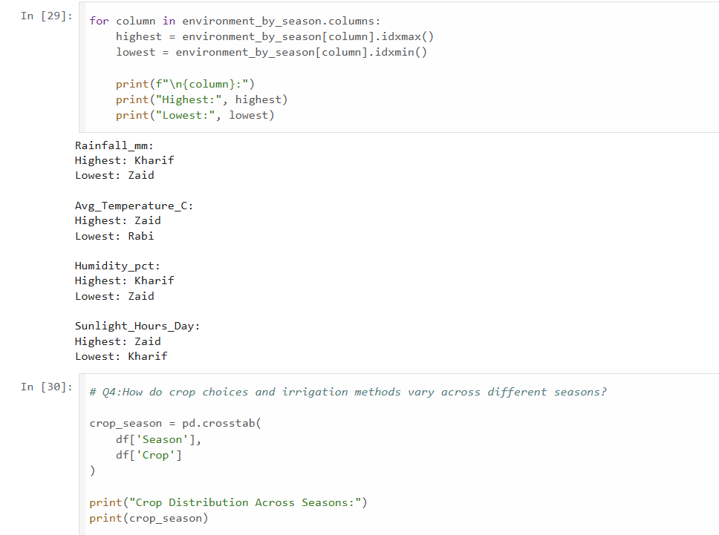
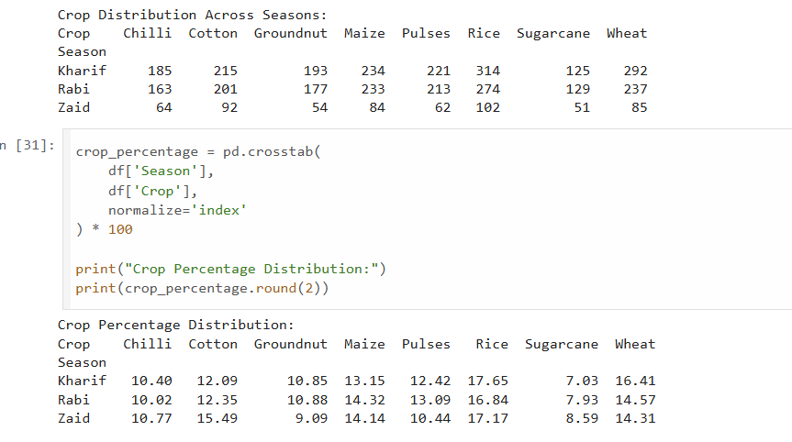
Results

Slide 12
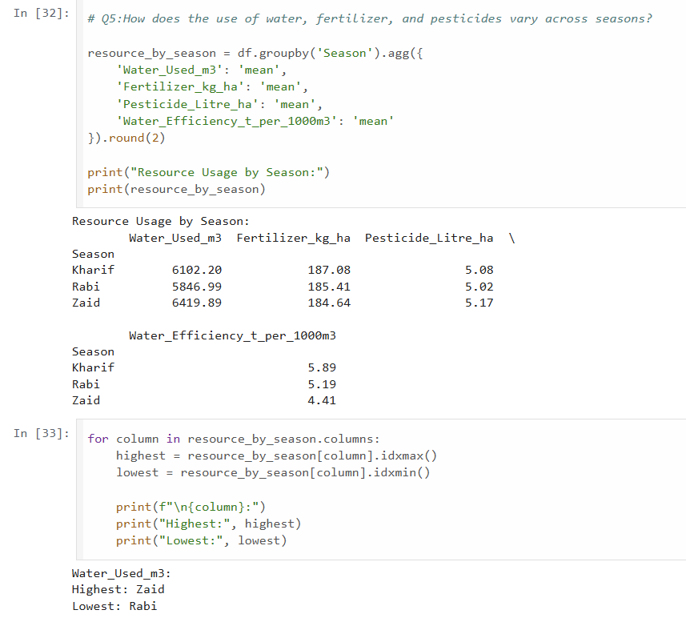
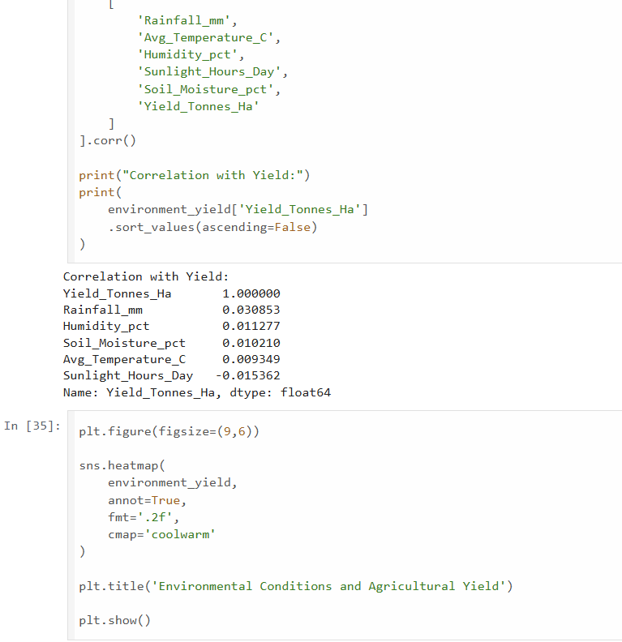
Results

Slide 13
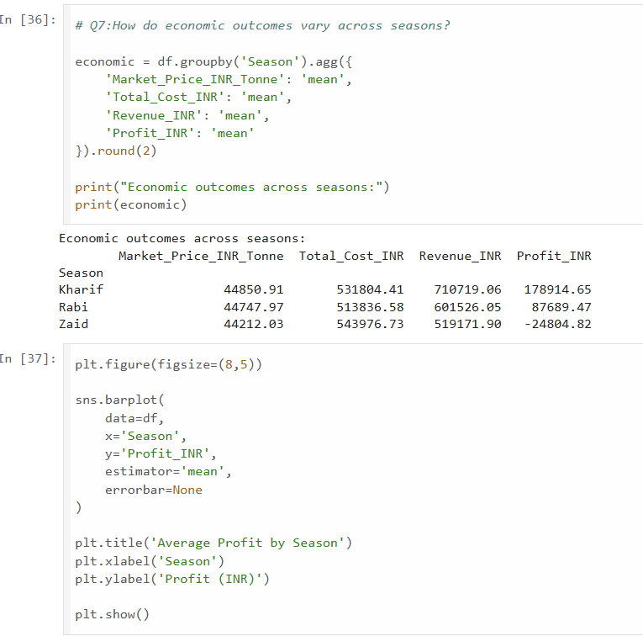
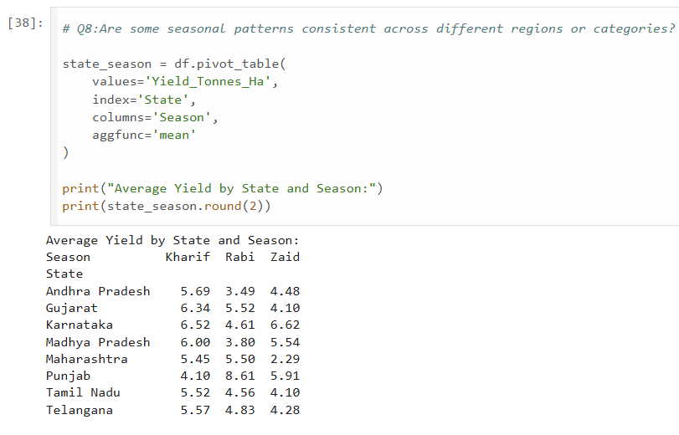
Results

Slide 14
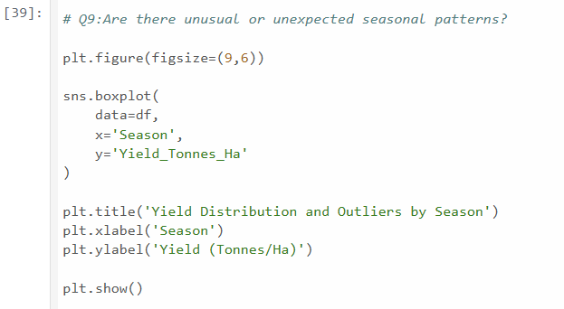
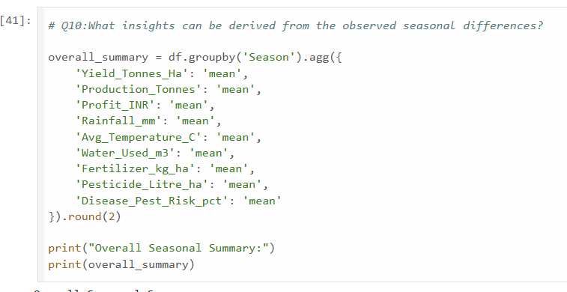
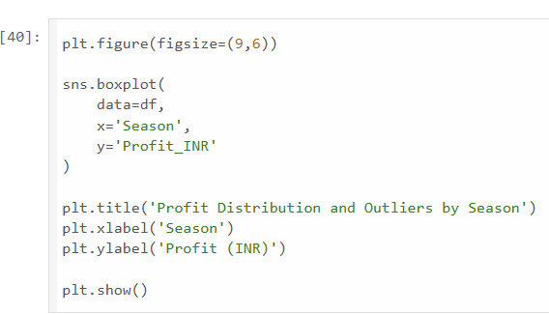
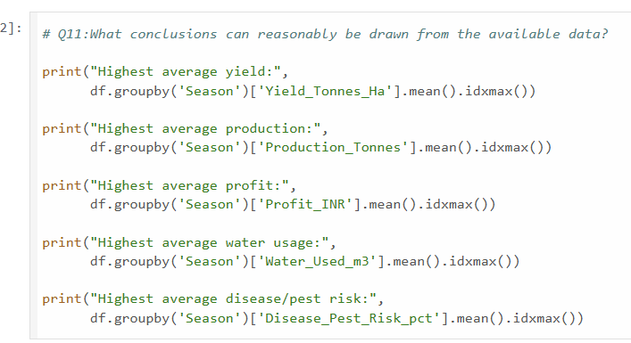
Results

Slide 15
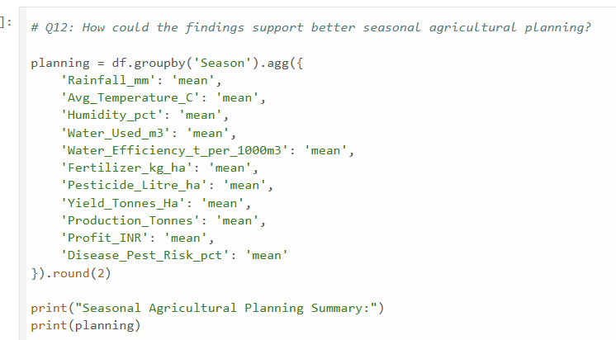
Results

Slide 16
Future scope
IoT & Satellite Imagery Integration
Integrate Sentinel-2 / Landsat NDVI satellite data and IoT ground sensors (soil moisture, pH) for real-time field monitoring.
Deep Learning for Climate Resilience
Implement advanced time-series models (e.g., LSTM, Transformer models) to forecast the impact of sudden weather anomalies, unseasonal rainfall, and droughts.
Hyper-Local Precision Advisory
Scale analysis down from district/state level to farm- or village-level precision recommendations for crop selection and fertilizer scheduling.
Market Intelligence & Price Forecasting
Correlate seasonal yields with APMC Mandi prices and Minimum Support Price (MSP) trends to guide farmers on optimal harvest timing and profitability.

Slide 17
GitHub Link
For detailed review of our complete project, including the dataset, code, analysis, visualizations, and results, please visit our
GitHub repository: https://github.com/ManasThakre-Max/seasonal-agriculture-performance-analysis

Slide 18
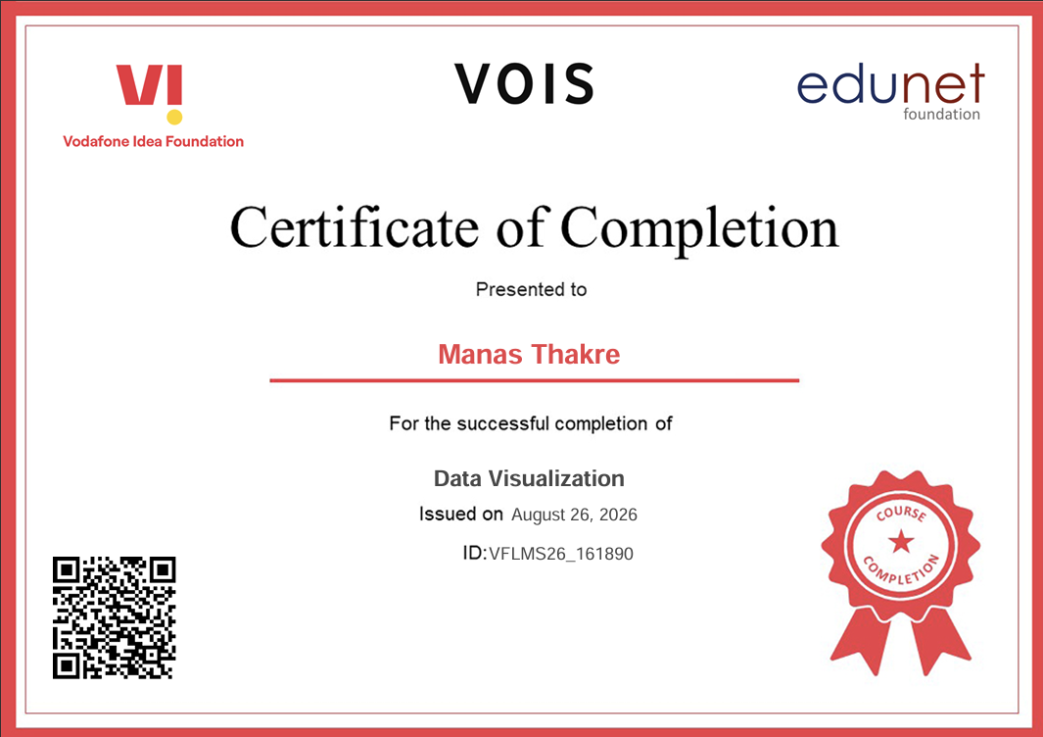
VOIS Course completion certificate - Course name- Data Visualization

Slide 19
Thank you
.
.

