Slide 1

RAJIV GANDHI UNIVERSITY OF KNOWLEDGE TECHNOLOGIES,BASAR
Underwater Image Enhancement Using NUCE and PSO Techniques
Guide: Mr.B.Venkat Raman
Renuka Thanniru(B191002)
Blesseena Yerra(B192121)
Harshitha Vallabudasu(B191476)
Notes:
1

Slide 2
Introduction & Literature Review
Introduction
Literature Review
Critical for marine research, navigation, archaeology
Traditional: Histogram Equalization, CLAHE, White-balancing
Challenges: color distortion, blurriness, uneven illumination
Recent: Deep learning methods
Limitations: Over-enhancement, detail loss, high cost
Notes:
2

Slide 3

Problem Statement & Objectives
1
Problem
2
Objectives
Neutralize color cast by dominant channels
Correct color distortion and improve contrast.
Enhance contrast via dual-intensity fusion
Use PSO for adaptive enhancement
Sharpen edges with unsharp masking
Notes:
3

Slide 4
Methodology
Neutralize color cast by dominant channels
Dual histogram stretching of intensity scales
Fuse intensities using mean averaging
PSO implementation
Apply unsharp masking to sharpen details
Notes:
4

Slide 5
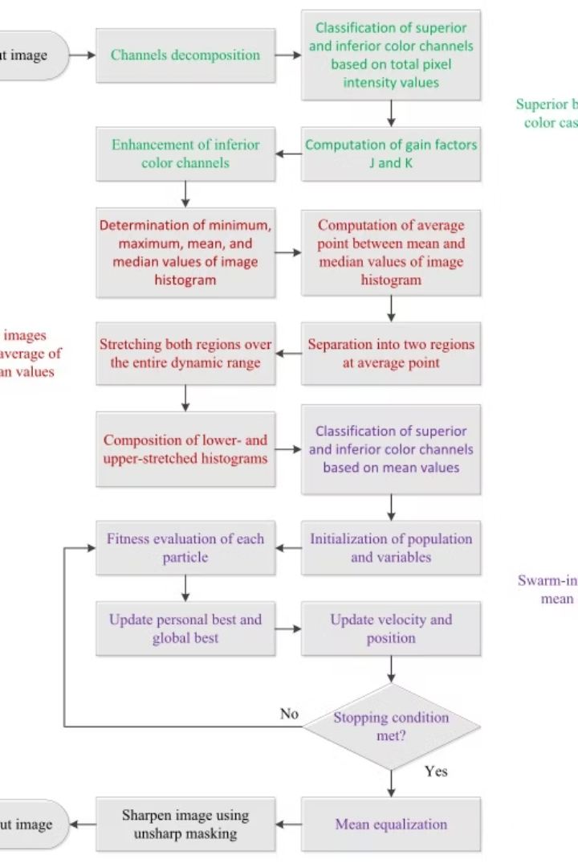

Implementation Details
Programming
Core Modules
Python with OpenCV, NumPy, Matplotlib libraries.
neutralize_image() - color cast correction
Stretching() - intensity segmentation
pso_image() - pixel intensity optimization
unsharp_masking() - detail enhancement
Dataset
Real underwater images from aquatic environments.
Notes:
5

Slide 6
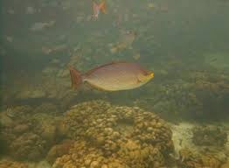
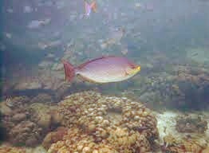
Results and Analysis
Visual Improvement
Quantitative Analysis
Significant visibility and sharpness enhancements observed.
Contrast histograms and channel distributions show uniform enhancement.
Balanced color tones
Notes:
6

Slide 7
Existing Techniques & Applications
Enhancement Techniques
Applications
Histogram Equalization improves global contrast but amplifies noise.
Marine Biology and Coral Monitoring
Underwater Robotics and Navigation
CLAHE offers local contrast improvement and noise control.
Submerged Archaeology Documentation
Defense and Surveillance
Limitations include color imbalance and reduced clarity in complex scenes.
Notes:
7

Slide 8
Conclusion and References
NUCE combined with PSO effectively enhances underwater images compared to conventional methods.
Improves contrast, color fidelity, and edge clarity with minimal artifacts.
REFERENCES
ScienceDirect - Underwater Image Enhancement
ResearchGate - Swarm Intelligence in Image Enhancement
Notes:
8

Slide 9
THANK YOU
Notes:
9

