Slide 1
Power Bi Analysis

Slide 2
Agenda
1
Problem Statement
2
2
Expected Deliverables
3
Data Understanding
4
Approach
5
Challenges
6
Key Findings
7
Suggestions

Slide 3
The client is grappling with a major issue of high customer churn rates, which are undermining their revenue and escalating the costs of acquiring new customers. Their current retention strategies are mostly reactive and fail to utilize advanced predictive analytics to proactively identify customers at risk of leaving. Consequently, the client struggles to allocate resources efficiently or implement targeted retention campaigns that cater to the specific needs and pain points of individual customers. Additionally, there is a limited understanding of the primary factors driving churn—whether it's due to service quality, pricing, customer experience, or competitor offerings—making it challenging to develop effective strategies to reduce churn.
PROBLEM STATEMENT
Managers are having difficulty understanding how employees are spending their time across different projects. Some team members seem to be overloaded with work, while others are not reporting their hours accurately. Also, certain types of tasks are taking up a lot of time but aren’t delivering much value. Leadership needs better visibility into how time is being used and which tasks are most effective, so they can improve team productivity and manage resources more efficiently.

Slide 4
Agenda
1
Problem Statement
2
2
Expected Deliverables
3
Data Understanding
4
Approach
5
Challenges
6
Key Findings
7
Suggestions

Slide 5
Expected Deliverables
Average hours per employee/project
Productive vs non-productive time
Task type distribution
Project workload overview

Slide 6
Agenda
1
Problem Statement
2
2
Expected Deliverables
3
Data Understanding
4
Approach
5
Challenges
6
Key Findings
7
Suggestions

Slide 7
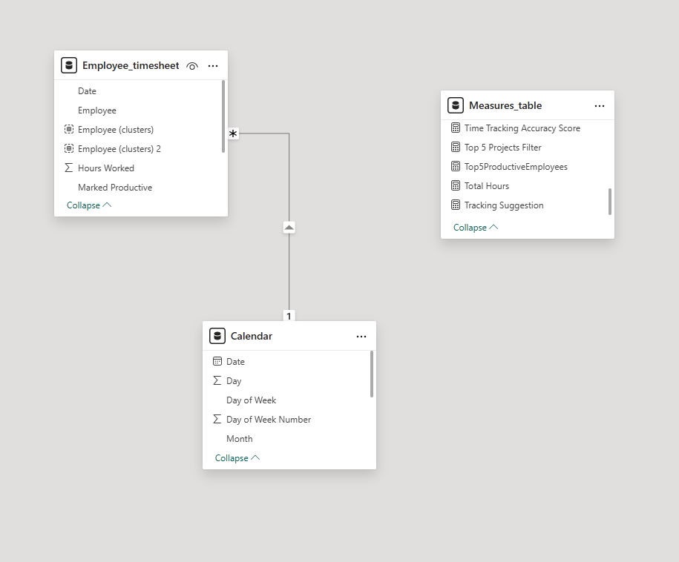
Data Understanding
The Data is organized across main table : Employee_timesheet.
Table gives us understanding about Timesheet Data of Employee:
Employee Name
Date : For March and April of 2025
Type of Project employees handling
Type of Task: Development, Testing, Meeting, Documentation , Design
Hours worked: How many hours each employee worked for both task and project
Marked productive : whether that employee is productive or not

Slide 8
Agenda
1
Problem Statement
2
2
Expected Deliverables
3
Data Understanding
4
Approach
5
Challenges
6
Key Findings
7
Suggestions

Slide 9
Approach
Analysis Methodology :
Correlation analysis between task types and productivity metrics
Trend analysis to identify patterns over time periods
Employee workload assessment using statistical thresholds
Comparative analysis between productive vs. non-productive time
Data Preparation :
Date field formatting for proper time-series analysis
Creation of calculated measures for productivity ratios
Development of employee workload benchmarks
Implementation of relationship modeling between data elements
Creation of DAX measures for advanced calculations

Slide 10
Agenda
1
Problem Statement
2
2
Expected Deliverables
3
Data Understanding
4
Approach
5
Challenges
6
Key Findings
7
Suggestions

Slide 11
Challenges
Understanding how different tasks , project kinds effects the productivity of employee
How different fields correlated with productivity and extracting required measures for KPIs calculation
How to choose what kind of plots for visualization of KPIs
Handling with Date Hirerachy when my timesheet data is of year 2025 March , April
How to add template in our existing power bi dashboard

Slide 12
Agenda
1
Problem Statement
2
2
Expected Deliverables
3
Data Understanding
4
Approach
5
Challenges
6
Key Findings
7
Suggestions

Slide 13
Key Findings
Time Tracking Accuracy Distribution
Percentage of workforce potentially underreporting (Needs Review) or overreporting (Highly Consistent) their hours
Productivity Patterns
Correlation between hours worked and productivity markers
Which projects show the highest vs. lowest productivity rates
Workload Distribution
Identification of potentially overworked employees (consistently logging >8 hours)
Identification of underutilized resources (consistently logging <7 hours)
Task Type Analysis
Which task types consume the most hours across the organization
Which task types show disproportionately low productivity rates
Opportunities to reallocate resources based on task proficiency
Project Efficiency
Projects with the highest and lowest productive time ratios
Comparison of time allocation efficiency across different projects
Time Tracking Behavior
Patterns of time entry behavior that suggest inaccurate reporting

Slide 15
Agenda
1
Problem Statement
2
2
Expected Deliverables
3
Data Understanding
4
Approach
5
Challenges
6
Key Findings
7
Suggestions

Slide 16
Suggestions
Approach:
Customers were grouped into High, Mid, and Low tiers based on their revenue contribution and studied by region and channel.
Insights:
Online preference decreases as revenue tier increases.
North has a balanced spread; East is strong in Mid-value — ripe for upselling.
South and West need intervention — high Low-value counts.
April dip likely fiscal year-related hesitation.
Recommendations:
Promote Offline exclusivity to High-value customers.
Upsell in East using bundles or premium options.
Run retargeting campaigns in South/West.
Create early fiscal year promotions to counteract April slowdowns..

Slide 17
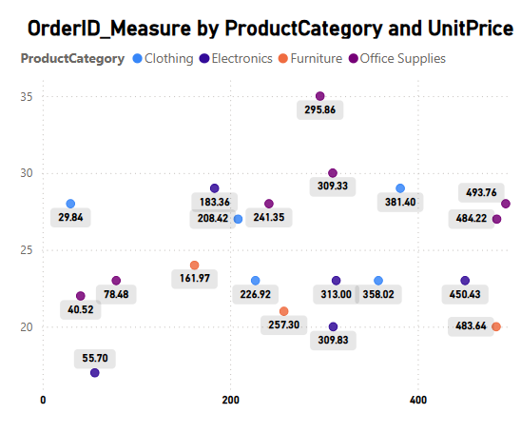
Unit Price Analysis
Approach:
Order quantity was analyzed in relation to unit price across categories and individual products.
Insights:
Office Supplies perform well even at high prices — high demand elasticity.
Furniture may be overpriced or undervalued by customers.
Product P013 (183) outperforms P020 (309) despite price difference.
Products with moderate orders but high-value buyers can sustain price hikes.
Some low-value customer-only products are overpriced — rethink.
Recommendations:
Expand Office Supplies and Clothing offerings — high potential.
Reassess Furniture pricing or increase perceived value.
Raise prices on high-value–backed SKUs like P013.Reduce price for products like P020 that appeal to lower-value segments.
Consider value-based pricing for niche products (e.g., 40.52) with low orders but strong buyer profiles.

Slide 18
THANK YOU

