Slide 1

“Analyzing the Impact of Climate Change on Agricultural Productivity
Using Statistical Methods”
University Post Graduate College (OU) , Secunderabad (A Constituent College Of Osmania University) DEPARTMENT OF COMPUTER SCIENCE M.SC.DATA SCIENCE II YEAR [2024-2026] Submitted by
B.Manasa 101024559011 Under the Guidance Of Dr.B.RANGANATHA RAO (Assistant Professor(C), Dept of Computer Science)

Slide 2
INTRODUCTION
Agriculture is highly dependent on climate conditions such as temperature and rainfall.
In recent years, climate change has caused irregular weather patterns and extreme conditions, which are negatively affecting crop growth and agricultural productivity.
Changes in temperature, precipitation, and CO₂ levels have created serious challenges for farmers and food security. Therefore, understanding the impact of climate variables on crop yield has become essential.
This project focuses on analyzing the impact of climate change on agricultural productivity using statistical methods and real-world data.

Slide 3
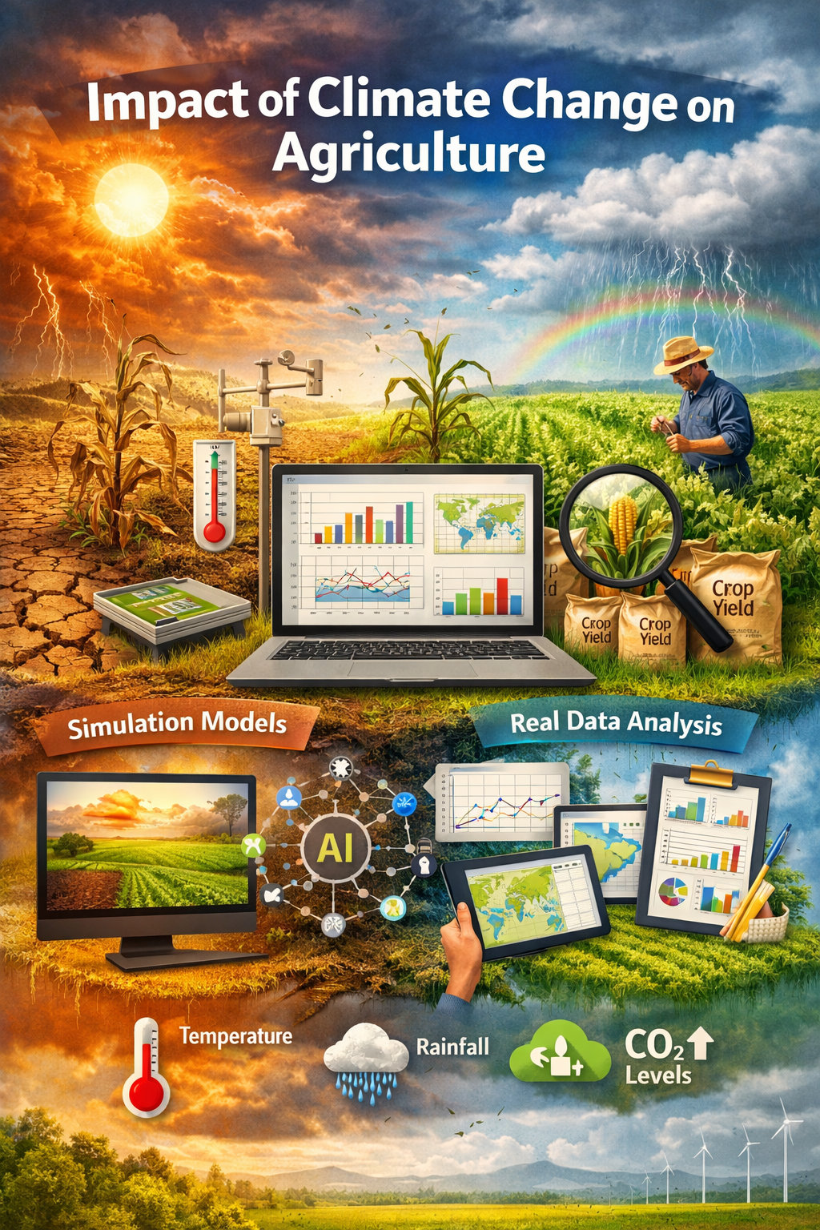

Slide 4
Motivation for Research
Climate change is increasingly affecting agriculture by causing changes in temperature, rainfall, and other environmental factors.
These changes make farming more difficult and reduce crop productivity. Farmers face uncertainty due to unpredictable weather conditions, which directly affects crop yield and income.
Although many studies have been conducted, most of them do not use real-world data or analyze multiple factors together.
This project is motivated by the need to use real data and statistical methods to understand the relationship between climate variables and crop yield, identify key factors, compare different regions, and predict agricultural productivity for better decision-making.

Slide 5
Literature review
Paper Title | Authors | Approach | Findings | Limitations
Climate Change Impact on Crop Yield | Cheng Zhao et al. (2023) | Used statistical models and global datasets Analyzed temperature and rainfall effects on crop yield | Increase in temperature reduces crop yield Climate variability significantly affects productivity | Focuses mainly on global level Limited use of region-specific real data
Impact of Weather Variability on Crop Yields | S. Kumar (2025) | Used regression analysis to study weather variability Examined rainfall and temperature effects | Irregular rainfall negatively affects crop production Temperature variation leads to yield instability | Limited number of variables considered Does not include economic impact

Slide 6
Impact of Abnormal Temperature on Crop Yield | Q. Li et al. (2026) | Analyzed extreme temperature effects using statistical models | High temperatures significantly reduce crop yield Extreme heat events are harmful to agriculture | Focuses mainly on temperature Does not consider multiple climate variables
Global Crop Yield Sensitivity to Climate Change | Toshichika Iizumi & Navin Ramankutty (2022) | Used statistical modeling and global datasets | Crop yield is highly sensitive to climate change Temperature rise negatively affects productivity | Focuses on global trends Limited use of real-time or local datasets

Slide 7
Problem statement
Climate change is affecting agriculture through changes in temperature, rainfall, and CO₂ levels, which impact crop productivity. Many existing studies rely on simulation models and consider only limited factors. There is a lack of proper analysis using real-world data and multiple variables together. Therefore, this project aims to analyze the impact of climate change on agricultural productivity using statistical methods and real data.

Slide 8
Research objectives
Objective 1:
To analyze the relationship between climate variables (temperature, rainfall, humidity) and crop yield.
Objective 2:
To identify the most significant climate factors affecting agricultural productivity using regression analysis.
Objective 3:
To compare agricultural productivity across different regions and crop types using ANOVA.
Objective 4:
To analyze trends and patterns in agricultural productivity over time using time series analysis.
Objective 5:
To build a statistical model to explain and predict crop yield based on climate variables.

Slide 9
methodology
Dataset: Climate Change Impact on Agriculture Dataset (2024)
Link : https://www.kaggle.com/datasets/patelris/crop-yield-prediction-dataset/code
Size : samples are 10,000 rows and variables: 15 columns and it includes
Climate variables (temperature, rainfall, CO₂, etc.)
Agricultural variables (crop yield, irrigation, soil health, etc.)
Preprocessing:
Handling Missing Values
Removing Duplicates
Data Cleaning
Data Transformation
Normalization / Scaling
Outlier Detection
Data Organization
DESCRIPTIVE DATA AND VISUALIZATION:
Descriptive statistics help us understand the data using average and range values. Visualization uses graphs like line charts and scatter plots to show patterns. These help us see how climate factors affect crop yield.

Slide 10
Exploratory data analsis
EDA is used to understand the dataset by using basic statistics and graphs. It helps to find patterns, trends, and relationships between climate factors and crop yield. This step prepares the data before applying statistical models.
Advanced statistical techniques:
Correlation → to see relationship between climate and crop yield
Regression → to find important factors and predict yield
ANOVA → to compare yield in different regions
Time Series → to study changes over time
Interpretation of results:
Climate factors like temperature and rainfall affect crop yield
Temperature reduces yield, while rainfall helps improve it
Different regions and crops show different productivity levels
Crop yield changes over time due to climate changes
The model can be used to predict crop yield

Slide 11
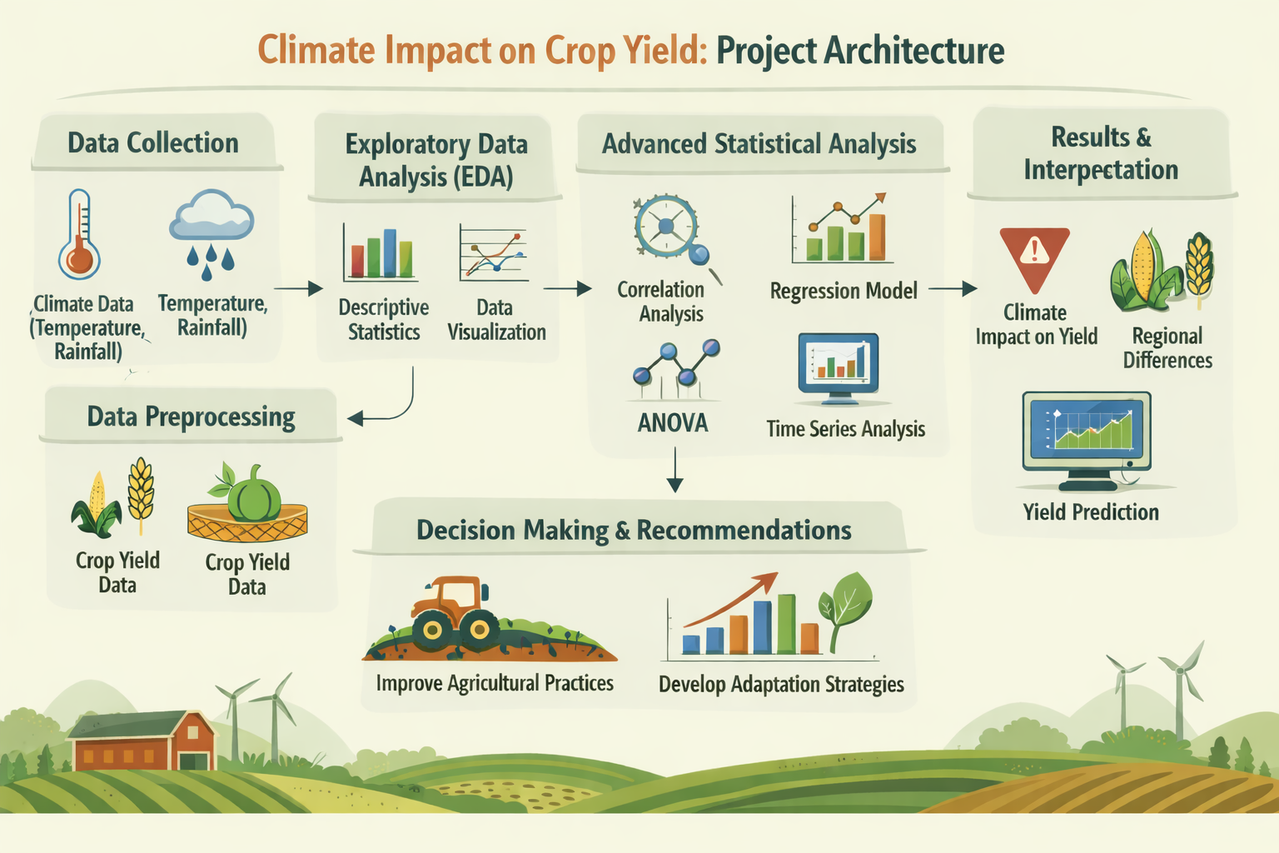

Slide 12
references
1.Cheng Zhao et al. (2023). Climate Change Impact on Crop Yield. Scientific Reports, 13, 30813.
2.S. Kumar (2025). Impact of Weather Variability on Crop Yields. MPRA Paper, 125806.
3.X. Hu et al. (2024). Crop Yield Response to Climate Variability.
4.Q. Li et al. (2026). Impact of Abnormal Temperature on Crop Yield. arXiv Preprint.
5.Toshichika Iizumi & Navin Ramankutty (2022). Global Crop Yield Sensitivity to Climate Change.

Slide 13
Thank You
Queries & Suggestions

