Slide 1
Steganography – Hiding Text Inside an Image
Presented By:
Student Name-KUTHADI MANASA VENKATA NAGA SRUTHI
College Name-DMSSVH COLLEGE OF ENGINEERING
Department- COMPUTER SCIENCE AND ENGINEERING

Slide 2
OUTLINE
Problem Statement
System Development Approach
Algorithm & Deployment
Result
Conclusion
Future Scope
References

Slide 3
Problem Statement
In today's digital world, ensuring the security and confidentiality of sensitive information is a major concern. Traditional cryptographic methods may make messages unreadable, but they can still be detected. This project aims to explore steganography — the technique of hiding information within media — to secretly embed text inside an image without noticeably altering its appearance. This method ensures that the existence of the hidden message remains unknown to unintended viewers. The project focuses on using the Least Significant Bit (LSB) technique for hiding text in image pixels.

Slide 4
System Approach
Programming Language: Python
Libraries Used: OpenCV, NumPy, Tkinter (for GUI)
Image Format: PNG (preferred due to lossless compression)
Technique: LSB (Least Significant Bit) Steganography

Slide 5
Algorithm & Deployment
Encoding (Hiding the Message):
1. Load the cover image using OpenCV.
2. Convert the message text into binary format.
3. Modify the least significant bits of the image pixels to embed the message.
4. Save the modified image as the stego-image.
Decoding (Retrieving the Message):
1. Load the stego-image.
2. Extract the least significant bits from the pixels.
3. Reconstruct the binary data into readable text.

Slide 6
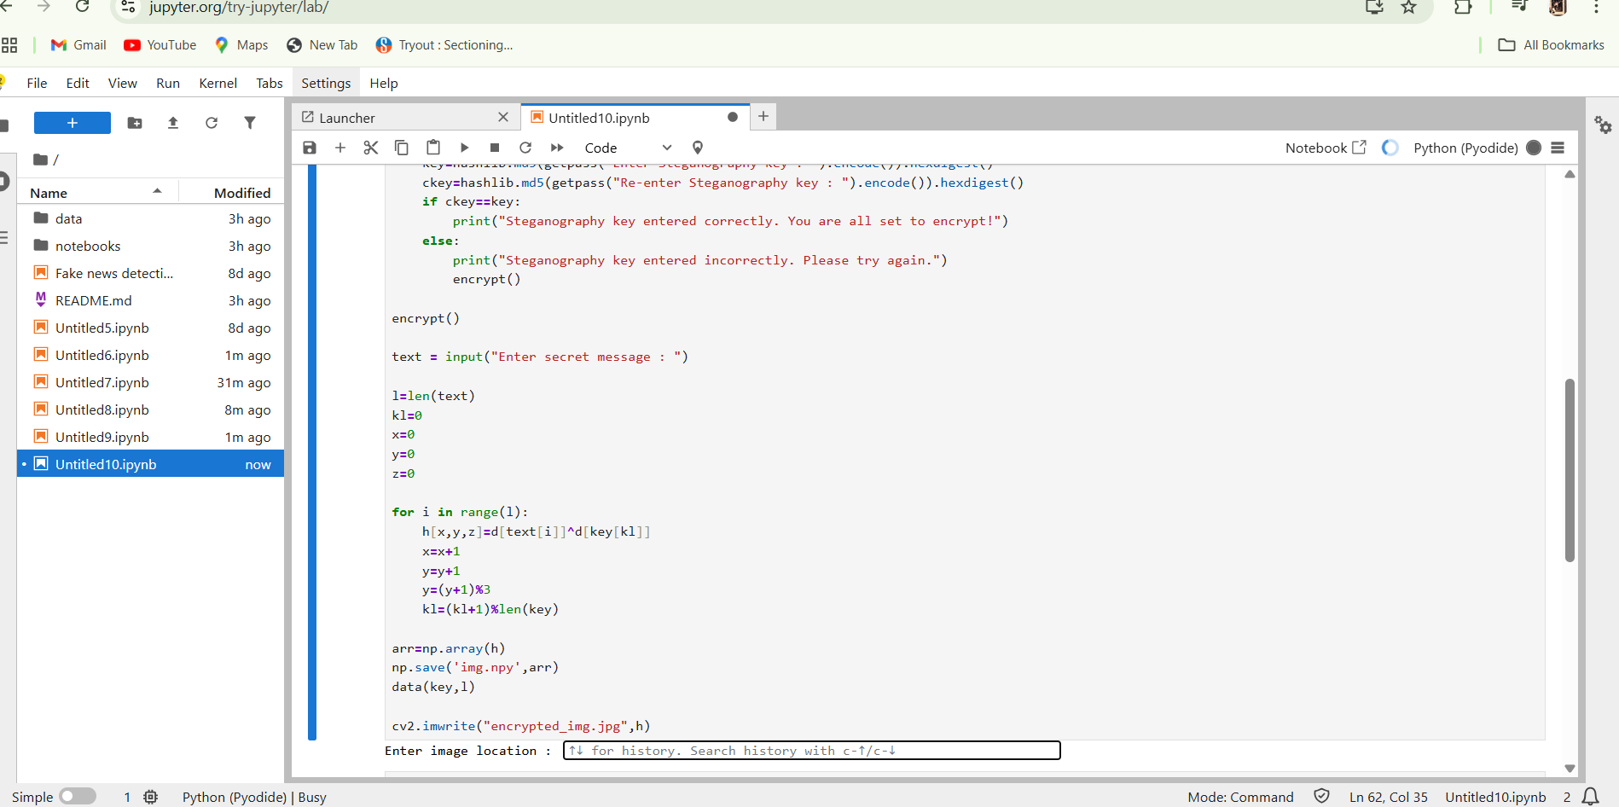
Result
Git hub link : https://github.com/Manasa272/Manasa_CS-Project.git

Slide 7
Conclusion
This project successfully demonstrates how steganography can be used to hide sensitive information inside digital images. The technique ensures data confidentiality while maintaining image integrity, making it an effective solution for secure communication.

Slide 8
Future scope(Optional)
Can be extended to hide data in audio or video files.
Add password protection to enhance security.
Implement image compression techniques while preserving hidden data.
Create a user-friendly web or mobile interface.

Slide 9
References
1. https://en.wikipedia.org/wiki/Steganography
2. https://pypi.org/project/pillow/
3. Digital Image Processing Textbooks

Slide 10
THANK YOU

