Slide 1
MPCA LAB MINI PROJECT
PROJECT TITLE: HOME AUTOMATION SYSTEM
SECTION: D
STUDENTS NAME & SRN:
1) Malavika V PES2UG19CS212
2) Manasa R PES2UG19CS215
3) Manaswini Rathore PES2UG19CS217
4) Mihir Soni PES2UG19CS232

Slide 2
PROBLEM STATEMENT
As technology is advancing so houses are also getting smarter. Modern houses are gradually shifting from conventional switches to centralized control system, involving detection using sensors. Presently, conventional wall switches located in different parts of the house makes it difficult for the user to go near them to operate. Even more it becomes more difficult for the elderly or physically handicapped people to do so. The main objective of this project is to develop a Home Automation system using Arduino and various sensors.

Slide 3
INTRODUCTION
This project helps the user to control all the electronic devices using sensors. Time is a very valuable thing. Everybody wants to save time as much as they can. New technologies are being introduced to save our time. To save people’s time we are introducing Home Automation system. With the help of this system you can control your home by these sensors which detect movement, temperature, distance and display it on a LCD.

Slide 4
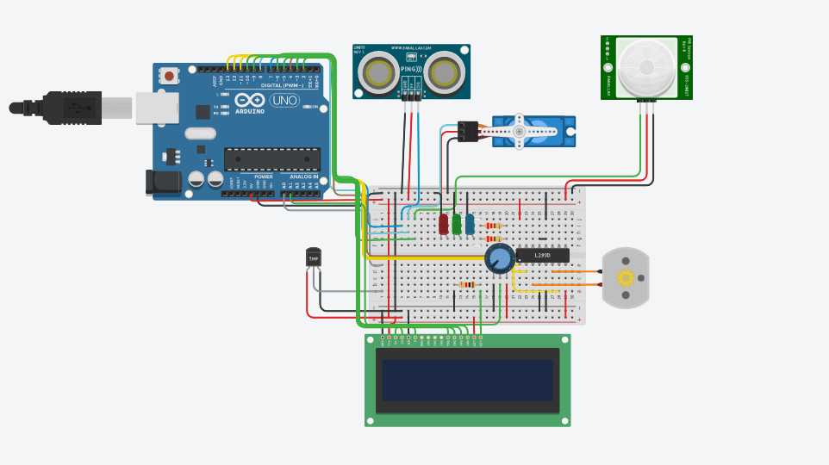
BLOCK DIAGRAM

Slide 5
REQUIRED COMPONENTS
Arduino uno
Ultrasonic distance sensor
PIR sensor
Micro servo
Temperature sensor
LCD
DC motor
LEDs
H-bridge motor driver
Potentiometer

Slide 6
PROJECT DESCRIPTION
• The door opens if anyone comes within 40 cm of it, and stays open for 2 seconds. If the person is still standing near the door, it will remain open for another 2 seconds or close.
An ultrasonic sensor is used to measure the distance and a servo motor is used to open or close the door.
• If any movement is detected in the room, the LEDs will light up.
Here, PIR is used to detect movement.

Slide 7
PROJECT DESCRIPTION
• Room temperature is calculated and if it is greater than 20 degree Celsius, a fan will be switched on and be running.
Otherwise, it's switched off.
The status of any of the above is displayed on the LCD Screen.

Slide 8
APPLICATIONS
Home automation system with automated door locking and security cameras facilitates more security.
Lighting control
Efficient use of electricity and other household devices
AI driven digital experience
Smart home appliances
Automatic sensors can be used to water the garden

Slide 9
REFERENCES(Website links, Books etc.
http://www.energiazero.org/simulazioni/Intro% 20thinkercad.pdf
https://www.tinkercad.com/things/cVd15n3xCu d-arduino-with-lcd-interface
https://www.tinkercad.com/things/iovuycemCB W-temperature-sensor-display-with-lcd-inarduino
https://www.theengineeringprojects.com/2018/ 06/introduction-to-arduino-uno.html

Slide 10
THANK YOU

