Slide 1

DATA STRUCTURES USING C
Unit-4
Prof. P. S. Avadhani
M. Tech., PhD., F.I.E,FCSI, FAPAS.
Visiting Professor, Central University of Odisha
Former Director, IIIT, Agartala
Former Principal, AU College of Engg,
Andhra University, Visakhapatnam

Slide 2
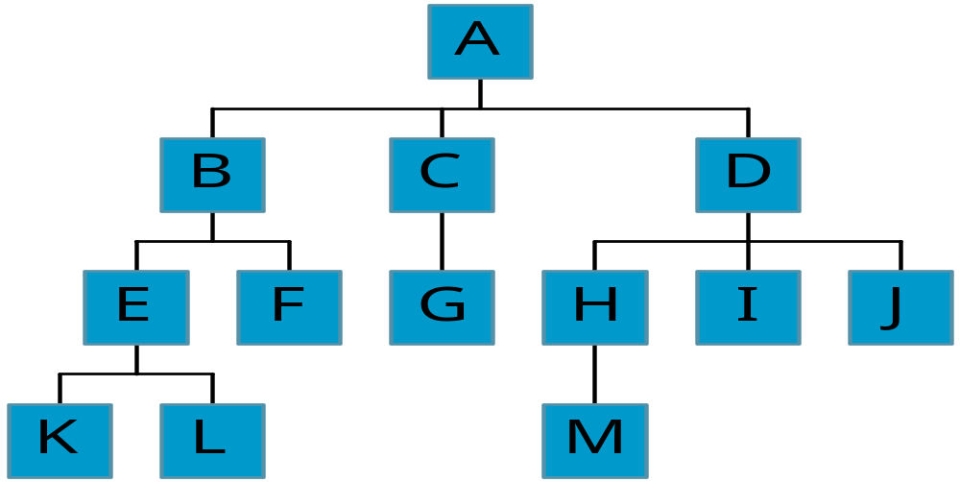
Tree

Slide 3
Definition of Tree
A tree is a finite set of one or more nodes
such that:
There is a specially designated node called the root.
The remaining nodes are partitioned into n>=0 disjoint sets T1, ..., Tn, where each of these sets is a tree.
We call T1, ..., Tn the subtrees of the root.
A set of trees is called forest

Slide 4
Terminology
The degree of a node is the number of subtrees
of the node.
The degree of a tree is the maximum degree of all the nodes of the tree.
In the previous slide, The degree of A is 3; the degree of C is 1 and the degree of the tree is also 3.
Node with degree 0 is called leaf or terminal
node.
A node that has subtrees is called the parent of the
roots of the subtrees.
The roots of these subtrees are the children of the node. Children of the same parent are siblings.
The ancestors of a node are all the nodes
along the path from the root to the node.

Slide 5
Level and Depth
The level of root node is 0 and if the level of a node n is j then the level of its children will be at j +1.
The height of a tree is the maximum of the levels of all nodes of the tree.
The height is also called the depth.
In some books, level of the root is defined as one and the other parts of the definition remains the same.
CHAPTER 5

Slide 6
Binary Trees
A binary tree is a finite set of nodes that is
either empty or consists of a root and two
disjoint binary trees called the left subtree
and the right subtree.
Any tree can be transformed into binary tree.
    by left child-right sibling representation
The left subtree and the right subtree are distinguished.
Alternatively, a binary tree is a tree with degree 0 or or 1 or 2. (Degree will be discussed in graphs) That is, no node will have more than two subtrees

Slide 7
Left Child - Right Sibling
data
A
left child
right sibling
B
C
D
E
F
G
H
I
J
K
L
M

Slide 8
Adjusting properly, the binary tree is as below.
A
B
E
C
G
D
K
F
H
L
M
I
J

Slide 9
Samples of Binary Trees
Complete Binary Tree
A
A
1
A
B
B
2
B
C
C
Skewed Binary Tree
3
D
E
F
G
D
4
H
I
E
5

Slide 10
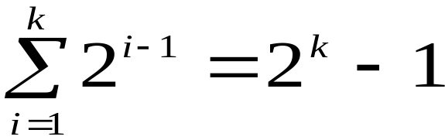
Maximum Number of Nodes
in a Binary Tree
The maximum number of nodes on level i of a binary tree is 2^{i-1}, i >=1.
The maximum number of nodes in a binary tree of depth k is 2^{k}-1, k>=1 because

Slide 11
Full and Complete Binary Trees
A full binary tree of depth k is a binary tree of
depth k having 2^{k} -1 nodes, k >= 0.
A binary tree with n nodes and depth k is
complete iff its nodes correspond to the nodes numbered from 1 to n in the full binary tree of
depth k.
A
A
B
C
B
C
D
E
F
G
D
E
F
G
H
H
I
J
K
L
M
N
O
I
Complete binary tree
Full binary tree of depth 4

Slide 12
Binary Tree Representations
As usual there are two ways to represent a binary tree
Array representation
Linked list representation
Here array representation, naturally, requires more space and manipulations become slightly combursome. Hence linked (list) representations are preferred.

Slide 13
Binary Tree Representation as an Array
If a complete binary tree with n nodes (depth = log₂(n+1)) is represented sequentially, then for any node with index i, 1<= I <= n, we have the following observations
  parent(i) is at i/2 if i !=1.
  If i =1, i is at the root and has no parent.
  left_child(i) is at 2i if 2i <= n.
  If 2i > n, then i has no left child.
  right_child(i) is at 2i+1 if 2i +1 <= n.
  If 2i +1 > n, then i has no right child.
Based on these observations the data is stored as an array.

Slide 14
Example
The binary trees below are stored as arrays a follows:
A | B | C | D | E | F | G | H | I
A | B | C | D | E | F | G | H | I | J | K | L | M | N | O
A
A
B
C
B
C
D
E
F
G
D
E
F
G
H
H
I
J
K
L
M
N
O
I

Slide 15
Linked Representation
struct node
{
int data;
struct node *left_child, *right_child;
}
typedef struct node tree;
data
left_child
data
right_child
left_child
right_child

Slide 16
Operations on binary trees
Creating a Binary Tree
Inserting a node into a binary tree
Deleting a node from a binary tree
Searching a Binary Tree ( Will be discussed in Binary Search Trees)
Traversing a binary tree
  Inorder Traversal
  Preorder Traversal
  Postorder Traversal

Slide 17
Creating an empty Binary Tree
(linked list representation)
typedef struct node *tree_pointer;
typedef struct node
{
int data;
tree_pointer left_child,right_child;
};
data
tree_pointer
left_child
right_child
left_child | data | right_child

Slide 18
Creating a new node
To start with, we have to create a node (the first node) and make head point to it as follows:
  tree_pointer = (node *) malloc(sizeof(node));
tree_pointerr

Slide 19
Creating a Binary Tree
There are many types of binary tree like
Binary search Tress
Heaps
AVL Tress and many more
The way nodes are inserted and the creating a binary tree depends on the type of the binary tree ane will be discussed when we discuss those topics

Slide 20
Binary Tree Traversals
Let L, V, and R stand for moving left, visiting the node and moving right.
There are six possible combinations of traversals LVR, LRV, VLR, VRL, RVL, RLV
Assuming that we traverse left before right, only VLR, LVR and LRV are valid.
VLR: pre-order as the node V is before both L and R.
LVR: inorder as the node is in-between both L and R.
LRV: postorder as node is after L and R.

Slide 21
Example-1
Observe that in case of
pre-order the root node will be the first element while in case of post-order root node will be the last element.
A
B
D
C
E
F
Pre-order: A B C D E F G H I
In-order: B C A E D G H F I
Post-order: C B E H G I F D A
G
I
H

Slide 22
Example-2:Arithmatic expression tree
Arithmetic expressions can be represented as binary trees with variables as leaf nodes
+
+
-
and operators as intermediate nodes
*
*
X₃
X₁
-
-
X₃
X₂
X₁
For example
(x₁ * (-x₂)) + (- x₁ * x₃) + (-x₃)

Slide 23
Example-3: Logical expression tree
(x₁ ∧ ¬x₂) ∨ (¬ x₁ ∧ x₃) ∨ ¬x₃
∨
∨
¬
∧
∧
X₃
X₁
¬
¬
X₃
X₂
X₁

Slide 24
Traversals of Arithmetic Expression Binary Tree
Observe that the inorder traversal traversal of an expression is its infix expression, the preorder traversal is its prefix expression and the postorder traversal is its postfix expression
+
inorder traversal
A / B * C * D + E
infix expression
preorder traversal
+ * * / A B C D E
prefix expression
postorder traversal
A B / C * D * E +
postfix expression
*
E
*
D
C
/
A
B

Slide 25
Some Important Points
The pre-order traversal of an expression tree is its prefix expression.
The post-order traversal of an expression tree is its postfix expression
The in-order traversal of an expression tree is its infix expression.
The root node of a binary tree will be the first element in its pre-order traversal.
The root node of a binary tree will be the last element in its post-order traversal.
Binary tree can be constructed if its in-order traversal and one ot its pre-order or post-order traversals are known.

Slide 26
Inorder Traversal
typedef struct node *tree_pointer;
typedef struct node {
int data;
tree_pointer left_child, right_child;
};
void inorder (tree_pointer ptr)
{
if (ptr != NULL) {
inorder (ptr->left_child);
printf (“%d”, ptr->data);
inorder (ptr->right_child);
}
}

Slide 27
Preorder Traversal
void preorder(tree_pointer ptr)
{
if (ptr != NULL)
{
printf (“%d”, ptr->data);
preorder (ptr->left_child);
preorder (ptr->right_child);
}
}

Slide 28
Postorder Traversal
void postorder(tree_pointer ptr)
{
if (ptr != NULL)
{
  postorder (ptr->left_child);
  postorder (ptr->right_child);
printf (“%d”, ptr->data);
}
}

Slide 29
Copying a Binary Tree
tree_poointer copy(tree_pointer original)
{
tree_pointer temp;
temp = (tree_pointer) malloc(sizeof(node));
if (original != NULL)
{
temp->left_child=copy(original->left_child);
temp->right_child=copy(original->right_child);
temp->data=original->data;
}
return temp;
}

Slide 30
Equality of two Binary Trees
int equal(tree_pointer first,tree_pointer second)
{
return (
(!first && !second) || (first && second &&
(first->data == second->data) &&
equal(first->left_child, second->left_child) && equal(first->right_child,second->right_child))
)
}
The above function returns false if the binary trees first and second are not equal, else returns true

Slide 31
Binary Search Tree
A binary tree is called a binary search tree if
The value in a nonempty left node is smaller than the value of its parent node and
the value of the right right is larger than the value of its parent node.
Every element has a unique value
(no duplicates).

Slide 32
Examples of Binary Search Trees
20
30
60
12
25
5
40
70
22
65
80
10
15
2

Slide 33
Searching in a Binary Search Tree
tree_pointer search(tree_pointer tree, int key)
{
while (tree != NULL)
{
if (key == tree->data) return tree;
else if (key < tree->data) tree = tree->left_child;
else tree = tree->right_child;
}
}

Slide 34
Inserting a node into a Binary Search Tree
Check if the current node of the tree is NULL
If so, simply add the node and return
else if the current node’s value < the value of the new node, traverse the right sub-tree
else if it is > then traverse the left sub-tree
Continue moving down until a leaf node is reached.
Insert the new node to the right sub-tree, if the value of the new node is > the value of its parent
else insert the new node to the left sub-tree

Slide 35
Example: Insert Node in Binary Search Tree
30
30
30
40
5
40
5
40
5
2
80
2
35
80
2
Insert 80
Insert 35

Slide 36
Deletion of a node is divided into three cases
Deleting a node that has no children
  Just delete that node
Deleting a node with one child
  Set the node’s child as the child as node’s parent
  That is, if the node is the left child of the node’s parent, the node’s child becomes the left child of the node’s parent.
  if the node is the right child of the node’s parent, the node’s child becomes the right child of the node’s parent.
  Delete the node as in case 1 above
Deleting a node with two children
  Replace the node’s value with its in-order predecessor ( largest value in th left sub-tree)
  Replace the node’s value with its in-order successor ( smallest value in the right sub-tree)
  The in-order predecessor or in-order successor can then be deleted using case 1 or case 2 above.

Slide 37
Case 1:Deletion a node with no children
Deleting 78 from the following tree
45
45
39
56
39
56
54
78
54
55
55

Slide 38
Case 2:Deletion a node with one child
Deleting 54 from the following tree
45
45
39
56
39
56
54
78
55
78
45
55
54
39
56
55
78

Slide 39
Case 3: Deleting a node with two children
non-leaf
node
40
40
20
60
20
55
10
30
50
70
10
30
50
70
45
55
45
52
52
Before deleting 60
After deleting 60

Slide 40
Building binary tree when inorder & postorder are given
preorder: A B C D E F G H I
inorder:B C A E D G H F I
A
A
D, E, F, G, H, I
B
D
B, C
A
C
E
F
B
D, E, F, G, H, I
G
I
C
H

Slide 41
Implementation of all operations of trees

Slide 42
/*Binary search tree and implement all its operations*/
#include <stdio.h>
#include <conio.h>
#include <malloc.h>
struct node
{
int data;
struct node *left;
struct node *right;
};
struct node *tree;

Slide 43
void create_tree( struct node *);
struct node *insert_element( struct node *, int);
void preorder_traversal( struct node *);
void inorder_traversal( struct node *);
void postorder_traversal( struct node *);
struct node *smallest_element( struct node *);
struct node *larget_element( struct node *);
struct node *delete_element( struct node *, int);
struct node *mirror_image( struct node *);
int *total_nodes( struct node *);
int *total_external_nodes( struct node *);
int *total_internal_nodes( struct node *);
int height( struct node *);
struct node *delete_tree( struct node *);

Slide 44
int main()
{
int option, val; struct node *ptr;
create_tree( tree); clrscr ();
do { printf (" 1 --> insert element \n");
printf (" 2 --> preorder traversal \n");
printf (" 3 --> inorder traversal \n");
printf (" 4 --> postorder traversal \n");
printf (" 5 --> Find the smallest element \n");
printf (" 6 --> Find the largest element \n");
printf (" 7 --> delete an element \n");
printf (" 8 --> count the toal number of nodes \n");
printf (“ 9 --> count the total no. external nodes \n");
printf("10-->count the total no. of internal nodes \n");
printf (" 11 --> Find the height of the tree \n");
printf (" 12 --> Find the mirror image of the tree \n");
printf (" 13 --> delete the tree \n");
printf (" 14 --> EXIT\n");

Slide 45
printf(“\n enter your option : “);
scanf(“%d”, &option);
Switch(option) {
case 1: printf(“\n Enter the value of the new node : );
scanf(“%d”, &val);
tree = insert_element(tree, val); break;
case 2: printf(“\nThe elements of the tree in preorder :);
preorder_traversal(tree); break;
case 3: printf(“\n elements of the tree in inorder are :);
inorder_traversal(tree); break;
case 4: printf(“\n elements of the tree in postorder are :);
postorder_traversal(tree); break;
case 5: ptr = smallest_element(tree);
printf(“\n smallest element: %d”, ptr -> data); break;

Slide 46
case 6: largest_element( tree);
printf(“\n largest element: %d”, ptr -> data); break;
case 7: printf(“\n enter the value to be deleted :);
scanf(“%d”, &val); tree = delete_element(tree); break;
case 8: printf(“\ntotal no. of nodes = %d”, total_nodes(tree); break;
case 9: printf(“\n the total no. of external nodes = %d”, total_external_nodes(tree); break;
case 10: printf(“\n the total no. of internal nodes = %d”, total_internal_nodes(tree); break;

Slide 47
case 11: printf(“\nheight of the tree is : “, height(tree); break;
case 12: tree = mirror_ image (tree);
break;
case 13: tree = delete_tree(tree);
break;
}
}while (option != 14);
getch();
return 0;
}

Slide 48
void create_tree ( struct node *tree)
{
tree = NULL;
}
void preorder_traversal( struct node *tree)
{
if( tree ! = NULL) {
printf(“ %d\t”, tree -> data);
preorder_traversal(tree -> left);
preorder_traversal(tree -> right);
}
}

Slide 49
struct node *insert_element (struct node *tree, int val)
{
struct node *ptr, *nodeptr, parentptr;
ptr = (struct node *)malloc(sizeof(struct node));
ptr -> data = val; ptr -> left = NULL; ptr -> right = NULL;
if( tree == NULL){ tree = ptr; tree ->left = NULL; tree ->right = NULL; }
else { parentptr = NULL; nodeptr = tree;
while (nodeptr != NULL) {
parentptr = nodeptr;
if( val < nodeptr -> data) nodeptr = nodeptr -> left;
else nodeptr = nodeptr -> right;
}
if( val < parentptr -> data) parentptr-> left = ptr;
else parentptr-> right = ptr;
}
return tree;
}

Slide 50
void inorder_traversal( struct node *tree)
{
if( tree ! = NULL) {
inorder_traversal(tree -> left);
printf(“ %d\t”, tree -> data);
inorder_traversal(tree -> right);
}
}
void postorder_traversal( struct node *tree)
{
if( tree ! = NULL) {
postorder_traversal(tree -> left);
postorder_traversal(tree -> right);
printf(“ %d\t”, tree -> data);
}
}

Slide 51
struct node *smallest_element( struct node *tree)
{
if( (tree == NULL) || (tree -> left = NULL))
return tree;
else return smallest_element(tree -> left);
}
struct node *largest_element( struct node *tree)
{
if( (tree == NULL)||(tree ->right == NULL))
eturn tree;
else return largest_element(tree -> right);
}

Slide 52
struct node *delete_element(struct node *start, int val)
{
struct node *cur, *parent, *ptr, *suc, *psuc;
if (tree-> left == NULL) {
printf(“ The tree is empty”); return tree;
}
parent = cur; cur = tree -> left;
while( cur != NULL && val != cur-> data)
{
parent = cur; cur = (val < cur -> data) ? cur ->left : cur->right;
}
if ( cur == NULL) {
printf(“\nthe value to be deleted is not present”);
return tree;
}

Slide 53
if ( cur -> left == NULL) ptr = cur -> right;
else if( cur -> right == NULL) ptr = cur -> left;
else { /* Find the inorder successor and its parent */
psuc = suc; cur = cur -> left;
while ( suc -> != NULL) { psuc = suc; suc = suc -> left; }
if ( cur == psuc) suc -> left = cur -> right; /* situation 1*/
else if( cur -> right == NULL) ptr = cur -> left;
else { /* situation 2*/
suc>left= cur->left; psuc->left= suc->right; suc->right=cur->right;
}
ptr = suc;
}
if(parent -> left == cur) parent -> left = ptr; else parent -> right -> ptr; free(cur); return tree;
}

Slide 54
int total_nodes( struct node *tree)
{
if(tree == NULL) return 0;
else return(total_nodes(tree ->left) + total_node(tree-> right)+1);
}
int total_external_nodes( struct node *tree)
{
if(tree == NULL) return 0;
else if (tree ->left == NULL) && (tree ->right == NULL)) return 1;
else return(total_external_nodes(tree ->left) + total_external_nodes(tree ->right)+1);
}

Slide 55
int height( struct node *tree)
{
int lh, rh;
if(tree == NULL) return 0;
else {
lh = height(tree ->left); rh = height(tree ->right);
if (lh > rh) return(lh + 1); else return( rh + 1);
}
}
int total_internal_nodes( struct node *tree)
{
if(tree == NULL) return 0;
else if(tree->left == NULL)&&(tree->right == NULL))return 1;
else return(total_internal_nodes(tree ->left) + total_internal_nodes(tree ->right)+1);
}

Slide 56
struct node *mirror_image (struct node *tree)
{
struct node *ptr;
if(tree != NULL) {
mirror_image(tree -> left);
mirror_image(tree ->right);
ptr = tree ->left;
ptr->left = ptr ->right;
tree->right = ptr;
}
}
struct node *delete_tree ( struct node *tree)
{
if(tree == NULL)
{
delete_tree(tree ->left);
delete_tree(tree ->right);
free(tree);
}
}

Slide 57
Introduction to AVL trees
The basic idea of the tree data structure is to store and retrieve (search) data in an efficient manner.
In this process, binary search trees (BST) were discussed.
Although BST take O(log n) time, on the worst case it can be O(n) in case of skewed binary search trees.
Efficiency of the search depends on two aspects: a) the height of the tree and b) the bushy nature of the tree.
AVL trees are designed to overcome the weakness of binary search trees, by balancing the heights of nodes.
AVL trees were proposed in 1962 by G. M. Adelson-Velskii and E. M. Landis, and hence the name.

Slide 58
Introduction to AVL trees
Inserting A, B, C …. Z or Z, Y, X……,A into a binary search tree makes them skewed as shown below.
The search take O(n) time which is very inefficient.
A
Z
B
Y
C
X
This can be overcome by introducing the balance factor of nodes
This is the key to AVL Trees
D
.
.
.
.
.
A
Z

Slide 59
Balance factor
The balancing factor of a node in a binary tree is the height of its left subtree - the height of its right subtree.
A
2
The balance factors of each node of the binary tree given at the left is given in the right tree
B
C
-3
-1
D
E
2
0
F
1
G
0
Some people defined it as the height of its right subtree - the height of its left subtree. It doesnot affect AVL trees

Slide 60
AVL Tree Definition
An AVL-tree is a binary search tree (BST) with the property that at every node the difference in the depths of the left and right subtrees is at most 1.
In other words it is a BST with balance factor of every node is either 0, -1 or 1.
AVL trees are also called height-balanced trees
not an AVL tree
An AVL Tree

Slide 61
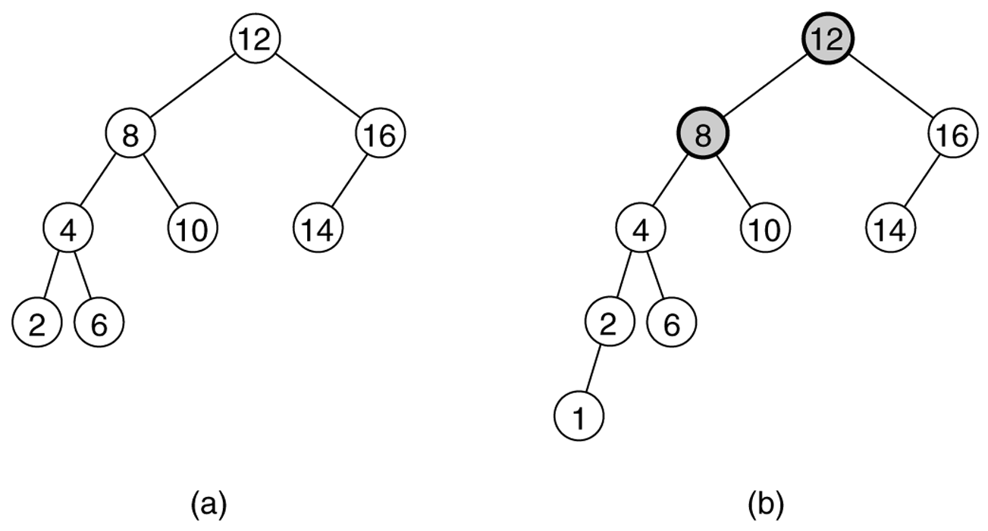
Examples
Given below two binary search trees in which (a) an AVL tree and (b) not an AVL tree (unbalanced nodes are darkened)

Slide 62
Creation & Insertion
AVL tree creation:
  Start with an empty tree
  Add nodes as a BST
  Rebalance the nodes to keep the balancing factor of the nodes to be either 0, 1 or -1.
Inserting nodes into an AVL tree:
  Start with an empty tree
  Add nodes as a BST
  Rebalance the nodes to keep the balancing factor of the nodes to be either 0, 1 or -1 by rotating one or more of the following four types of rotations:
  Left-Left (LL) Left-Right (LR)
  Right-Left (RL) Right-Right (RR)

Slide 63
Tree Balancing Rotations
To perform rotations, it is necessary to identify a specific node A whose BF(A) is neighter 0,-1 or 1 and which is the nearest ancestor to the inserted node on the path from the inserted node to A will have their balance factors to be 0, -1 or 1. The rebalancing rotations are classified as LL, LR, RR and RL, based on the position of the inserted node with reference to A.
LL: Inserted node is in left subtree of left subtree of A
RR: Inserted node is in right subtree of right subtree of A
LR: Inserted node is in right subtree of left subtree of A
RL: Inserted node is in left subtree of right subtree of A

Slide 64
Tree Balance Rotations
Note that after an insertion only the nodes in the path from root to the node have their balance information altered
Find the node that violates the AVL condition and rebalance the tree.
Assume that X is the node that has violated the AVL condition
  I.e The left and right sub trees of X is differ by 2 in height.

Slide 65
LL Rotation
Left subtree of left child of X violates the BF property.
Rotate RIGHT
y
X
y
X
C
A
B
A
C
B

Slide 66
RR Rotation
Right subtree of right child of X violates the property.
Rotate LEFT
X
y
X
y
C
A
A
B
C
B

Slide 67
LR Rotation
Right subtree of left child of X violates the property
X
X
Rotate the tree LEFT about X’s child and Grandchild
A
A
Z
y
y
B
D
Z
C
B
D
C
Ctd..

Slide 68
LR Rotation contd…
Rotate the tree RIGHT about X and its new child
Z
X
y
X
A
Z
D
C
B
A
y
B
D
C

Slide 69
RL Rotation
Left subtree of right child of X violates the property
Rotate the tree RIGHT about Y and Z
X
X
D
D
Z
y
y
A
Z
C
A
B
C
B
Ctd..

Slide 70
RL Rotation Contd…
Rotate the tree LEFT about X and Z
Z
X
D
X
y
Z
D
C
B
A
C
y
A
B

Slide 71
Example of Insertions in an AVL Tree
2
20
Insert 5, 40
0
1
10
30
0
0
25
35
AVL Trees

Slide 72
Example of Insertions in an AVL Tree
2
3
20
20
1
1
1
2
10
30
10
30
0
0
0
1
0
0
5
25
35
5
25
35
0
40
Now Insert 45
AVL Trees

Slide 73
Single rotation (outside case)
3
3
20
20
1
2
1
2
10
30
10
30
0
0
2
0
0
5
25
35
5
25
40
1
0
0
35
45
1
40
Imbalance
0
45
Now Insert 34
AVL Trees

Slide 74
Double rotation (inside case)
3
3
20
20
1
3
1
2
10
30
10
35
0
0
2
0
1
5
Imbalance
25
40
5
30
40
1
0
1
0
25
34
45
35
45
0
Insertion of 34
0
34
AVL Trees

Slide 75
AVL Tree Example:
Insert 14, 17, 11, 7, 53, 4, 13 into an empty AVL tree
14
11
17
7
53
4

Slide 76
AVL Tree Example:
Insert 14, 17, 11, 7, 53, 4, 13 into an empty AVL tree
14
7
17
4
11
53
13

Slide 77
AVL Tree Example:
Now insert 12
14
7
17
4
11
53
13
12

Slide 78
AVL Tree Example:
Now insert 12
14
7
17
4
11
53
12
13

Slide 79
AVL Tree Example:
Now the AVL tree is balanced.
14
7
17
4
12
53
11
13

Slide 80
AVL Tree Example:
Now insert 8
14
7
17
4
12
53
11
13
8

Slide 81
AVL Tree Example:
Now insert 8
14
7
17
4
11
53
8
12
13

Slide 82
AVL Tree Example:
Now the AVL tree is balanced.
14
11
17
7
12
53
4
8
13

Slide 83
AVL Tree Example:
Now remove 53
14
11
17
7
12
53
4
8
13

Slide 84
AVL Tree Example:
Now remove 53, unbalanced
14
11
17
7
12
4
8
13

Slide 85
AVL Tree Example:
Balanced! Remove 11
11
7
14
4
8
12
17
13

Slide 86
AVL Tree Example:
Remove 11, replace it with the largest in its left branch
8
7
14
4
12
17
13

Slide 87
AVL Tree Example:
Remove 8, unbalanced
7
4
14
12
17
13

Slide 88
AVL Tree Example:
Remove 8, unbalanced
7
4
12
14
13
17

Slide 89
AVL Tree Example:
Balanced!!
12
7
14
4
13
17

Slide 90
Example
Build an AVL tree with the following values:
  15, 20, 24, 10, 13, 7, 30, 36, 25

Slide 91
  15, 20, 24, 10, 13, 7, 30, 36, 25
20
15
15
24
20
10
24
13
20
20
13
24
15
24
10
15
13
10

Slide 92
  15, 20, 24, 10, 13, 7, 30, 36, 25
20
13
13
24
10
20
10
15
7
15
24
7
30
13
36
10
20
7
15
30
24
36

Slide 93
  15, 20, 24, 10, 13, 7, 30, 36, 25
13
13
10
20
10
20
7
15
30
7
15
24
24
36
30
25
13
25
36
10
24
7
20
30
15
25
36

Slide 94
  Remove 24 and 20 from the AVL tree.
13
13
10
24
10
20
7
20
30
7
15
30
15
25
36
25
36
13
13
10
30
10
15
7
15
36
7
30
25
25
36

Slide 95
AVL Tree Deletion
Similar but more complex than insertion
  Rotations and double rotations needed to rebalance
  Imbalance may propagate upward so that many rotations may be needed.
AVL Trees

Slide 96
Lazy deletion
5
3
7
2
4
6
9
On average, deleting even half of the nodes by marking leads to depth penalty of only 1.

Slide 97
Pros and Cons of AVL Trees
Arguments for AVL trees:
Search is O(log N) since AVL trees are always balanced.
Insertion and deletions are also O(logn)
The height balancing adds no more than a constant factor to the speed of insertion.
Arguments against using AVL trees:
Difficult to program & debug; more space for balance factor.
Asymptotically faster but rebalancing costs time.
Most large searches are done in database systems on disk and use other structures (e.g. B-trees).
AVL Trees

Slide 98
Thank you

Slide 99
Thank you

Slide 100
Thank you

