Slide 1


SIMATS ENGINEERING
SAVEETHA INSTITUTE OF MEDICAL AND TECHNICAL SCIENCES
Design and Development of a Fake Website Detection and Cybersecurity Risk Assessment Platform Using Machine Learning and URL Analysis
CSA4315 – Internet Programming
Date : 29/10/2026 Batch : 10
Guided by:
Dr. Krishnaraj Mony
Associate Professor/CSE
Presented by:
P.Mohitha-192324025
M.Manasa-192425189
K.Yasaswini-192324042

Slide 2



INTRODUCTION
Fake websites are created to cheat users and steal personal information.
These websites may steal passwords, banking details, and other sensitive data.
Machine learning helps identify fake websites by analyzing their URLs and features.
The system checks website URLs and classifies them as legitimate or suspicious.
This project helps users identify potential threats and browse the internet more safely.

Slide 3
OBJECTIVES
1 Data Collection & Preprocessing
To detect fake and phishing websites using machine learning.
To analyze URLs and identify suspicious website features.
To classify websites as legitimate or fake.
To assess cybersecurity risks and warn users about potential threats.
To improve online safety and protect users from website-based fraud.
2 URL Analysis
3 ML Model Development
4 Cybersecurity Risk Assessment
5 Platform Design & Evaluation

Slide 4
LITERATURE SURVEY
S.No | Title | Authors | Year | Techniques Used | Problem Addressed
1 | Phishing Websites Detection Based on URL Features | Sahingoz et al. | 2019 | Natural Language Processing (NLP), Machine Learning | Detecting phishing websites by analyzing URL patterns and characteristics.
2 | An Effective Machine Learning-Based Approach for Phishing Website Detection | Research authors to be verified | 2020 | Random Forest, Decision Tree, SVM | Identifying phishing websites and improving classification accuracy.
3 | Phishing Website Detection Using Machine Learning Techniques | Research authors to be verified | 2021 | Logistic Regression, Random Forest, SVM | Classifying websites as legitimate or phishing based on URL features.
4 | URL-Based Phishing Detection Using Deep Learning | Research authors to be verified | 2022 | Deep Learning, Neural Networks | Detecting suspicious URLs and identifying potential phishing websites.
5 | Explainable Machine Learning for Phishing Website Detection | Research authors to be verified | 2024 | Explainable AI, Feature Importance, Machine Learning | Explaining why a website is classified as suspicious and helping users understand cybersecurity risks.

Slide 5
EXISTING SYSTEM
Blacklist-Based Protection: Browsers and tools mainly block URLs already listed as malicious.
Delayed Detection: Fake websites are short-lived and may cause harm before being reported.
Manual Verification: Users must inspect URLs and certificates themselves, which is error-prone.
Single-Aspect Analysis: Many tools check only the URL or only the certificate, missing combined signals.
No Explanation or Unified Report: Most tools give only an allow/block decision, with no explanation or unified report.

Slide 6
PROPOSED SYSTEM
ML-Based Detection Engine: A trained machine learning classifier labels a submitted website as legitimate or fake.
URL Analysis: Combines URL, domain/WHOIS, HTML content and SSL certificate features for stronger detection.
Security Checks: Checks HTTPS and certificate validity, domain age, redirects and blacklist status, and summarises the findings.
Cybersecurity Risk Assessment: Produces a risk score and risk level with the top indicators that influenced the decision.
Web-Based Platform: Users submit a URL and receive an instant report; scan history is stored for later review.

Slide 7
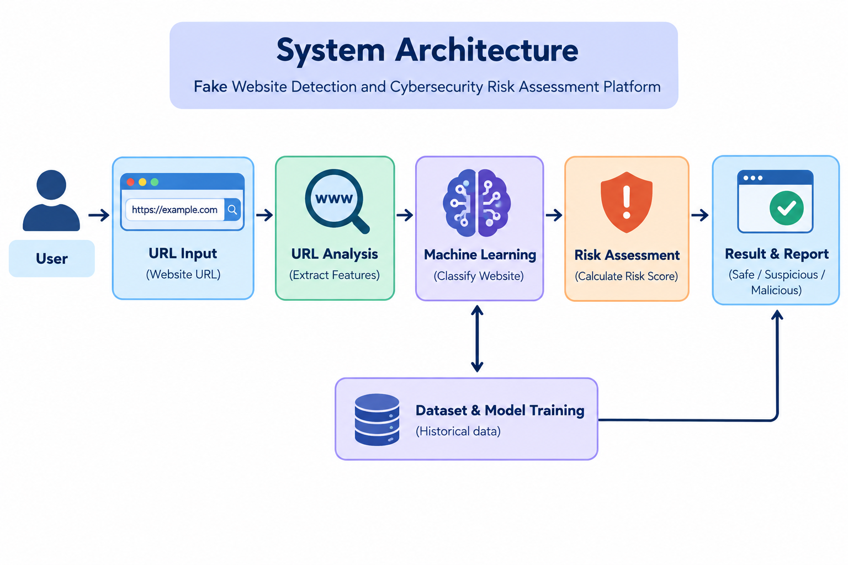
ARCHITECTURE DIAGRAM

Slide 8
CONCLUSION
The system helps detect fake and phishing websites using machine learning.
URL analysis helps identify suspicious website features.
It classifies websites as legitimate or potentially malicious.
It alerts users about possible cybersecurity risks.
The proposed system improves online safety and helps protect users from cyber fraud.

Slide 9
REFERENCES
Dutta, A. K. (2021). “Detecting Phishing Websites Using Machine Learning Technique.” PLOS ONE.
Safi, A., & Singh, S. (2023). “A Systematic Literature Review on Phishing Website Detection Techniques.” Journal of King Saud University – Computer and Information Sciences.
Wei, W., et al. (2020). “Accurate and Fast URL Phishing Detector: A Convolutional Neural Network Approach.” Computer Networks.
URL Phishing Detection Using Machine Learning Techniques Based on URLs Lexical Analysis. (2021). IEEE International Conference on Information and Communication Systems (ICICS).
“Phishing or Not Phishing? A Survey on the Detection of Phishing Websites.” (2023). IEEE Access, 11, 18499–18519.

Slide 10
THANK YOU

