Slide 1




USED CAR PRICE ANALYSIS
A COMPREHENSIVE DATA ANALYTICS STUDY OF USED CAR PRICES IN INDIA

Slide 2
INTRODUCTION
The used car market is a significant sector in the automotive industry, with millions of transactions taking place every year. With the rise of online marketplaces and digital platforms, the used car market has become more accessible and transparent.
The goal of this project is to analyze the used car market and identify the factors that influence car prices. By analyzing the relationships between various factors, such as car brands, models, years, conditions, and locations.
This project aims to provide insights into the used car market, helping buyers and sellers make informed decisions and identify good quality cars at affordable prices.

Slide 3
This study uses python which is high level, interpreted, easy to use programming language for web scraping. Web scraping is the process of extraction data from web pages.
Power BI is used to make visualizations on the data. Power BI is one of the data analytics tools which is used to create visualizations.
The conclusions on the colleges are drawn using Power BI.

Slide 4
Scrap the data using Web Scraping
Convert the data to CSV file
Website
Data visualization ( Add visualizations using the data)
Extract, Transform and Load the csv file into visualization tool
Construct Dashboards and Draw Conclusions
End Process

Slide 5
Web Scraping
Choose the website (career360) to scrap and extract the data from the website using web scraping with python using Beautiful Soup library.
Get the useful data from the website and convert the data into required form.
Read all the extracted data into the model using pandas.
Pandas is used to read files in different formats and creates data frames and series. It is used for data manipulation and data analysis.
Load the data into a csv file from model to csv file and name the csv file as Engineering colleges.

Slide 6
Extract, Transform and Load Data(ETL)
Extract the Engineering Colleges csv file which is created using web scraping into Power BI Desktop.
Data cleaning is important step in ETL process
Transform the data in the power query editor by adding some columns and removing null values and convert the data into required form which can be used for data visualization
After transforming the data load it into the Power BI Desktop and create visualizations on the data.

Slide 7
Data Visualization
Data Visualization is the graphical representation of the data. We can create different visualizations using data visualization tools like Power Bi.
Data visualization is the important step in data analysis. Visualizing the data makes it easy for data analytics.
After loading the data in to Power BI we can create visualizations using visualization options available in the Power BI. We can also add columns and measures to the data using formulas which are supported by Power BI.
We can create dashboards in Power BI by creating multiple visualizations in a single page.

Slide 8
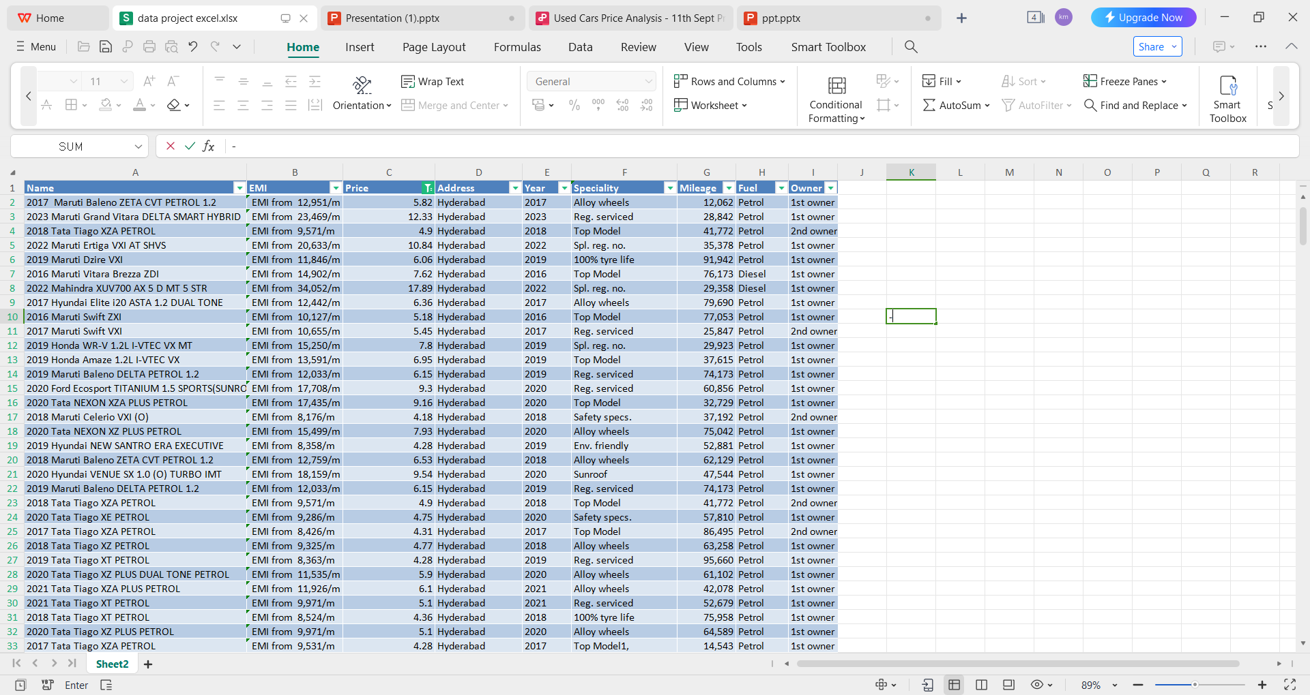
Visualizations

Slide 9
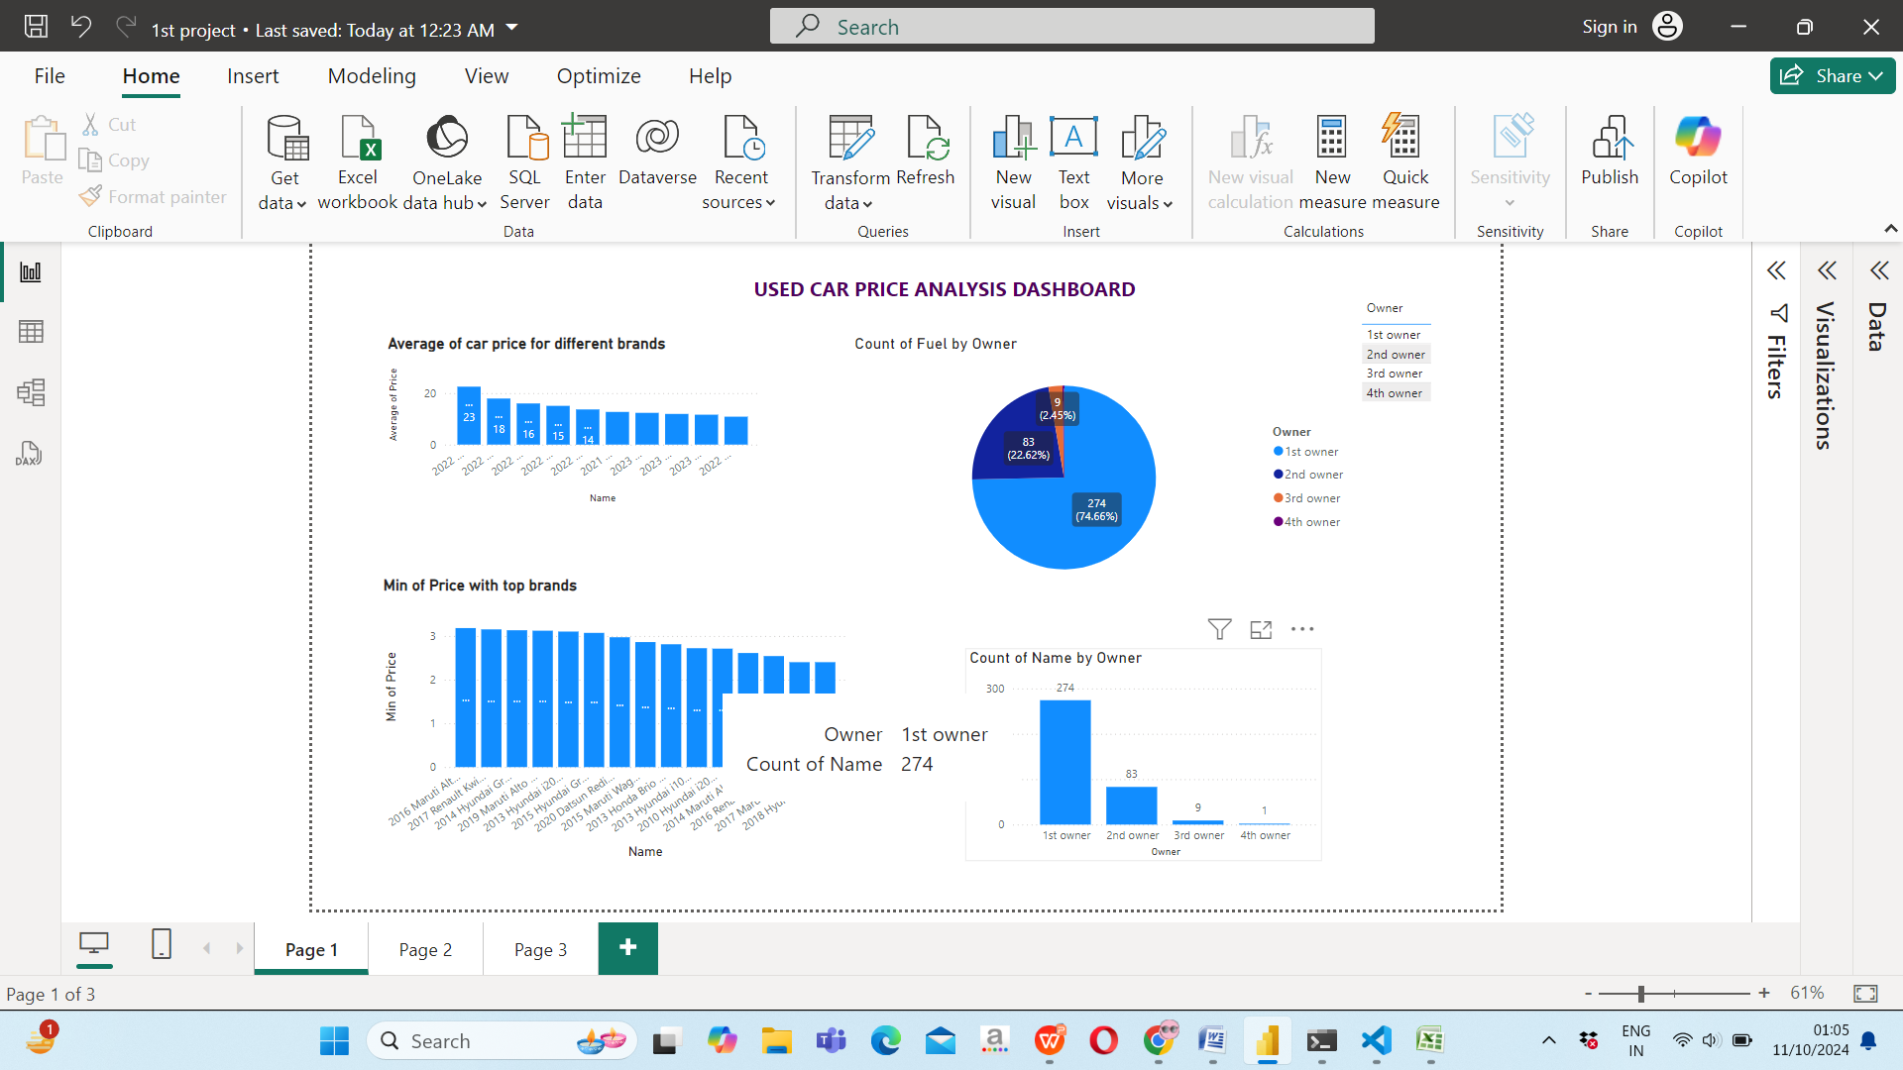
VISUALS

Slide 10
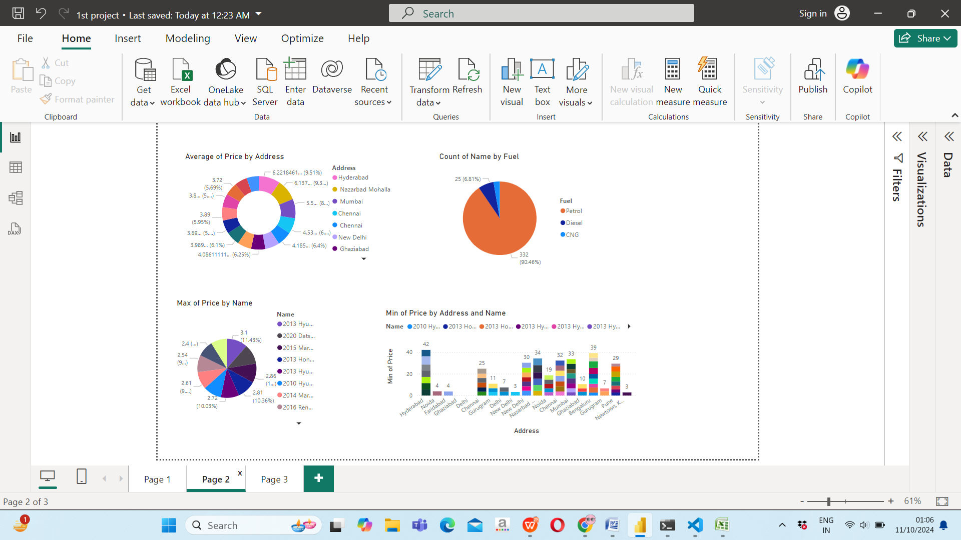

Slide 11
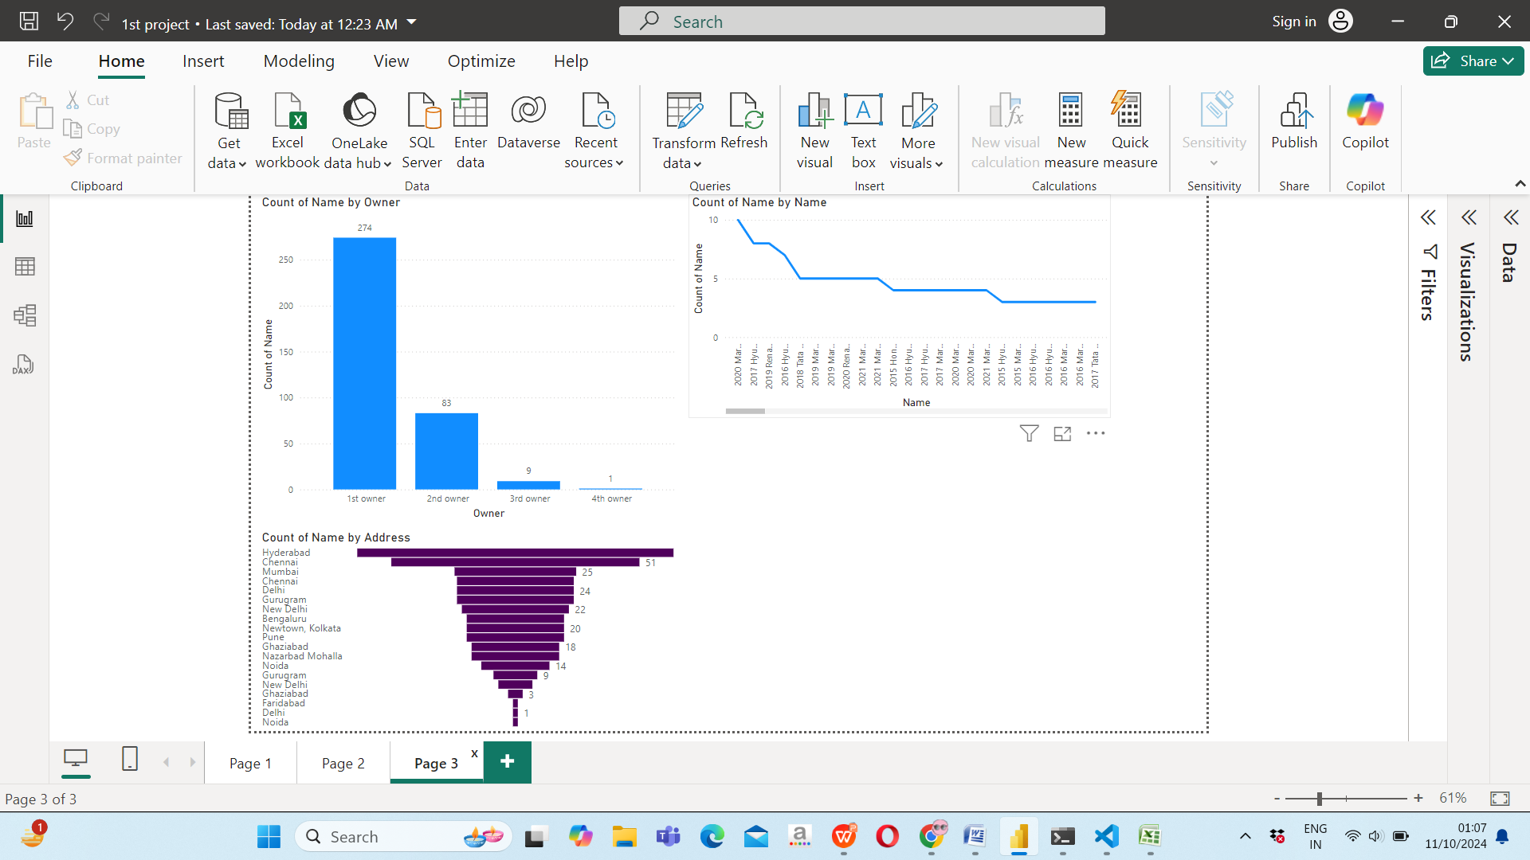

Slide 12
CONCLUSION
The analysis of used car prices based on various car brands reveals significant insights into market trends and consumer preferences. By evaluating factors such as price, quality, and brand reputation, it becomes evident that certain brands consistently offer high-quality vehicles at more affordable price points.

