Slide 1

AutoSense: Smarter Market Estimator for the Road Ahead
MINOR PROJECT - I
Presented by:
Manasa Barik (23CSEDS039)
Satya Prakash Samal (23CSEDS019)
Swapnajit Barik (23CSEDS030)
Guided by:
Mr. Saroj Kumar Behera
Group: 07

Slide 2
TABLE OF CONTENTS
• Introduction
• Basic Concepts Used
• Tools & Technologies Used
• Project Development Process
• Results & Outcomes (So Far)
• Future Scope & Improvements
• Conclusion
• References & Acknowledgments

Slide 3
iINTRODUCTION
AutoSense is a smart automobile platform that integrates car price prediction with an admin-managed car listing system.
Helps users estimate fair car prices
•Ensures only verified, admin-approved listings are displayed
Provides a secure and user-friendly web platform

Slide 4
Basic Concepts Used
✅ Machine Learning models for price prediction
✅ Data Preprocessing (handling missing values, feature engineering)
✅ Train-Test Split for model development
✅ Web Development for front-end and back-end integration
✅ Database for storing car listings
✅ Admin Dashboard for management

Slide 5
Tools & Technologies Used
🛠 Python – core programming language
📒 Jupyter Notebook – ML model development
📊 Pandas & NumPy – dataset cleaning, preprocessing
📉 Scikit-learn – for predictive models
🌐 Django – backend framework
💻 HTML, CSS, JS – frontend design
🗄 MySQL– database for listings

Slide 6
Project Development Process
✅ Dataset collection & preprocessing (Completed)
✅ Index page design (Completed)
✅ Insight Gathering
🔄 Model training (Preliminary Stage )
🔄 Backend integration with database (Pending)
🔄 Admin dashboard (Pending)

Slide 7
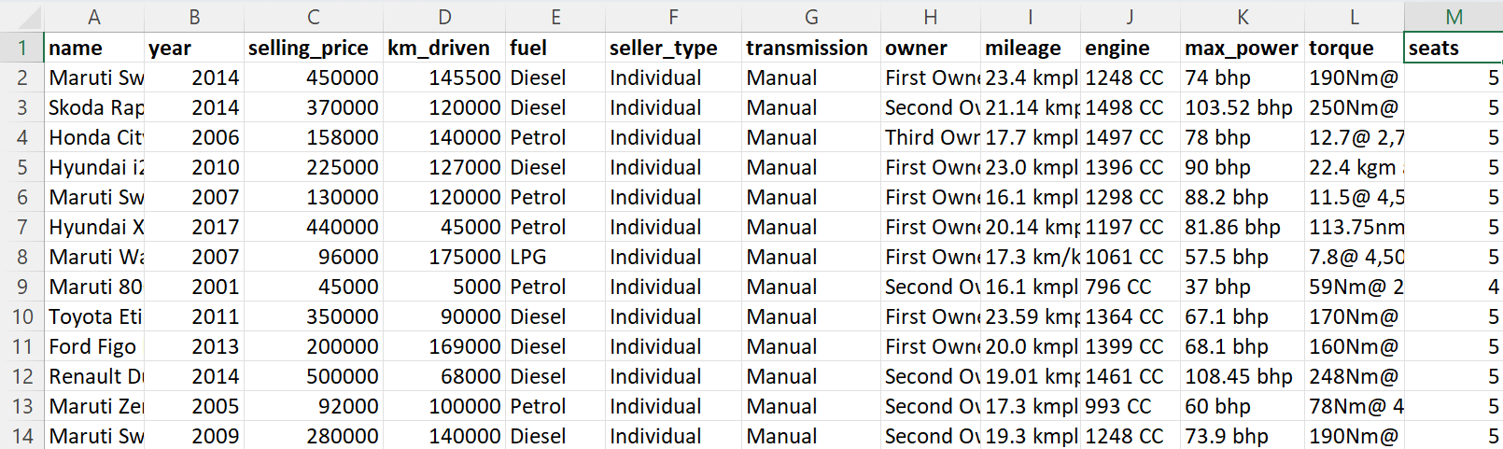
DATASET

Slide 8
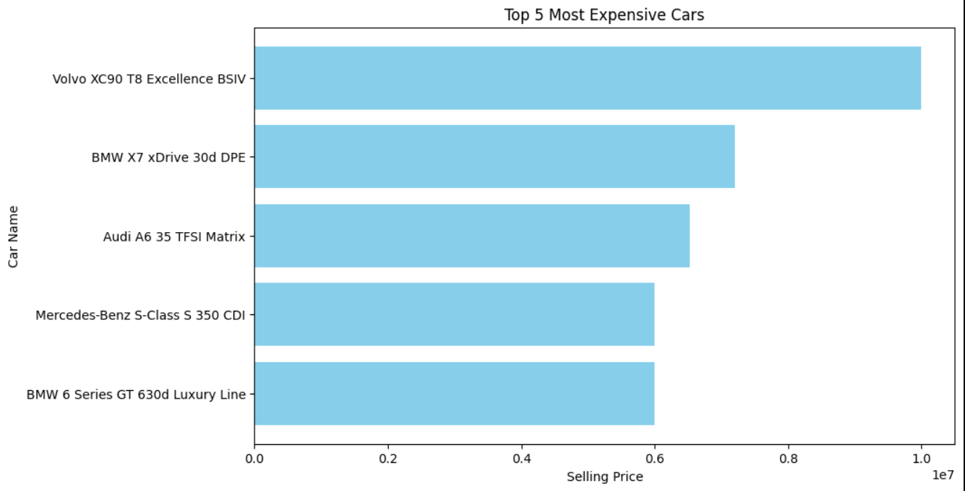
INSIGHTS

Slide 9
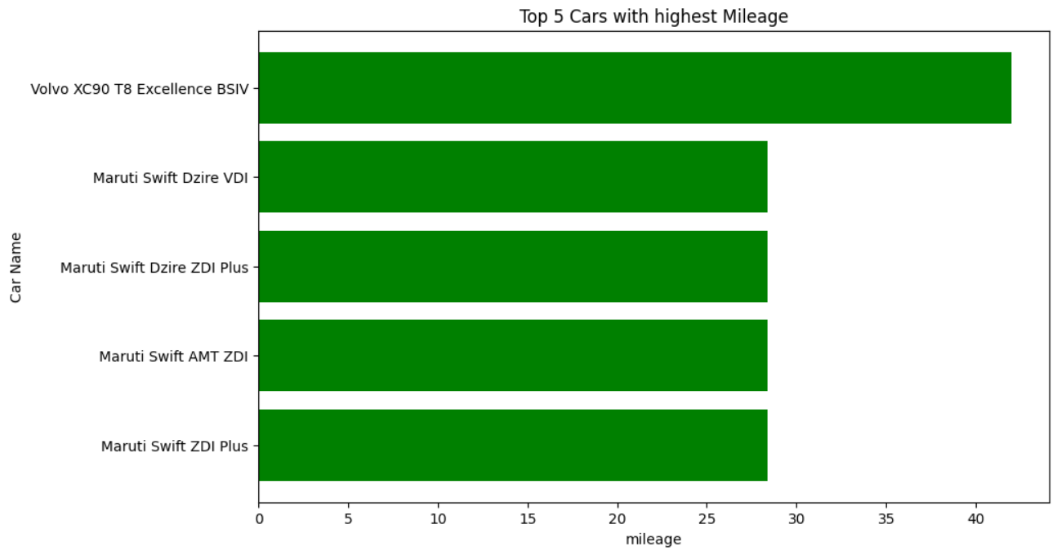
INSIGHTS

Slide 10
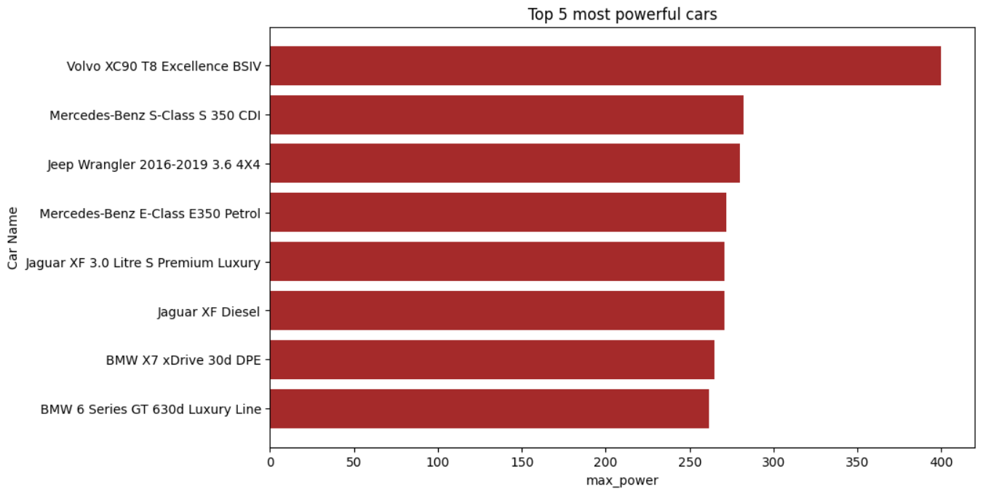
INSIGHTS

Slide 11
Results & Outcomes (So Far)
•Cleaned dataset ready for ML model
• Basic web interface initiated
• We are working to:
→ Get accurate car price predictions
→ Browse verified car listings managed by admin

Slide 12
Future Scope & Improvements
•Build and train predictive model for price prediction
• Implement a fully functional admin dashboard
• Add advanced features:
→ Search & filter for cars
→ Recommendation system for best deals
→We Will be building a Car Inventory

Slide 13
Conclusion
•AutoSense aims to provide:
• A reliable car price prediction tool
•A secure and admin-verified car marketplace.
•With further development, it will become a complete platform for buyers to make smarter decisions.

Slide 14
REFERENCE & ACKNOWLEDGEMENT
•Datasets: Kaggle & Car Market Data Sources
•Supervisor: Mr. Saroj Kumar Behera
•Tools: Python, Jupyter, Django, MySQL ACKNOWLEDGMENTS

Slide 15
THANK YOU!!

