Slide 1
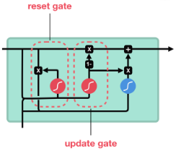
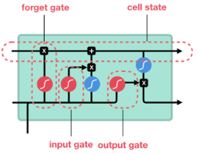
Quora Insincere Questions Classification
Background
- To handle toxic and divisive content on Quora
Related Work
- Natural Language Processing
- TF-IDF, Word embeddings for vectorizing words
- Naive Bayes, SVM, LSTM+GRU
- Class imbalance- use F1-score
Motivation
- Manually analysing every question is impossible
Gowri Manasa Dharani
Keerthana Reddy Nerella

Slide 2
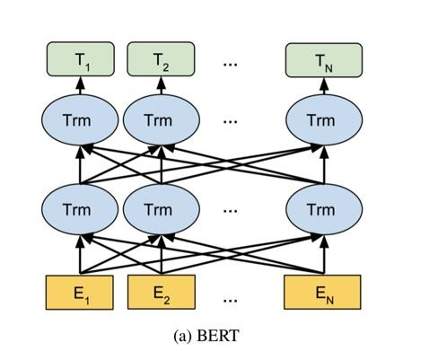
Methodology
BERT- Pre-trained on a large corpus of unlabelled text which includes the entire Wikipedia and a book corpus. Bidirectional model that is based on the transformer architecture, replaces the sequential nature of RNN (LSTM & GRU) with a much faster Attention-based approach
Integration of BERT with Fastai - Customize Fastai’s tokenizer and vocab with BERT’s wordpiece tokenizer and vocab.
Team Assignments
Gowri Manasa - Logistic Regression+TF-IDF(Baseline1), Using pretrained BERT model, Fitting model with databunch, label prediction.
Keerthana Reddy - LSTM+GRU(Baseline2), Customizable BERT Tokenizers, Vocab, Wrappers for Fastai (Fastai integration).

Slide 3
Results and Analysis
Logistic Regression + TF-IDF : F1 score - 0.5932455512092998
LSTM+GRU : F1 Score - 0.6060070671378092
BERT : 0.665614925577886
An improvement of performance compared to the baseline models.
Analysis
LSTM and GRU are recurrent neural networks. So they will remember the context. So, the model performs better than LR.
Because it is bidirectional and trained, BERT knows the complete context and hence performs better. The BERT model captures information related to language in a compositional way that is similar to tree-like structures
Future Work
XLNet- Recent model, Outperforms BERT on 20 NLP tasks

