Slide 1
POSHAN ABHIYAAN
KESHAV MEMORIAL INSTITUTE OF TECHNOLOGY
JNTU HYDERABAD
Under the Guidance
of
Jyoshna Bejjam
Assistant Professor
By:
Rishika Gade - 16BD1A054D
Gottam Manasa - 16BD1A054N
Koyati Swetha - 16BD1A055K

Slide 2

ABSTRACT
There is a high pressure to remember life critical information amidst juggling work and home for the parents.
Our Web Application facilitates young parents in tracking the immunization of their children.
Our Application's aim is to keep track of the vaccinations that needs to be taken during pregnancy and after delivery for the baby.
An Email Alert will be sent to the user 2 days, 1 day prior to the vaccination and on the day of vaccination; to remind the user of vaccination.

Slide 3
Problems with Existing systems
There are web sites which provide information regarding the vaccinations.
But they don’t provide any kind of alerts and notifications for the users for their email.
User needs to check multiple sites to know information about vaccinations, nutrition to be taken and the exercises to be done.

Slide 4
Proposed System
The user will have to enter his/her pregnancy details(if any) and their child details(if any).
List of vaccinations and their respective dates are displayed.
An Email Alert will be sent to the user for reminding about vaccinations and tests.
The Nutrition that needs to be taken and Exercises to be done are given.

Slide 5
SCOPE OF the project
A daily Meal plan is recommended to the pregnant women.
We send Alerts and Notifications for the users regarding vaccination dates.
We provide emergency hospital search based on Pincode given.
Women can see their previous pregnancy details in archive section

Slide 6
Technologies used
Java 8
Java Servlets
Java Server Pages
HTML
JavaScript 1.8.5
CSS 3
MySQL 8.0
Apache Tomcat Server 9.0.27

Slide 7
IMPLEMENTATION DETAILS
•Initially the web application consists of registration/login along with information about women and child nutrition and exercises
•It takes information from the user in the HTML form where javascript is used for validation.
•With the help of a servlets and JSP the information from the HTML page is retrieved and processed.
•MySQL JDBC connector is used to connect to the database and do operations.
•Mail API is used for sending mails to User.

Slide 8
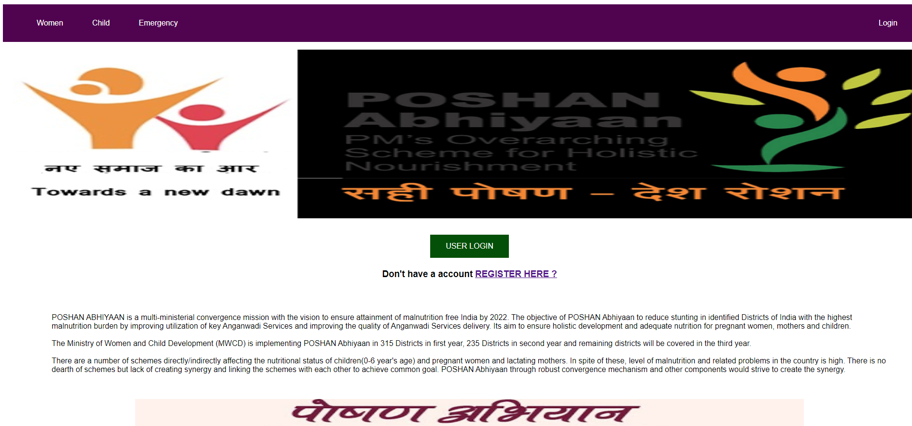
HOME PAGE

Slide 9
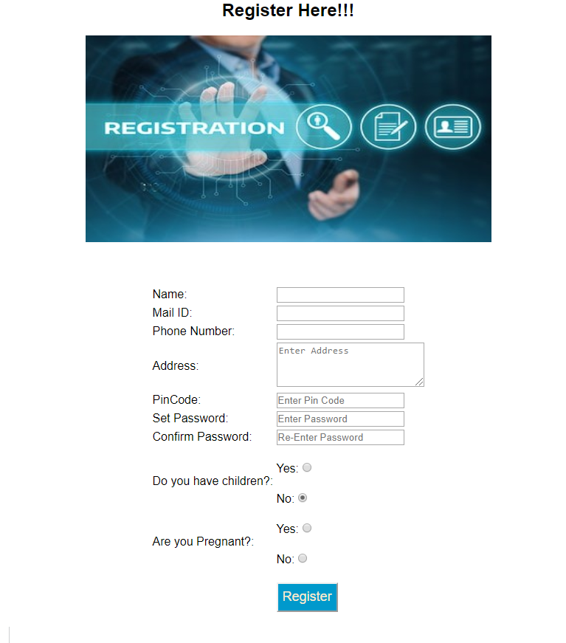
USER
REGISTRATION

Slide 10
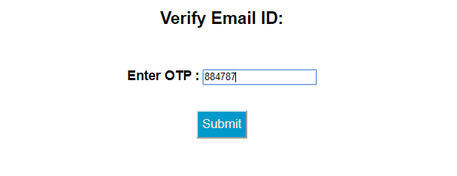
VERIFY EMAIL ID

Slide 11
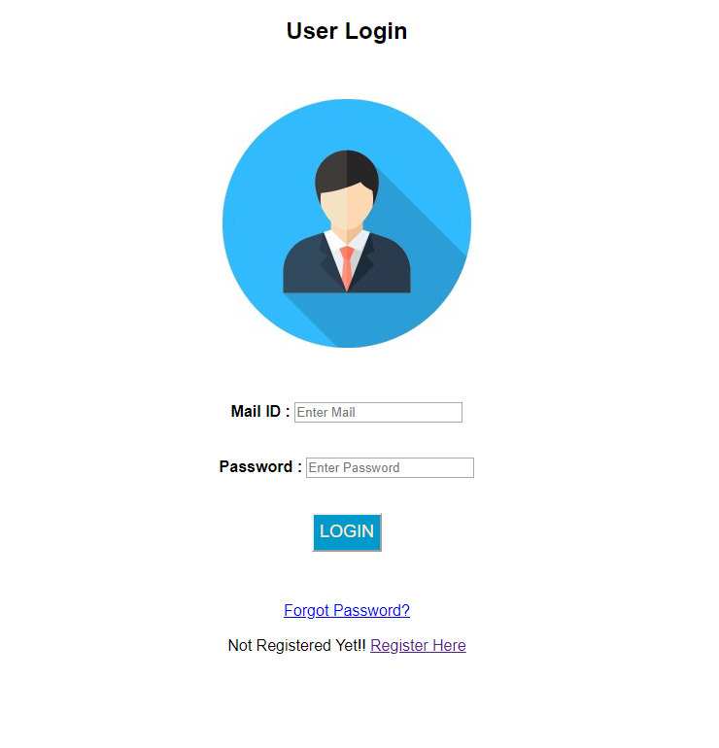
USER LOGIN

Slide 12
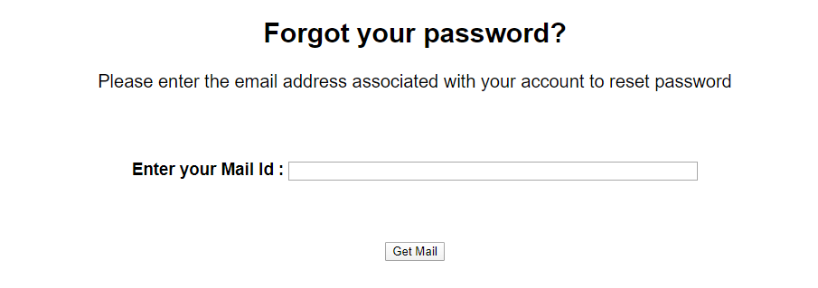
FORGOT PASSWORD

Slide 13
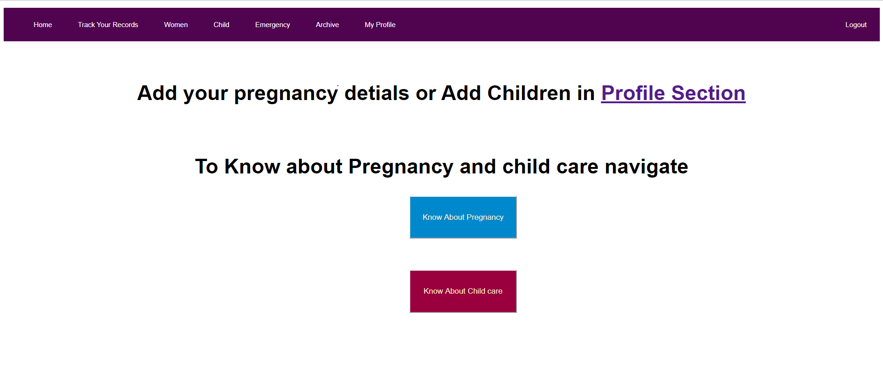
TRACK YOUR RECORDS

Slide 14
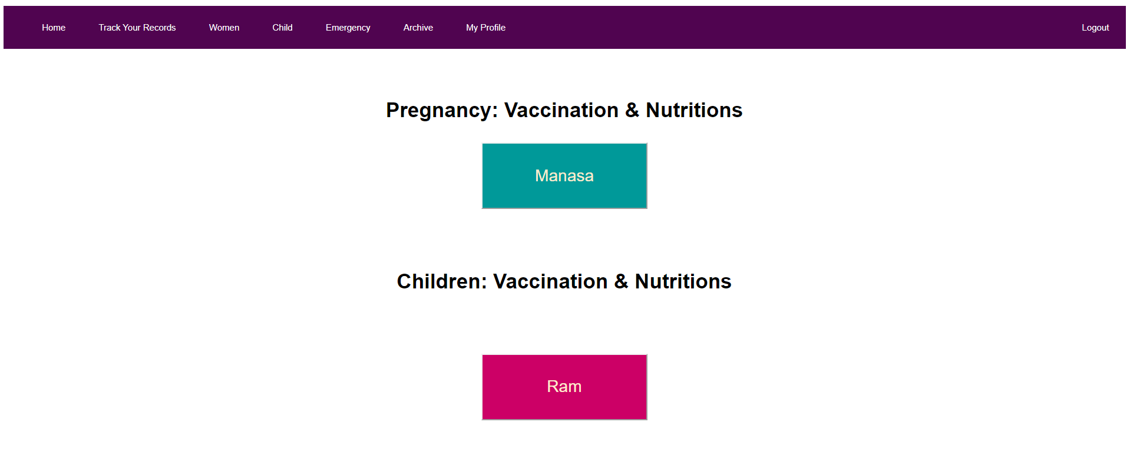
TRACK YOUR RECORDS

Slide 15
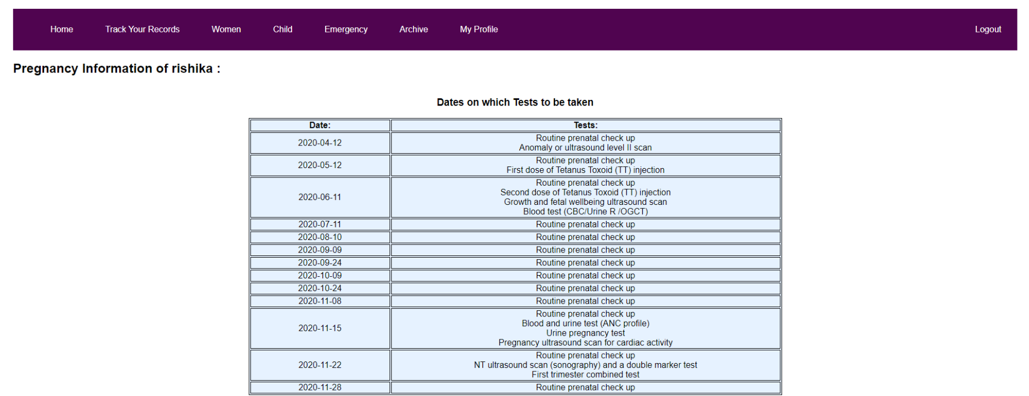
VIEW PREGNANCY DETAILS

Slide 16
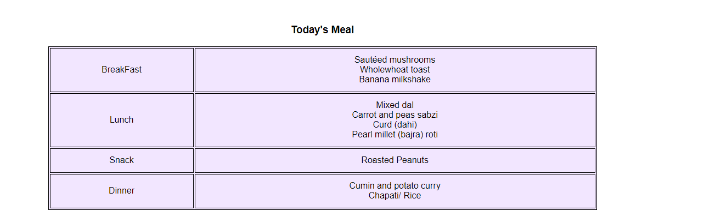
VIEW DAILY MEAL PLAN

Slide 17
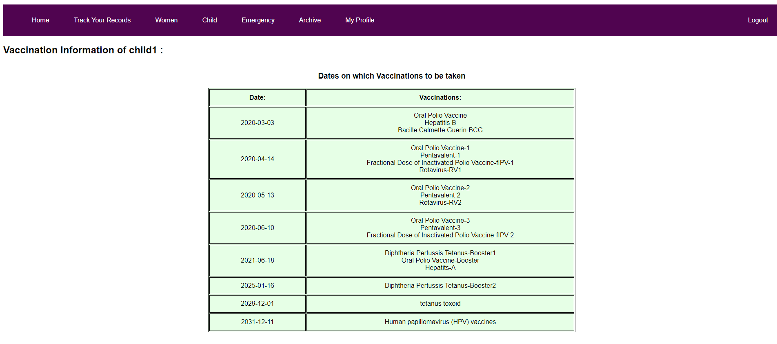
VIEW CHILD DETAILS

Slide 18
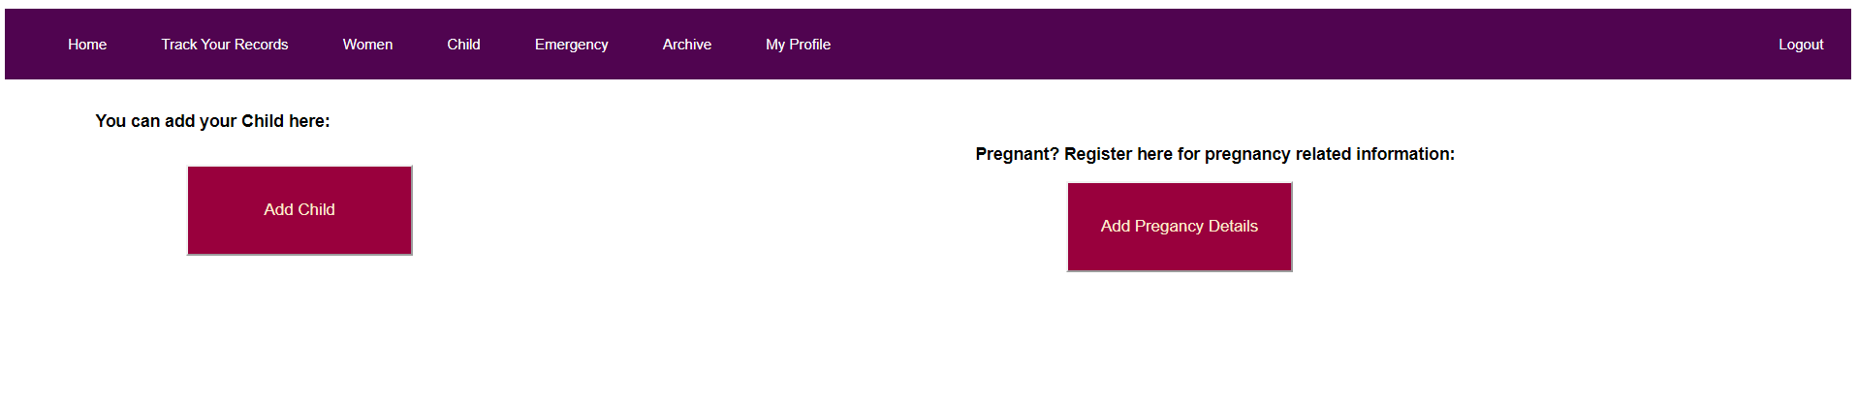
PROFILE SECTION

Slide 19
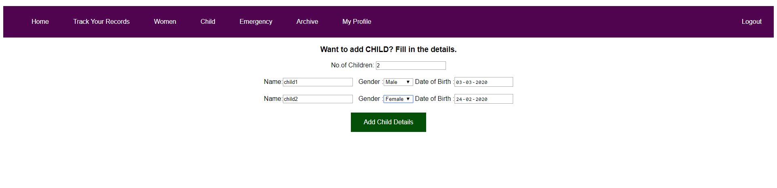
ADD CHILD

Slide 20
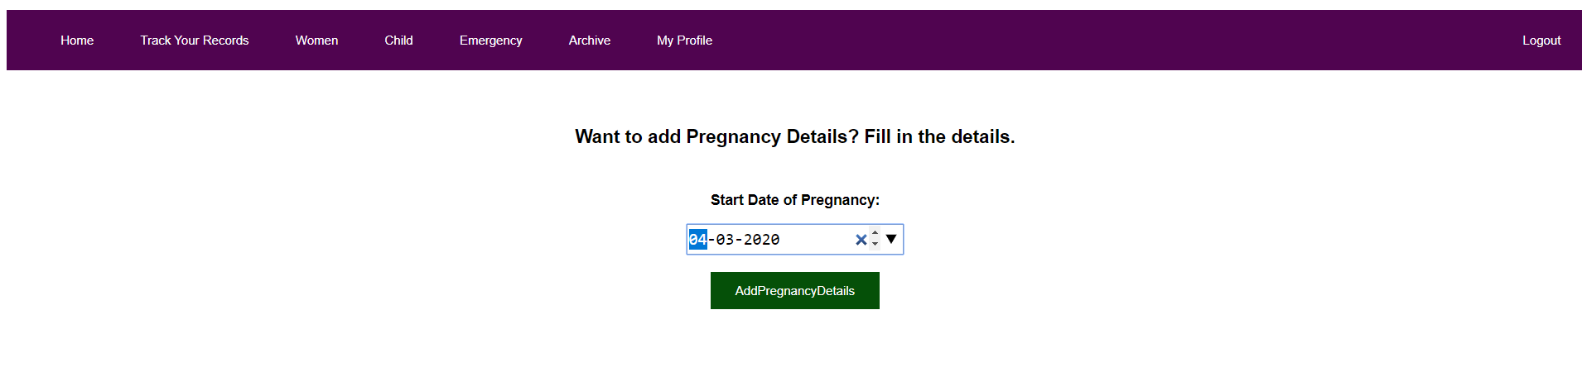
ADD PREGNANCY

Slide 21
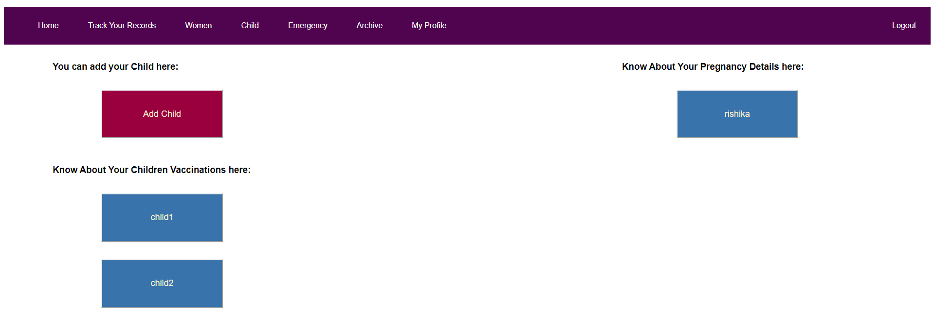
PROFILE SECTION

Slide 22
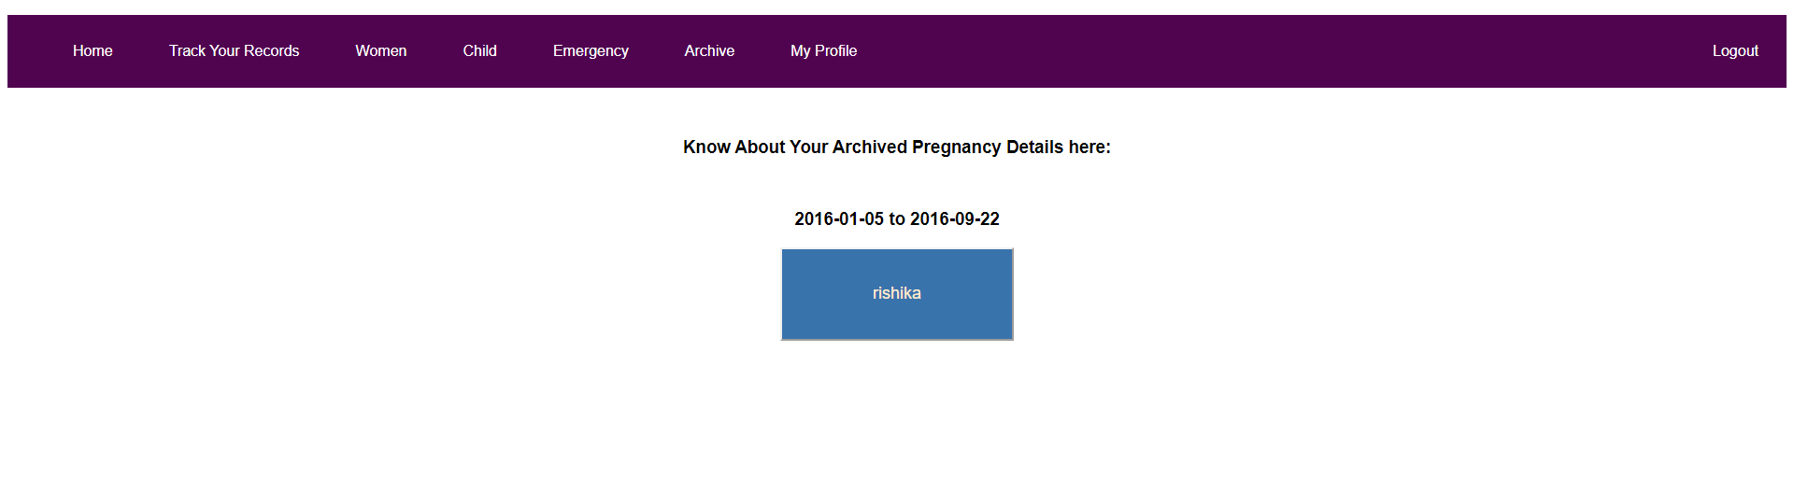
ARCHIVE SECTION

Slide 23
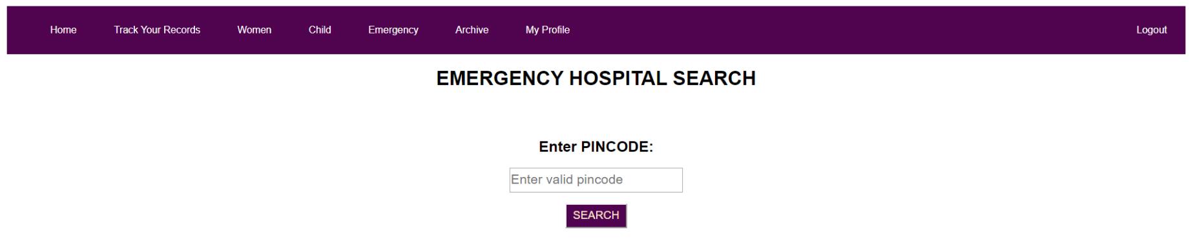
EMERGENCY SEARCH

Slide 24
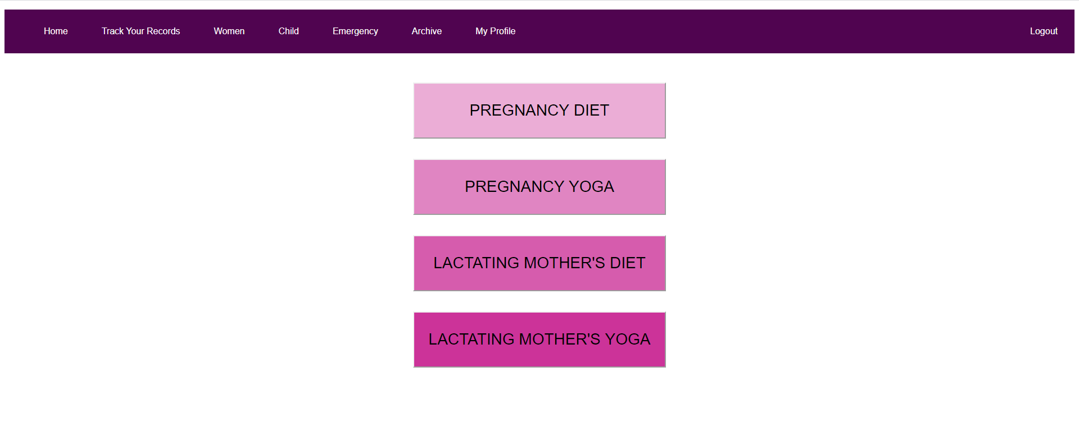
WOMEN

Slide 25
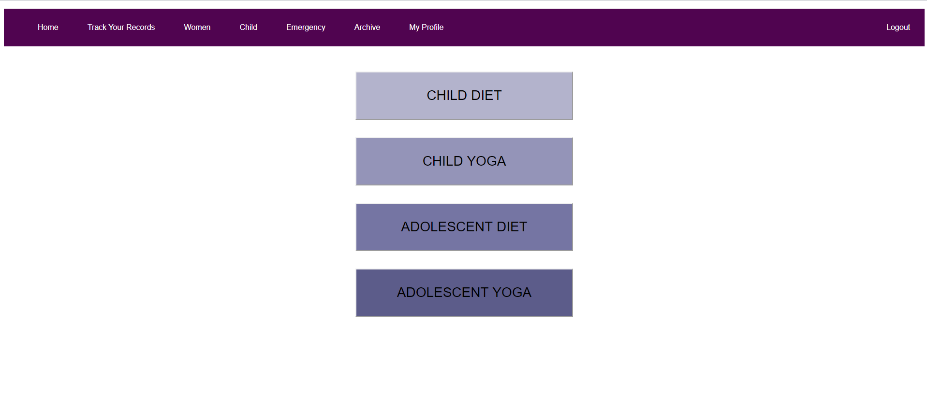
CHILD

Slide 26
conclusion
Poshan Abhiyaan provides one stop for all needs where the user can get diet plan suggestions, nutrition information, yogic diet and yoga, vaccination alerts for both children and pregnant woman.
The website provides the user an ease of access to information and also helps them ensure that they never miss a vaccination or test.
Thus, Poshan Abhiyaan helps in contributing to the health of women and children.

Slide 27
Future enhancement
In the future, we would like to make the web application capable of taking the location of the user with the help of a GPS to provide the list of hospitals nearby.
We also intend to make communication stronger by enabling an SMS system where the reminders for vaccination will be messaged to the user.
We also intend to develop an android application with the above mentioned improvements for easier usage and convenience.

Slide 28
DEMO

Slide 29
THANK YOU

