Slide 1
Concrete Compressive Strength Prediction
DATA - 601 Prof. Ajinkya Borle
Manasa Goud Jagati (QF80659)
Sairam Prudhvi Karri (BA13810)
Satvik Reddy Singi Reddy (KD80413) Satwik Reddy Ala (RP22297)

Slide 2
Table of Contents
Data Collection and info
Null values check
Data distribution check
Outliers check
Correlation analysis
ML Model Implementation
Comparing different ML Models.

Slide 3
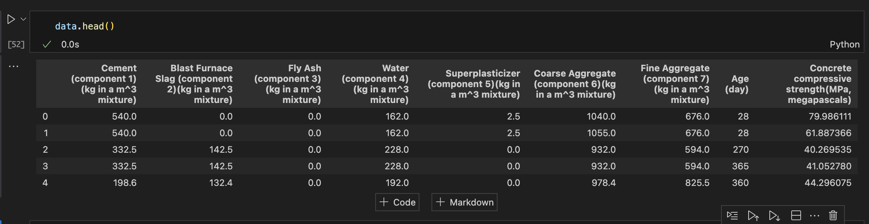
Data Collection and Info
Total 9 columns( including target) and 1039 entries.
All the columns are in same units. So, no need for scaling data.

Slide 4
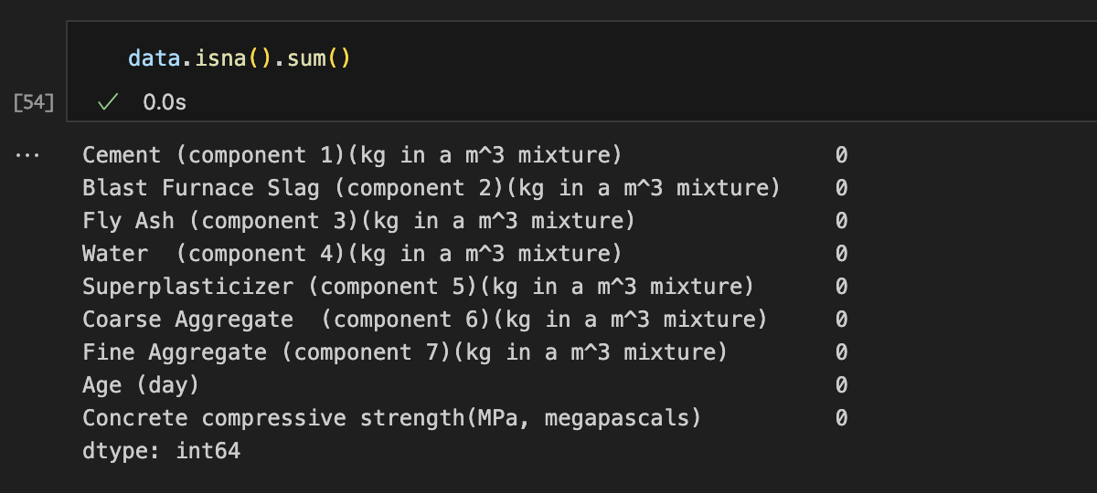
Null Values
No null entries found

Slide 5
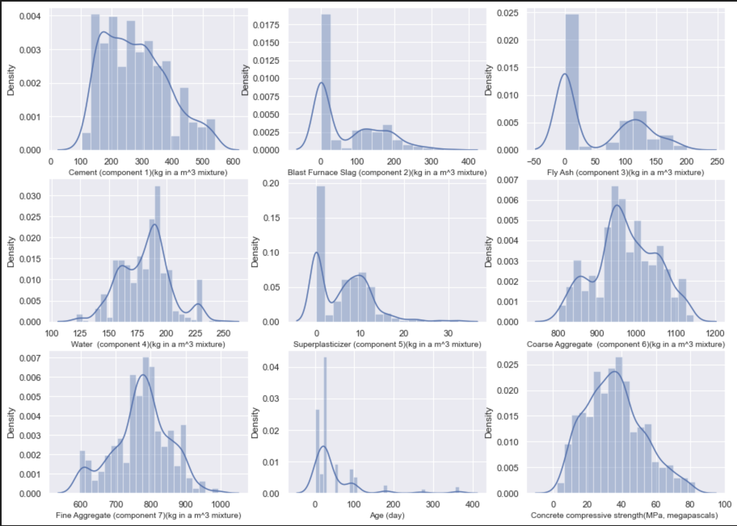
Data Distribution
Found some data skewness in columns like Blast Furnace, Fly Ash, Superplaster, and Age.
Need to work on scaling the data to bring it to normal distribution.

Slide 6
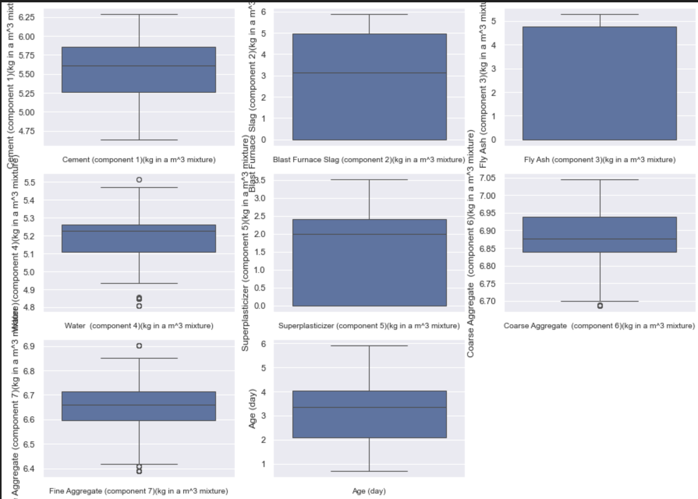
Outliers
Found some outliers in columns like Water, Coarse Aggregate, Fine Aggregate, and Age.
There are very few outliers and removed those.

Slide 7
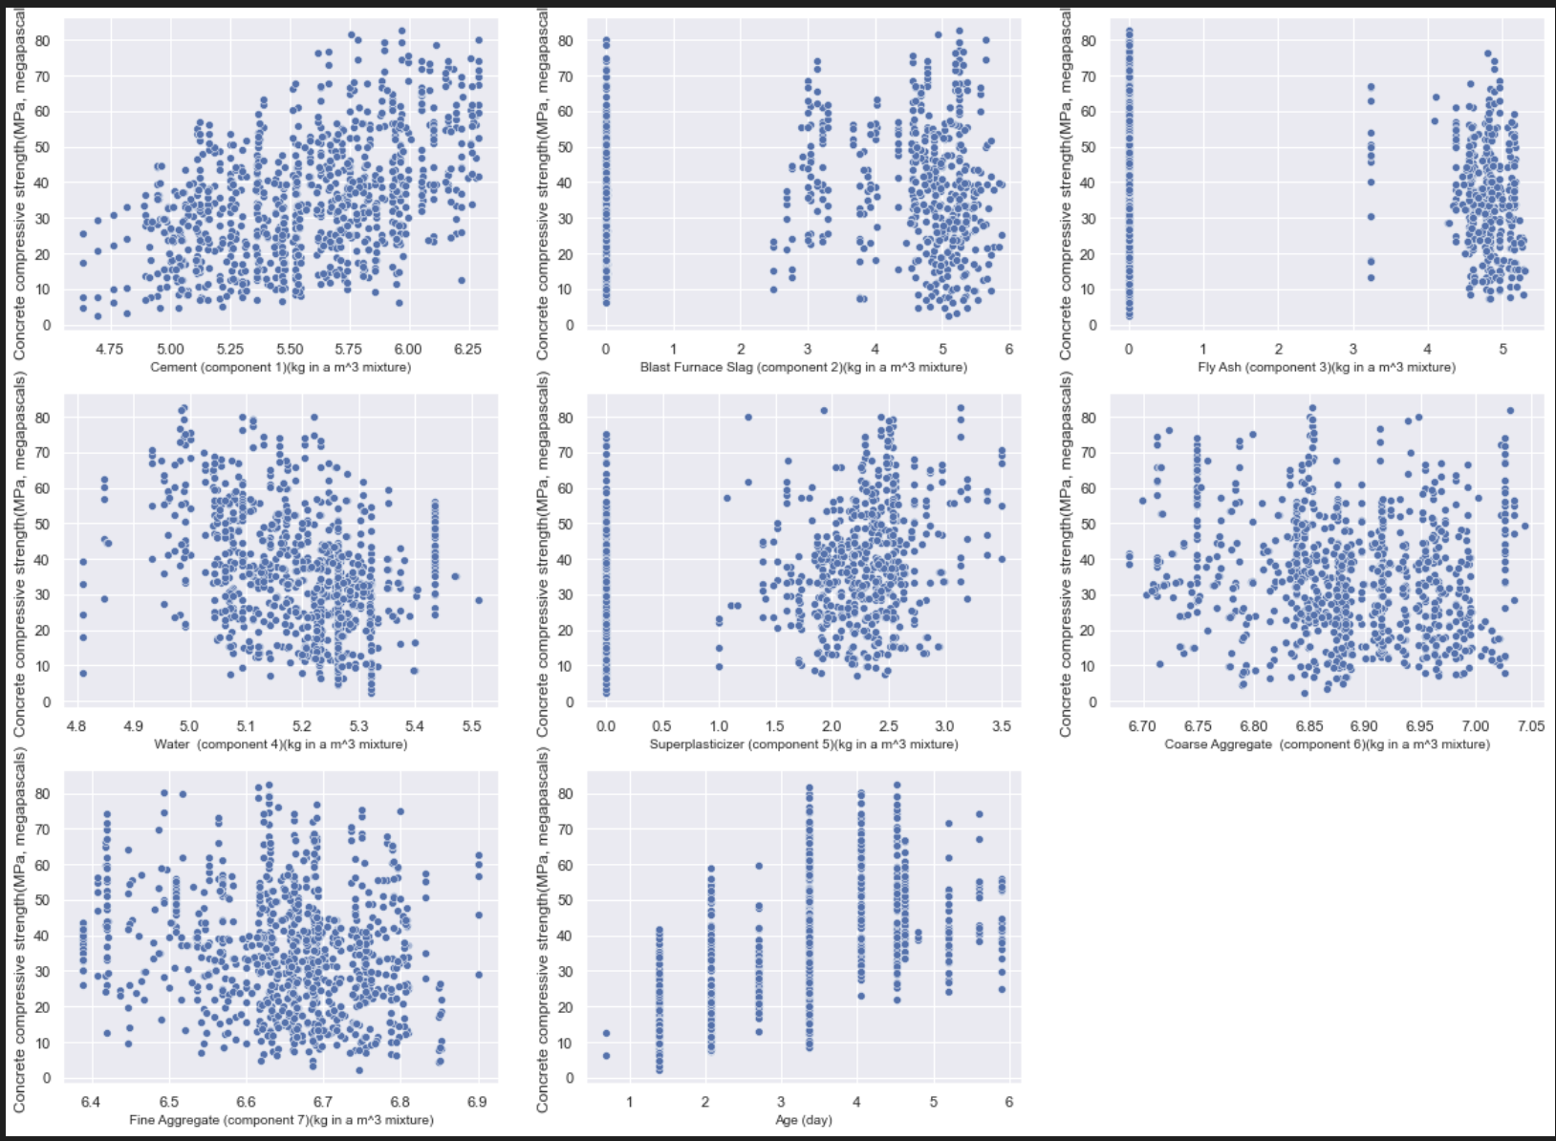
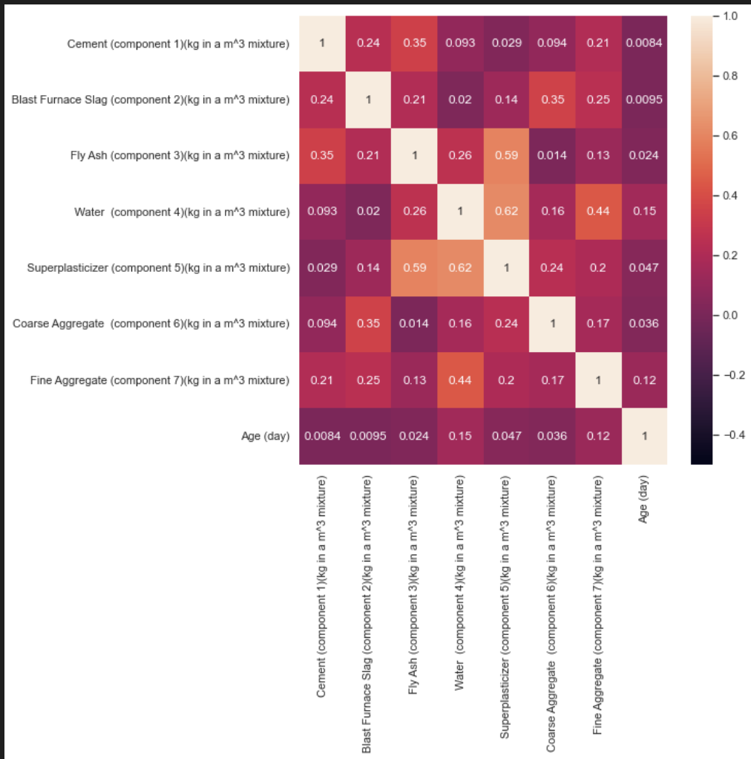
Correlation Analysis
Features like Cement and Water have linear relation with target column. These two columns may contribute better to prediction results.
There is no correlation identified between input features. Hence, all features are retained.

Slide 8
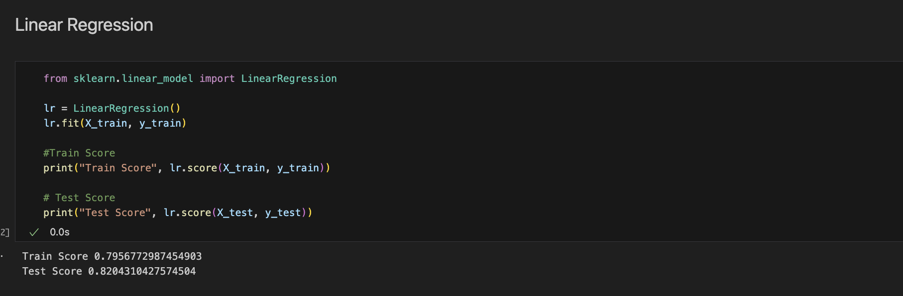
Model Implementation
We tried implementing different models starting from Linear regression to as advanced as XgBoost and compared all the model’s output.

Slide 9
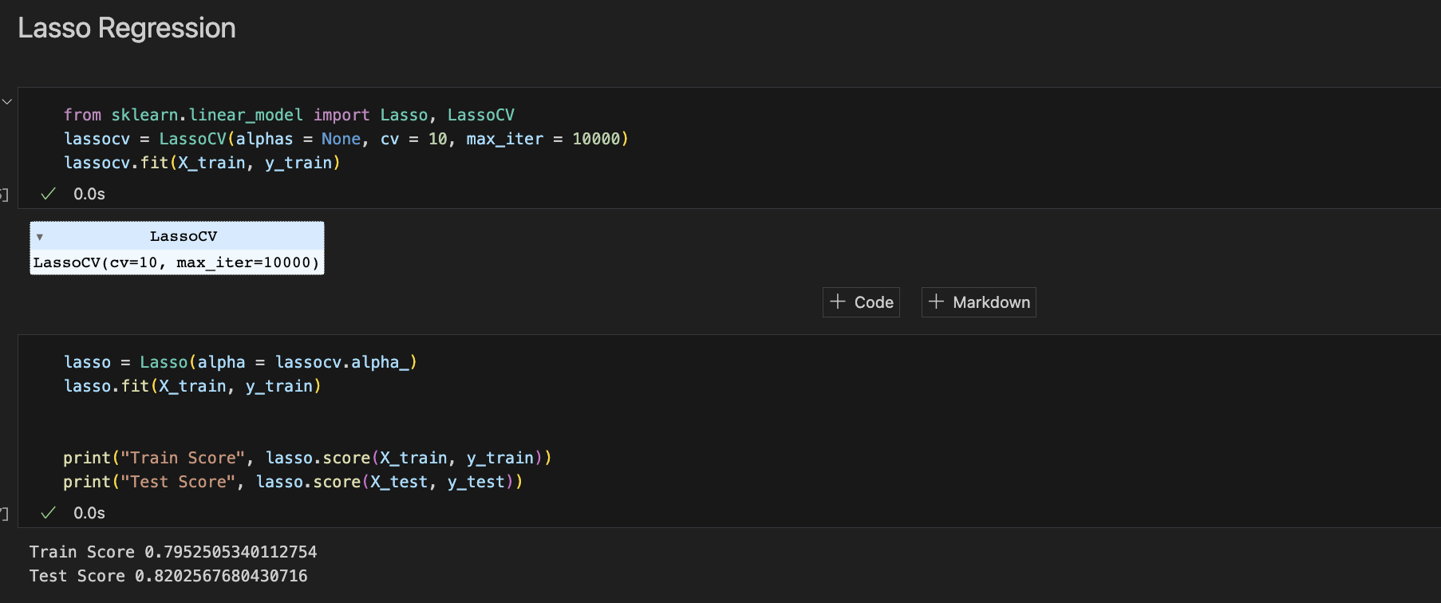
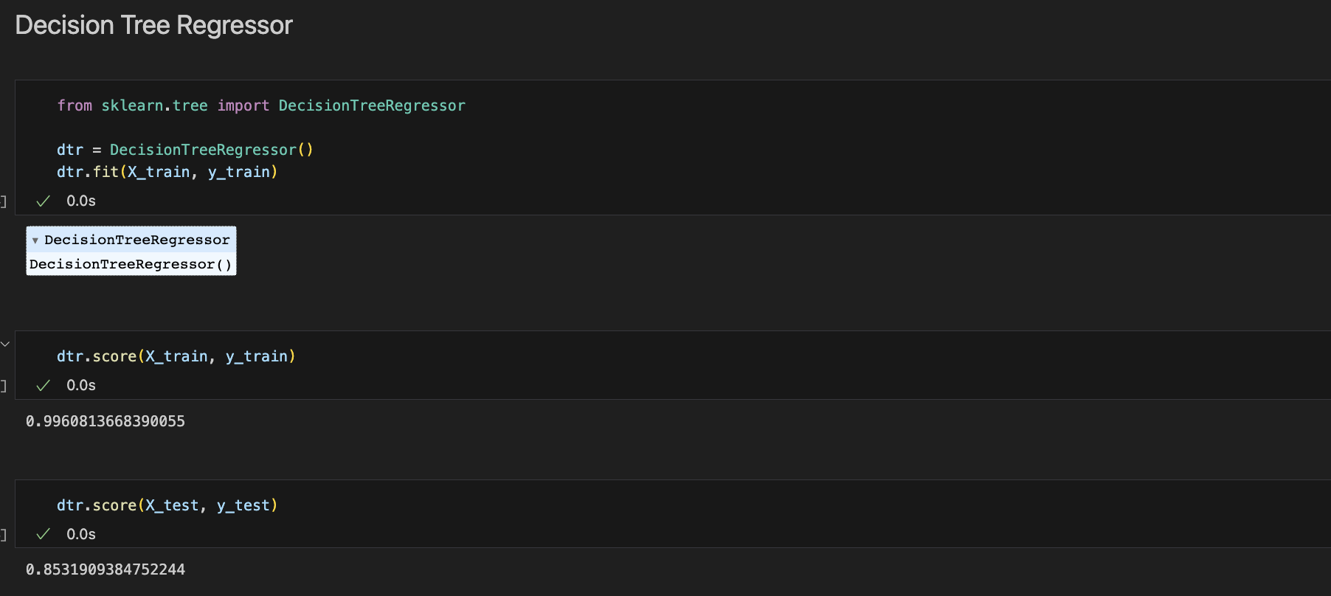
Model Implementation
We tried LASSO Regression, and it gave results like Linear regression. So, we started with Decision Tree Regressor and found the model is overfitting to the train data and performing not so good to the test data.

Slide 10
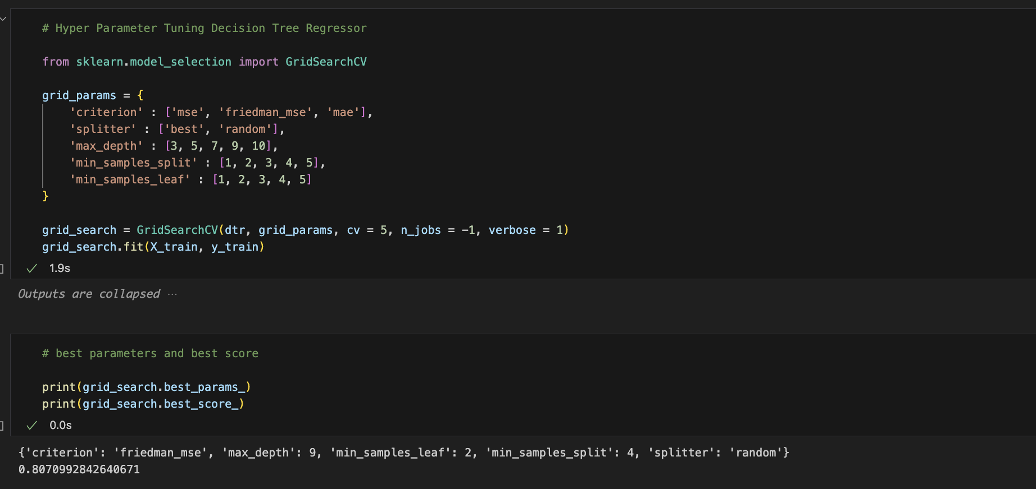
Hyper Parameter Tuning
As the Decision tree regressor is getting overfitted to the train data. We did hyperparameter tuning and found out below parameters are good for model prediction.

Slide 11
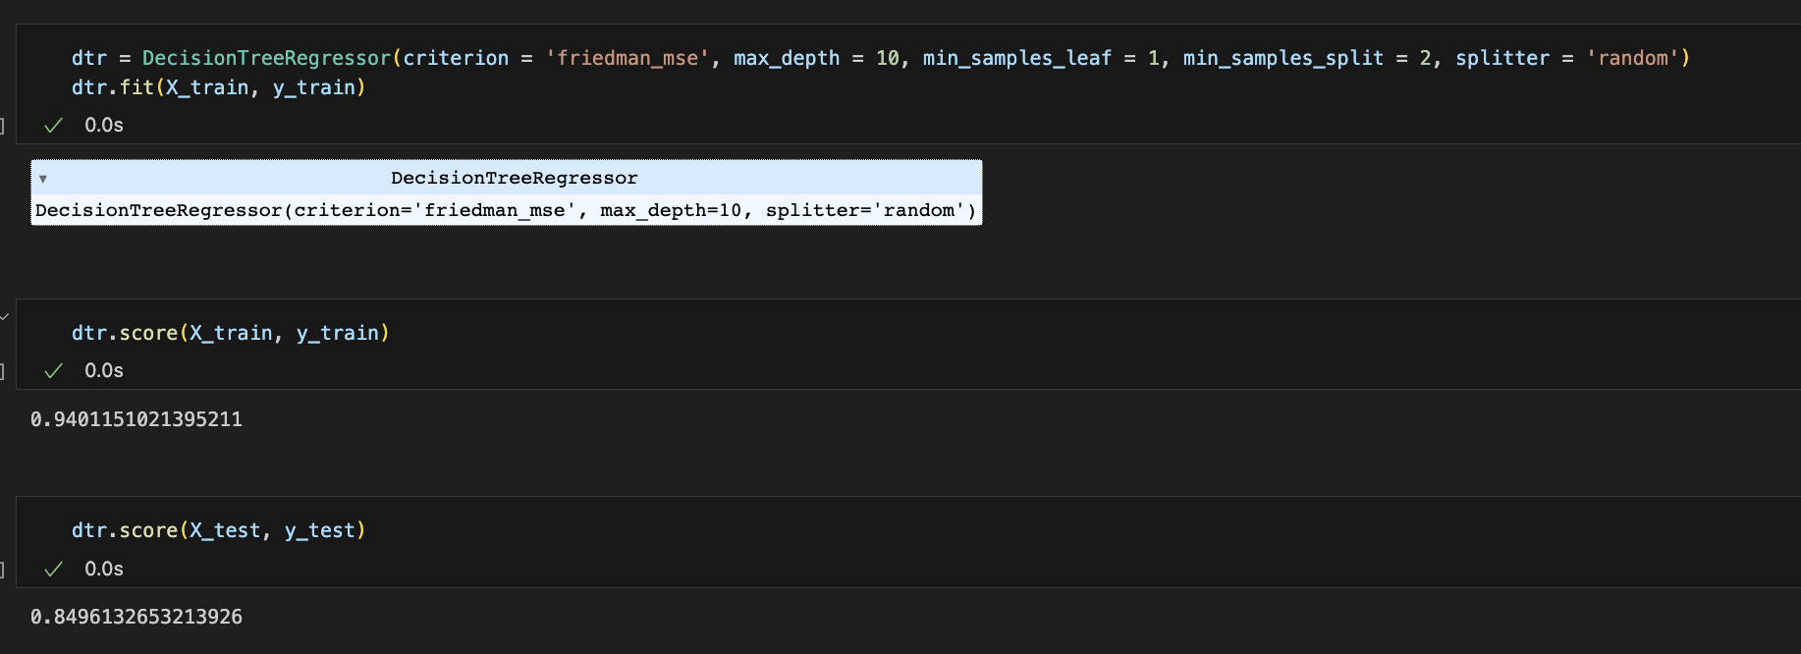
Improved Results
After tuning parameters, Decision tree performance seems like not overfitted to the data.

Slide 12
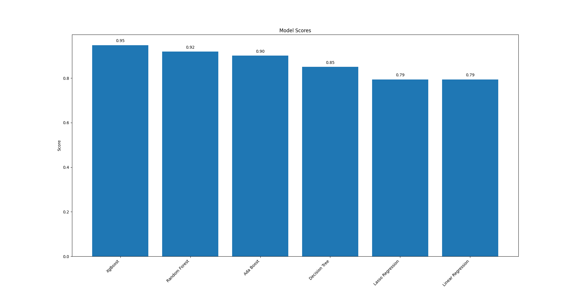
Implemented some more algorithms for better prediction

Slide 13
Thank You..!

