Slide 1


“Hybrid Fake News Detection Using BERT and Speaker Credibility Ranking via PageRank”
Paper ID : 68
Paper Title :
Presented By:
Chandrashekhar Pomu Chavan
Manasa K
Haripriya L

Slide 2

Introduction
Introduction
Fake news is a growing threat – spreads rapidly online, harming trust & democracy.
Text-only models are limited – ignore who makes the claim.
Speaker credibility matters – history of truthfulness is crucial.
BERT captures semantics – understands context & nuances in text.
Our hybrid approach – combines BERT + credibility + PageRank for trust-aware detection

Slide 3
Problem Statement
Problem Statement
Current models rely only on text → miss credibility aspects.
They cannot capture speaker influence in information networks.
Lack of trust-aware features (credibility scores, PageRank).
Pure text models struggle with sarcasm, bias, and ambiguity.
There is a need for a hybrid model that fuses text semantics with speaker credibility and influence.

Slide 4
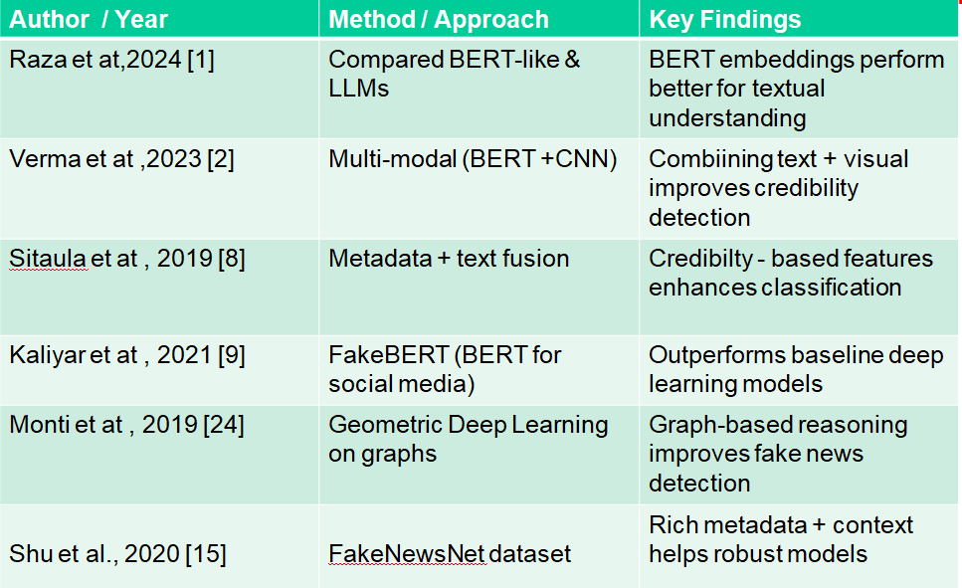
Literature Review

Slide 5
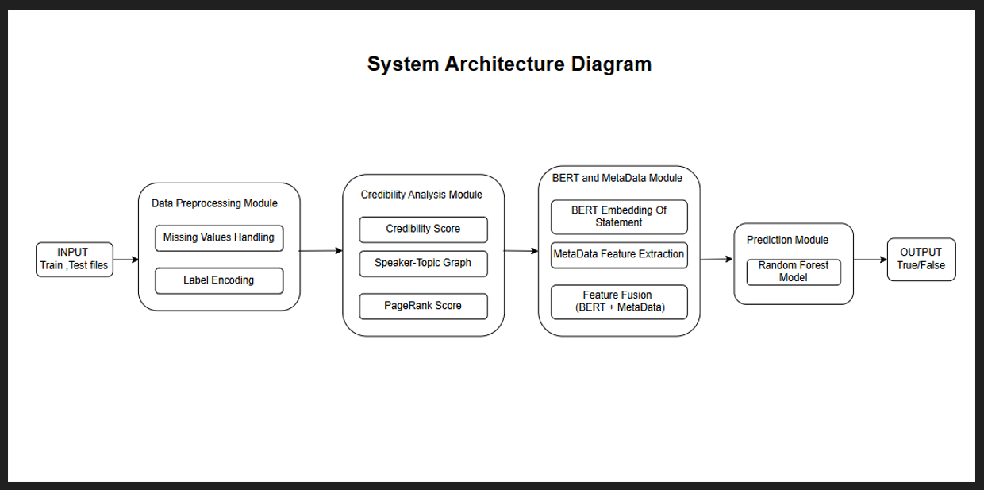
Proposed Method / Solution

Slide 6
Proposed Method / Solution
Input → Political statements + metadata (speaker, party, history).
BERT Module → Extracts semantic embeddings (768-dim) from text.
Credibility Module → Calculates speaker credibility score from past truthfulness.
PageRank Module → Builds a speaker–topic graph, assigns influence scores.
Fusion + Classifier → Combine BERT + metadata + credibility + PageRank → Random Forest predicts truth label.

Slide 7
Dataset Description
Dataset Used – LIAR Fake News Dataset (from Kaggle).
Content – ~13K short political statements with metadata.
Labels – Six classes: pants-fire, false, barely-true, half-true, mostly-true, true.
Metadata – Speaker, party, job title, state, context, past truth counts.
Split – ~10K training, ~1K validation, ~1K test.

Slide 8
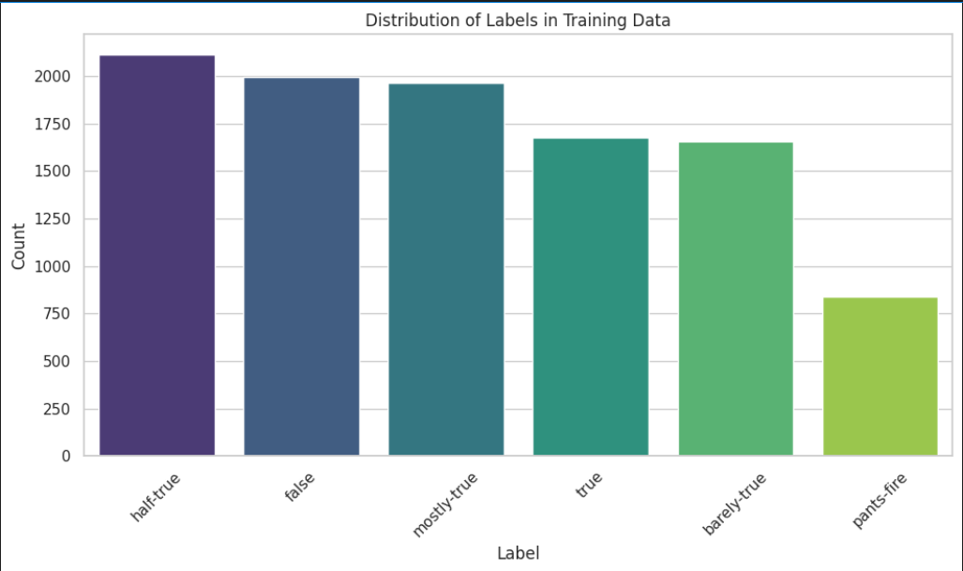
Dataset Description

Slide 9
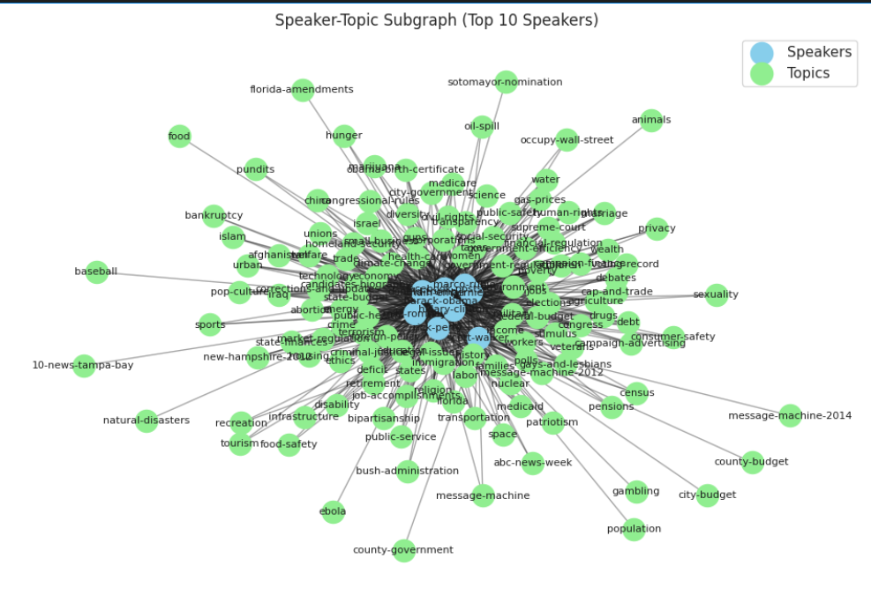
Results

Slide 10
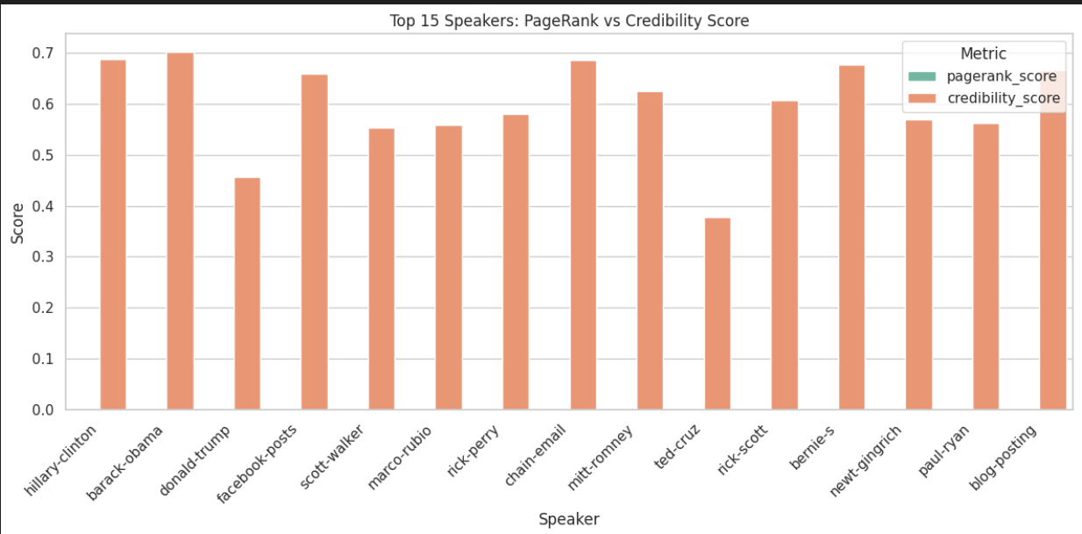
Results

Slide 11
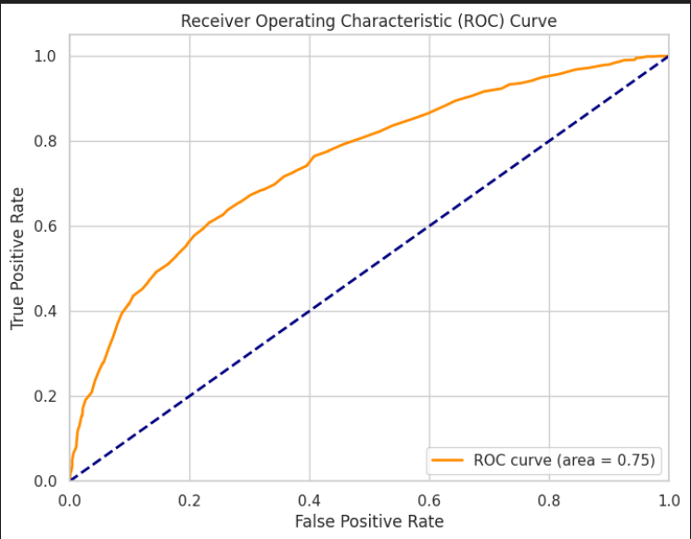
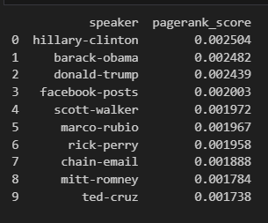
Results

Slide 12
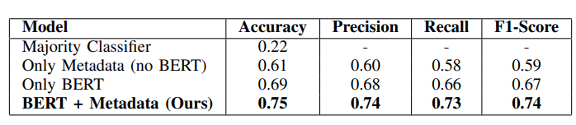
Results

Slide 13
Conclusion
Proposed a hybrid fake news detection model (BERT + metadata + credibility + PageRank).
Fusion approach outperformed BERT-only and metadata-only baselines.
Credibility & PageRank features added trust-aware insights.
Limitations: class imbalance, missing metadata, high BERT cost.
Future scope: model optimization & handling subtle cues (e.g., sarcasm).

Slide 14
Future Scope
Graph Neural Networks (GNNs): Applying GNNs on speaker-topic graphs could better capture latent relationships.
Larger Language Models: Leveraging more advanced pre-trained models such as RoBERTa, GPT, or LLaMA may improve contextual understanding and generalization.
Cross-Dataset Evaluation: Testing the model across multiple fact-checking datasets could validate its robustness and generalizability
Real-time Adaptability: Streamlining preprocessing and embedding generation to support online or real-time fake news detection pipelines.

Slide 15
References
[18] S. Vosoughi, D. Roy, and S. Aral, "The Spread of True and False News Online," Science, 2018.
[19] J. Thorne and A. Vlachos, "Automated Fact Checking: Task Formulations, Methods and Future Directions," COLING, 2018.
[21] K. Shu, S. Wang, and H. Liu, "Understanding User Profiles on Social Media for Fake News Detection," ICDM, 2018.
[14] K. Shu et al., "FakeNewsTracker: A Tool for Fake News Collection, Detection, and Visualization," CMOT, 2019.
[24] F. Monti et al., "Fake News Detection on Social Media Using Geometric Deep Learning," arXiv, 2019.
[15] K. Shu et al., "FakeNewsNet: A Data Repository for Studying Fake News on Social Media," Big Data, 2020.
[16] P. Meel and D. K. Vishwakarma, "Fake News, Rumor, and Information Pollution: A Contemporary Survey," Expert Systems with Applications, 2020.
[17] X. Zhou and R. Zafarani, "A Survey of Fake News: Theories, Detection Methods, and Opportunities," ACM Computing Surveys, 2020.
[11] B. Palani et al., "CB-Fake: A Multimodal Deep Learning Framework Using Capsule Network and BERT," Multimedia Tools and Applications, 2022.
[26] Kaggle, "LIAR Fake News Dataset," 2020.

Slide 16
“Hybrid Fake News Detection Using BERT and Speaker
Credibility Ranking via PageRank”
THANK YOU

