Slide 1



TEAM MARS
DK181

Slide 2


Workflow for Teacher Login
Document
Text
Presentation
Question-Answer pair

Slide 3
Generating presentation
Extract the text from the given pdf
Use the Bidirectional Encoder Representations from Transforms(BERT) model to get the summary of the document as given in this paper (Text Summarization with Pretrained Encoders, NIPS 2019)
This model will generate a summary of every page.
This model summary is added to the presentation.
The title of the page is generated using BERT model, as mentioned in the given paper(Automated title generation in English language using NLP)
This ppt is available for the teacher to download.

Slide 4
Generating Question and Answers
A Bidirectional Attention Flow model is built and trained on the SQuAD dataset.
This model takes a text input and it generates Question Answers pairs for the teachers to use.
This works with the help of Encoder Layers and Attention Layers.
The text from the uploaded chapter is extracted and fed to the Bidirectional Attention Flow model. This model then outputs sets of question-answer pairs.
This model is capable of building short-answer type questions, fill in the blank questions, MCQs, and true or false questions.
This model is built with reference to the following paper(SQuAD: 100,000+ Questions for Machine Comprehension of Text).

Slide 5
Finding Answers for given questions:
The question-answer pairs are generated using the previously mentioned method.
When a student asks for a question, it checks for cosine similarity with the already present questions.
The model will return the most probable answer to the given question.

Slide 6
Workflow of the GAN Generated Image
Voice
Text
Image
GAN-generated Image

Slide 7
Generating Image from text using GAN:
This model is a stacked GAN model.
It takes text input and encodes it using its respective embeddings and LSTM layers.
This encoded text and its respective images are fed into the GAN model for training.
On training, this model tries to achieve a Nash Equilibrium, where the losses for both the generator and discriminator are at a minimum.
Once the Nash Equilibrium is achieved, the discriminator is removed and the generator is used to generate Images from a given text.
This model is in reference to the NIPS, 2016 paper - Generative Adversarial Text to Image Synthesis

Slide 8
Workflow for Multisensory learning
Text
c
Image
Voice

Slide 9
Visualization of the text:
Apart from using Generative Adversarial Networks to visualize text, we are also following another method for visualizing huge paragraphs.
We are extracting information from the paragraph and fetching images to display to the student.
This saves a lot of memory.

Slide 10
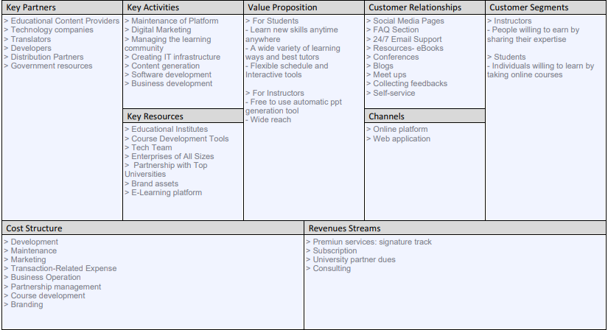
Business Model Canvas

Slide 11
Infographic Style
Meet Our Team
VATSAL KANDOI
WEB DEVELOPER
ARUN KUMAR L
AI DEVELOPER
MANASA R
AI DEVELOPER
RITIKA SHUKLA
AI DEVELOPER
SNIGDHA M.
CONTENT CREATOR
RADHIKA A.
UI/ MANAGER

Slide 12
Thank You

