Slide 1

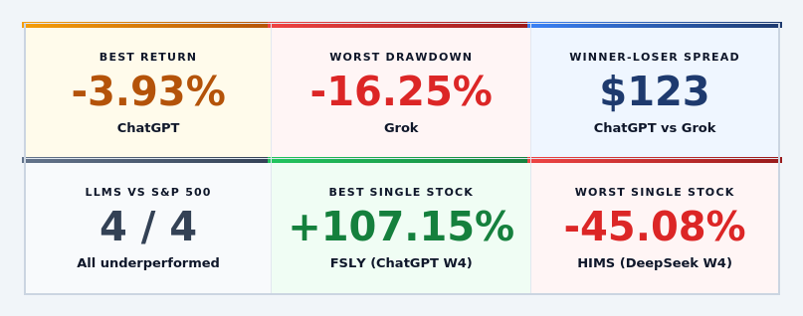
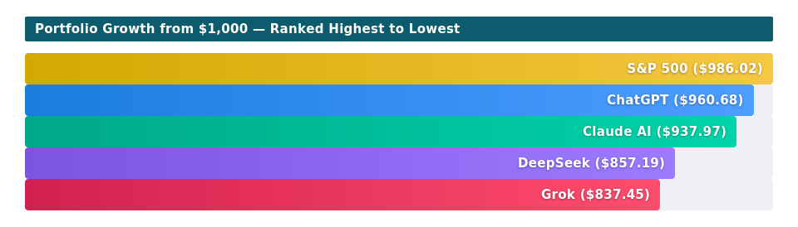
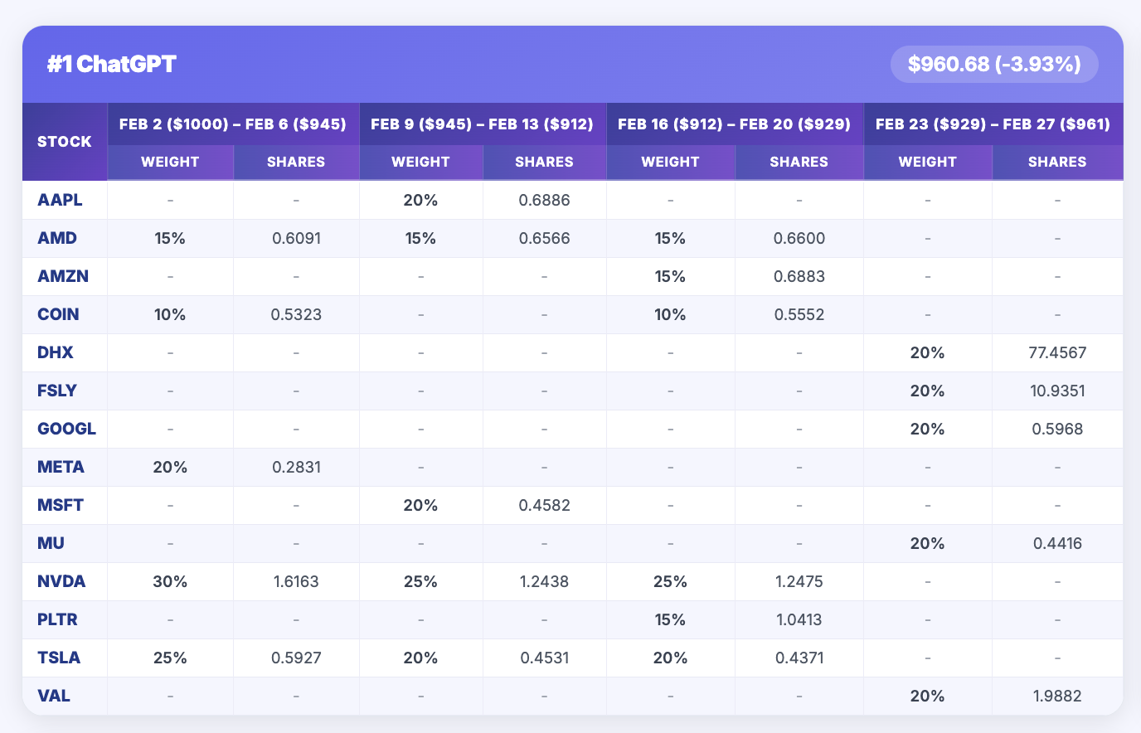
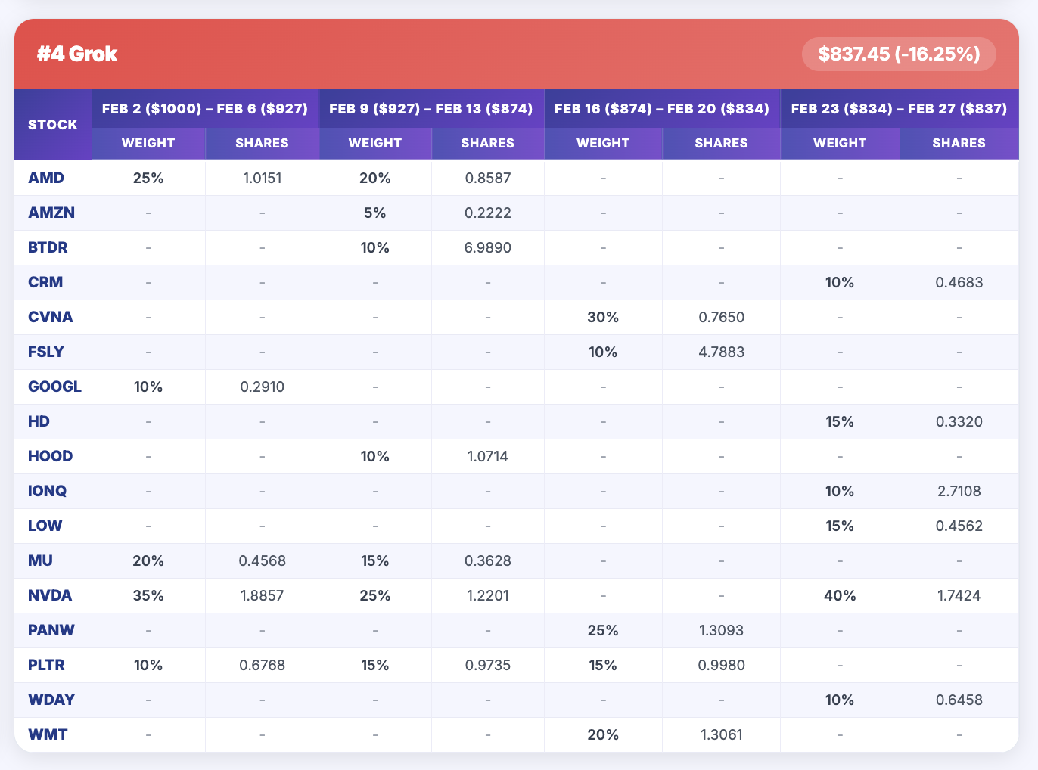
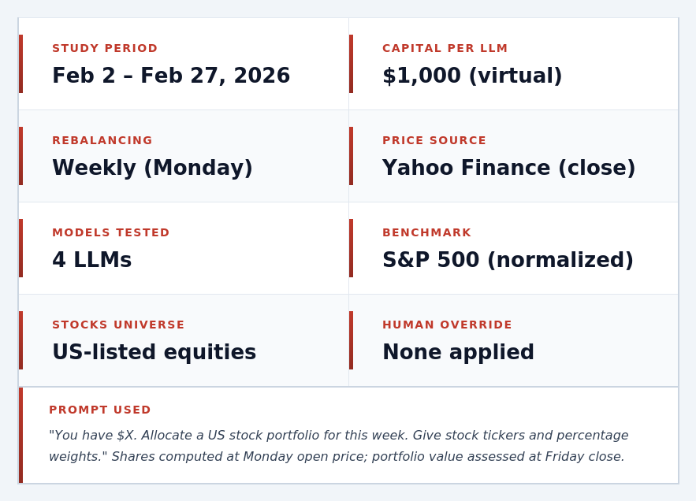
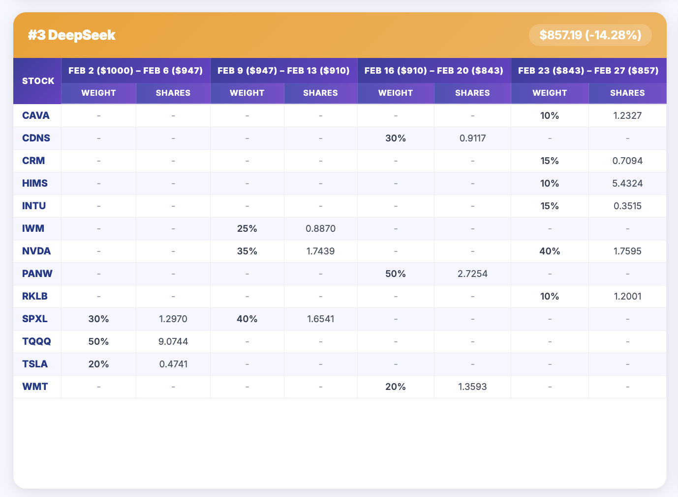
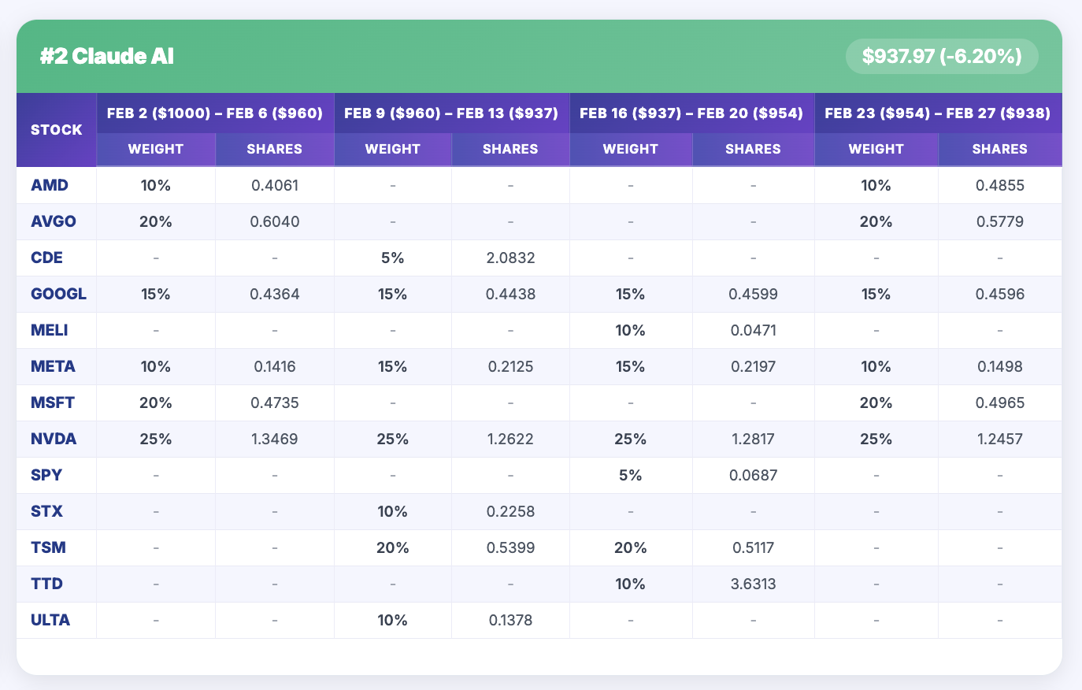
A LIVE PORTFOLIO BATTLE
Evaluating Claude AI, ChatGPT, DeepSeek & Grok on Real US Equity Markets — February 2026
Manasa Dontireddy , Dr. Orhan Erdem
📅 Feb 2 – Feb 27, 2026
💰 $1,000 Per LLM
📊 Rolling Weekly Strategy
🌐 Yahoo Finance Prices
📈 S&P 500 Benchmark
Key Findings : All four LLMs underperformed the S&P 500 in February 2026, yet ChatGPT was the clear leader — losing only -3.93% vs GROK's -16.25%, a $123 spread between best and worst on identical starting capital.
ABSTRACT & INTRODUCTION
CUMULATIVE PORTFOLIO VALUE vs S&P 500
SCAN HERE FOR LIVE UPDATES
ABSTRACT & INTRODUCTION
CUMULATIVE PORTFOLIO VALUE vs S&P 500
SCAN HERE FOR LIVE UPDATES
Large language models (LLMs) are increasingly used to assist in financial decision-making. But how effective are they at selecting stocks? This study puts four leading AI systems ( Deep Seek , Grok , Chat GPT, Claude AI ) head-to-head in a live, unmanipulated portfolio simulation over February 2026.
Each model received $1,000 in virtual capital and was prompted weekly to build a portfolio of US equities from scratch. No human guidance on picks was applied. Portfolios were tracked daily using Yahoo Finance closing prices, rebalanced every Monday, and benchmarked against the S&P 500 (SPY).
Results reveal stark differences in strategy, risk tolerance, and capital preservation. ChatGPT maintained the strongest performance with key contrarian picks - while Claude AI was most consistent and Grok and DeepSeek took aggressive leveraged positions that backfired.
CUMULATIVE PORTFOLIO VALUE vs S&P 500
KEY STATISTICS
KEY STATISTICS
CONCLUSION
LITERATURE REVIEW
LITERATURE REVIEW
ChatGPT ranked #1 overall, driven by high-conviction contrarian picks in Week 4 (FSLY +107%, VAL +65%) that overcame earlier losses decisively.
All 4 LLMs underperformed the S&P 500 (−1.40%), suggesting passive indexing still outperforms AI-driven active stock-picking even after accounting for Feb’s market decline.
NVDA was the consensus pick, held by every LLM in most weeks - suggesting strong shared conviction in AI-infrastructure stocks.
ChatGPT’s Week 4 recovery via FSLY (+107%) and VAL (+65%) shows LLMs can make high-conviction contrarian calls that pay off - propelling it to the top ranking.
Not a single LLM beat the S&P 500 during our test period (February 2026)
Recent studies suggest LLMs show promise in financial decision-making. Kirk (2025a, 2025b) demonstrates ChatGPT can construct diversified portfolios, finding distinct risk styles across models. Ko and Lee (2024) confirm ChatGPT-generated portfolios show greater diversity than random selection, improving portfolio efficiency. Romanko et al. (2023) show a ChatGPT-selected S&P 500 portfolio can outperform benchmark strategies in controlled settings. Lopez-Lira and Tang (2023) find ChatGPT sentiment signals positively predict short-term stock returns. However, none of these studies test multiple LLMs head-to-head under identical live capital constraints.
This study addresses that gap - running four leading LLMs simultaneously with $1,000 each on real U.S. equities over February 2026, with no human override, measuring actual daily performance against the S&P 500.
LITERATURE REVIEW
Weekly Portfolio Allocations by LLM - Weights (%), and Shares
Weekly Portfolio Allocations by LLM - Weights (%) & Shares
REFERENCES
METHODOLOGY & SETUP
Erdem O. (2025) Can ChatGPT Outsmart the Market? SSRN
Kirk, M. (2025a). Can ChatGPT build a financial portfolio? Financial Times.
Kirk, M. (2025b). Eight LLMs, one prompt: Who builds the best portfolio? Financial Times.
Lopez-Lira, T., & Tang, Y. (2023). Can ChatGPT forecast stock price movements? Working Paper
Ko, H., & Lee, J. (2024). Can ChatGPT improve investment decisions? From a portfolio management perspective. Finance Research Letters, 64, 105433.
Romanko, O., Narayan, A., & Kwon, R. H. (2023). ChatGPT-based investment portfolio selection. Operations Research Forum, 4(4), 91. Springer.
METHODOLOGY & SETUP

