Slide 1
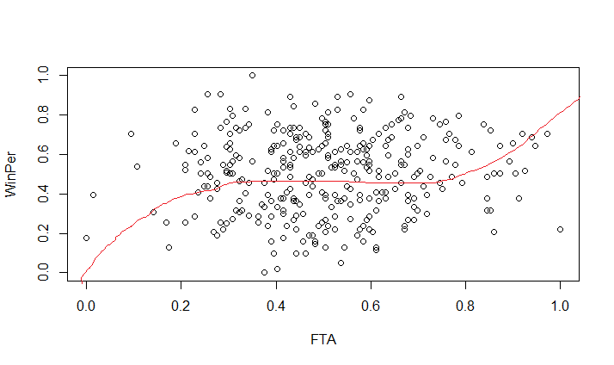
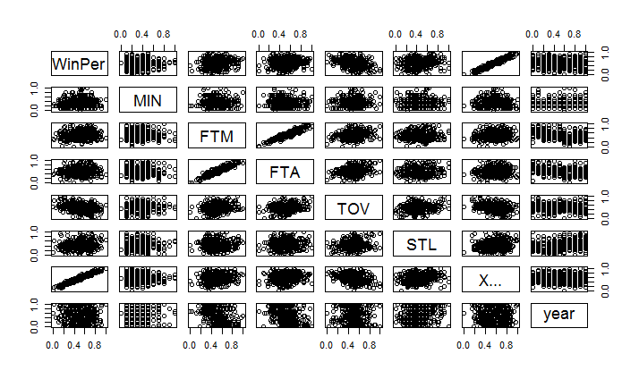
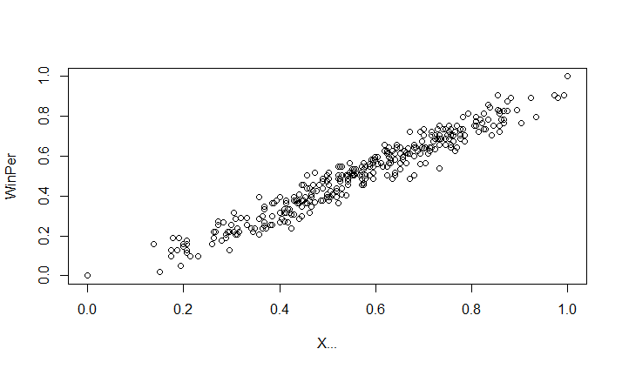
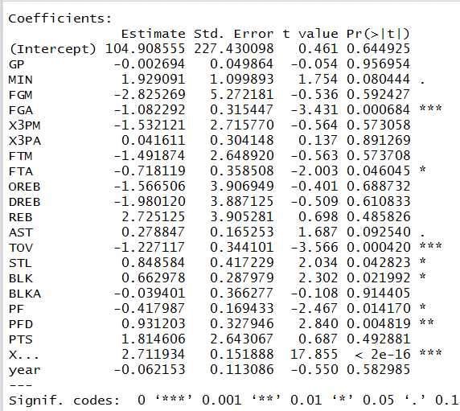
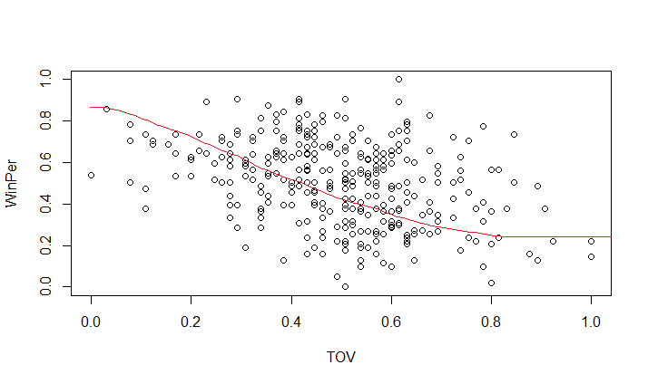
NBA WINNING PREDICTION USING LOGISTIC REGRESSION
Output Graphs:
We have used the pairs() function to find the relationship between the predictors
This the plot of Winning Percentage vs FTA (Free Throws Attempted)
Goal : To obtain the key factors which will effect the winning possibilities of an NBA team using Logistic Regression.
Ideology: We have taken open source NBA data into a .csv file and used this data for our predictions.
Steps Included:
Data Load
Normalisation on Data
Fitting the model using Logistic Regression
Listing out important predictors
Predicting the outcome
Plotting the graph
This the plot of Winning Percentage vs X (Change in Winning Percentage Over Years)
This the plot of Winning Percentage vs TOV (Turn Over's)
Conclusion: We have obtained the best model with least error rate using TOV, FTA, X predictors

