Slide 1

Smart TV Market Insights Through Web Scraping and
Data Analysis
A Comprehensive Analysis of Smart TV Market Dynamics Based on Flipkart Data
Presented by:
Manasa Siripurapu.

Slide 2
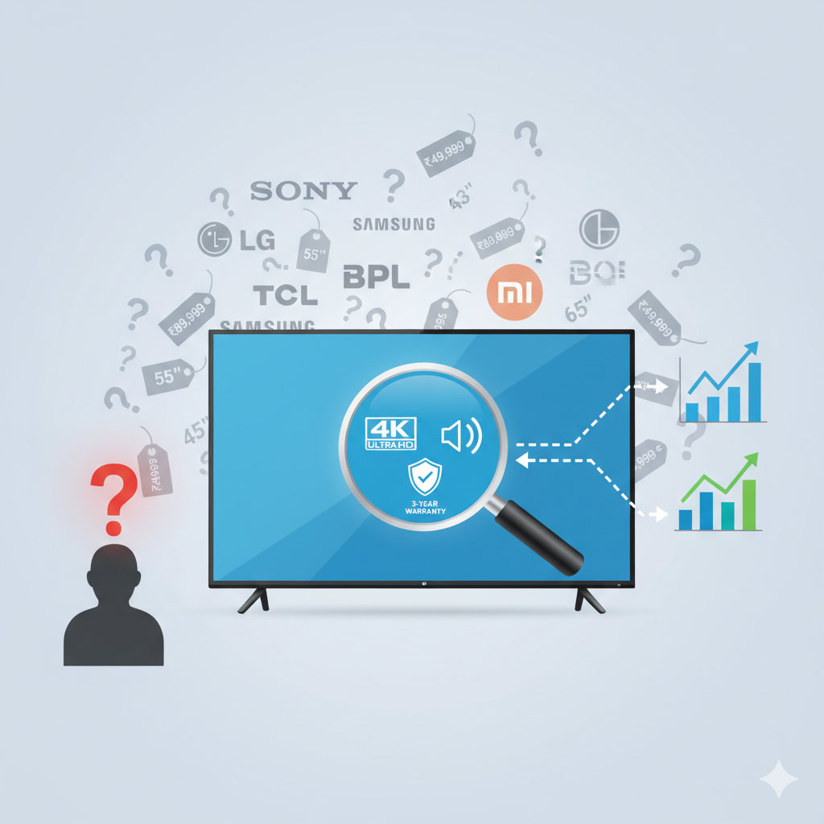
INTRODUCTION
The Smart TV market in India is highly competitive, with many brands offering models across different sizes, technologies, and price ranges.
Customers often struggle to find the best value for their budget due to too many options and inconsistent feature information.
From a business analytics perspective, it’s important to understand how features like display type, resolution, and sound output influence pricing and customer satisfaction.
This project analyses the Smart TV data from Flipkart to uncover market trends, feature impact, and consumer preferences.
The goal is to provide data-driven insights that can help both customers and businesses make informed decisions.

Slide 3
AGENDA

Slide 4

Objective of the Project
To extract, clean, and analyse Smart TV product data from Flipkart using Python-based web scraping.
To study how different product features (like display type, resolution, and sound output) influence price and customer ratings.
To identify dominant display technologies and examine price distribution across various market segments.
To uncover trends in product launches and sound configurations to understand the evolving Smart TV landscape.
To generate data-driven insights that help consumers make better purchase decisions and guide businesses in understanding feature–price relationships and customer expectations.

Slide 5
Web Scraping Methodology: Process Overview
Target Website
Flipkart Smart TV Product Listings
Libraries Used
requests, BeautifulSoup → for extracting and parsing web data
pandas, numpy → for structuring and cleaning data
re → for regular expressions and text cleaning
Technology Used:
Programming Language: Python
Tools: Jupyter Notebook
Method: Automated Web Scraping with HTML Parsing

Slide 6
PROCESS FOLLOWED:
1
Identified multiple Smart TV listing pages on Flipkart to capture a wide variety of brands and models.
2
Extracted key product attributes including:
Brand, Product Name, Display Size, Display Type, Sound Output, Warranty, Resolution, Original Price, Discounted Price, and Ratings
3
Used regular expressions to extract required data by identifying patterns.
4
Created a structured DataFrame using pandas, handled missing values, and converted data into appropriate formats (int, float, object)..
5
Combined all individual scraped pages into a single, cleaned dataset, ready for exploratory data analysis and visualization.

Slide 7
Data Summary: Scope of the Collected Dataset
616
12
50+
Total Records
Columns Analyzed
Brands
Number of unique Smart TV product entries collected.
Number of attributes extracted per product listing.
Diversity of manufacturers represented in the dataset.
The dataset provides a robust snapshot of the current Smart TV market, allowing for detailed comparative analysis across diverse product segments.

Slide 8
Key Dataset Attributes
The 12 extracted columns provide comprehensive data points covering core product identifiers, technical specifications, and consumer feedback.
Product & Brand Information
Brand: Manufacturer name
Model_Id: Unique product code
Product_Name: Full commercial name
Launch_Year: Year of market introduction
Technical Specifications
Display_inches: Screen size
Resolution: Screen pixel density (e.g., 4K, Full HD)
Display_Type: Panel technology (e.g., LED, OLED)
Sound_Output_Watt: Speaker output power
Pricing & Consumer Metrics
Original_Price: MSRP on the platform
Discounted_Price: Current selling price
Ratings: Average user rating (out of 5)
Warranty: Duration of product warranty

Slide 9
EXPLORATORY DATA ANALYSIS

Slide 10
Data Cleaning:
Removed duplicate records based on Model ID. Cleaned price columns by removing ₹ and “,” symbols and converted them to integer type.
Replaced blank and null values in the Warranty field with 0.
Extracted year from Launch_Year column (originally in YYYY-MM-DD format).
Standardized data types across all columns for uniformity.
Data Manipulation:
Created a new derived column Discount_Percentage to analyze price reductions.
Converted Display_inches from integer to object type to enable feature-based grouping.

Slide 11
UNIVARIATE
ANALYSIS

Slide 12
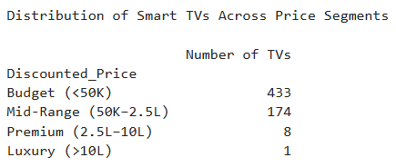
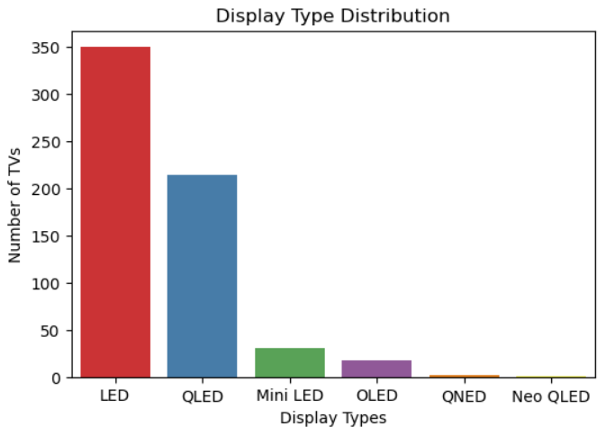
Smart TV Price Distribution Across Market Segments
Key Insights:
Majority of Smart TVs fall under the Budget Segment (<₹50K)
Mid-Range (₹50K–₹2.5L) segment forms the second largest share
Premium (₹2.5L–₹10L) TVs have very limited presence
Luxury Segment (>₹10L) is almost non-existent
Display Technology Trends in the Smart TV Market
Key Insights:
LED TVs dominate the market with the highest number of models.
QLED TVs form the second-largest share, mainly in mid to high price range.
Mini LED and OLED TVs are limited but growing gradually.
QNED and Neo QLED TVs have very few models - represent latest premium technology.

Slide 13
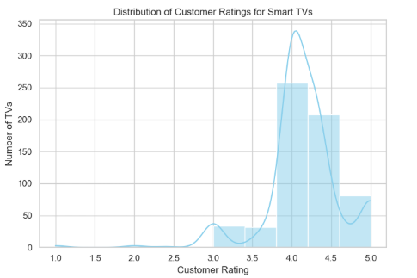
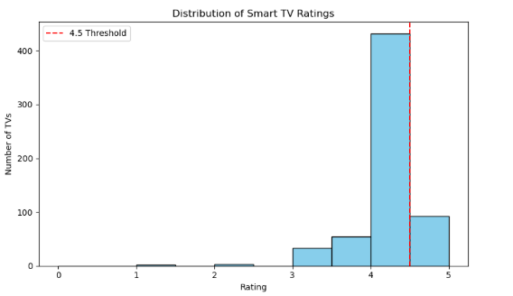
What is the distribution of Ratings across all smart TVs — and how many TVs are rated above 4.5?
Key Insights:
1.Customer satisfaction for the smart TVs in this dataset
is generally very high.
2.The distribution of ratings is heavily left-skewed,
meaning most products receive high scores.
3.The most frequent rating is around 4.0 to 4.2,
with significant clusters also rated around 4.5 and 5.0.
4.Very few TVs received ratings below 3.5.
What is the overall customer satisfaction level based on ratings?
Key Insights:
The histogram confirms high customer satisfaction, with the vast majority of ratings falling between 3.8 and 5.0.
Approximately 70 TVs in the dataset fall into the top-performing category with a rating above 4.5.

Slide 14
BiVARIATE
ANALYSIS

Slide 15
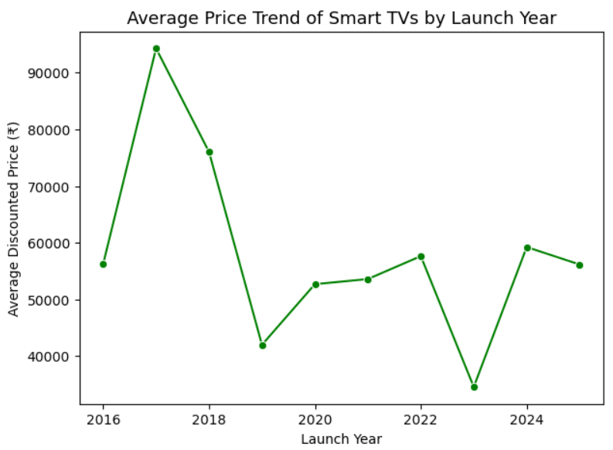
Price Trends Across Different Launch Years
Key Insights:
Smart TVs were most expensive around 2017–2018
Noticeable drop in prices after 2018
Prices stayed stable between 2020 and 2021
Slight price increase in 2024 model.

Slide 16
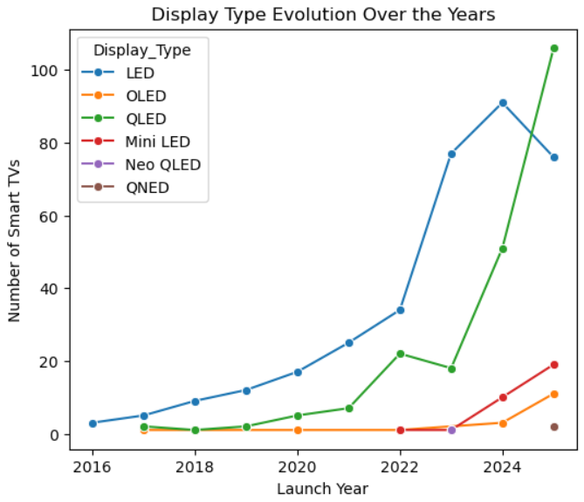
Evolution of Display Quality in Smart TVs Over the Years
Key Insights:
LED TVs are dominant across all years
QLED TVs grew strongly after 2022
OLED and Mini LED are slowly rising
New display types like Neo QLED and QNED just started

Slide 17
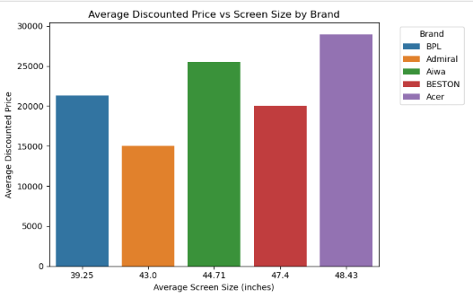
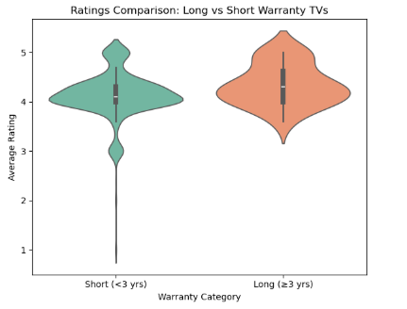
How does price vary across screen sizes within each brand?
Key Insights:
Generally, larger average screen sizes correlate with higher average prices (e.g., Acer).
This correlation isn't perfect, as Admiral offers a 43.0" size for the lowest price in the group.
Price isn't determined by size alone; BPL's small 39.25" TV costs more than Admiral's (43.0") and BESTON's (47.4").
Do TVs with longer warranties receive better ratings?
Key Insights:
The data strongly suggests a link between warranty length and customer satisfaction.
Short-warranty TVs (<3 years) have widely spread ratings (3.0-5.0) centered around 4.2.
Long-warranty TVs (≥3 years) have a higher median rating (around 4.5) and a tighter, more consistent distribution, indicating they are more reliable high-performers.

Slide 18
MuLtiVARIATE
ANALYSIS

Slide 19
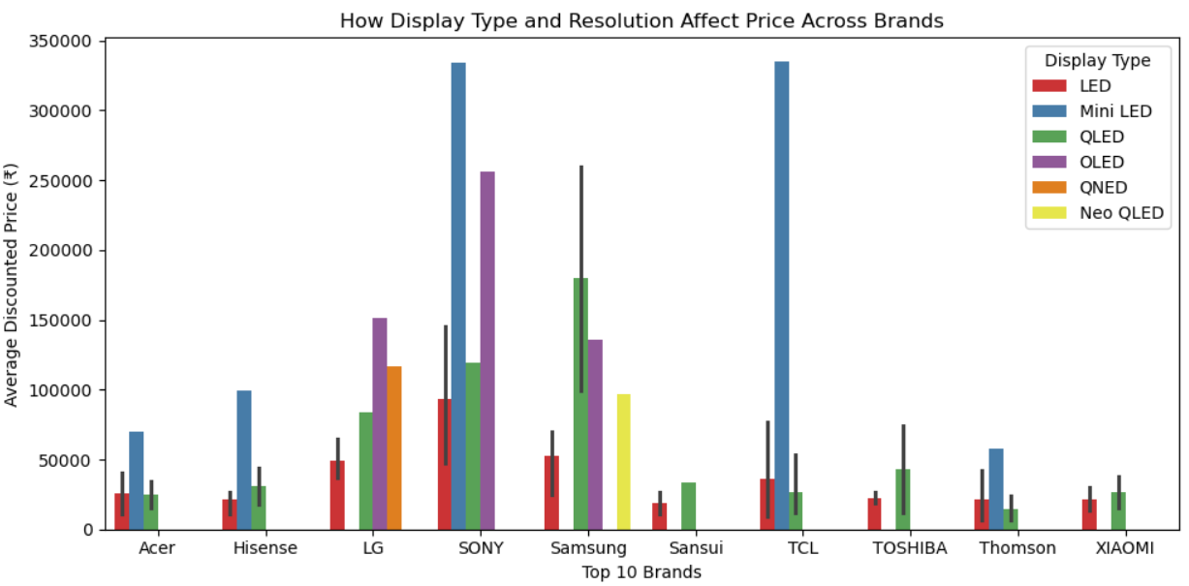
Impact of Display Type and Resolution on Price Across Top Brands
Key Insights:
Mini LED and OLED TVs are the most expensive.
Sony and TCL have the highest-priced models overall.
LG and Samsung offer both budget and premium options.
Budget brands mostly stick to LED or QLED.
QLED TVs are mid-range across brands.
Display type plays a major role in pricing.

Slide 20
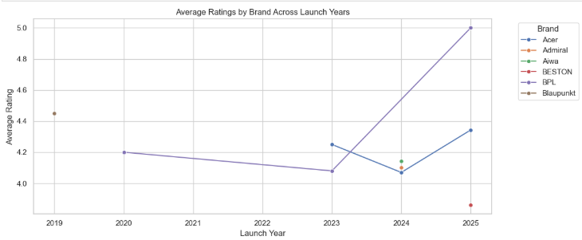
Which combination of brand, launch year, and rating reveals consistent customer satisfaction over time?
Key Insights:
For this analysis we have taken the first top 10 brands and year combinations in the data (primarily Adsun, BPL, and Blaupunkt), shows:
BPL demonstrated strong, consistent satisfaction, with its average rating holding steady around 4.2-4.3 between 2018 and 2021.
Blaupunkt also showed high consistency in its 2021 and 2022 models, with ratings around 4.3-4.4.
Adsun experienced a slight decline in average ratings from 2019 to 2021.

Slide 21
Conclusion
Key Findings:
The Smart TV market is dominated by budget LED models (<₹50K).
Display technology is the main price driver — Mini LED and OLED are the most premium.
Most models launched in 2024–2025, showing rapid market refresh.
High customer satisfaction (ratings between 3.8–5.0).
TVs with longer warranties (3+ years) receive higher and more consistent ratings.
Suggestions for Flipkart:
Highlight key features clearly (display type, sound output, warranty) to help buyers make faster decisions.
Promote longer warranty offers — customers associate them with higher trust and satisfaction.
Use feature-based filters and comparison tools (e.g., “Best 4K TVs under ₹50K”) to simplify browsing.
Feature mid-range QLED TVs more — they balance price and quality and have strong sales potential.
Focus marketing on new launches and feature upgrades rather than only discounts.

Slide 22
Conclusion
Suggestions for Customers
Don’t rely only on price — check display type and warranty for long-term value.
LED TVs are great for budget buyers, while QLED or OLED are better for premium experience.
Look for 3+ year warranties — these models tend to have better reliability and user satisfaction.
Compare sound output if you prefer cinematic or loud viewing experiences.

Slide 23

THANK YOU

