Slide 1
CAPSTONE PROJECT ON OPENCART
UNDER THE GUIDENCE OF MRS. VAISHALI SONANIS MAM

Slide 2
INTRODUCTION
The Tutorials ninja(“https://tutorialsninja.com/demo/”) demo site is an e-commerce platform built using OpenCart. It serves as a showcase website to demonstrate online shopping workflows and highlight the features of an e-commerce system.
The site is organized into multiple product categories, it provides easy navigation through menus and footer links for quick access to essential sections.
The website includes complete e-commerce functionalities such as user account creation and login, shopping cart management, checkout process, and support for multiple currency options.
The design offers a clean and user-friendly layout with well-structured product displays.

Slide 3
RESPONSIBILITIES
Analyzed requirements & created test scenarios for Tutorialsninja different modules like Registration, Login, Search, Adding and Wishlist items to Cart, Change Currency, My account management.
Conducted negative testing by giving invalid input credentials like invalid usernames, passwords and contact details.
Tested UI elements including buttons, search bar, dropdowns, headers and footers etc.
Identified defects and Prepared Test reports.

Slide 4
OVERVIEW
Tutorials ninja:
Tutorials ninja is a demo e-commerce website built on the OpenCart platform.
It showcases a wide range of products such as laptops, phones, cameras, and accessories.
The site supports essential e-commerce flows including account creation, login, shopping cart, and checkout.
It provides features like product search, wishlist, multiple currency options, and order management, making it an ideal platform for testing and learning e-commerce functionalities.

Slide 5
MODULES
MODULE 1: REGISTRATION
Check all the functionalities on the account creation with fields for personal details like First Name, Last Name, Phone number, email, password, Conform Password, newsletter subscription, Agree to Terms and conditions.
MODULE 2: LOGIN
Login functionality allows users to sign in with registered credentials like email and password.
MODULE 3: SEARCH BAR
Provides product search functionality with keyword-based results. Includes category navigation, filters, and sorting options for easier product discovery.

Slide 6
MODULES
MODULE 4: ADD TO CART
Enables users to add products to the shopping cart directly from product listings or detail pages.
Cart view displays product details, quantity updates, price calculations, and checkout options.
MODULE 5: WISHLIST
Allows users to save favorite products for future reference.
Wishlist can be managed from the account section and products can be moved to the cart.

Slide 7
MODULES
MODULE 6: CHANGE PASSWORD
Provides functionality to update the account password from the account settings section.
Includes password confirmation for security before changes are applied.
MODULE 7: CHANGE CURRENCY
Supports multiple currencies such as USD, GBP, and EUR.
Currency selector updates product prices and checkout values dynamically.
MODULE 8: MENUS
Top navigation menu includes categories like Desktops, Laptops & Notebooks, Components, Phones & PDAs, Cameras, and MP3 Players.
Dropdown menus allow structured browsing of product subcategories.

Slide 8
MODULES
MODULE 9: CONTACT FORM
Provides a form for users to submit inquiries with name, email, and message fields.
Messages are sent to site administrators for customer support.
MODULE 10: FOOTER
Contains quick links such as About Us, Delivery Information, Privacy Policy, Terms & Conditions, Contact Us, Returns, Site Map, Brands, and Specials. Also includes newsletter subscription and information sections.

Slide 9
DEFECTS
Thank you for registering' email is not received to the registered email address after registering an account.
Telephone' field in 'Register Account' page is accepting the spaces and not showing warning message. User is able to register an account by providing an invalid phone number.
Leading and Trailing spaces are accepted by the text fields in the 'Register Account' page.
In checkout process it showing that all products are out of stock.

Slide 10
DEFECT_IDENTIFIER: D_001
Defect Summary: First Name and Last Name fields are accepting leading and trailing spaces, which should not be allowed.
Test_ID: TC - 001
Test Case Name: Verify that First Name and Last Name fields do not accept leading or trailing spaces.
Module Name: Registration
Reproducible:
Open Tutorials ninja demo site and navigate to the Registration page.
Enter a space before and after the first and last name and submit the registration form.

Slide 11
DEFECT_IDENTIFIER: D_001
Expected Result: The system should trim leading and trailing spaces from First Name and Last Name fields or display a validation error.
Actual Result: The system accepts names with leading and trailing spaces without any validation error.
Severity: Medium
Priority: High
Raised By: Manasa Aduvala
Environment: Windows 10/11, Chrome browser, Tutorialsninja Demo Site.
Attachments: Screenshots of Registration form showing First Name and Last Name with spaces being accepted.
Reported To: Vishali Mam(Trainer)

Slide 12
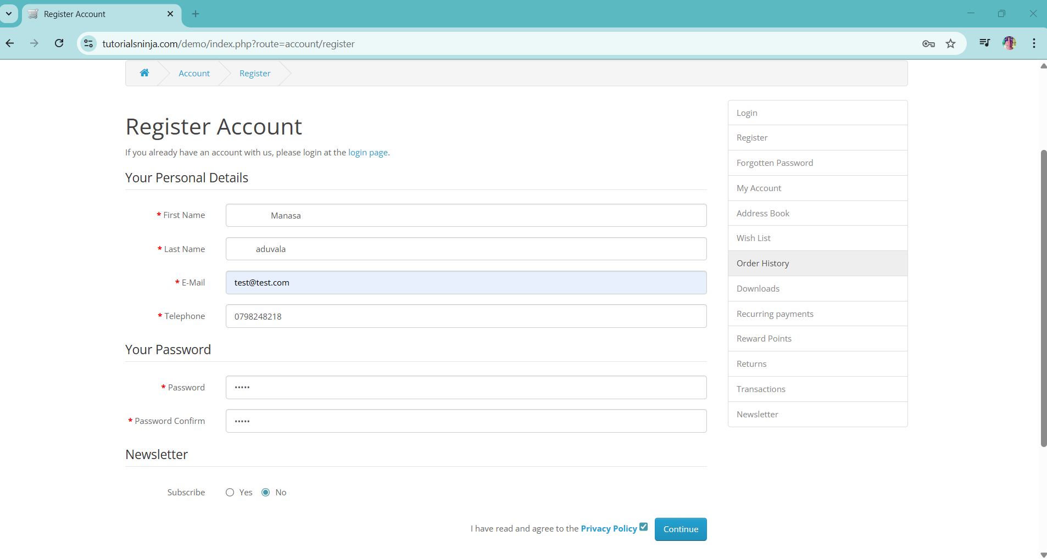

Slide 13
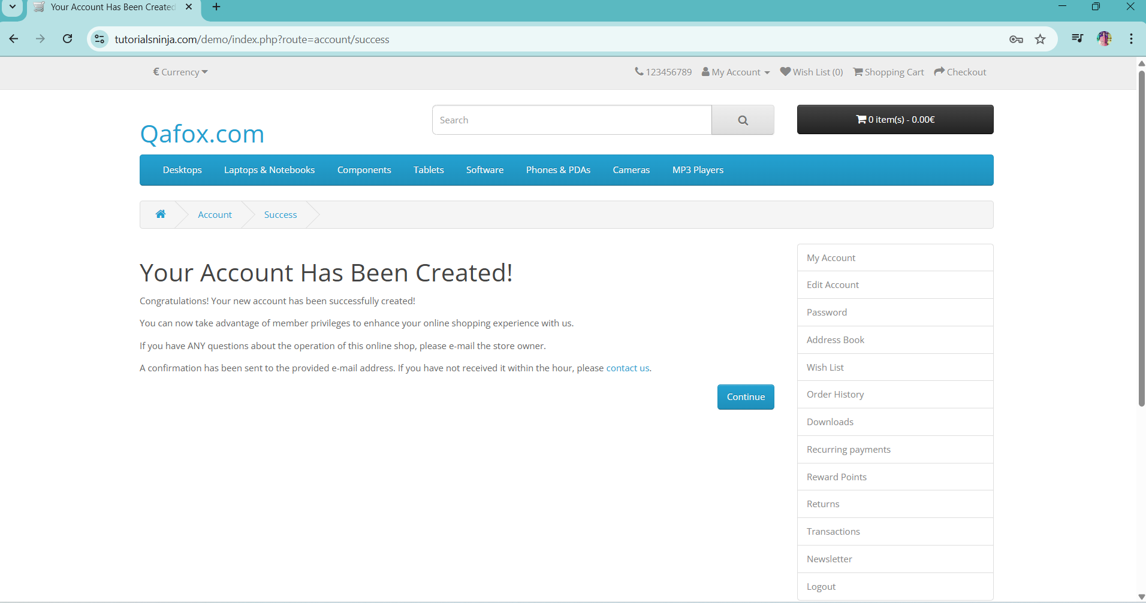

Slide 14
DEFECT_IDENTIFIER: D_002
Defect Summary: Invalid phone number (all zeros) is accepted during registration
Test_ID: TC - 002
Test Case Name: Verify user telephone field is accepting phone number with all zero values eg:0000000000
Module Name: Registration
Reproducible:
Open the registration page
Enter valid details in all fields expect the Telephone field.
Enter all zeros in the Telephone filed eg:- 0000000000
Click on continue button.

Slide 15
DEFECT_IDENTIFIER: D_002
Expected Result: The system should display a validation error and not allow registration with an invalid telephone number.
Actual Result: The form accepts all zeros in the Telephone field and allows the user to register successfully.
Severity: Major
Priority: High
Environment: Windows 10/11, Chrome browser, Tutorialsninja Demo Site.
Attachments: Screenshot of registration form with zeros in the Telephone field.
Reported To: Vishali Mam(Trainer)

Slide 16
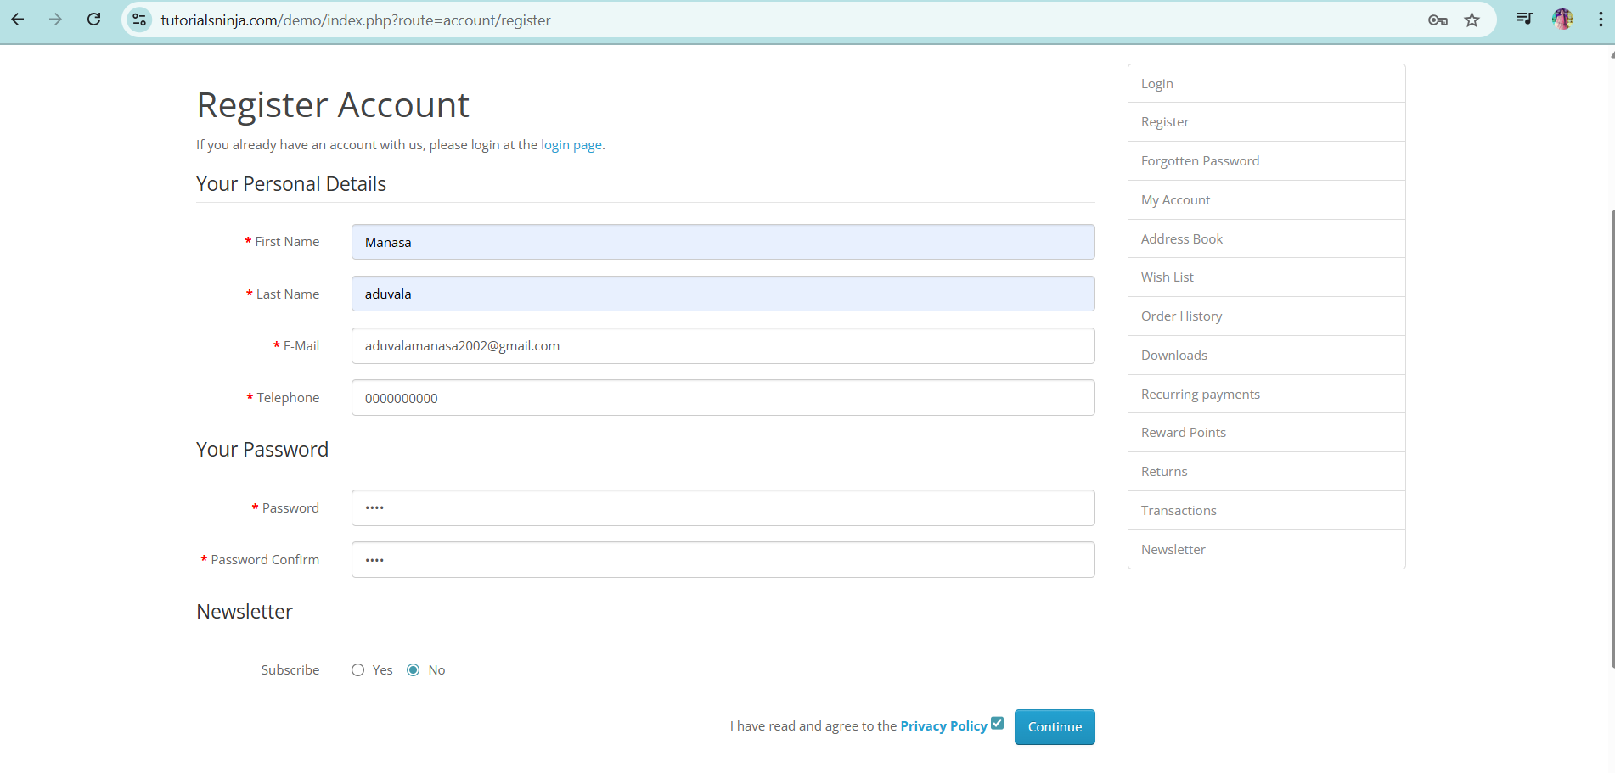

Slide 17
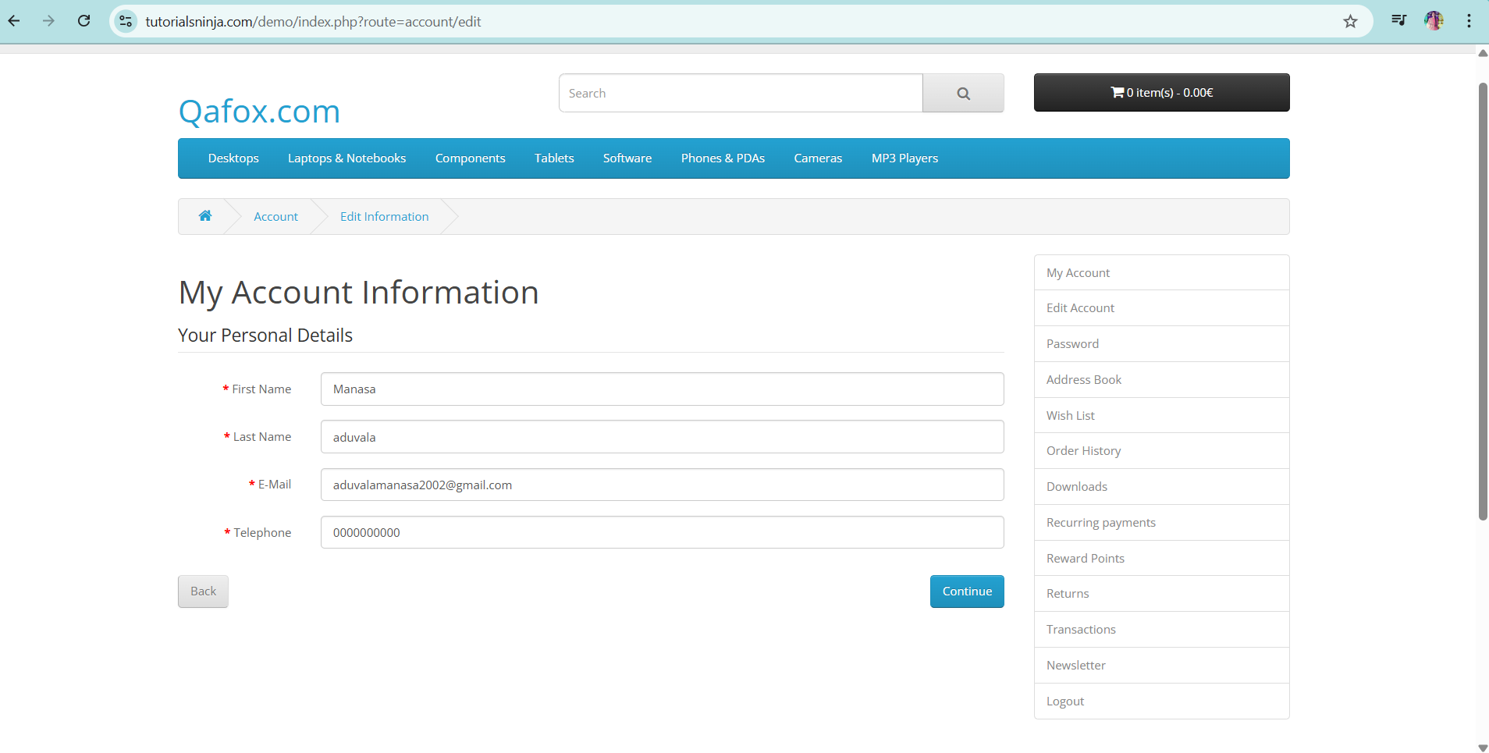

Slide 18
DEFECT_IDENTIFIER: D_003
Defect Summary: Showing all products are out of stock during checkout process.
Test_ID: TC - 003
Test Case Name: Verify checkout process after adding products to cart.
Module Name: Checkout Process
Reproducible:
Login and add items to cart.
Then click on checkout process.
Observe the whether checkout is proceeding further or not.
Add different items and verify the checkout process.

Slide 19
DEFECT_IDENTIFIER: D_003
Expected Result: The checkout page should correctly display the stock status of each product and allow purchase if the product is in stock.
Actual Result: All products are displayed as “Out of Stock,” even if they are available, preventing users from completing the purchase.
Severity: Major
Priority: High
Environment: Windows 10/11, Chrome browser, Tutorialsninja Demo Site, login credentials
Attachments: Screenshot of the checkout page showing products marked as out of stock.
Reported To: Vishali Mam(Trainer)

Slide 20
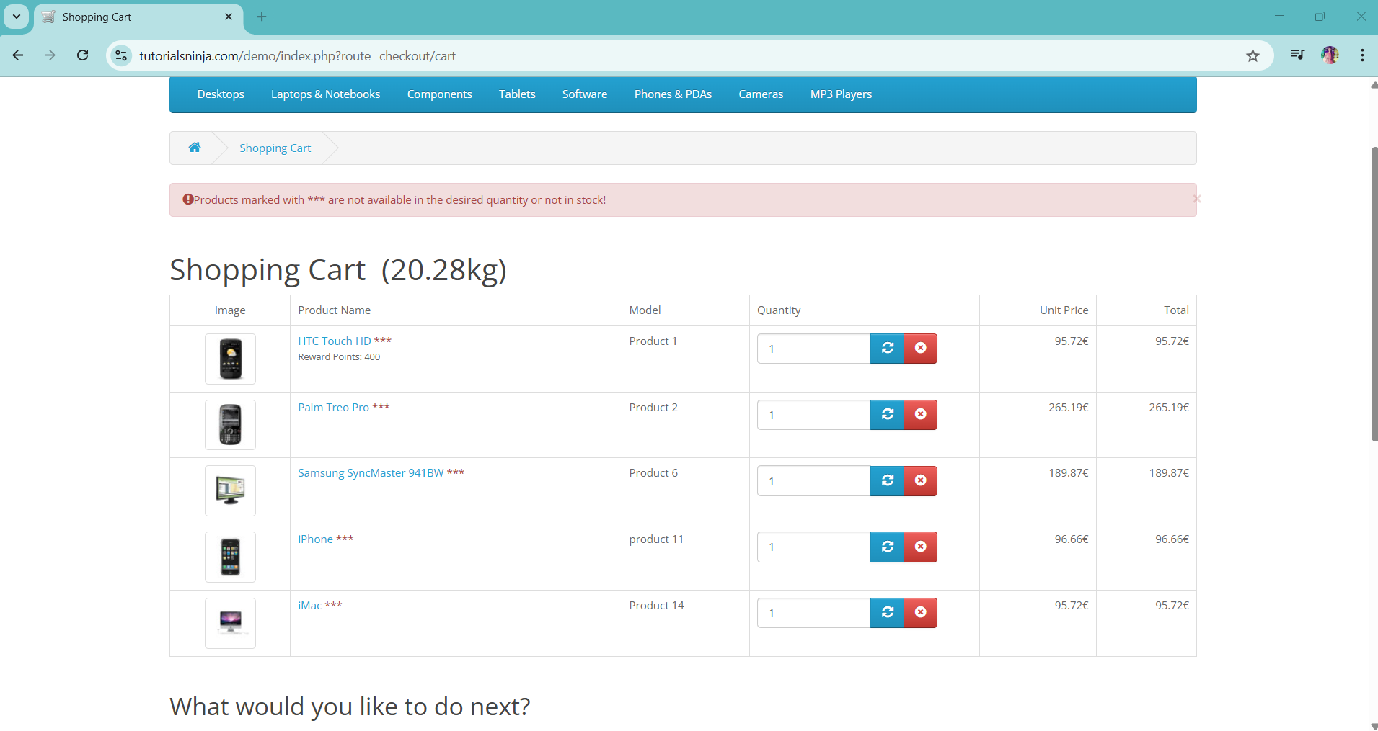

Slide 21
Challenges
Registration form lacked proper input validation, requiring manual verification for edge cases like all zeros.
Checkout testing was blocked due to incorrect stock status, preventing end-to-end purchase verification.
Ensuring defects were consistently reproducible required cross-verifying product stock across different pages and sessions.

Slide 22
Experience
During testing, I identified critical issues such as the registration form accepting invalid phone numbers (all zeros) and checkout incorrectly showing all products as out of stock. These defects directly impacted user experience and the purchasing workflow.
By documenting these defects with detailed steps to reproduce, expected vs actual results, and supporting screenshots, I learned how data validation and inventory synchronization are crucial for maintaining application reliability and customer trust.
This experience helped me understand the importance of prioritizing defects based on severity and business impact and enhanced my ability to document, present, and explain technical findings in a clear way.

Slide 23
THANK YOU

