Slide 1
MINI PROJECT ON eBay
UNDER THE GUIDENCE OF MRS. VAISHALI SONAWANE MAM

Slide 2
INTRODUCTION
eBay is a global online marketplace where individuals and businesses can buy and sell a wide variety of items, both new and used, through auctions or fixed-price listings.
The eBay service is accessible via websites and mobile apps.
eBay can be used by individuals, companies and governments to purchase and sell almost any legal, non-controversial item.

Slide 3
RESPONSIBILITIES
Analyzed requirements & created test scenarios for different eBay modules like Search, Product Details, Adding items to Cart.
Conducted negative testing by giving invalid input credentials like invalid usernames and passwords.
Tested UI elements including buttons, search bar, dropdowns, headers and footers etc.
Identified defects and Prepared Test reports.

Slide 4
OVERVIEW
eBAY:
eBay is a global e-commerce marketplace connecting buyers and sellers worldwide.
Offers a wide range of categories like electronics, fashion, home, laptops, etc.
Supports multiple selling formats such as fixed – price listings and buy – it now.
Provides features like secure payments, seller ratings and global shipping programs.

Slide 5
MODULES
MODULE 1: SIGN IN PAGE
Check all the functionalities on the User Module which included registration, login, profile management, and account settings.
MODULE 2: SEARCH BAR
Check all the functionalities on the Product/Search Module which included product search, filters, sorting, and categories.
MODULE 3: PRODUCT DESCRIPTION
This module includes the product description, images, pricing, reviews, and related items.

Slide 6
MODULES
MODULE 4: CART
The add to Cart or Wishlist Module which includes add or delete items, update quantity.
MODULE 5: CHANGE LOGIN NAME
The Change login name module is used to change the username.
MODULE 6: DROP DOWN
Used to check the functionalities of UI elements like dropdowns

Slide 7
MODULES
MODULE 7: SHOP BY CATEGORY
Shop by Category is basically grouping products into meaningful sections so that users can easily find what they want.
MODULE 8: HELP & CONTACT
This module is used to get personalized help and see your recent orders
MODULE 9: SELL
This module is used to sell their own products or resell the other’s products to make business.
MODULE 10: HEADER AND FOOTER
Show all valid details on header and footer like ,logo, contact us, sign in, add to cart, all information about site like terms and conditions, about us, contact us.

Slide 8
DEFECTS
When I searched for “Electronic Appliances” on the site, the search results displayed irrelevant items such as stickers instead of actual appliances. The expected behavior is that the system should return only relevant products like TVs, refrigerators, or other electronic appliances. This defect is critical because it misleads users, reduces trust in the search functionality, and negatively impacts the overall conversion rate.

Slide 9
DEFECT_IDENTIFIER: D_001
Defect Summary: Searching for Electronic Appliances returns irrelevant results like stickers instead of actual appliances.
Test_ID: TC - 001
Test Case Name: Verify relevant results are displayed for category keyword “Electronic Appliances”
Module Name: Search Bar
Reprocducible:
Open eBay homepage
Enter “Electronic Appliances” in the search bar and click enter
Observe the results.

Slide 10
DEFECT_IDENTIFIER: D_001
Expected Result: Results should list electronic appliances like TVs, refrigerators, laptops, mixers, etc. relevant to the query.
Actual Result: Results include unrelated items such as stickers/decals instead of electronic appliances.
Severity: Major
Priority: High
Raised By: Manasa Aduvala
Environment: Windows 10/11, Chrome browser, eBay.com login details.
Attachments: Screenshot of search results showing stickers for the query “Electronic Appliances”.
Reported To: Vishali Mam(Trainer)

Slide 11
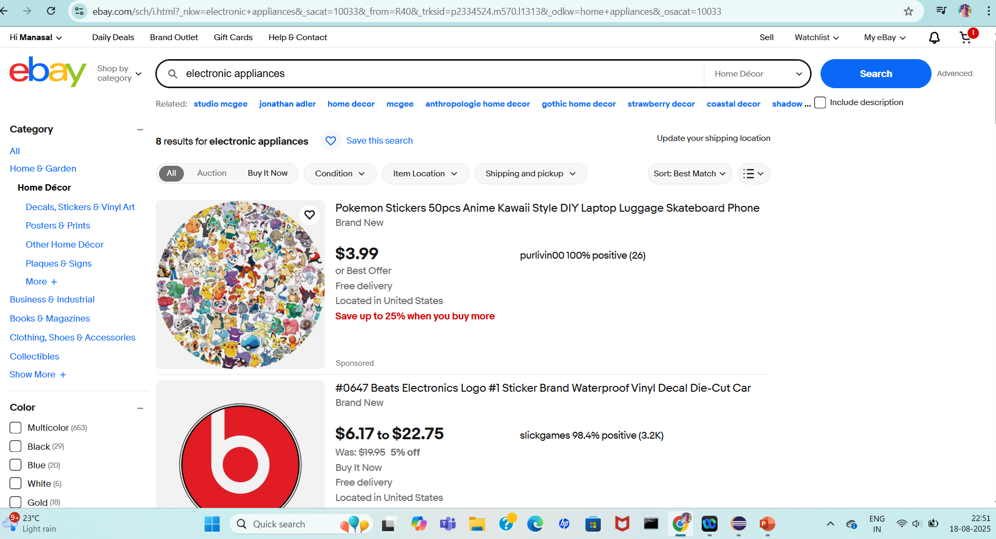

Slide 12
DEFECT_IDENTIFIER: D_002
Defect Summary: Unable to increase product quantity beyond 3 in cart for the same item e.g., waterproof camera.
Test_ID: TC - 002
Test Case Name: Verify user can increase the quantity of a product in the cart according to availability.
Module Name: Cart / Add to Cart
Reprocducible:
Open eBay homepage
search for waterproof camera and add it in cart
in the cart try to increase the quantity to 4.

Slide 13
DEFECT_IDENTIFIER: D_002
Expected Result: User should be able to increase the product quantity to 4 (or more) if stock is available.
Actual Result: Cart only allows a maximum of 3 items, even when the user tries to increase to 4.
Severity: Major
Priority: High
Environment: Windows 10/11, Chrome browser, eBay.com, login credentials
Attachments: Screenshot of cart showing only 3 quantities allowed when user attempts to add 4.
Reported To: Vishali Mam(Trainer)

Slide 14
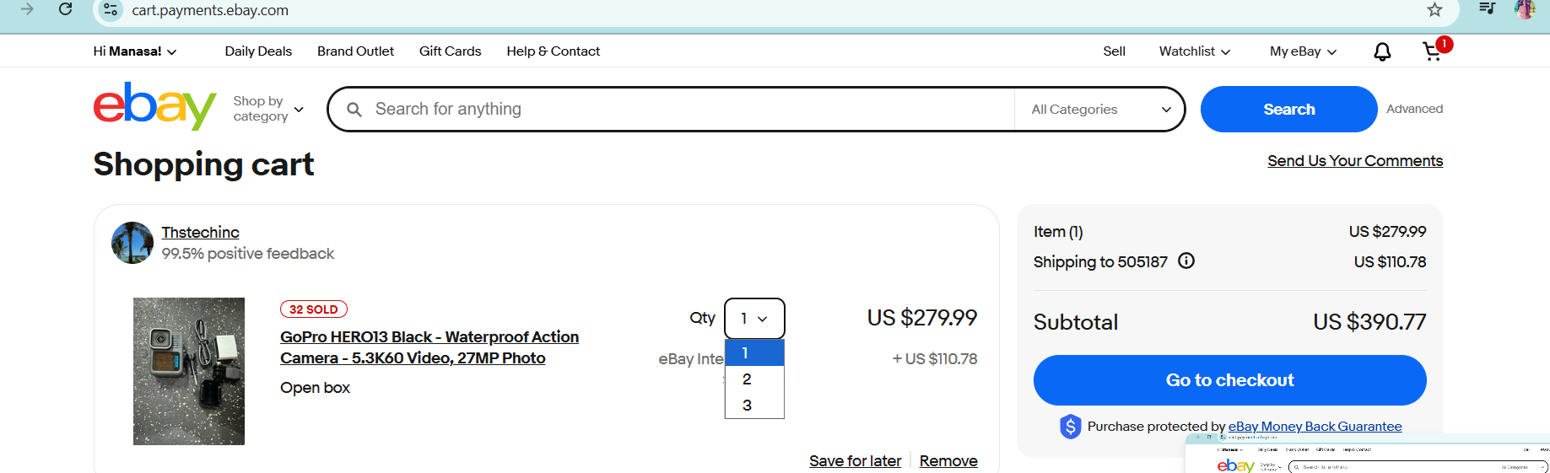

Slide 15
Challenges
Search results and product availability keep changing in real-time, making it difficult to reproduce test cases consistently.
Sometimes captcha verifications interrupted automated test flows.
While Search and finding Product Details it taking longer to load specially when multiple filters are applied.

Slide 16
Experience
During testing, I identified issues like irrelevant search results, cart quantity mismatches, and UI misalignments, which directly affect customer experience and usability.
By documenting these defects with clear steps, expected vs actual results, and screenshots, I learned how even small issues like a search typo’s can have a major impact on sales and customer satisfaction.
This experience helped me understand the importance of prioritizing defects based on severity and business impact.
This enhanced my ability to document, present, and explain technical findings in a clear way.

Slide 17
THANK YOU

