Slide 1
E-Commerce Sales Analysis for Data-Driven Decision Making
Prepared By: Manasa P

Slide 2
Project Overview
• Sales Analysis
• Customer Segmentation
• Sales Forecasting
• Business Opportunities

Slide 3
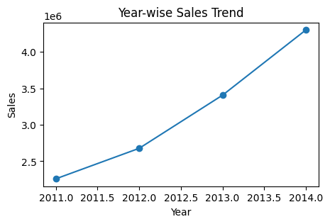
Year-wise Sales Trend
• Sales increased steadily from 2011 to 2014
• 2014 recorded highest sales

Slide 4
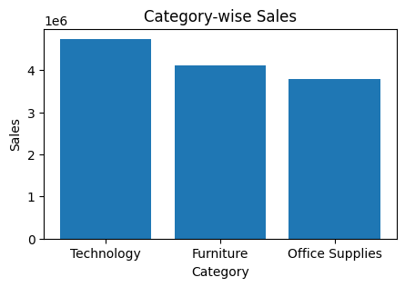
Category-wise Sales Analysis
• Technology generated highest revenue
• Furniture showed strong growth
• Office Supplies maintained stable demand

Slide 5
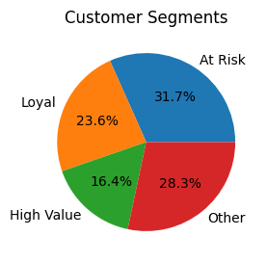
Customer Segmentation
• Loyal and At-Risk customers identified
• High-value customers contributed major revenue

Slide 6
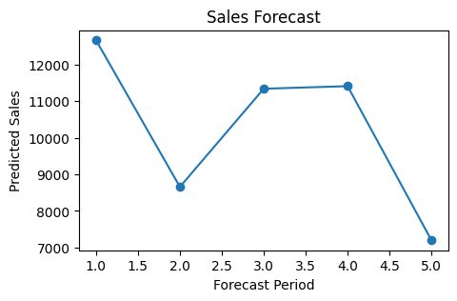
Sales Forecasting
• ARIMA model applied
• Future sales trends predicted
• Forecasting supports inventory planning

Slide 7
Business Opportunities
• Expand technology products
• Promote premium furniture
• Improve customer retention
• Use targeted marketing campaigns

Slide 8
Recommendations
• Focus on high-demand products
• Launch loyalty programs
• Improve regional marketing
• Use forecasting for inventory optimization

Slide 9
Conclusion
• Business insights were generated using analytics
• Forecasting improved strategic planning
• Customer segmentation improved business understanding

