Slide 1
Employee Attrition & Workforce Insights
POWER BI PROJECT PRESENTATION
Presented By
MANASA K V

Slide 2
AGENDA
Project Overview
Dashboard Development
1
5
Dataset Summary
Dashboard Analysis
2
6
Data Cleaning & Transformation
Key Insights
3
7
Data model design
Roadmap
4
8

Slide 3
Dataset Summary
📊 Power BI Analytics HR insights using Power BI dashboards
👥 Workforce Analysis Employee demographics & attrition metrics
📁 Dataset Source Kaggle dataset in Excel format
💡 Business Insights Retention and workforce planning analysis

Slide 4
Power Query Data Transformation Steps
Imported the HR dataset from Excel into Power BI
Enabled automatic data type detection
Cleaned employee records for analysis
Renamed columns for better readability
Converted columns into appropriate data types (Text, Whole Number, Date)
Removed unnecessary or unused columns
Standardized categorical values for consistency
Prepared employee attrition and workforce data for reporting
Loaded transformed data into Power BI for dashboard visualization

Slide 5
Data Model Design
Created a centralized HR data model in Microsoft Power BI
Used the HR Employee dataset as the primary fact table
Organized employee information into structured fields and categories
Established relationships between employee attributes and HR metrics
Connected department, job role, gender, and attrition data for analysis
Applied one-to-many relationships where required
Optimized the model for fast dashboard performance
Enabled filtering and drill-down analysis across visuals
Supported KPI calculations and interactive reports
Improved data consistency and analytical accuracy

Slide 6
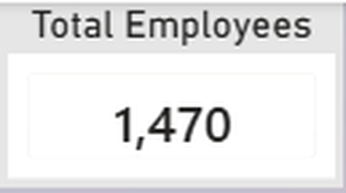
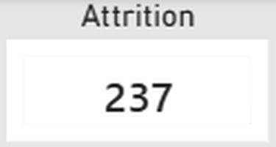
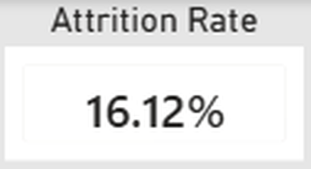
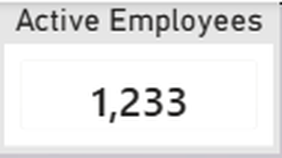
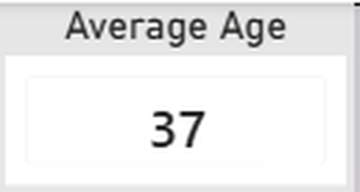
1. KPI Cards
HR ANALYTICS & ATTRITION DASHBOARD
Total Employees – 1,470 Shows the total number of employees in the organization.
Attrition – 237 Represents employees who left the company.
Attrition Rate – 16.12% Indicates the percentage of employee turnover.
Active Employees – 1,233 Displays the current active workforce.
Average Age – 37 Represents the average employee age.

Slide 7
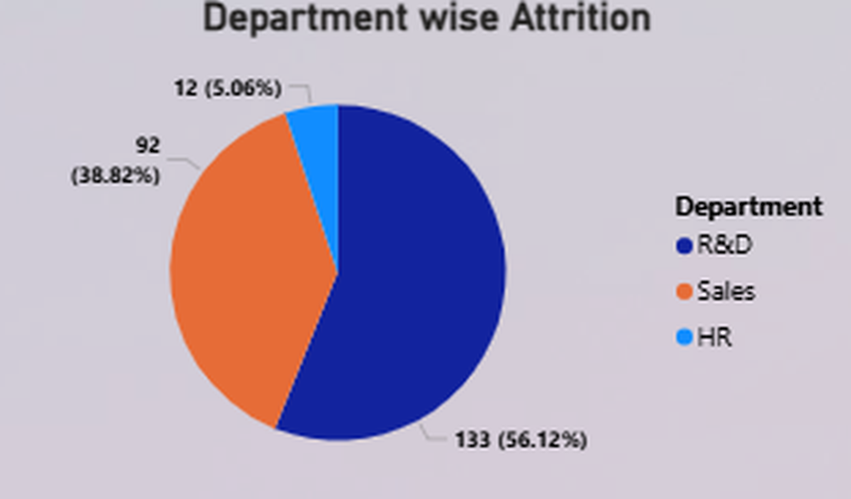
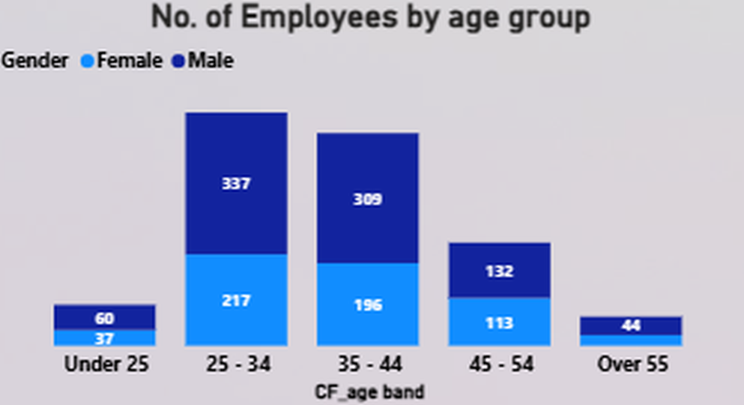
3. Employees by Age Group (Bar Chart)
2. DEPARTMENT-WISE ATTRITION (PIE CHART)
The chart shows attrition distribution across departments.
R&D department has the highest attrition.
Sales department shows moderate attrition.
HR department has the lowest attrition.
Displays employee distribution across different age groups.
Majority of employees belong to the 25–34 and 35–44 age categories.
Fewer employees are above 55 years.
Applied age-group sorting for clear workforce analysis.

Slide 8
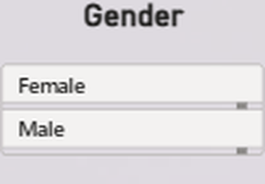
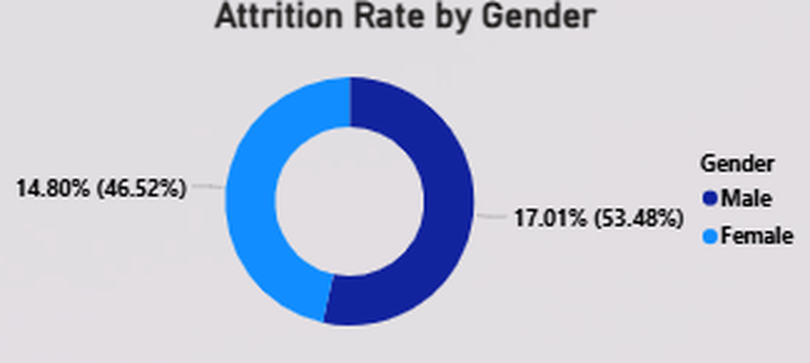
4. GENDER FILTER (SLICER)
Allows users to filter dashboard visuals by gender.
Makes the dashboard interactive and dynamic.
5. ATTRITION RATE BY GENDER (DONUT CHART)
Compares attrition percentage between male and female employees.
Male employees show slightly higher attrition compared to females.

Slide 9
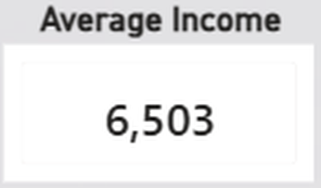
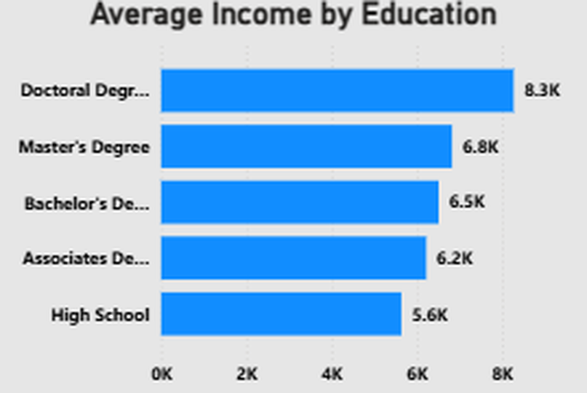
EMPLOYEE INCOME & EDUCATION ANALYSIS
1. AVERAGE INCOME KPI CARD
Displays the overall average monthly income of employees.
The average income in the organization is 6,503.
2. AVERAGE INCOME BY EDUCATION (BAR CHART)
Compares employee income across different education levels.
Employees with Doctoral Degrees earn the highest average income.
Employees with High School education earn comparatively lower salaries.

Slide 10
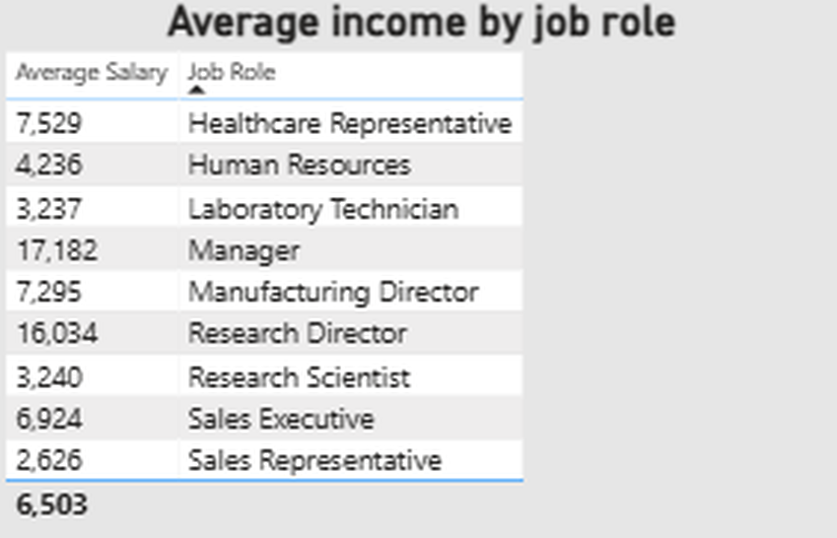
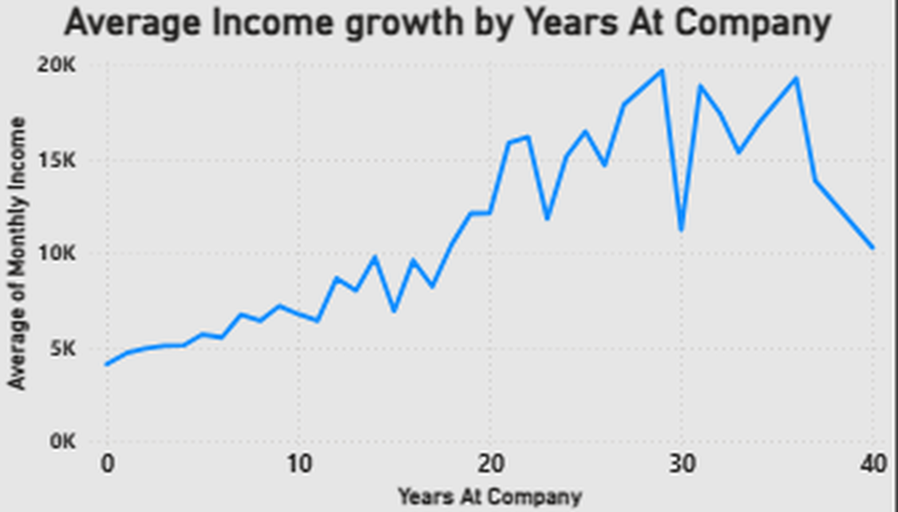
3. Average Income by Job Role (Table)
Shows average salary for different job roles.
Manager and Research Director roles have the highest salaries.
Sales Representatives and Laboratory Technicians have lower average income.
4. Average Income Growth by Years at Company (Line Chart)
Displays how employee income changes with years of experience in the company.
Income generally increases with employee tenure.
Some fluctuations indicate role changes or salary variations.

Slide 11
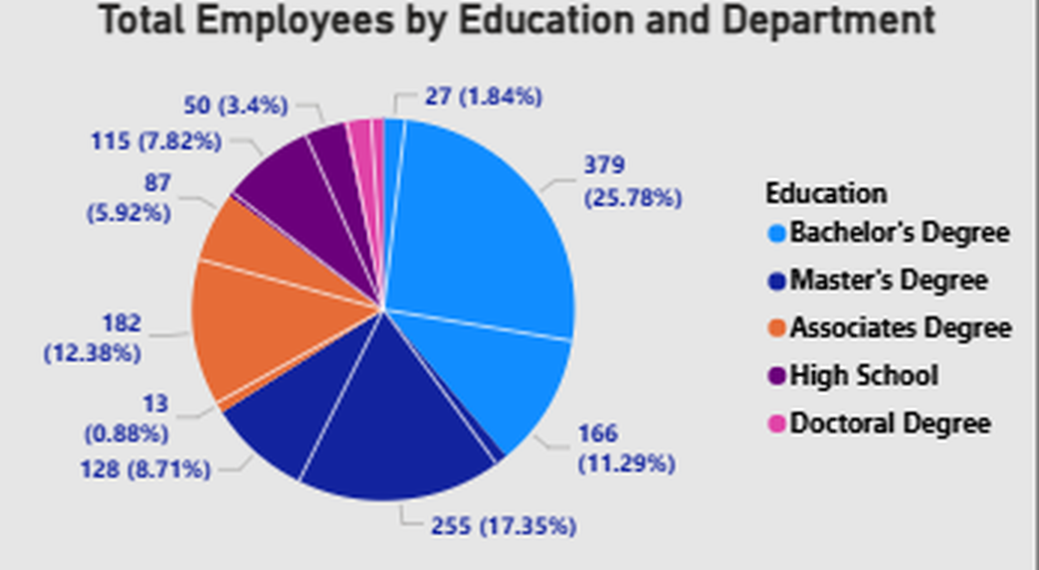
5. Total Employees by Education and Department (Pie Chart)
Shows employee distribution based on education level and department.
Bachelor’s Degree employees form the largest workforce segment.
Doctoral Degree employees represent the smallest group.

Slide 12
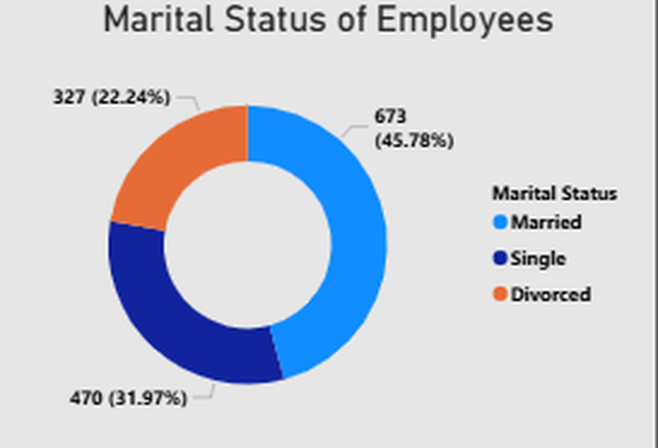
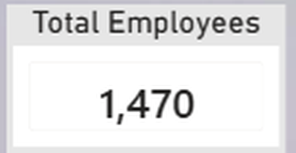
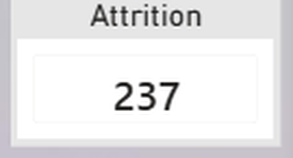
EMPLOYEE MARITAL STATUS ANALYSIS
1. Marital Status Distribution (Donut Chart)
Displays employee distribution based on marital status.
Married employees represent the largest portion of the workforce.
Single employees form the second-largest group.
Divorced employees represent the smallest category
2. KPI Cards
Total Employees – 1,470
Shows the total workforce count in the organization.
Attrition – 237
Represents the number of employees who left the company

Slide 13
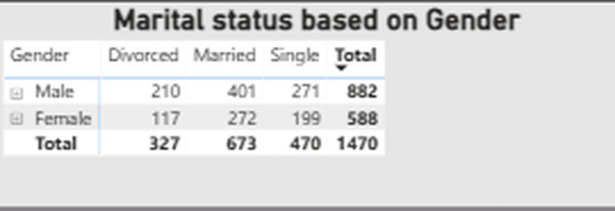
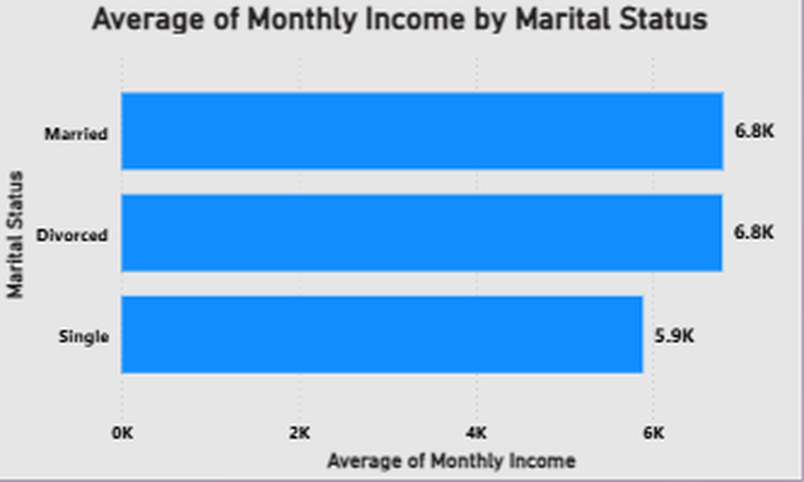
3. Marital Status Based on Gender (Table)
Displays marital status distribution separately for male and female employees.
Male employees have higher overall counts across all marital categories.
Married employees are dominant in both genders
4. Average Monthly Income by Marital Status (Bar Chart)
Compares employee income based on marital status.
Married and divorced employees have higher average income.
Single employees have comparatively lower average salary

Slide 14
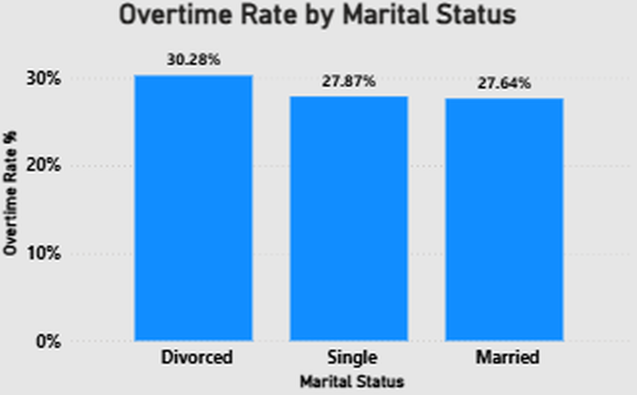
5. Overtime Rate by Marital Status (Column Chart)
Shows overtime percentage among different marital groups.
Divorced employees have the highest overtime rate.
Married employees show slightly lower overtime participation.

Slide 15
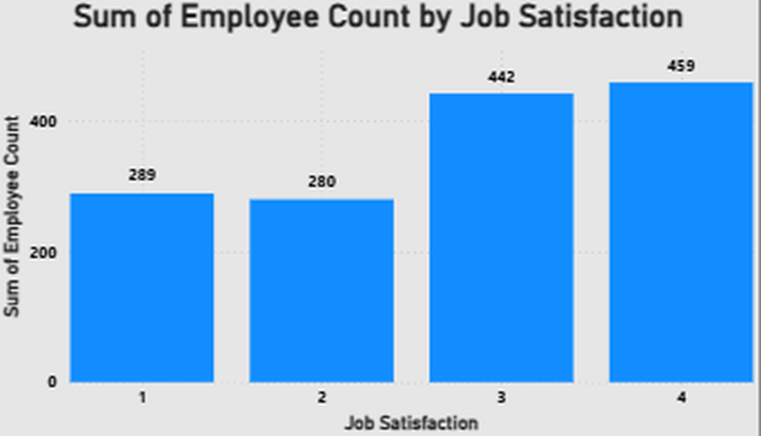
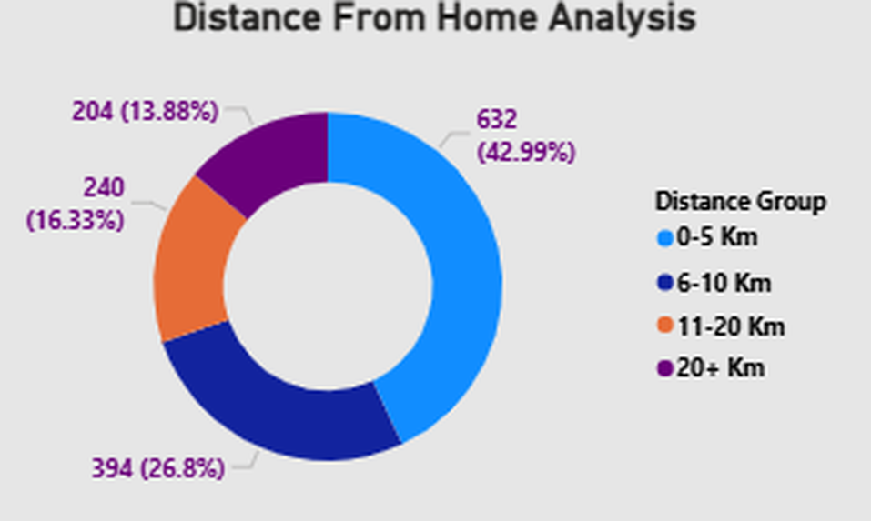
EMPLOYEE SATISFACTION & WORKFORCE ANALYSIS
1. Job Satisfaction Analysis (Bar Chart)
Displays employee count based on job satisfaction levels.
Satisfaction levels range from 1 to 4.
Most employees fall under satisfaction levels 3 and 4.
Fewer employees are in lower satisfaction categories.
2. Distance From Home Analysis (Donut Chart)
Shows employee distribution based on travel distance from home to workplace.
Most employees live within the 0–5 km range.
Fewer employees travel longer distances above 20 km.

Slide 16
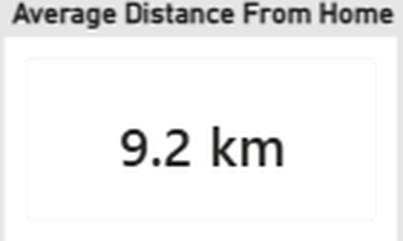
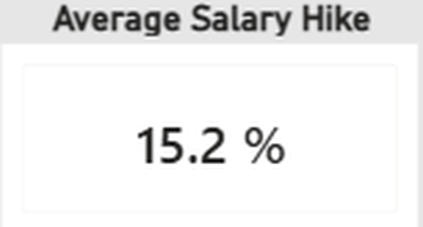
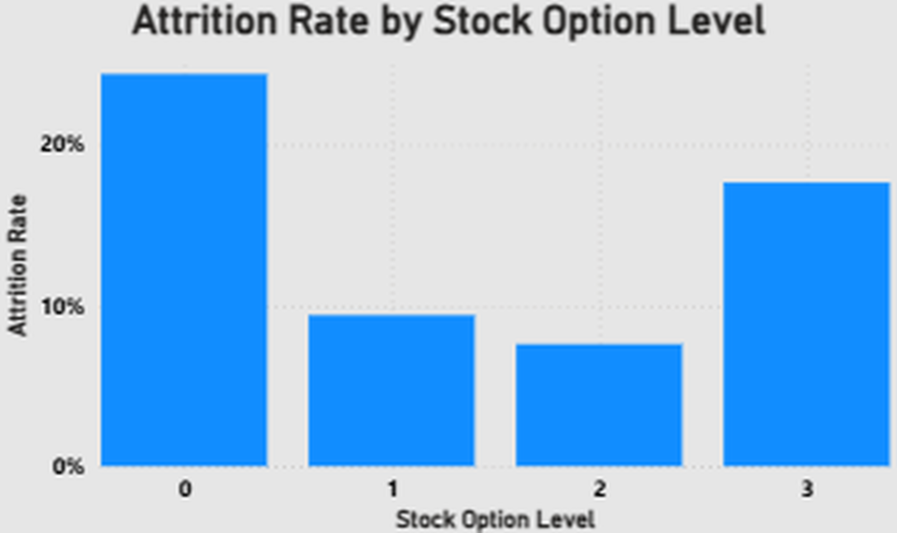
3. Average Distance From Home AND AVERAGE SALARY HIKE (KPI Cards)
Displays the average commuting distance and average salary increment provided to employees.
The average distance from home is 9.2 km.
The average salary hike is 15.2%.
4. Attrition Rate by Stock Option Level (Column Chart)
Analyzes employee attrition based on stock option levels.
Employees with lower or no stock options show higher attrition rates.
Attrition decreases at certain stock option levels.

Slide 17
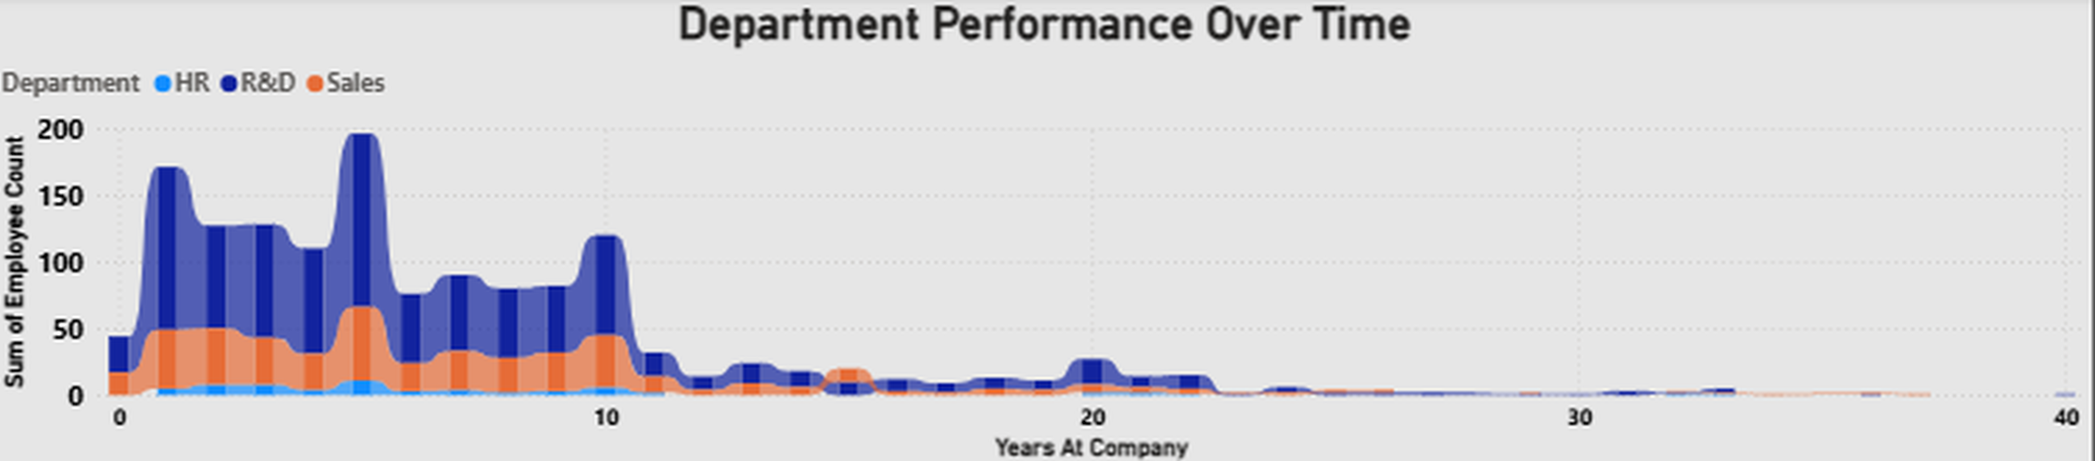
EMPLOYEE PERFORMANCE OVERVIEW
1. Department Performance Over Time (Area Chart)
Displays employee performance trends across departments over years at the company.
Compares HR, R&D, and Sales departments over time.
R&D and Sales departments show higher employee activity initially.
Employee count gradually decreases over longer years of service.

Slide 18
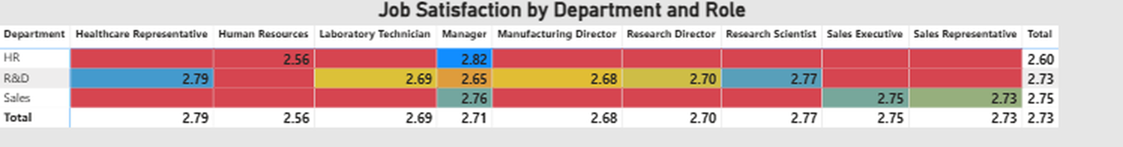
2. Job Satisfaction by Department and Role (Heatmap/Table)
Shows job satisfaction scores across departments and job roles.
Different colors represent different satisfaction levels.
Managers and Research-related roles show relatively higher satisfaction.
HR department shows comparatively lower satisfaction in some roles.

Slide 19
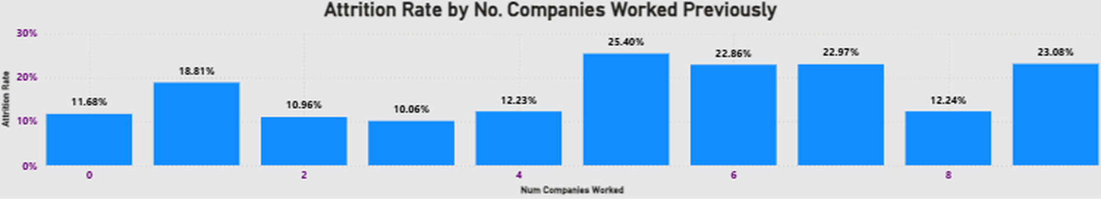
3. Attrition Rate by Number of Companies Worked Previously (Bar Chart)
Analyzes attrition based on employee’s previous work experience.
Employees who worked in multiple companies show higher attrition rates.
Attrition is lower for employees with fewer previous employers.
DAX Measures Used:
Total Employees = COUNT(Employee ID)
Attrition Count = CALCULATE(COUNT(Employee ID), Attrition = "Yes")
Attrition Rate = (Attrition Count / Total Employees) × 100

Slide 20
Key Insights
Improved understanding of Power BI dashboard development
Learned data cleaning and transformation using Power Query
Gained experience in creating DAX measures and KPIs
Understood the importance of proper data visualization
Roadmap
Enhance the dashboard with advanced HR analytics features
Integrate real-time data sources for live reporting
Add predictive analysis for employee attrition forecasting
Improve dashboard UI/UX for better user experience

Slide 21
THANK YOU
QUESTIONS & DISCUSSIONS

