Slide 1
PAWSURE
A Comprehensive Pet Insurance Data Standards Framework
BY:
Manasa Ramaka MS Business Analytics & Project Management University of Connecticut

Slide 2
AGENDA
The Challenge
My Solution – Hybrid Methodology
Execution & Technical Work
Results & Deliverables
Conclusion & Future Enhancements
1

Slide 3
CHALLENGE

Slide 4
THE STAKES – WHY THIS MATTERS?
Pet Insurance
Growing
Carriers
$21 Billion Market
12% Annually
60+ Carriers, No common structure
2
ACORD Student Challenge
Notes:
Let's start with the market context. Pet insurance is a 21 billion dollar global market growing at 12% annually—one of the fastest-growing insurance sectors.
However, there are over 60 carriers in the U.S. market, and each one operates with completely different data structures. There's no common language, no shared standards, no consistency whatsoever.
This is precisely the type of standardization problem ACORD was created to solve.

Slide 5
The Problem – “The Industry is Broken”
NO STANDARDIZED DATA ELEMENTS
What this means:
Every carrier reinvents the wheel
Inconsistent requirements across companies
Duplicate efforts waste millions
Digital innovation is STALLED
Customers suffer from inefficiency
The pet insurance industry is operating in chaos.
3
Notes:
The industry faces significant challenges due to this lack of standardization. Every carrier reinvents the wheel, creating duplicate efforts that waste millions of dollars. Digital innovation is stalled because there's no foundation to build on. And the inconsistency creates friction throughout the entire ecosystem.
This fragmentation is holding back a multi-billion dollar industry.

Slide 6
THE CHALLENGE
"ACORD Asked: Can You Fix This?"
The mission
- Identify ALL data fields for pet insurance underwriting
- Not just a list but production-ready standards
- Something the entire industry can use
- Solo mission - just me, my laptop, and determination
4
Notes:
ACORD's challenge was straightforward but ambitious: identify all data fields necessary for pet insurance underwriting, and organize them into production-ready standards that the entire industry can adopt.
I took this on as an independent project, determined to create a comprehensive solution.

Slide 7
SOLUTION

Slide 8
MY CRAZY IDEA
What if we combined AI brilliance with real-world truth?
The insight
- Most people would use AI or carrier data
- I thought: Why not BOTH?
- Dual-Source Validation Methodology
5
Notes:
Here's my core insight: most people would either use AI to generate fields OR manually collect from carriers. I asked—why not both?
This became my dual-source validation methodology. I used AI for comprehensive theoretical coverage, then validated against what carriers actually collect in the real world. This approach combines breadth with accuracy.

Slide 9
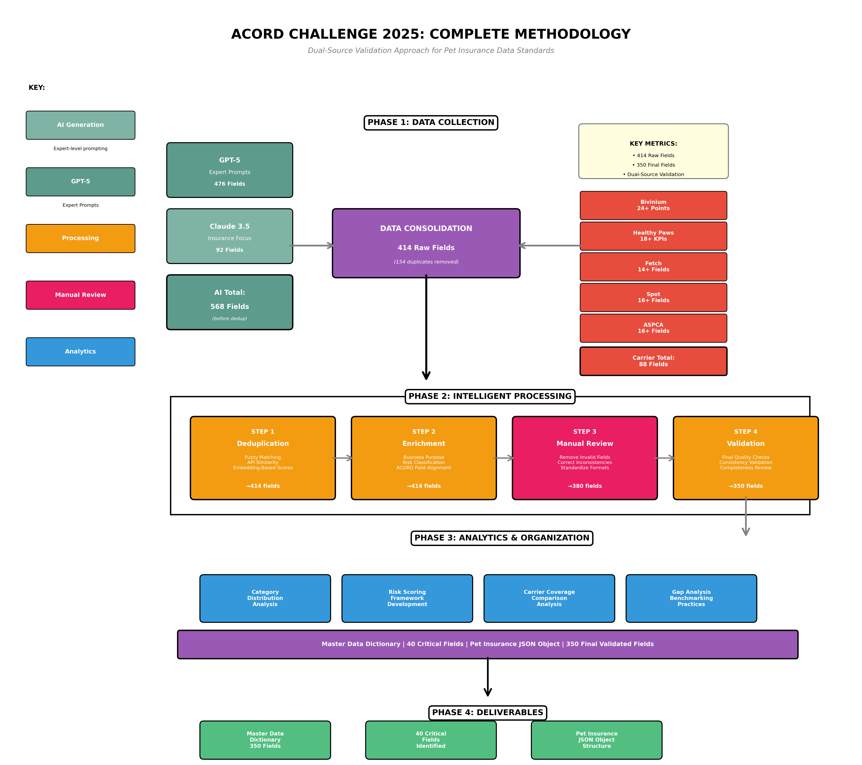
6
Notes:
This diagram shows my complete methodology.
At the top is Phase 1: data collection from two parallel streams—AI generation on the left and carrier validation on the right. These merge to create 614 raw fields.
Phase 2 processes these through multiple refinement steps: deduplication, intelligent filtering, and manual quality control.
Phase 3 performs analytics and organizes everything into logical categories.
Phase 4 produces 37 production-ready output files.
This is an end-to-end methodology from raw data to implementable standards.

Slide 10
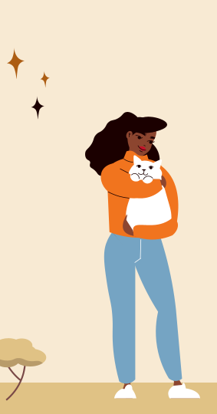
EXECUTION & TECHNICAL WORK

Slide 11
THE AI BRAIN TRUST
I Recruited Two AI Geniuses
GPT-5
Claude 3.5
- The comprehensive thinker
- Generated 476 fields
- Expert-level reasoning
- The innovator
- Generated 92 specialized fields
- Future-focused thinking
Total : 568 AI-generated fields
7
Notes:
For the AI component, I used two large language models with complementary strengths.
GPT-5 generated 476 fields using expert-level prompting. I instructed it to think like a senior underwriting professional with deep domain knowledge.
Claude 3.5 generated 92 fields with a focus on innovation and emerging technologies.
Combined, these AI sources provided 568 comprehensively reasoned fields. But the key wasn't just asking questions—it was engineering sophisticated prompts that embedded insurance expertise directly into the generation process.

Slide 12
THE SECRET WEAPON: PROMPT ENGINEERING
How I Made AI Think Like a 20-Year Insurance Veteran?
Not just asking questions — architecting intelligence
1."You are a senior underwriting expert with 20 years experience..."
Result: 200+ fields with risk assessments
2."Extract and normalize fields from this carrier form..."
- Result: Structured JSON with metadata
3."What data sources will transform pet insurance in 3-5 years?"
- Result: IoT, genetic testing, telemedicine fields
8
Notes:
My prompt engineering approach had three components:
First, the senior expert prompt: "You are a senior underwriting professional with 20 years of experience." This generated over 200 fields with built-in risk assessments and business justifications.
Second, the extraction prompt that normalized carrier form data into structured JSON with complete metadata.
Third, the forward-looking prompt about emerging technologies—capturing fields for IoT wearables, genetic testing, and telemedicine that will transform the industry in 3-5 years.
This wasn't casual questioning—it was architecting intelligence.

Slide 13
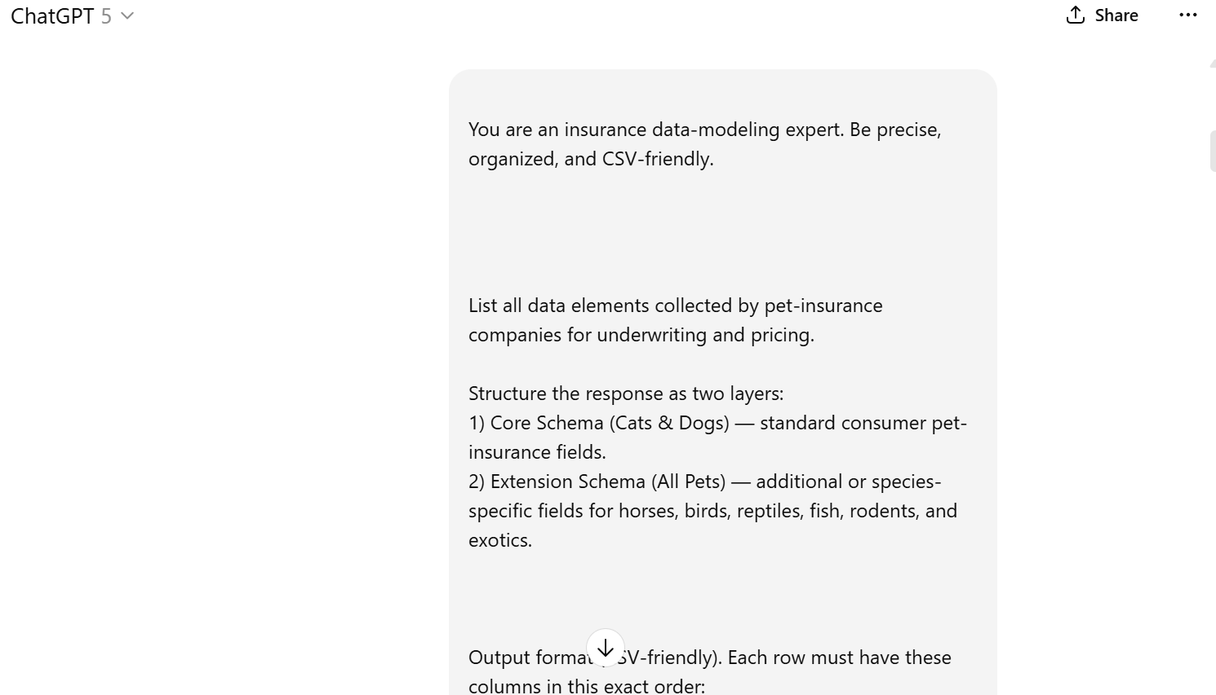
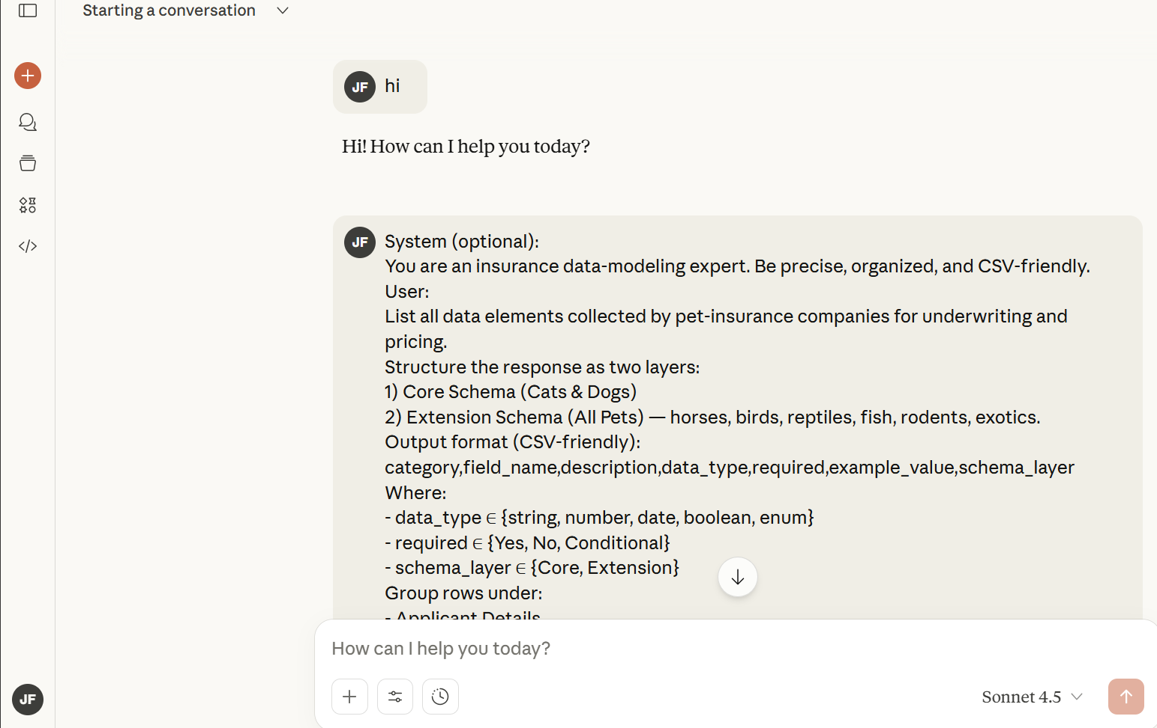
9

Slide 14
Real-World Data Collection Process
01
Trupanion
20 fields – Dev tools on website + Image extract
02
Fetch
4 fields – Dev tools on website + Image extract
03
Healthy Paws
6 fields – Dev tools on website + Image extract
04
SPOT
6 fields – Dev tools on website + Image extract
05
ASPCA
10 fields – Dev tools on website + Image extract
10
Notes:
But AI alone isn't sufficient. I needed real-world validation.
I analyzed the top 5 carriers representing approximately 40% of the U.S. market: Trupanion, Healthy Paws, Fetch, Spot, and ASPCA.
Using browser developer tools and OCR extraction, I captured 46 fields from their actual quote forms—what they're collecting in production today, not what they theoretically should collect.
This grounded my comprehensive AI coverage with real-world requirements.

Slide 15
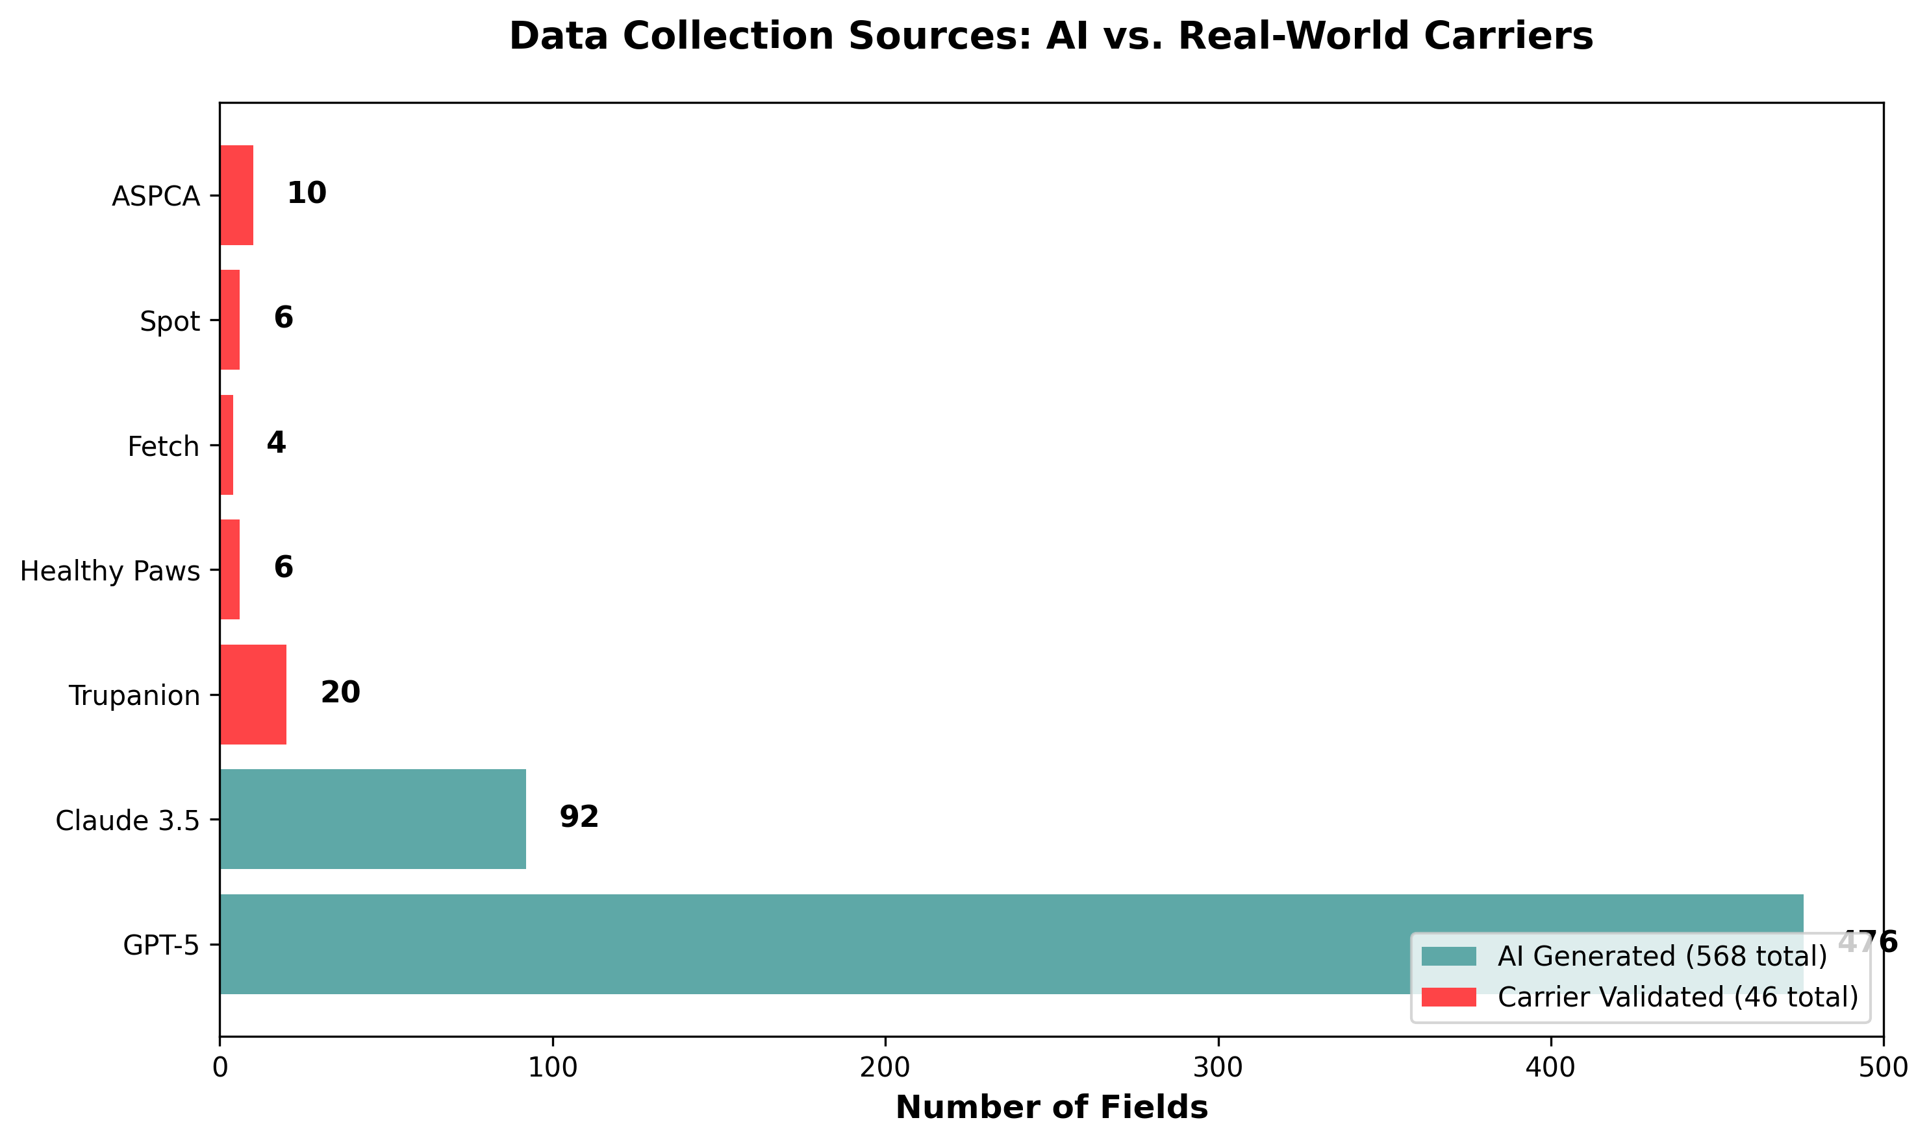
11

Slide 16
THE CHAOS: 614 FIELDS
614 raw fields collected from dual sources. But we had a PROBLEM:
- Duplicates EVERYWHERE
‘pet_age’ vs ‘animal_age’ vs ‘age_of_pet’
‘pre-existing conditions’ vs ‘preexisting_conditions’
- Same concepts, different names
PURE CHAOS. Now what?
12
Notes:
Now I had 614 raw fields from both sources. But there was a significant problem: massive duplication.
I encountered "pet_age," "animal_age," and "age_of_pet"—three names for the same concept. This pattern repeated across hundreds of fields. Same concepts, different naming conventions, inconsistent formats.
Complete chaos requiring intelligent resolution.

Slide 17
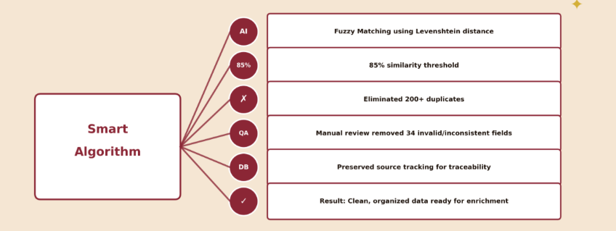
THE BREAKTHROUGH I Built a Smart Deduplication Algorithm
13
Notes:
I built a fuzzy matching algorithm using Levenshtein distance to measure semantic similarity between field names.
With an 85% similarity threshold, the algorithm identified and consolidated 71 duplicate fields—an 11.6% reduction from 614 to 543 unique fields.
This automated what would have taken weeks of manual comparison.

Slide 18
THE HUMAN TOUCH: MANUAL DATA CLEANING
THE PROBLEM:
Invalid fields from AI hallucinations
Inconsistent naming conventions that fuzzy matching missed
Fields with unclear business purpose
Redundant fields with subtle differences
Low-quality metadata needing correction
THE PROCESS:
Reviewed every field individually
Removed 34 invalid or low-quality fields
Standardized naming conventions
15
Notes:
I manually reviewed all 298 remaining fields. Despite sophisticated algorithms, human judgment was essential for catching edge cases.
I identified 39 fields requiring removal: 29 were junk fields—unclear purposes, AI hallucinations, or invalid concepts. Another 10 were low-value fields that didn't meet production quality standards.
This manual oversight brought me to 259 high-quality fields. This human-in-the-loop approach is what distinguishes my work from pure automation. It ensures production readiness.

Slide 19
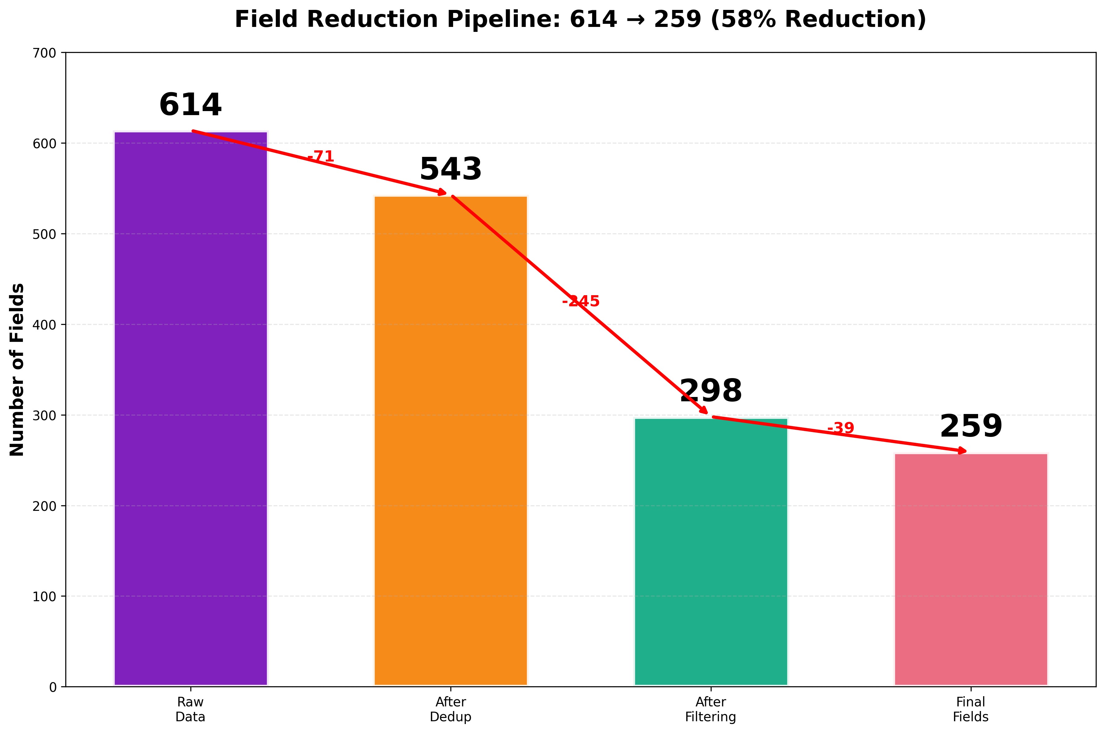
Data Processing Pipeline Results
14
Notes:
This diagram shows the complete reduction pipeline.
After deduplication gave me 543 fields, I applied intelligent filtering algorithms to identify redundant and low-quality entries. This removed 245 fields, reducing the dataset to 298.
But I didn't stop with automation. And this next phase is critical.

Slide 20
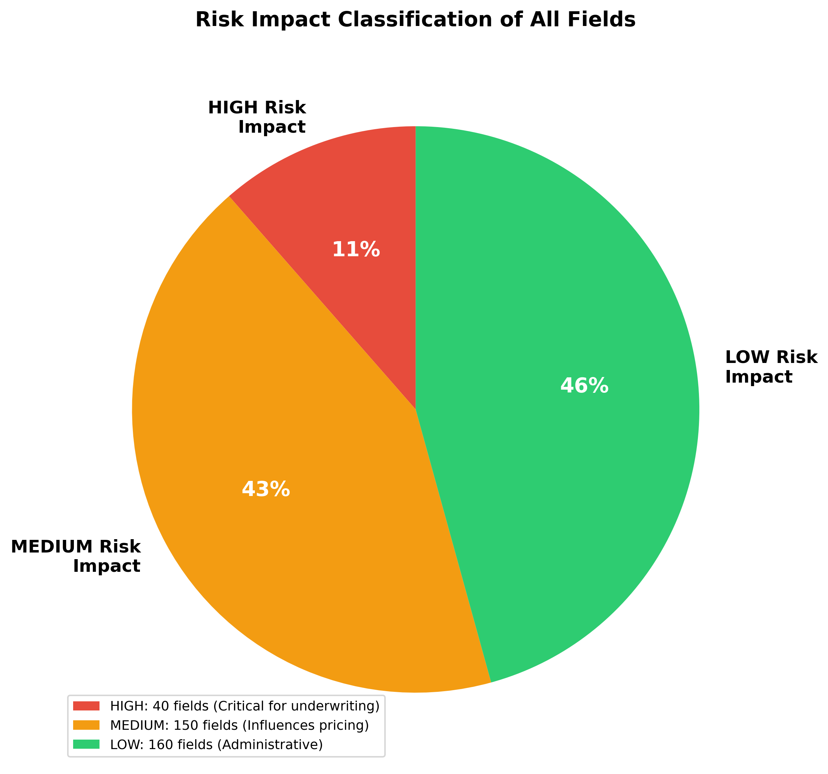
MAKING IT VALUABLE
Data Without Meaning is Just Noise
Through the Enrichment process,
Every field got:
- Business Purpose: Why insurers need it
- Risk Impact: HIGH/MEDIUM/LOW classification
- Rich Metadata: Data types, examples, validation rules
Not just a list - actionable intelligence
16
Notes:
Raw field names alone aren't sufficient. Each field needed comprehensive metadata.
I enriched all 259 fields with three key elements: business purpose explaining why insurers need the field, risk impact classification as HIGH, MEDIUM, or LOW for prioritization, and technical metadata including data types, validation rules, and examples.
This transforms a simple list into actionable intelligence.

Slide 21
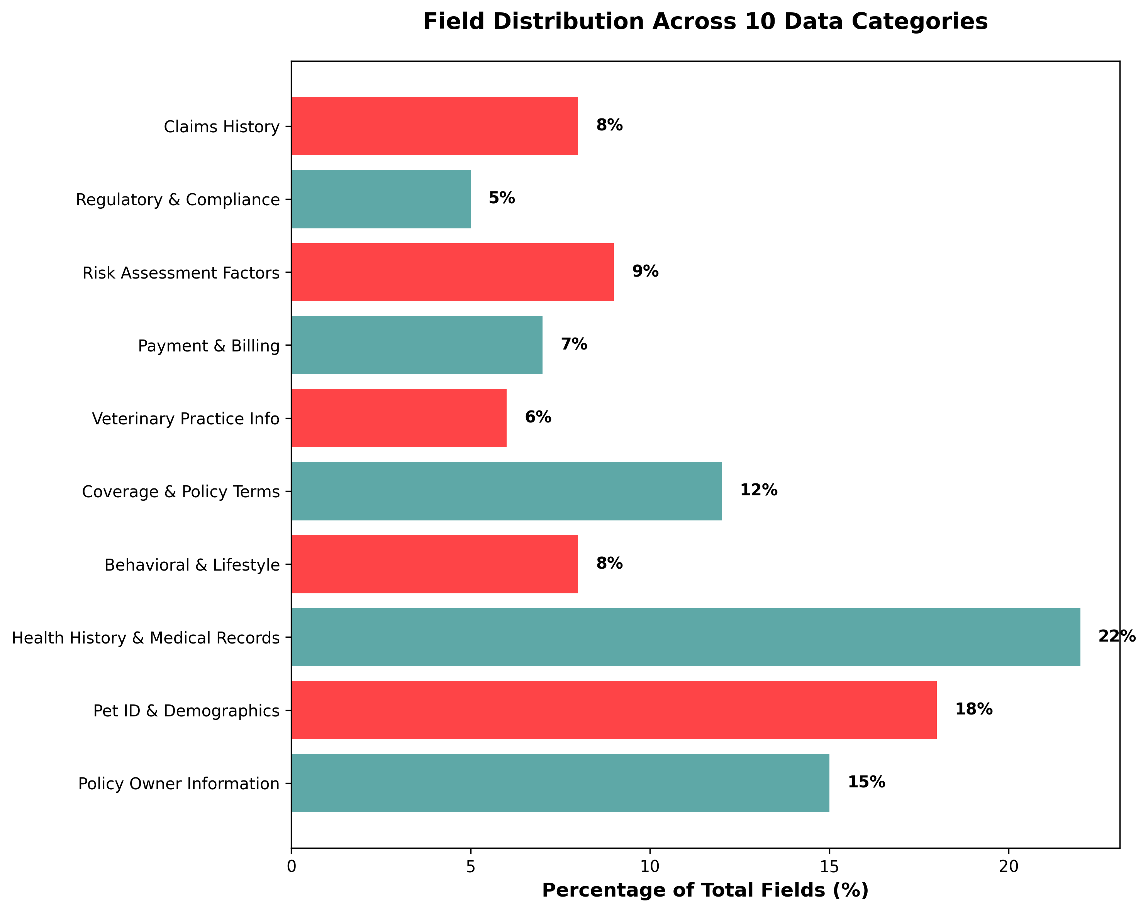
THE STRUCTURE EMERGES 10 Perfect Categories
17
Notes:
The 259 fields are organized into 10 logical categories:
Policy Owner Information. Pet Identification and Demographics. Health History and Medical Records. Behavioral and Lifestyle Factors. Coverage Selection and Policy Terms. Veterinary Practice Information. Payment and Billing. Risk Assessment Factors. Regulatory and Compliance. And Claims History.
This structure serves underwriters, IT systems, and business stakeholders equally well.

Slide 22
RESULTS & DELIVERABLES

Slide 23
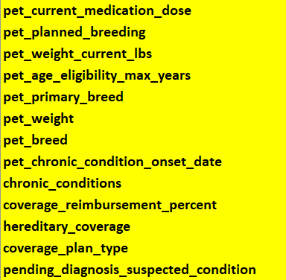
THE CRITICAL 40 Priority Implementation Roadmap
Not all 614 fields are equal
Therefore, identified TOP 40 CRITICAL fields
These are the "must-haves" for immediate implementation
Examples: - Pet Age, Breed, Pre-existing Conditions
Available in master_data_dictionary_highlighted.xlsx
18
Notes:
Not all 259 fields have equal priority. I identified the 40 most critical fields necessary for core underwriting functionality.
These include foundational elements like Pet Age, Breed, and Pre-existing Conditions, plus operational requirements like Owner Address, Coverage Type, and Deductible Amount.
A carrier could implement just these 40 fields and have a fully functional underwriting system. This serves as the priority implementation roadmap.

Slide 24
DELIVERABLES: 37 Production-Ready Files
Everything a carrier needs to implement TODAY
The arsenal:
Master Data Dictionary(CSV, XLSX, JSON)
JSON Schema for validation
OpenAPI Specification for APIs
Complete Documentation
Analytics & Gap Analysis
Risk Scoring Models
19
Notes:
I delivered 37 production-ready files spanning multiple formats and use cases.
The master data dictionary in CSV, XLSX, and JSON ensures compatibility with any system. JSON Schema enables technical validation. OpenAPI Specification allows immediate API development. Complete documentation includes methodology, implementation guides, and best practices. Analytics reports identify gaps and opportunities. And risk scoring models enable automated decision-making.
This isn't academic research—it's an implementation package.

Slide 25
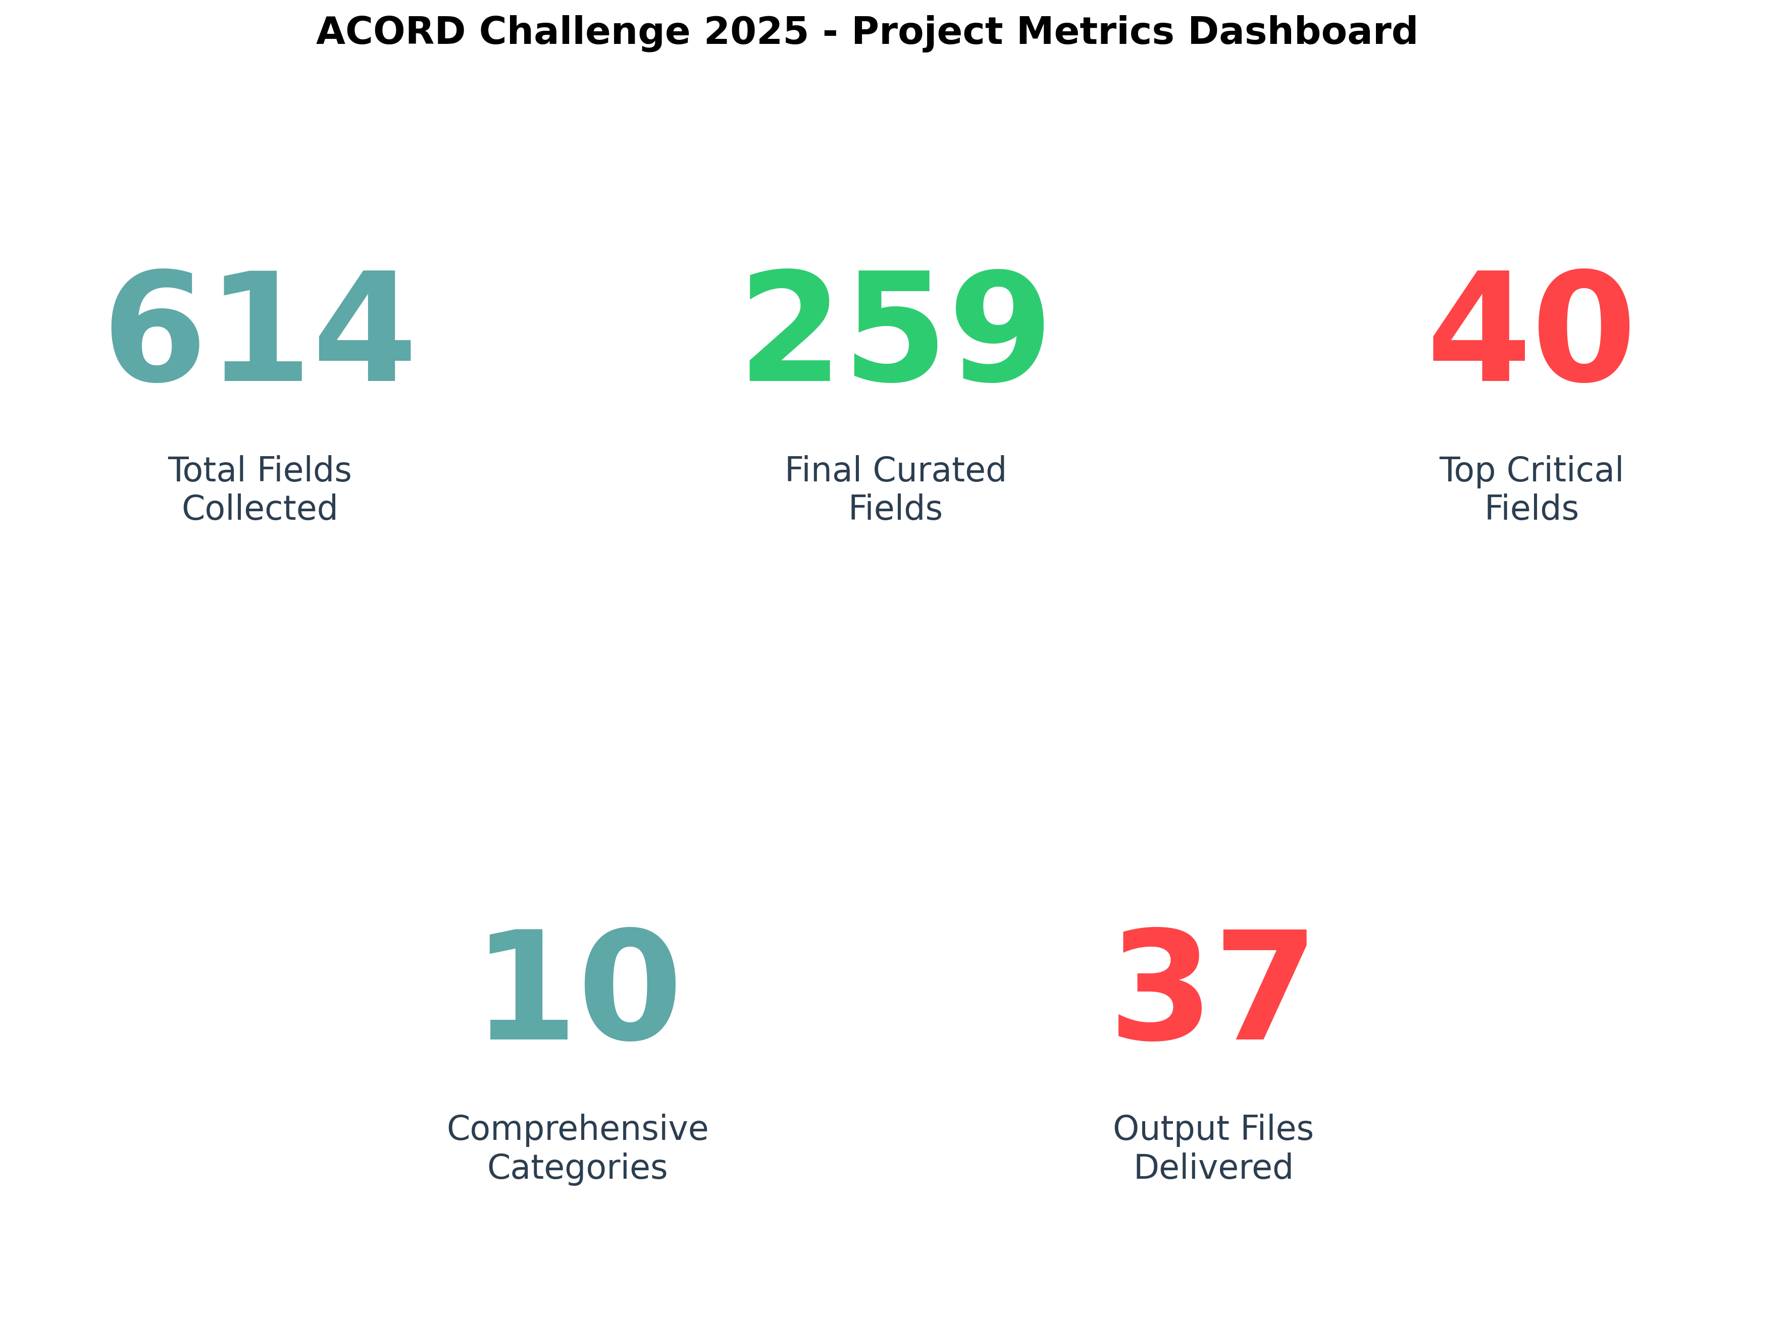
BY THE NUMBERS The Impact
20
Notes:
Here are the key metrics:
259 final curated fields, each validated and enriched. 40 critical fields identified for priority implementation. 10 comprehensive categories. 37 output files delivered.
For context: I started with 614 raw fields and removed 355 through rigorous processing—a 58% reduction. But this wasn't about minimizing quantity; it was about maximizing quality. Every remaining field has been validated, enriched, and proven valuable for underwriting.

Slide 26
CONCLUSION & FUTURE ENHANCEMENTS

Slide 27
THE FUTURE I SAW
Where Pet Insurance is Heading (3-5 Years)
The vision
IoT Pet Wearables: Real-time health data
Genetic Testing: Predicting disease risk
Telemedicine: Remote vet consultations
Smart Home: Behavioral monitoring
Microchip Registries: Identity verification
I didn't just solve today's problem — I mapped tomorrow's landscape
21
Notes:
This framework isn't limited to today's requirements. I mapped emerging technologies that will transform the industry:
IoT pet wearables providing real-time health monitoring. Genetic testing predicting disease risk before symptoms appear. Telemedicine enabling remote veterinary consultations. Smart home devices tracking behavioral patterns. Microchip registries for identity verification.
The standards include fields for all these technologies, ensuring carriers are prepared for tomorrow's innovations.

Slide 28
WHY THIS MATTERS
Accelerates digital transformation
Unlocks innovation
Carriers save 6-12 months of research
AI underwriting, automated processing
Enables standardization
Foundation for ACORD standards
Seamless data exchange across ecosystem
Industry-wide adoption pathway
Reduces costs
Immediately implementable
No more reinventing the wheel
Not just theoretical
22
Notes:
The business impact is substantial:
Carriers save 6-12 months of research time by implementing these standards immediately. The industry gains seamless data exchange capabilities across the entire ecosystem. Costs decrease as carriers stop reinventing identical solutions. Innovation accelerates through AI-powered underwriting and automated processing. And ACORD gains a foundation for formal industry standards.
Most importantly: this is immediately actionable, not theoretical.

Slide 29
WHAT MADE THIS DIFFERENT Technical Excellence
Dual-Source Validation
Comprehensive Metadata
Not just AI, not just carriers — BOTH for complete coverage
Every field tells a story -purpose, risk, examples
Advanced Processing
Production Ready
Fuzzy matching, intelligent normalization
APIs, schemas, documentation
23
Notes:
Four elements differentiate this work:
Dual-source validation combining AI comprehensiveness with carrier reality. Advanced processing using fuzzy matching and intelligent normalization, not manual effort. Comprehensive metadata where every field includes purpose, risk classification, and technical specifications. Production-ready outputs with APIs, schemas, and complete documentation.
This represents technical excellence combining automated efficiency with human judgment.

Slide 30

WHAT’S NEXT: FUTURE IMPROVEMENTS
Smarter AI understanding: fine-tune prompts with insurance-specific language for higher precision
Better deduplication: move from fuzzy matching to semantic similarity (embedding-based)
Auto-validation pipeline: build a script that detects schema drift as new carrier forms appear
Beyond cats and dogs: expand coverage to exotic pets and species-specific risk factors
Predictive risk modelling: integrate IoT and behavioral data for real-time risk scoring
24
Notes:
Thank you for your time.
To summarize: I've created a comprehensive data standards framework for pet insurance using dual-source validation. Starting from 614 raw fields, I applied intelligent processing and manual quality control to produce 259 production-ready fields organized into 10 categories, with 40 critical fields prioritized for immediate implementation.
The result is 37 production-ready files that carriers can implement today, accelerating digital transformation and enabling standardization across the 21 billion dollar pet insurance industry.

Slide 31
THANKS!
Do you have any questions?
fhc24001@uconn.edu
Notes:
My contact information is on your screen. I welcome questions about implementation or adoption pathways.
Thank you.

