Slide 1
Semester: III DSA Role Play Academic Year: 2024-25
Student Record Management System
Presented to : Dr. Nitin Choubey

Slide 2
Algorithms Used :
#1. Student Struct
struct Student {
int id;
char name[100];
float cgpa;
};
#2. Node Struct
struct Node {
Student data;
Node* left;
Node* right;
};

Slide 3
Algorithms Used :
# 1. Create New Node
createNode(data):
node = new Node()
node.value = data
node.left = NULL
node.right = NULL
return node

Slide 4
Algorithms Used :
# 2. Insertion
insertNode(root,data):
if (root==nullptr):
root=createNode(data)
else if(data.id<root.data.id):
root.left=insertNode(root.left,data)
else:
root.right=insertNode(root.right,data)
return root

Slide 5
Algorithms Used :
# 3. Search
searchNode(root, id):
if (root == nullptr or root->data.id == id):
return root
else if (id < root.(data.id)):
return searchNode(root.left, id)
else:
return searchNode(root.right, id)

Slide 6
Algorithms Used :
# 4. Minimum value
MinVal(root):
current = root
while (current && current.left != nullptr):
current = current.left;
return current

Slide 7
Algorithms Used :
# 5. Deletion
DeleteFromBST(root, id):
if (root == nullptr):
return root
if (id < root.(data.id)):
root.left = DeleteFromBST(root.left, id)
else if (id > root->data.id) :
root.right = DeleteFromBST(root.right, id)
else :

Slide 8
Algorithms Used :
// Case 1: No child
if (root.left == nullptr and root.right == nullptr):
delete root
return nullptr

Slide 9
Algorithms Used :
// Case 2: One child (left or right)
if (root.left != nullptr and root.right == nullptr):
temp = root.left
delete root
return temp
if (root.left == nullptr and root.right != nullptr):
temp = root.right
delete root
return temp

Slide 10
Algorithms Used :
// Case 3: Two children
if (root.left != nullptr and root.right != nullptr):
temp = MinVal(root.right)
root.data = temp.data
root.right = DeleteFromBST(root.right, temp.(data.id))
return root

Slide 11
Binary Search Tree
67
57
75
74

Slide 12


Slide 13
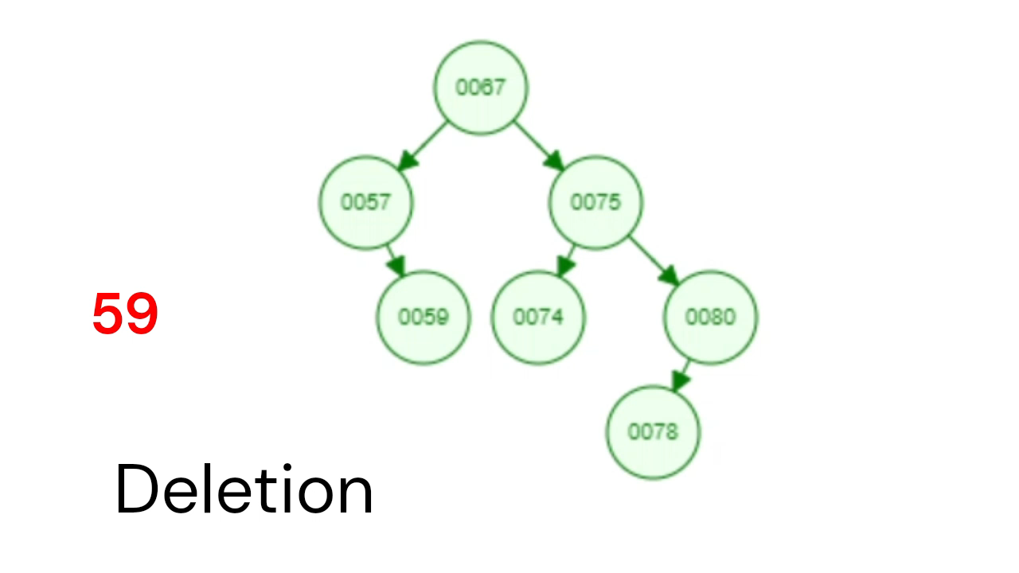

Slide 16
THANK YOU

