Slide 1
World of Point Clouds
By Manash J Konwar

Slide 2




Table of Contents
01
03
OVERVIEW
EXPLORATION
What are Point Clouds?
LIDARS
Applications around Point Clouds
Current Solution
Datasets Utilized
Features of Solution
Dash Integration
02
04
POINTNET
NEXT STEPS
Overall Architecture
Features of Pointnet
Usage of Pointnet
Frustum Pointnet/ Voxel Pointnet
3D Object Detection
Develop Benchmark Metrices
Code Repository Links

Slide 3
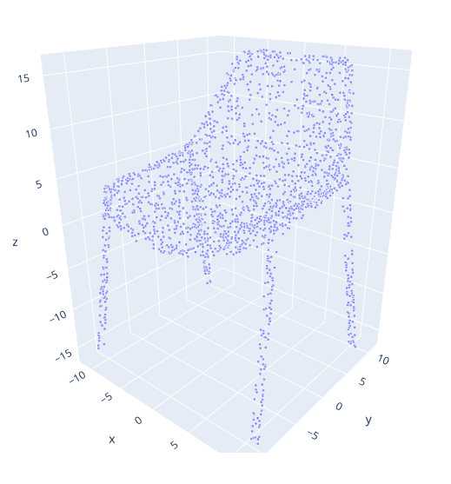
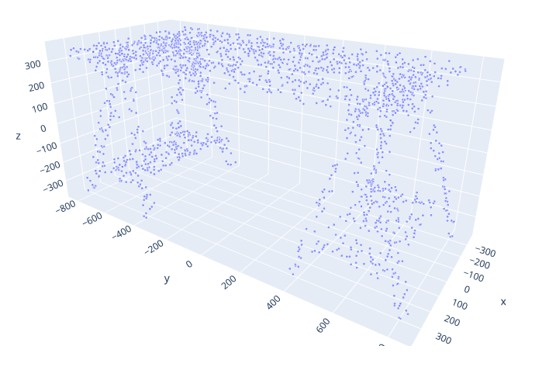
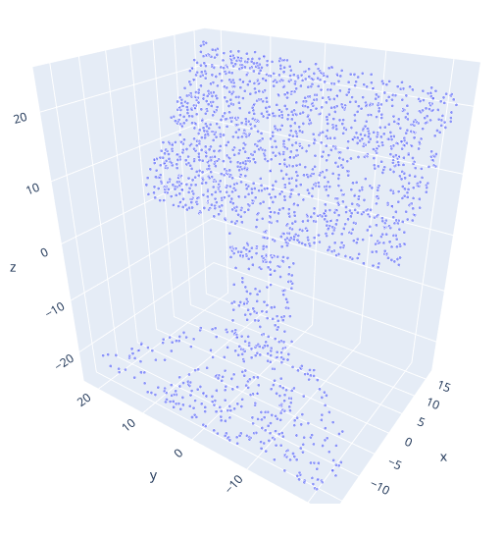
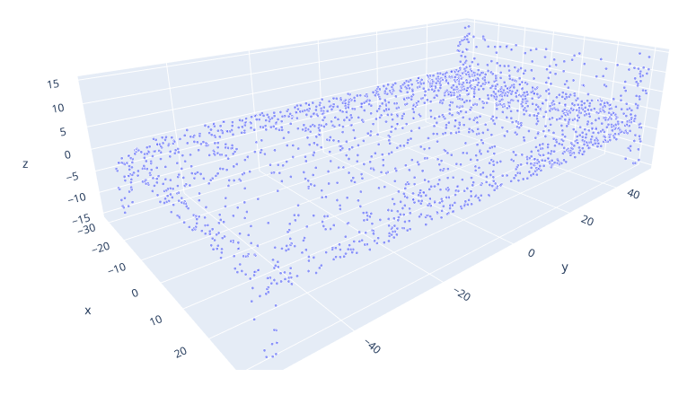
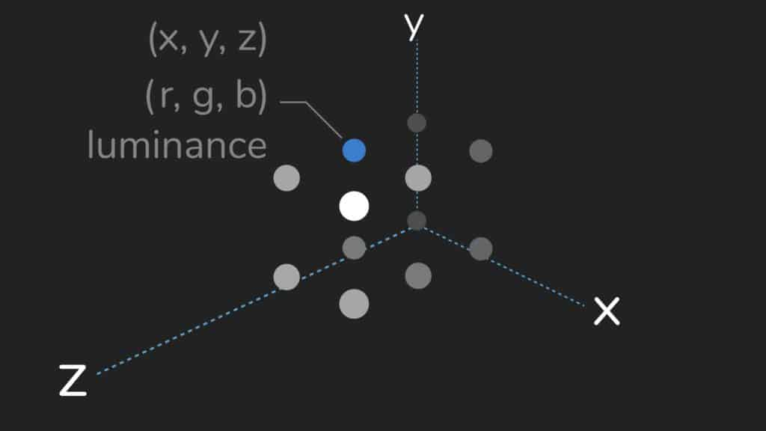
Overview
What are Point Clouds?
Point clouds are essentially the simplest form of 3D models. They are collections of individual points plotted in 3D space.
Each point contains several measurements, including its coordinates along the X, Y, and Z-axes, and sometimes additional data such as a color value, which is stored in RGB format, and luminance value, which determines how bright the point is.

Slide 4
Overview
LIDARS

