Slide 1
Data Visualization ADTA 5250
Pharmacy Dataset EDA
This Presentation consists of 8 Principal Visuals which gives Insights to the stake holders
Manasha Kundala
Summer 2023

Slide 2
Executive Summary
Veterinary Medicines purchased holds more than 50% of total order revenue generated.
All customers have a greater number of Over the Counter(OTC) orders.
South region has highest overall sales.
Idaho has highest sales.
Intramuscular is the second highest revenue generated Route type.
Iv(Infusion) has highest sales in OTC medicines.
Creams are the most expensive and highly profit generating orders placed.
Quarter 4 of 2013 has the highest sales.

Slide 3
Recommendation
Medicines purchased over the counter(OTC) are more in number, but the revenue generated by it is not even 20% of the total revenue.
In contrary, Veterinary medicines also called as “Animal” market segment holds ~53% of overall Revenue with only ~25% of total units sold.
This gives us a conclusion that Veterinary Medicines are highly expensive and more Revenue generating ones.
South and West regions has most of the sales overall which means more profit. Inventory Stock should be maintained, and more units should be sent in those regions.
IV(Infusion) has highest sales for OTC type, Delayed Release for Animals and Oral for Human-RX. These medicine types are most selling and should keep an eye on inventory.
Creams are the medicines which gives more profit which means they are in high demand even being expensive.

Slide 4
Veterinary Medicines purchased holds more than 50% of total order revenue generated.
Annotations: Medicines purchased are
Distributed in 3 different market segments.
Animal
Human – OTC
Human – RX
Animal market segment has Revenue $38.15M
Which is more than half of the
total revenue generated by all orders.

Slide 5
All customers have a greater number of Over the Counter(OTC) orders
Annotations: Most of the orders
Have Placed are OTC. But the Revenue
Generated are for Veterinary medicines.

Slide 6
South region has highest sales overall
South, West, Central and East is the order of regions with high sales
Annotation: East region has lowest sales

Slide 7
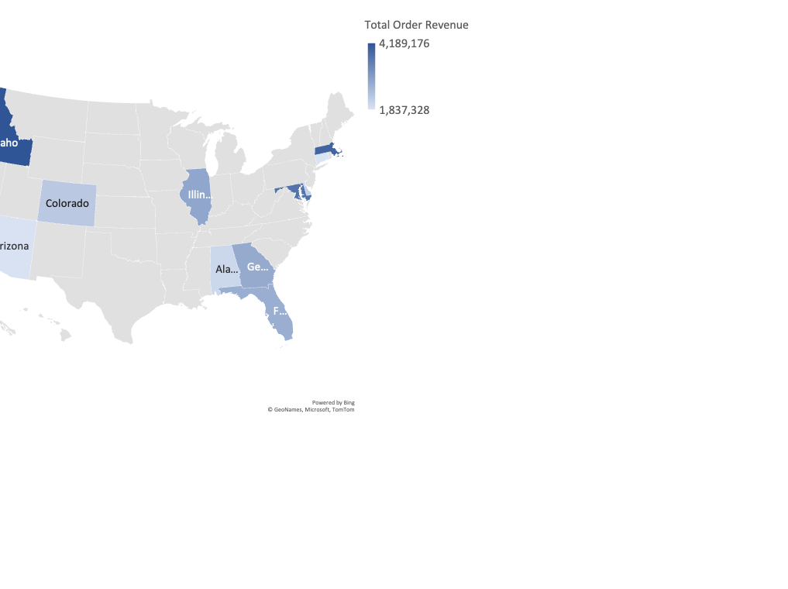
Idaho has highest sales. Total order Revenue by state. Annotation: Idaho and New York are the top 2 states by sales.

Slide 8
Intramuscular is the second highest revenue generated Route type.
Annotations: Intramuscular is the only
Route type which is in top 3 sales even
Though it’s sales in the individual
Market segment is not highest.

Slide 9
Iv(Infusion) has highest sales in OTC medicines.
Annotations:
Iv(Infusion) Rx Route type
Has highest Sales for the sub-categories
Human-OTC.
Delayed Release type has highest sales
For the Animal sub-category.
Oral Type has highest sales for the
Human-Rx sub-category.

Slide 10
Creams are the most expensive and highly profit generating orders placed.
Annotations: Cream, Concentrate
And spray are the most expensive
Medicines bought.

Slide 11
Quarter 4 of 2013 has the highest sales
Annotations: Q4 of 2013 has highest sales and Q1 of 2014 has the lowest sales overall.

