Slide 1
LOGISTICS & PORTS · TRACK L1 · CRITICAL NOW
PORTFLOW
AI Operations Optimiser — Container Congestion Predictor & Port Operations Optimizer
Predict congestion before it happens. Optimise berths, cranes and yard automatically.
Reroute vessels with Virtual Arrival. Execute with a live 72-hour operations plan.
⚓ 225 vessels live-synced
📡 IBM Bob Copilot onboard
📈 72-h ML congestion forecast
TEAM PORTFLOW
Manashvi Choksi · Rudra Joshi · Princee Bhingradiya · Krish Sabhaya — Hackathon 2026

Slide 2
THE PROBLEM
Ports drown in congestion — decisions come too late
100+ ships
$10B+
Manual
queued offshore for weeks in the 2021 LA / Long Beach backlog
drained from global supply chains by that single crisis
berth, crane & yard allocation done in spreadsheets, port by port
Why it keeps happening
WHAT CHANGES WITH PORTFLOW
✗ Reactive detection
Hotspots are spotted only after vessels are already queuing at anchorage.
BEFORE
Congestion discovered at anchorage, fuel burned waiting
AFTER
Hotspots predicted 72 h out; vessels slow-steam just-in-time
✗ Late routing calls
Alternate routing decisions arrive when the window to help has closed.
BEFORE
Berth conflicts resolved by phone calls and guesswork
✗ Fragmented data
Vessel schedules, berth capacity, crane status and yard space live in silos.
AFTER
Auto-optimiser reassigns berths & cranes, zero overlaps
BEFORE
Supervisors plan shifts from memory & spreadsheets
✗ No forward plan
Shift supervisors lack a data-driven 72-hour execution plan.
AFTER
AI-generated 72-h plan with per-shift checklists

Slide 3
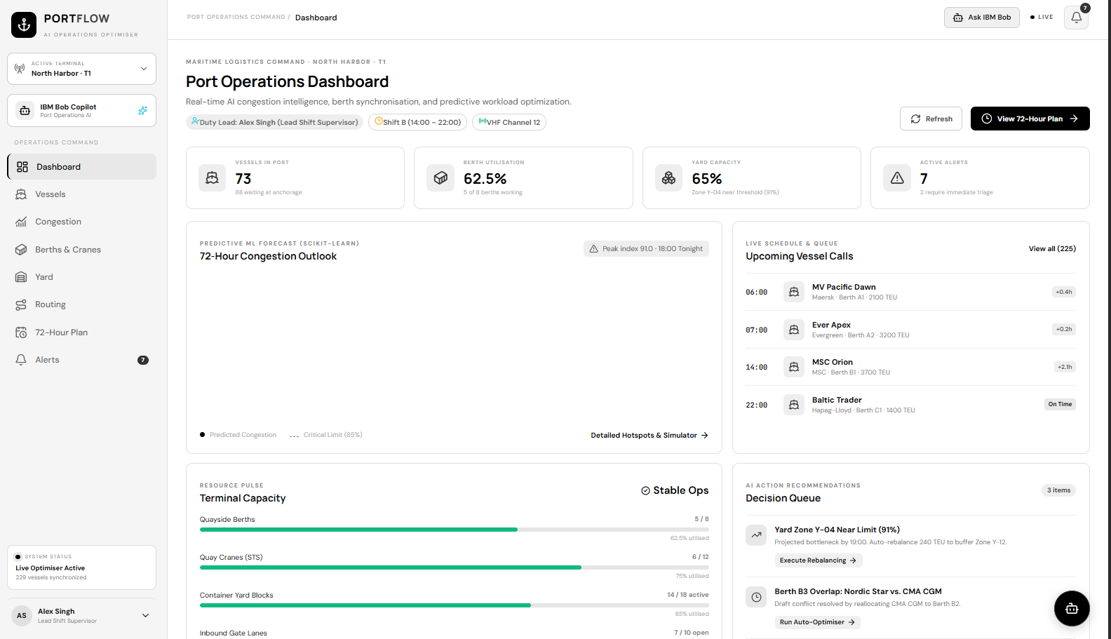
THE SOLUTION
PORTFLOW: one AI command centre for the terminal
4 AI pillars
PREDICT
ML congestion hotspots 72 h ahead
OPTIMISE
Berth, crane & yard allocation
REROUTE
Virtual Arrival + berth swaps
EXECUTE
72-h shift supervisor plan
A single live dashboard turns 225 vessel calls, 8 berths, 12 cranes and 18 yard zones into one synchronised,
optimised, forward-looking operating picture — replacing spreadsheets and guesswork.

Slide 4
ARCHITECTURE
How the system works
DATA INGESTION
AI PREDICTION LAYER
OPTIMISATION ENGINE
ACTIONS
Vessel schedules & AIS · berth specs · crane telemetry · yard capacity · gate & tides
Scikit-learn random-forest regressor forecasts berth, crane, yard & congestion 72 h out
Auto-optimiser resolves berth conflicts, balances yard zones, sequences crane gangs
Alerts · rerouting · 72-h plan · supervisor checklist
🤖 IBM Bob Copilot — conversational Port Operations AI: explains every recommendation, drafts Virtual Arrival notices, and lets supervisors execute fixes by chat.
SIX LIVE MODULES, ONE SYNCHRONISED STATE
Dashboard
Vessels
Congestion
Berths & Cranes
Yard
Routing + 72-h Plan + Alerts
live port pulse
225 calls tracked
ML forecast + simulator
Gantt + auto-optimise
18 zones, dwell tracking
execute & triage

Slide 5
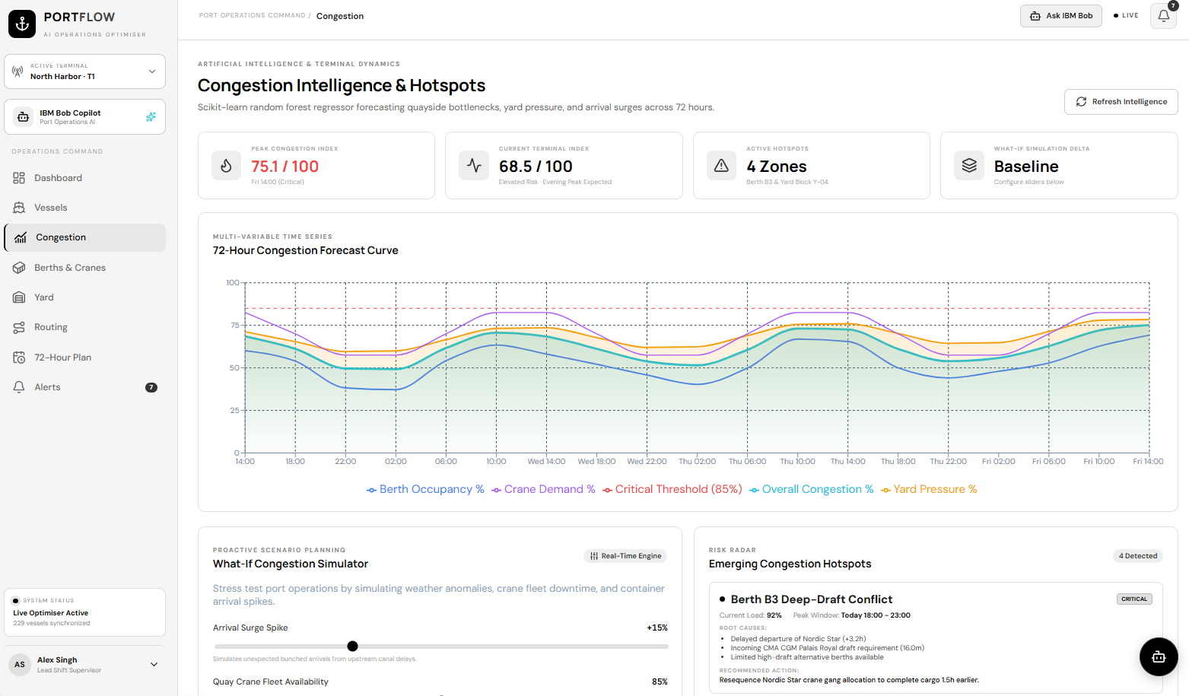
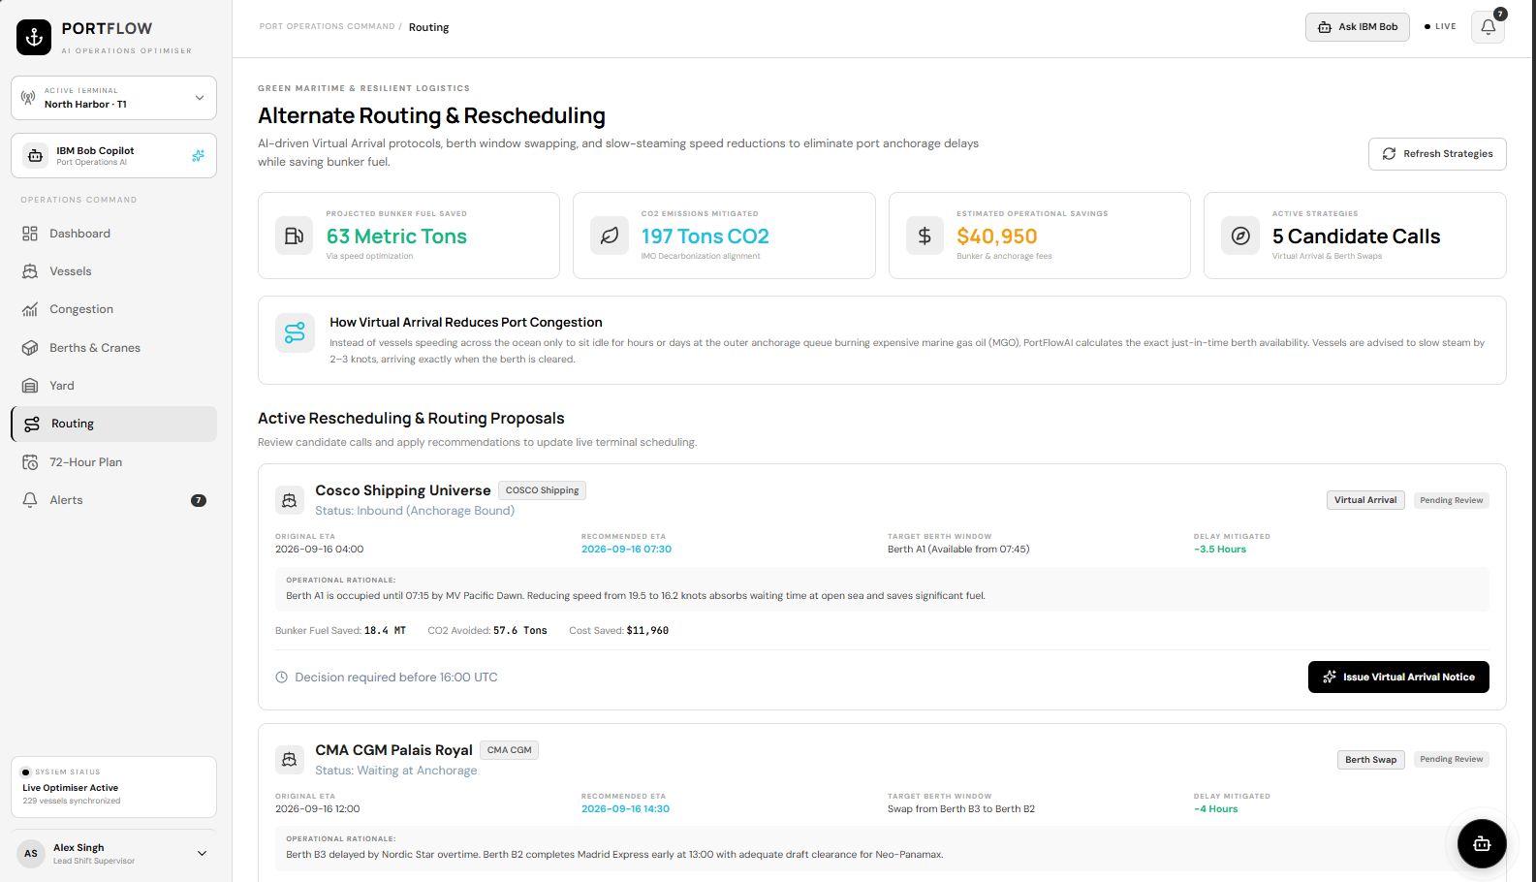
DEMO — KEY FEATURE
Virtual Arrival & berth conflict resolution
Instead of racing to anchorage and burning fuel while idle, PORTFLOW computes the exact just-in-time speed.
Cosco Shipping Universe: slow-steam 19.5 → 16.2 kn → −3.5 h delay, 18.4 MT bunker saved, 57.6 t CO₂ avoided, $11,960 saved · CMA CGM Palais Royal: berth swap B3 → B2 → −4 h delay.

Slide 6
IBM TECHNOLOGIES
Powered by IBM Bob
IBM Bob Copilot
Ask IBM Bob
Embedded Port Operations AI assistant in every module — explains forecasts and recommends actions in plain language.
Top-bar copilot gives supervisors instant natural-language answers on vessels, berths and congestion without leaving the screen.
AI Decision Queue
IBM Cloud deployment
Bob-ranked recommendations (yard rebalancing, berth swaps, crane reassignments) with one-click Execute — human-in-the-loop control.
Containerised microservices with live sync of 225 vessels; auto-optimiser runs synchronised with zero overlapping slots.
Design principle: Bob doesn't replace the supervisor — it surfaces the right decision at the right moment, and the human executes.

Slide 7
RESULTS & IMPACT
From reactive firefighting to proactive control
$40,950
63 MT
197 t
estimated operational savings from active routing strategies
bunker fuel saved via Virtual Arrival speed optimisation
CO₂ emissions mitigated — IMO decarbonisation aligned
75.1/100
−3.5 h
0
peak congestion index predicted 24 h in advance, not discovered at the quay
delay mitigated on a single call (Cosco Shipping Universe)
overlapping berth slots after auto-optimisation — “Synchronised”
Success = congestion is a forecast, not a surprise. Every hotspot ships with a root-cause analysis and a recommended fix the supervisor can execute in one click.

Slide 8
TEAM
Crew behind PORTFLOW
⚓ TEAM PORTFLOW
M
R
P
K
Manashvi Choksi
Rudra Joshi
Princee Bhingradiya
Krish Sabhaya
Team Lead · Product & Port Operations
AI / ML — congestion forecasting engine
Optimisation — berth, crane & yard allocator
Full-stack — dashboard & IBM Bob integration
What we learned & what's next
Learned: operators trust AI when every recommendation carries its rationale and a one-click execution path.
Next: multi-terminal federation, tidal-window optimisation, and predictive equipment-maintenance alerts fed back into Bob.

