Slide 1

Travel Package Purchase Prediction
Project Report

Slide 2
Objective
Problem Statement
The objective of this machine learning project in the Tourism domain is to build a predictive model using historical tourism data. The model aims to assist in efficiently and accurately determining whether the prospective customer will purchase the travel package or not.
Tourism is one of the most rapidly growing global industries and tourism forecasting is becoming an increasingly important activity in planning and managing the industry. Because of high fluctuations of tourism demand, accurate predictions of purchase of travel packages are of high importance for tourism organizations. The goal is to predict whether the customer will purchase the travel or not.

Slide 3
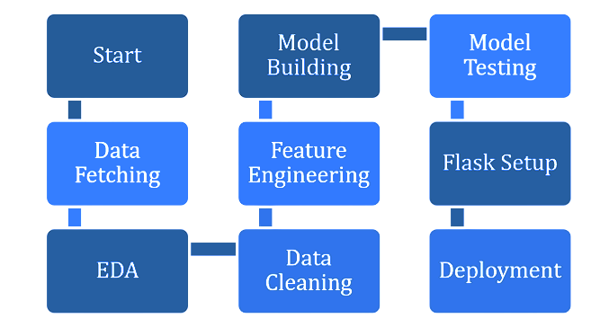
Architecture

Slide 4
Data Validation and Data Transformation
The dataset was taken from a Kaggle Page.
Data Type of Columns -
Validating the data type of the columns, if wrong, then were corrected.
Null values in Columns –
Validating the column in the dataset have null values or missing information.

Slide 5
Model Training
Data Pre-processing
Performing EDA to get insights of the data.
Imputing any Null values if present.
Treating Outliers if any
Encoding the categorical features/columns.
Performing K best selection to select features with high importance.

Slide 6
Model Selection
After pre-processing and model training, we find the best model for prediction. The model is trained on multiple Classification algorithms like Logistic Regression, Decision Tree, etc. After prediction, we will find the best model using evaluation metrics like Confusion Matrix and ROC-AUC.

Slide 7
Model Selection
After pre-processing and model training, we find the best model for prediction. The model is trained on multiple Classification algorithms like Logistic Regression, Decision Tree, XGBoost etc. After prediction, we will find the best model using evaluation metrics like Confusion Matrix and ROC-AUC.

Slide 8
QnA
Q1) What is the source data?
The source of the data is Kaggle. The data is in the form of a ‘CSV’ file.
Q2) What was the type of data?
The data was a combination of categorical and numerical values.
Q3) What’s the complete flow you followed in this project?
Refer to the 3rd slide for a better understanding

Slide 9
QnA
Q4) What techniques were you using for data pre-processing?
●Visualizing the relation of independent variables with each other and dependent variable.
●Checking the distribution of Continuous variables.
●Checking any null values present in the dataset.
●Converting categorical data into numeric values.
●Feature selection of data.
Q5) How was model training done or what models were used?
●Before training the model the dataset is divided into a training set and a testing/ validation set.
●The categorical columns were converted into numeric values.
●Algorithms like Logistic Regression, Decision Tree, XGBoost were used for model training, and based on Confusion Matrix, Recall, AUC ROC the XGBoost model is saved for Validation.

Slide 10
QnA
Q6) How prediction was done?
●On the basis of the trained model, the prediction was performed.
●We also created an API interface for estimating the sales of the store on the basis of various Inputs from users.
Q7) What are the different stages of deployment?
When the model is ready we deploy it in the Heroku platform.

Slide 11
QnA
Q1) What is the source data?
The source of the data is Kaggle. The data is in the form of a ‘CSV’ file.
Q2) What was the type of data?
The data was a combination of categorical and numerical values.
Q3) What’s the complete flow you followed in this project?
Refer to the 3rd slide for a better understanding
Q4) What techniques were you using for data pre-processing?
●Visualizing the relation of independent variables with each other and dependent variable.
●Checking the distribution of Continuous variables.
●Checking any null values present in the dataset.
●Converting categorical data into numeric values.
●Scaling the data.

