Slide 1
Cloud-Powered Task Manager
A CRUD Web App with IBM Cloudant NoSQL Database
Name: Manasi Singh

Slide 2
Introduction: What is a Task Manager?
Definition: A tool designed to help individuals or teams organize, track, and prioritize tasks efficiently.
From simple to-do lists to complex project management.
Why Cloud-Powered?
Accessibility: Access tasks from anywhere, on any device.
Scalability: Easily handle a growing number of tasks and users.
Data Persistence: Tasks are securely stored and always available.
Collaboration: (Potentially) Share tasks and work with others.
Key Functionalities (CRUD):
Create: Add new tasks.
Read: View existing tasks.
Update: Modify task details (e.g., status, description).
Delete: Remove completed or unnecessary tasks.

Slide 3
Introducing IBM Cloudant NoSQL Database
What is IBM Cloudant?
A fully managed, distributed NoSQL JSON document database service on IBM Cloud.
Built on Apache CouchDB, offering high availability and fault tolerance.
Designed for modern web, mobile, and IoT applications requiring flexible data storage.
Why Cloudant for a Task Manager?
Flexible Schema: Tasks can have various attributes (title, description, due date, priority, status) without strict predefined structures.
Easy Web Integration: RESTful API makes it simple to integrate with web applications using standard HTTP requests.
Scalability: Handles large volumes of data and concurrent users seamlessly.
Global Distribution: (If applicable) Can be deployed across multiple regions for low-latency access.

Slide 4
Project Objective
To design, develop, and demonstrate a basic web-based task manager application that:
Utilizes IBM Cloudant NoSQL Database for secure and scalable data storage.
Implements core CRUD (Create, Read, Update, Delete) operations for managing tasks.
Showcases the integration of cloud database services within a web application.
Key Features:
User Registration & Login.
Task Management (CRUD).
Priority Tagging.
Due Date Alerts
Task Categories
Weekly Task Summary

Slide 5
Technologies Used
Cloud Platform: IBM Cloud – for service provisioning & management.
Database: IBM Cloudant (NoSQL) – stores task data.
Frontend: HTML, CSS, JavaScript – page structure, styling & interactivity.
Backend: Python (Flask) – handles server-side logic & CRUD operations.
Development Environment: VS Code – used for coding and project management.

Slide 6
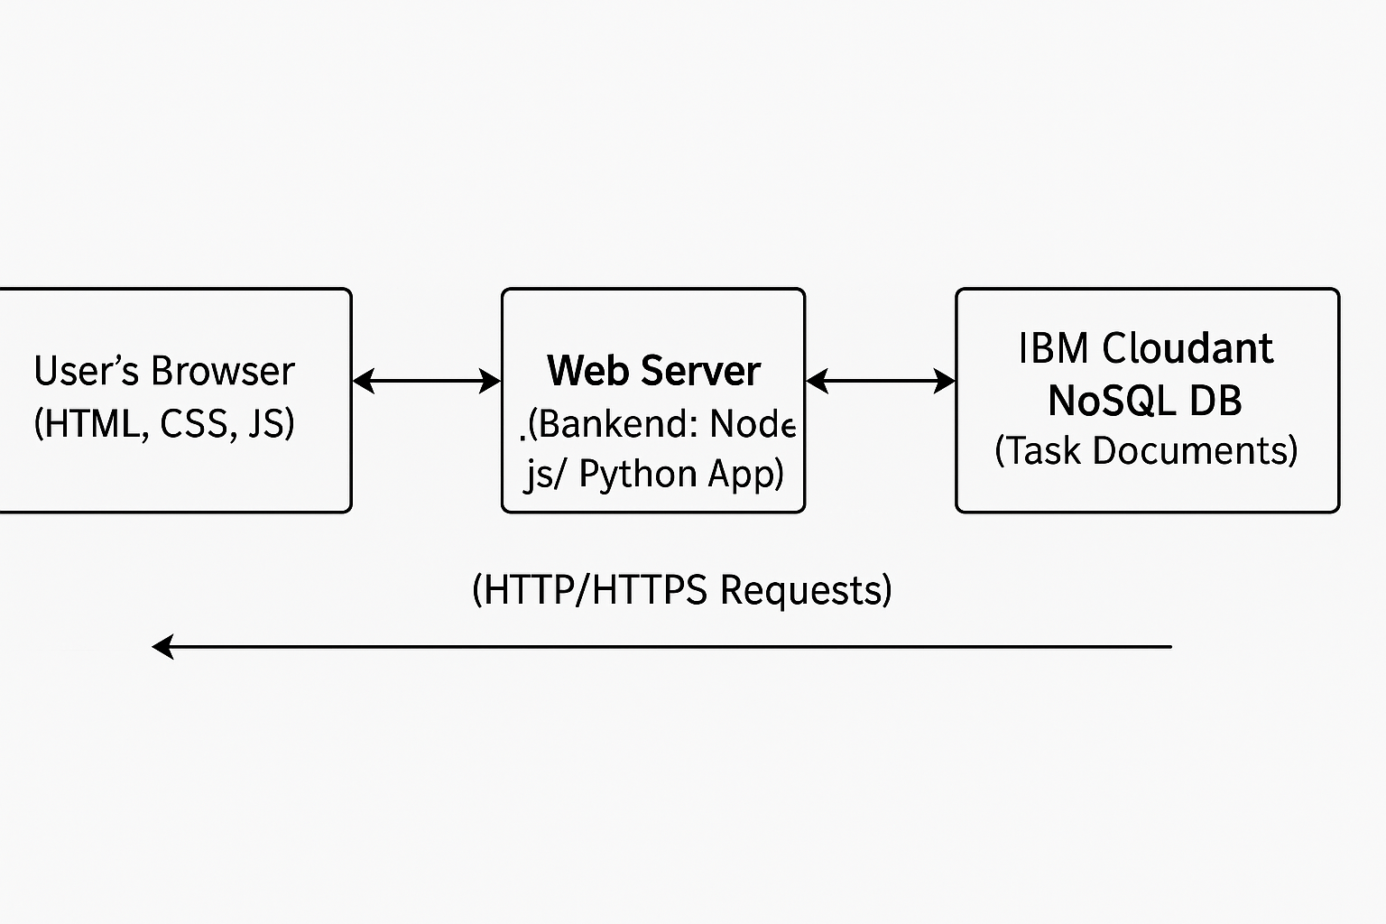
Architecture Overview

Slide 7
Steps Followed
1. IBM Cloud Setup
Created an IBM Cloud account.
Provisioned an IBM Cloudant NoSQL DB instance.
2. Database Configuration
Created a dedicated database
3. Application Development
Frontend: Built UI using HTML, CSS, JavaScript.
Backend: Developed server logic using Python (Flask) to handle requests.
4. CRUD Operations
Create: Add new task documents to Cloudant.
Read: Display all tasks from the database.
Update: Modify existing task details.
Delete: Remove tasks from the database.

Slide 8
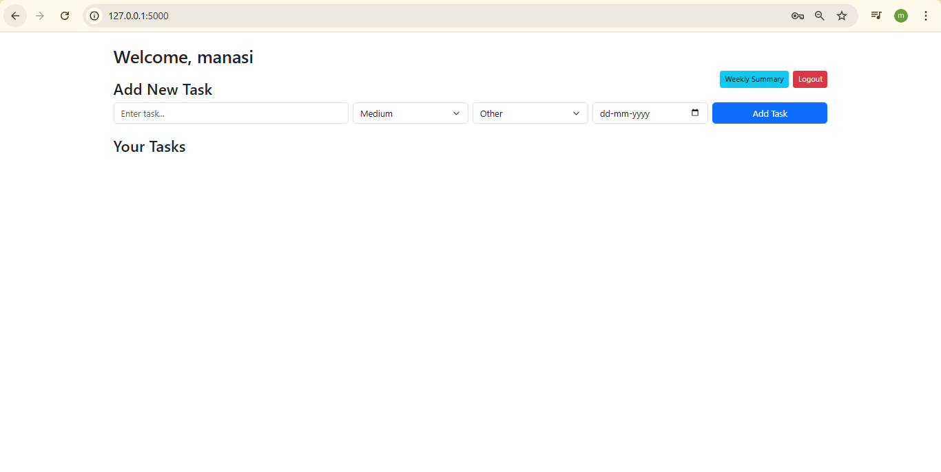
Frontend (Example: Creating a Task)

Slide 9
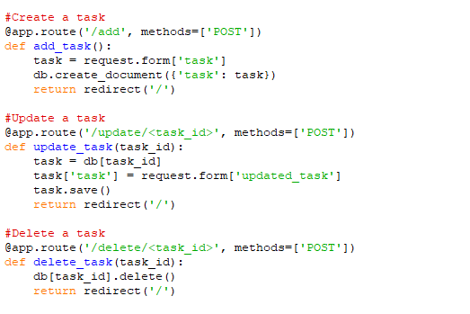
Backend/Database Interaction

Slide 10
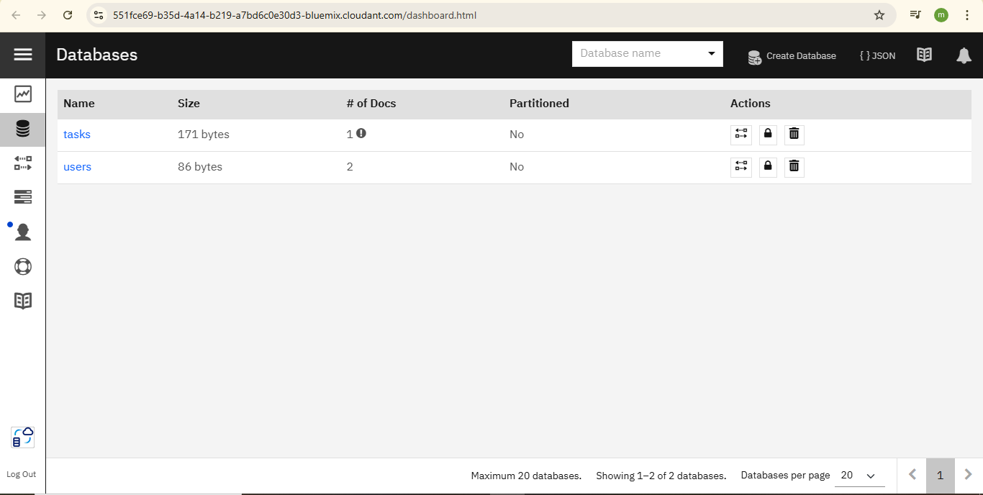
IBM Cloudant Console: Database View

Slide 11
Thank You
GitHub:-https://github.com/Manasi0804/Cloud-task-manager

