Slide 1

COMPASS
Human-Centred Demand Planning Intelligence
The human stays in the loop — and gets better at it.
5-min demo · FVA analysis across 23 planning cycles · 68,126 item-months
Notes:
Welcome. This is Compass — a system I've built around one observation: demand planners override machine forecasts all the time, and the reasons they give almost never get checked. Compass turns that wasted loop into something that actually learns. The human is never removed — they're made sharper every cycle. Let me show you why that matters.
1

Slide 2



THE PROBLEM
Every month, a planner overrides a machine forecast.
Machine forecast
arrives
Planner overrides
with a reason
Reason &
outcome discarded
Statistical model
runs. Number lands.
Free-text. One line.
No structure.
No score. No memory.
No feedback loop.
The outcome — did the override actually help? — is never measured.
So the system never learns. And the planner never improves.
2
Notes:
Here's the situation every demand planning team lives in. The machine produces a forecast. The planner looks at it, disagrees, writes a quick reason in a comment box — 'competitor activity', 'seasonal uplift', 'customer told us X' — and saves a different number. Then nothing happens. Nobody checks whether the override was right. The reason evaporates. The score is never taken. The same planner makes the same mistake next cycle. This is the core failure: a human is in the loop, but the loop is open.
2

Slide 3
THE SCALE OF THE PROBLEM
The problem is universal — and expensive.
52%
-3pp
of forecasts fail to beat a naive baseline. Morlidge (2014), 8 businesses.
accuracy drop after human review at Newell Rubbermaid (65% to 62% -- the edit destroyed value)
Billions in inventory decisions ride on a human edit nobody scores.
We don't replace the human — we finally close the loop.
Sources: Morlidge (2014), Foresight; Fildes & Goodwin (2009), Int. J. Forecasting; Schubert & Rickard (2011)
3
Notes:
This isn't a niche problem. Across academic literature and real deployments, the pattern repeats. Morlidge studied 8 businesses and found that more than half of forecasts don't beat a naïve baseline — next month equals last month. And human judgment often makes things worse, not better. Newell Rubbermaid is a stark example: human review took accuracy from 65% down to 62%. The override actively destroyed value. The reason this keeps happening is simple: nobody scores the edit, so nobody learns from it. That's the gap Compass closes.
3

Slide 4
THE ALPINE DATA FINDING
Humans helped — but only in specific, learnable directions.
Forecast accuracy (MAE) — 23 cycles, 68,126 item-months
Override direction vs. outcome (this dataset)
Machine forecast
Planner override
↑ Upward overrides
71% helped
29% hurt
2,013
1,574
−21.8%
↓ Downward overrides
34% helped
66% hurt
MAE (units)
MAE (units)
The bias direction is business-specific. Academic studies find upward overrides weaker (optimism bias). Here, upward helped 71% / downward hurt 66%. That difference is the whole argument: you can’t hard-code a rule — you must learn the asymmetry per context.
4
Notes:
I ran FVA on 23 historical planning cycles — 68,000 item-months. Overall, planners improved accuracy by 21.8%. That's real, and it matters. But the headline hides something more interesting: the improvement is asymmetric. Upward overrides — 'we think demand will be higher than the machine thinks' — helped 71% of the time. Downward cuts hurt 66% of the time. Now, the academic literature actually finds the opposite pattern in some businesses — upward overrides are weaker due to optimism bias. That tells us the direction of bias is company-specific, not universal. Which means you can't hard-code a correction rule. You have to learn it per context. That's exactly what Compass does — and that asymmetry, by reason type, is the pattern it feeds back.
4

Slide 5



THE COMPASS IDEA
Surface evidence. Human decides. Every decision scored.
Surface evidence
Human decides
Every decision scored
Agents scan order books, supplier data, finance plans, campaigns, and planner history — grounded in real rows, not guesses.
The planner sees machine vs instinct vs calibrated evidence — then commits a number. They own the call. Always.
When actuals arrive, the decision is graded: did it beat the machine? That score becomes memory for the next cycle.
The result: a system that compounds. Each cycle, the memory gets richer.
5
Notes:
The Compass idea is three things working together. First: surface evidence. Before the planner commits, specialist agents scan the actual data — order books, supplier performance, marketing campaigns, financial plans — and return grounded signals. Second: the human still decides. They see all the evidence, but the call is theirs. We're not automating the judgment; we're informing it. Third: every decision gets scored. When actuals arrive, Compass grades the override. Did it beat the machine? That score feeds back into memory for the next cycle. The system compounds. The planner compounds with it.
5

Slide 6
ARCHITECTURE
Five deterministic agents. One LLM call. Closed loop.
① Planner proposes
override + reason
DEMAND
order book · trends · returns
SUPPLY
③ RECONCILER
stock · OTIF · production
Claude Opus 4.8
One call per decision
② Reason classifier
→ fixed taxonomy
FINANCE
revenue plan · tariff movements
Calibrated value · confidence · plain-English rationale
rule-based Python
COMMERCIAL
campaigns · price changes
④ Planner commits
final number → DuckDB
MEMORY
this planner's scored track record
⑤ Actuals scored →
feed into MEMORY
rule-based Python · deterministic · auditable · zero model cost
6
Notes:
Let me walk through the architecture. The planner enters a proposed override and a free-text reason. Step one: a rule-based classifier maps that text to a fixed taxonomy — competitor exit, seasonal, promotional, and so on. Step two: five specialist agents read the actual data tables and return grounded signals — each one is a claim, a direction, and the evidence rows that back it up. DEMAND looks at the order book and customer trends. SUPPLY checks stock cover, supplier OTIF, production attainment. FINANCE compares against business plan and tariff movements. COMMERCIAL checks active campaigns and price changes. And MEMORY — crucially — pulls this planner's scored track record for this reason type. These agents are deterministic rule-based Python. Zero model cost per signal. Fully auditable. Then — and only then — a single Claude Opus 4.8 call reconciles all five signals and returns a calibrated value with confidence and plain-English rationale. One LLM call per decision. The planner commits. It goes to DuckDB. When actuals arrive, it's scored. That score feeds back into Memory. Closed loop.
6

Slide 7
TECH STACK
Deliberate simplicity — every cut earned.
DuckDB
NOT using
Embedded SQL — queries parquet directly, zero server, single binary.
Neo4j
Rule-based Python agents
SQL covers every graph query we have.
Deterministic, auditable, zero model cost per signal. Every signal traceable to source rows.
Vector DBs
Claude Opus 4.8
Structured lookup beats fuzzy search for scored memory.
One reconciliation call per decision. The only LLM in the pipeline. Keeps cost predictable.
Streamlit + Plotly
LangChain
Rapid, readable UI. Engineers can read and audit the whole frontend in an afternoon.
One API call needs no orchestration framework.
Restraint is a feature. Every component can be interrogated by a single engineer in a single afternoon.
7
Notes:
The stack is small by design, and I want to say why each piece is here. DuckDB: we query parquet files directly. No server to spin up, no cluster to manage. Rule-based Python agents: they're deterministic, which means auditable. Any compliance or audit question gets answered by looking at the code — there's no black box. Claude Opus 4.8: one call per decision, period. That's the only LLM cost in the entire pipeline. Streamlit and Plotly: readable, fast, and an engineer can understand the whole UI in an afternoon. Now the 'not using' list is equally important. We don't need Neo4j — every query we have is SQL. We don't need a vector database — scored memory is a structured lookup, not a fuzzy search. We don't need LangChain — when you're making one API call, an orchestration framework is overhead. Every cut was a deliberate choice. Restraint is a feature.
7

Slide 8
LIVE DEMO
Product CP-0271: machine vs instinct vs history.
Machine forecast
Planner instinct
Compass calibrated
833
~1,050
~959
units
units
units
29% below recent run-rate.
Reason: competitor just exited the market.
Based on experience.
No supporting evidence surfaced yet.
Memory: 'competitor_exit'
overrides historically +15% vs machine.
Five agents surface the evidence. Planner sees all three numbers on one screen. Then commits an informed call.
▶ Switching to live demo now.
8
Notes:
Let me set the scene. Product CP-0271. The machine says 833 units. But that number is 29% below the recent run-rate, and the reason is clear if you look at the data: a competitor just exited the market. The planner's gut says something like 1,050. Now watch what Compass does. The five agents surface the evidence — demand signal, supply cover, commercial context. And the Memory agent pulls the track record: overrides tagged 'competitor_exit' have historically realized about +15% against the machine. So Compass calibrates the machine number to roughly 959 — not the planner's gut, not the machine's naive number. The planner sees all three on one screen. They make an informed call. Let me show you this live.
8

Slide 9
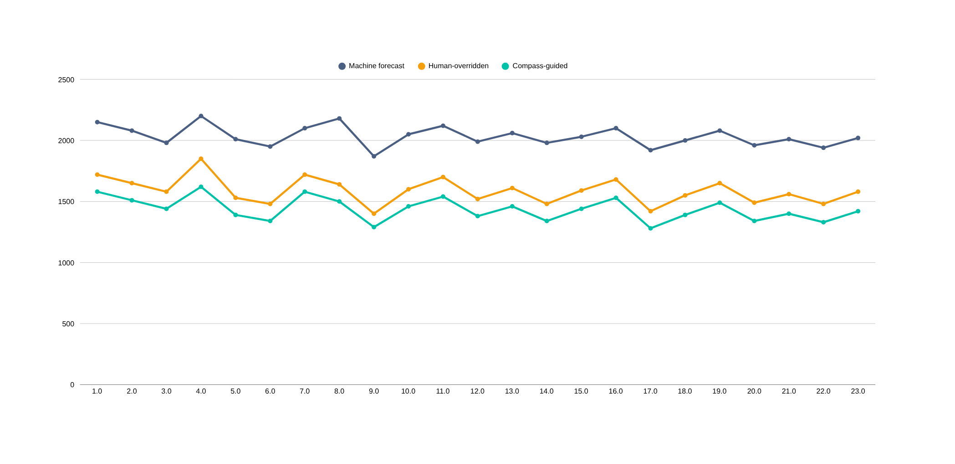
REPLAY DASHBOARD — THE PROOF IT COMPOUNDS
Compass consistently lowest — across all 23 cycles.
MAE (units) — lower is better
Each cycle, Compass-guided decisions build a richer memory. The accuracy gap compounds.
9
Notes:
This is the Replay Dashboard — and this is what I want you to look at. Three lines across 23 planning cycles. Slate-grey at the top: the raw machine forecast error. Amber in the middle: the human-overridden forecast error. Better overall, but volatile — you can see cycles where the planner made it worse. Teal at the bottom: Compass-guided decisions. Consistently lowest. And notice the pattern over time: as Memory gets richer — as more decisions get scored and fed back — the Compass line doesn't just stay low, it trends lower. This is a system that compounds. Every cycle, it learns more about which reason types, which planner decisions, drive accuracy — and it feeds that back. That's the core promise.
9

Slide 10
PORTABILITY
One engine. Any business. Thin adapter, no architecture change.
Any business's
data
Thin
ADAPTER
Compass
CORE ENGINE
Calibrated
decisions
different columns,
different file paths
file paths +
column mappings +
value resolver
classify → agents →
reconciler → score
100% unchanged
per-context bias
automatically learned
The core loop — classify → agents → reconciler → score → feed back — is 100% dataset-agnostic.
Porting = a thin adapter layer: file paths + column mappings + a machine-value resolver. No architecture changes.
Because bias direction is business-specific, the learning loop adapts automatically — same engine, calibrated per context.
Example: an industrial MRO dataset today; a DTC retail catalog tomorrow. Only the adapter changes.
10
Notes:
One last thing before the roadmap. The core loop Compass runs — classify the reason, agents surface evidence, reconciler calibrates, planner decides, score against actuals, feed back — none of that depends on this specific dataset. The problem is identical across any demand-planning business; only the data shape differs. Porting to a new business is a thin adapter layer: you provide the file paths, the column mappings, and a resolver that extracts the machine forecast value. The architecture is completely unchanged. And because the bias direction is business-specific — remember, the academic literature finds different patterns than we did here — the learning loop adapts automatically. You don't re-configure anything. The system learns the new company's asymmetry from its own history. One engine, many businesses.
10

Slide 11
FUTURE SCOPE
Where Compass goes next — five substantive directions.
Calibration-aware nudges
Reason-quality feedback
We know downward overrides hurt 66% of the time in this context. Compass can warn planners before they make a historically risky cut — debiasing in real time.
Score the reasons themselves over time, nudging planners toward the evidence patterns that have historically paid off.
Per-planner coaching dashboard
Multi-domain portability
Auto-score at scale, surface each planner's blind spots — which reason types they over/under-shoot — as an individual feedback report.
Core loop is dataset-agnostic today. An adapter layer ports Compass to any demand-planning business — DTC retail, pharmaceuticals, FMCG — with no architecture change.
Confidence-gated autonomy
Let Compass auto-commit high-confidence, low-stakes decisions; escalate the rest. Scale planner capacity without removing judgment where it matters.
Each extension sharpens the human — not replaces them.
11
Notes:
Let me close on where Compass goes from here — and I want to be specific, not vague. First, calibration-aware nudges. Because we know the direction of bias for this business, the system can flag a downward override before it's committed — 'heads up, cuts in this reason category hurt 66% of the time.' Second, per-planner coaching. Score every planner's decisions at scale and surface their blind spots — which reason types they consistently over or under-shoot — as a feedback dashboard. Third, confidence-gated autonomy. High-confidence, low-stakes decisions auto-commit; everything else escalates to a human. You scale planner capacity without surrendering judgment where it matters. Fourth, reason-quality feedback — score the quality of the reasons themselves, not just the outcomes, nudging planners toward evidence-backed language over time. And fifth, multi-domain portability — which I've already described. The thread through all of these is the same: every capability makes the human sharper.
11

Slide 12
COMPASS
AI that makes the human sharper, not obsolete.
21.8%
23
1 LLM call
accuracy improvement
from human override
planning cycles
analysed
per decision
everything else is free
Questions?
12
Notes:
I'll leave you with one sentence: AI that makes the human sharper, not obsolete. Compass doesn't remove the planner from the loop. It closes the loop they've always been in — but that was never scoring itself, never learning, never feeding back. Twenty-one-point-eight percent accuracy improvement. Twenty-three cycles analysed. One LLM call per decision. The rest is deterministic, auditable, and compounding. I'm happy to go deeper on any part of it — architecture, the FVA analysis, the demo, the roadmap. What would you like to dig into?
12

