Slide 1
ECS Instance Program
Guided by : Prof. R. M. Wahul
Group Members : Pooja Malpure (S17111004)
Bhagyashree Bhoite (S17111006)
Manasi Kshirsagar (S17111009)

Slide 2
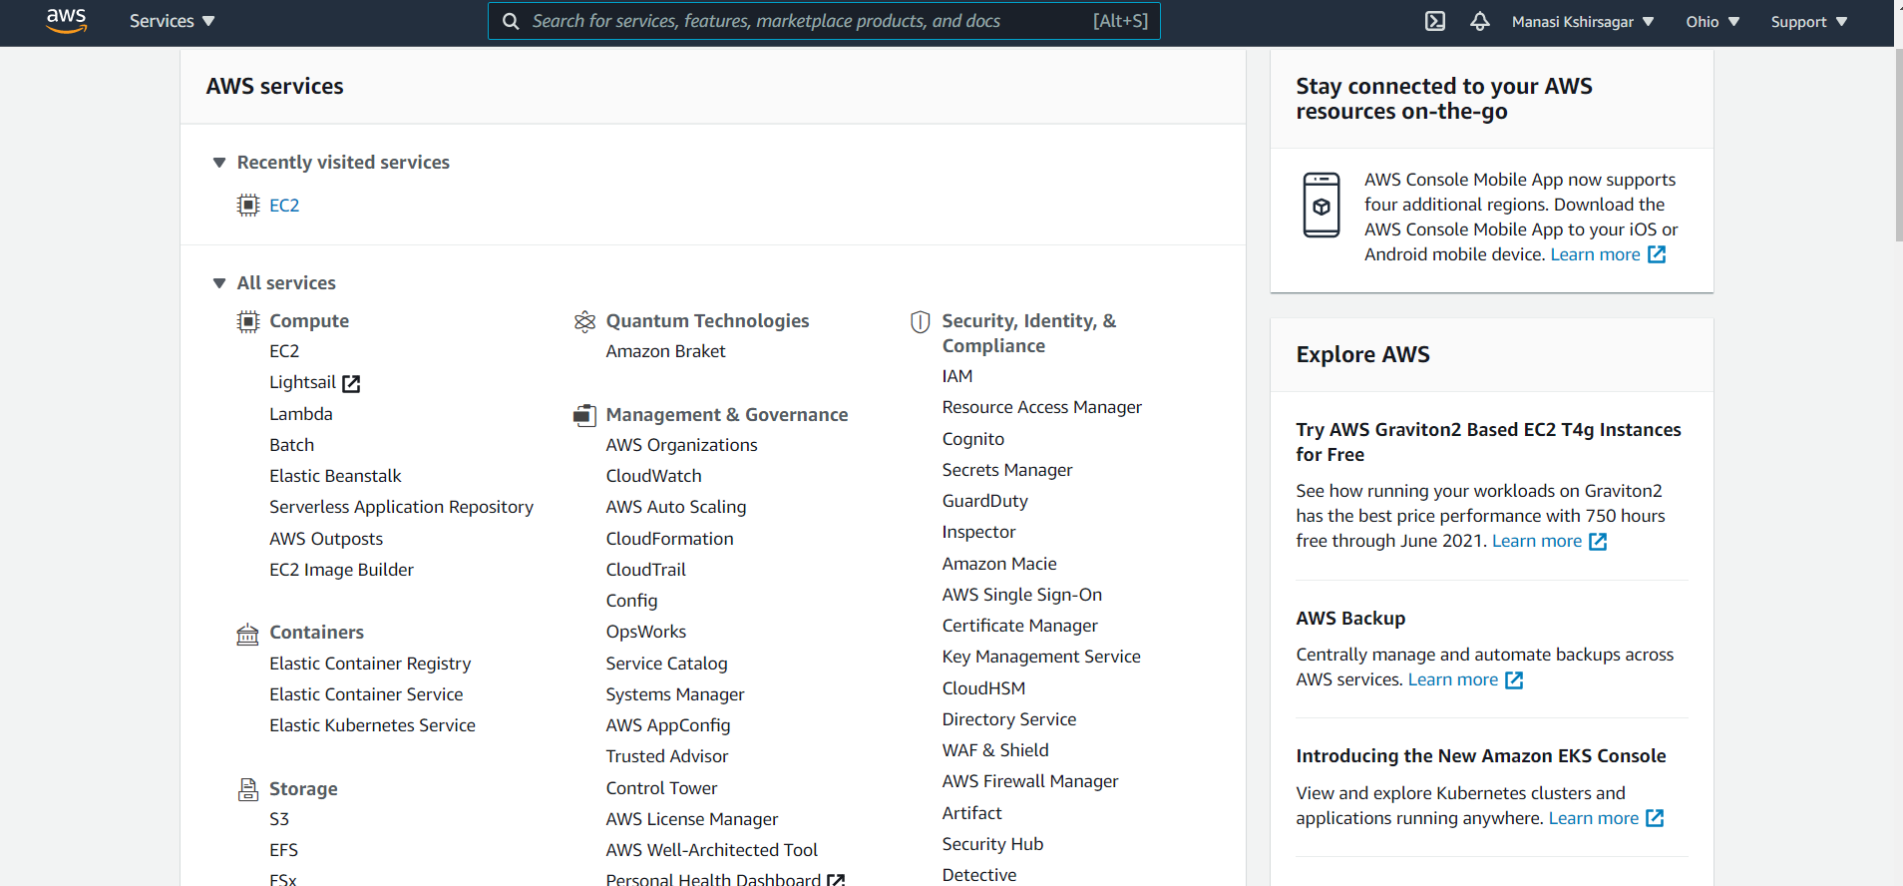
Log In into AWS account. Click on EC2 to launch instance

Slide 3
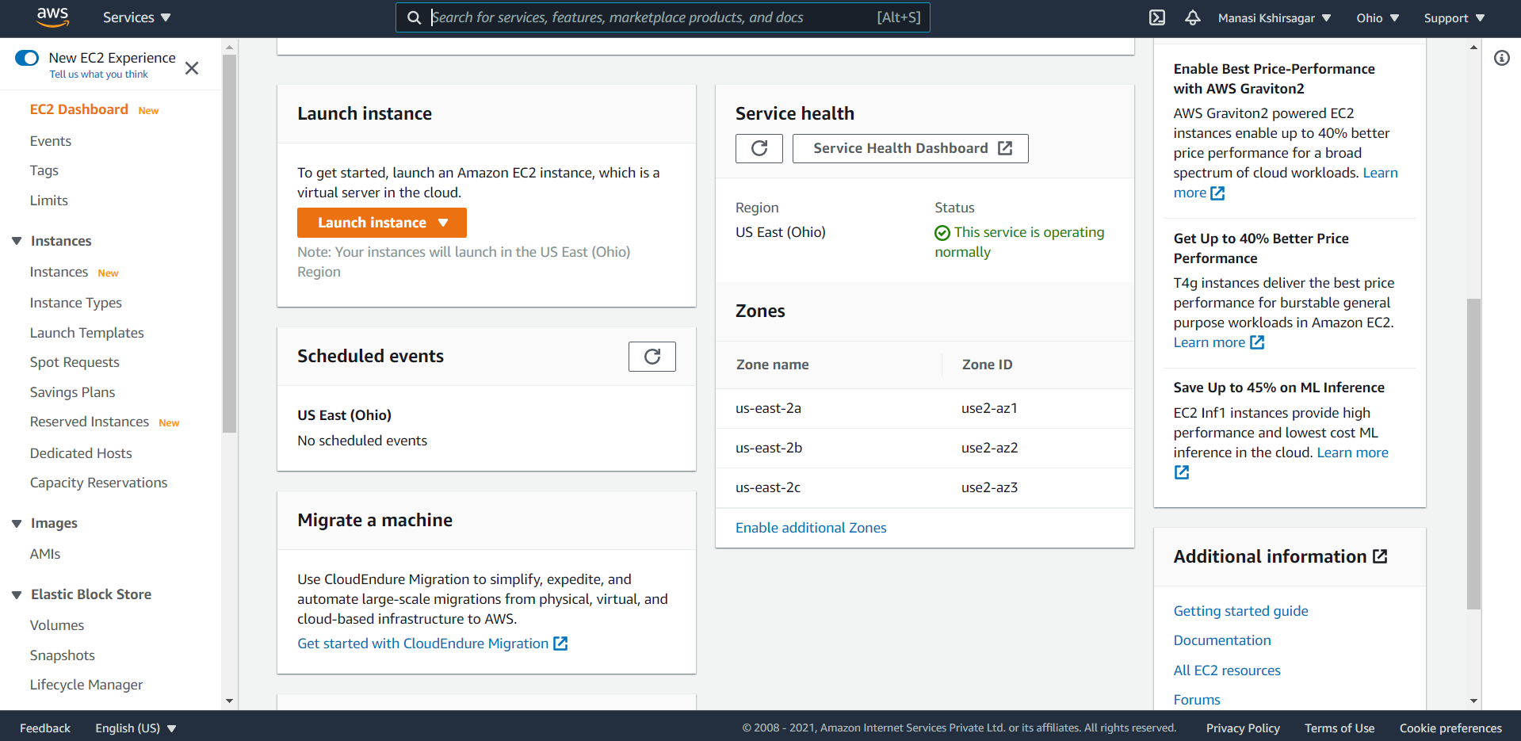
Click on Launch Instance

Slide 4
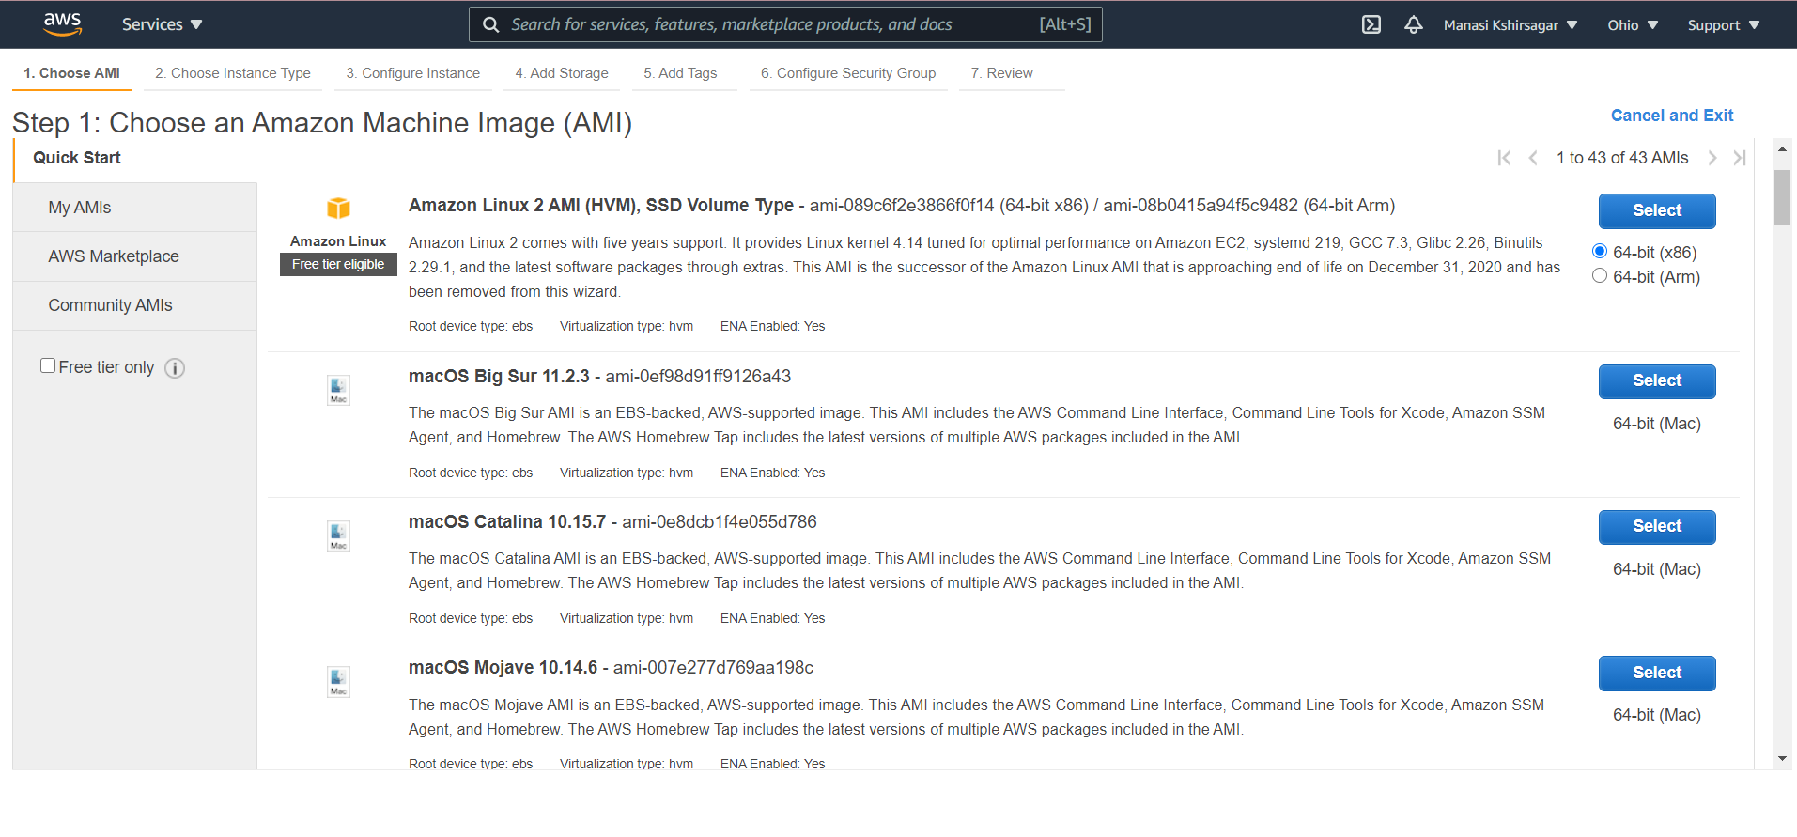
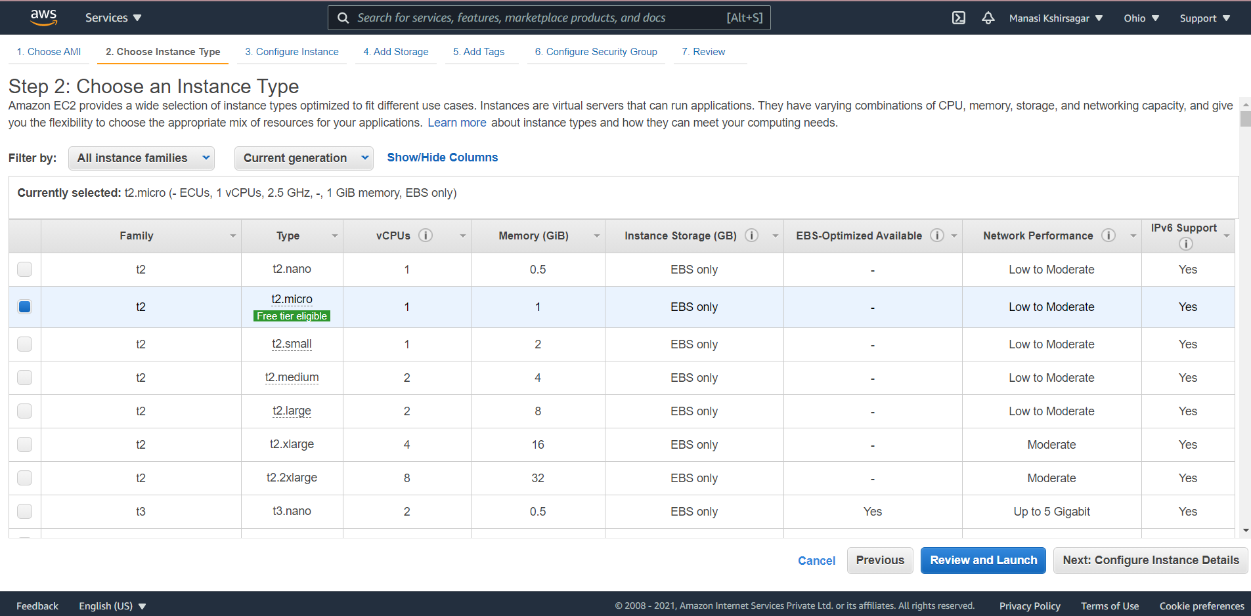
Keep default option marked for choosing Amazon Machine Image (AMI) and Instance type

Slide 5
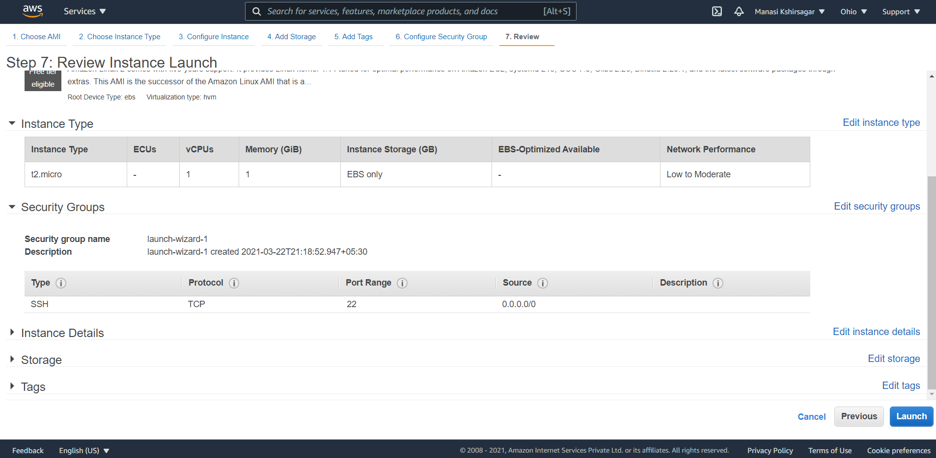
Review and launch instance

Slide 6
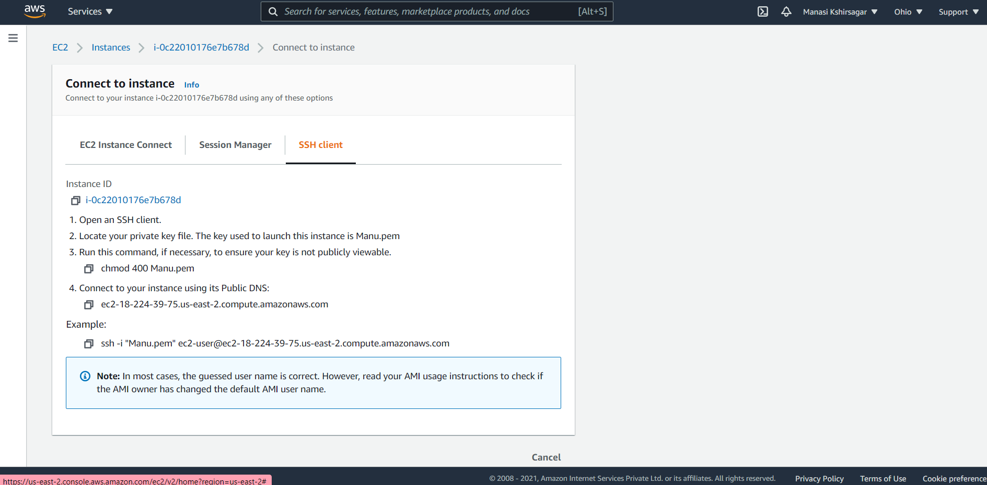
Connect to instance

Slide 7
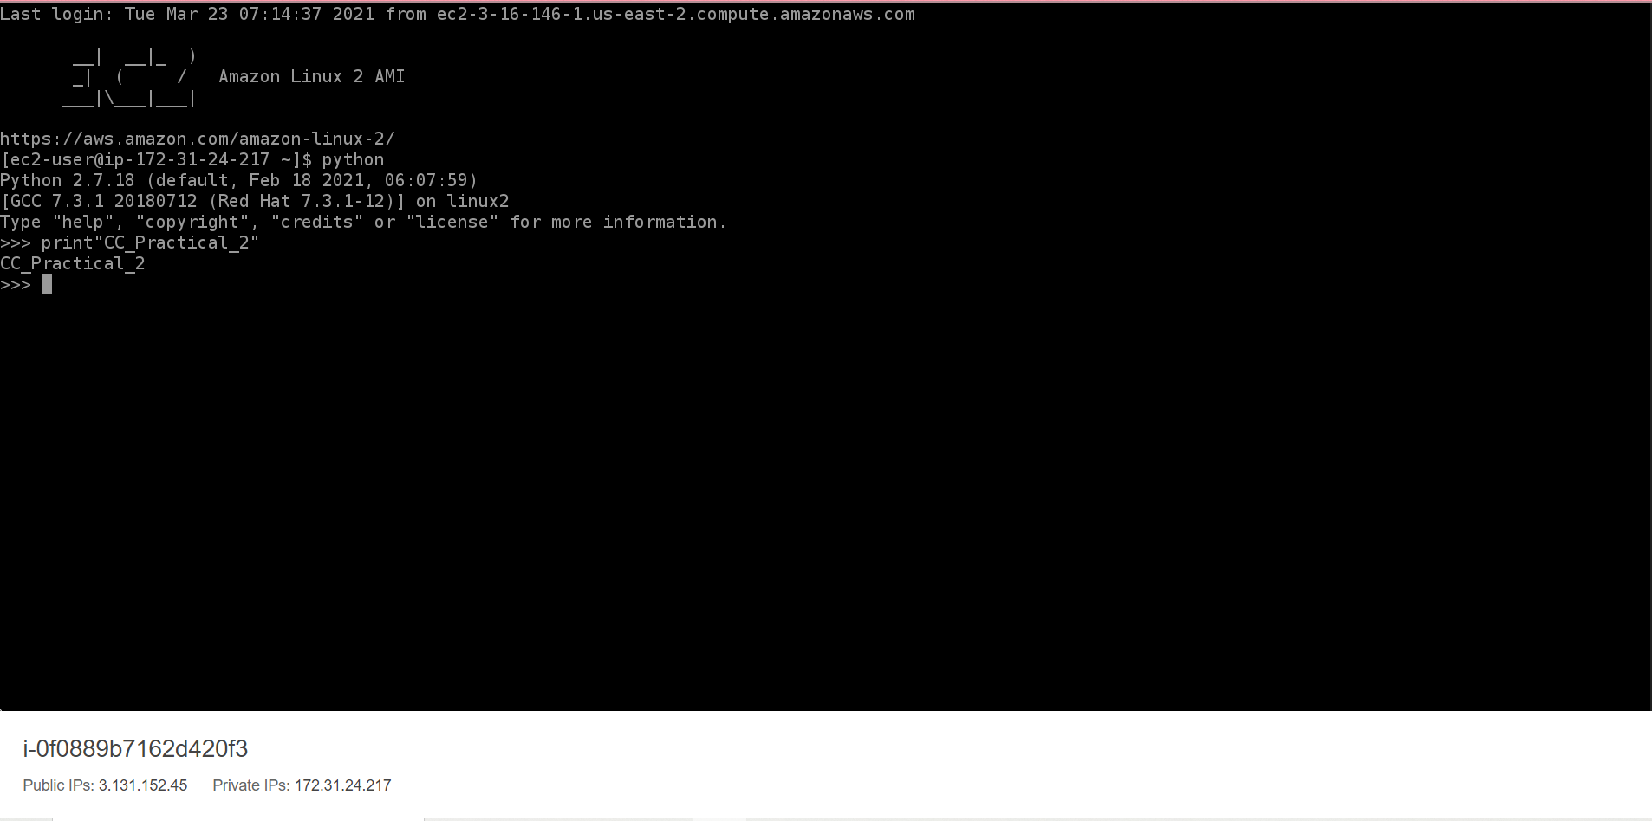
Write python code and run the code

Slide 8
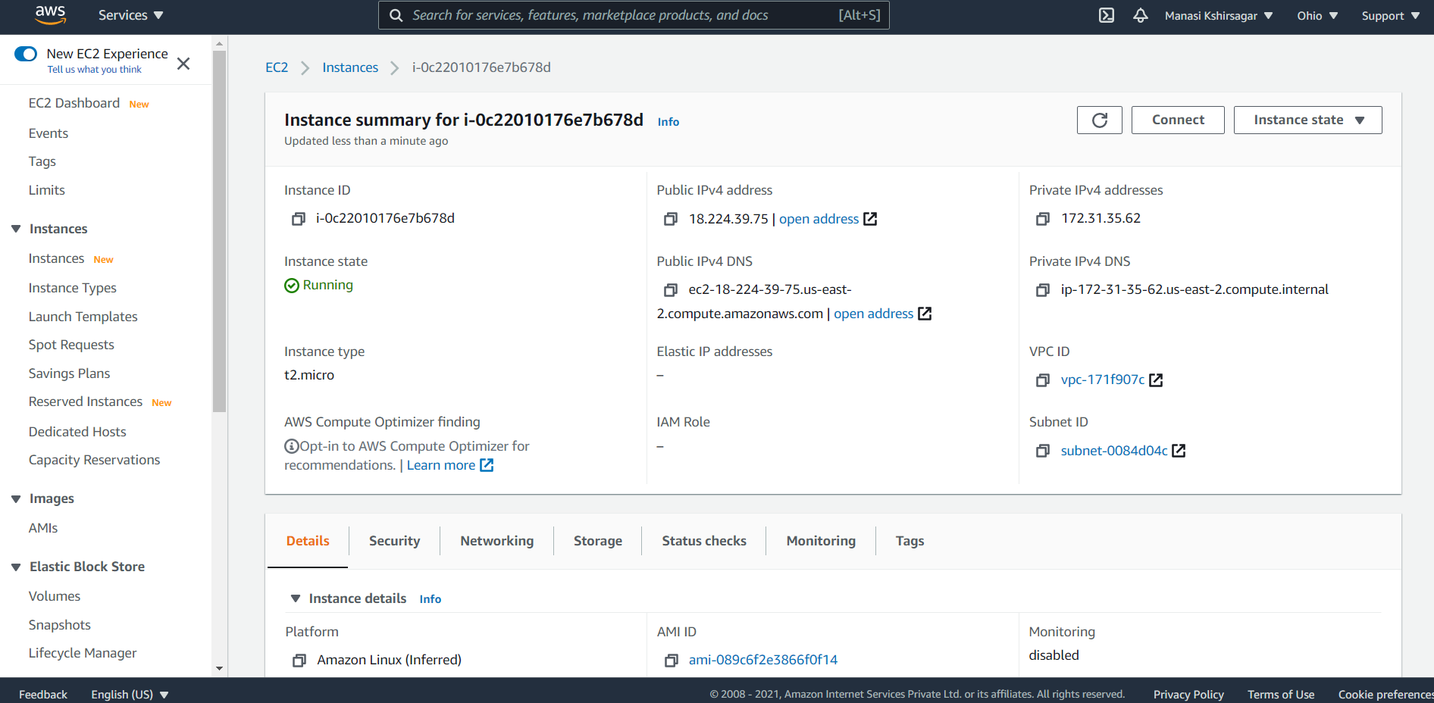
Click instance state, stop instance and logout from AWS account

