Slide 1
Project A Overview
Customer self-service portal for retail banking
Northwind Financial - Digital Channels
Notes:
Welcome slide. Introduce the programme and the sponsor.

Slide 2
Business Goals
Reduce call-centre contacts by 30 percent
Digital satisfaction score of 4.2 or higher
Launch core features within 12 months
Notes:
Explain that the call-centre reduction is the main funding justification.

Slide 3
Scope
In: balances, transactions, statements, card controls, disputes, messaging
Out: loans, investments, mobile app
Notes:
Be clear that mobile is a separate programme.

Slide 4
Technical Approach
React frontend, FastAPI backend, PostgreSQL database
Containers on Kubernetes across two availability zones
JWT authentication: HS256, 15 minute access tokens
API gateway validates every request
Notes:
This is the key architecture slide. Mention that the gateway verifies tokens so services stay simple.

Slide 5
Security
TLS 1.2 or higher in transit, AES-256 at rest
Refresh token rotation and revocation
Immutable audit log retained seven years
Notes:
Compliance reviewers care most about the audit log.

Slide 6
Team and Delivery
6 engineers, 1 designer, 1 product owner
Two-week sprints, staging release every sprint
Monthly usability sessions with customers
Notes:
Mention the team is split across two sites.

Slide 7
Results So Far
Load test: 5000 concurrent users, 1.4 s p95 latency
Active users grew from 800 in January to 4890 in December
Annual revenue contribution 655000 USD
Notes:
Numbers come from Project_Metrics.xlsx.

Slide 8
Timeline
Design complete: Q1
Beta with staff: Q3
Public launch: Q4
Notes:
Launch depends on the security audit sign-off.

Slide 9
Delivery Milestones
Milestone | Planned | Actual | Status
Design complete | Mar | Mar | Done
Beta with staff | Sep | Oct | Done
Security audit | Oct | Nov | Done
Public launch | Dec | - | Planned
Notes:
Beta slipped one month because the security audit was rescheduled.

Slide 10
Revenue by Quarter (native chart)

Slide 11
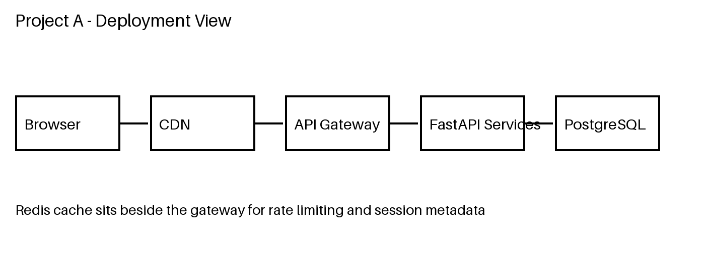
Deployment View
Notes:
Walk through the request path left to right.

Slide 12
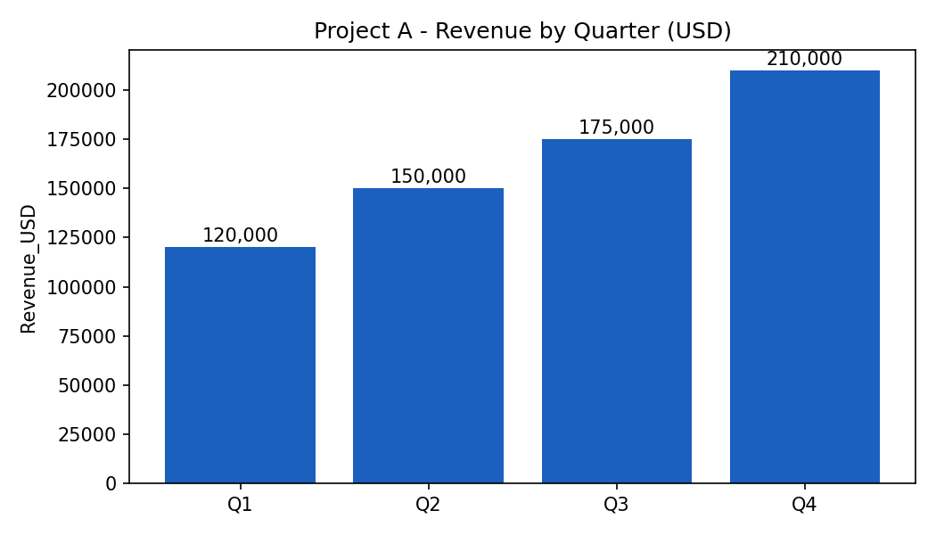
Revenue Chart (picture)

