Slide 1
Signify - Real-time ASL Detection Application
Manasi Jadhav - mjadhav
Sneha Singh - singh 43
Sneha Yadav - snehayad

Slide 2
Background
Approximately more than a half-million people throughout the US(1) use ASL to communicate as their native Language. First appeared in the 1800s, ASL is the third most commonly used language in the United States, after English and Spanish.
The commission on the Deaf and Hard of Hearing

Slide 3
Need for ASL
Communication Access - Everyone needs to have a basic knowledge of ASL in order to communicate with deaf and hard-of-hearing communities.
Cultural Identity - ASL plays a crucial role in the social integration and personal development of people who use it.
Education and Learning - Early exposure to ASL can significantly benefit educational outcomes for children who are deaf or hard of hearing.
Legal and Health Access - ASL helps prevent misunderstandings and ensures that individuals can make informed decisions about important aspects of their lives.

Slide 4
Research Needs in Computer Science
ASL Recognition and Translation Technologies
Enhanced Learning Tools
Accessibility in Digital Media
Human-Computer Interaction (HCI)
Ethical AI Use

Slide 5
Data Collection
The data are the images captured using the opencv library of python.
24 different classes of alphabets (j and z are excluded as they
require actions).
400 images for each class in the MNIST dataset format.
We are using 9600 images in total.
Used opencv library to capture these images through webcam.
Images are captured as frames and stored within their respective directories based on the class.

Slide 6
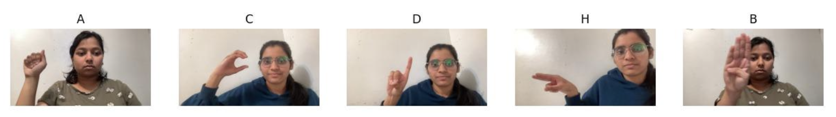
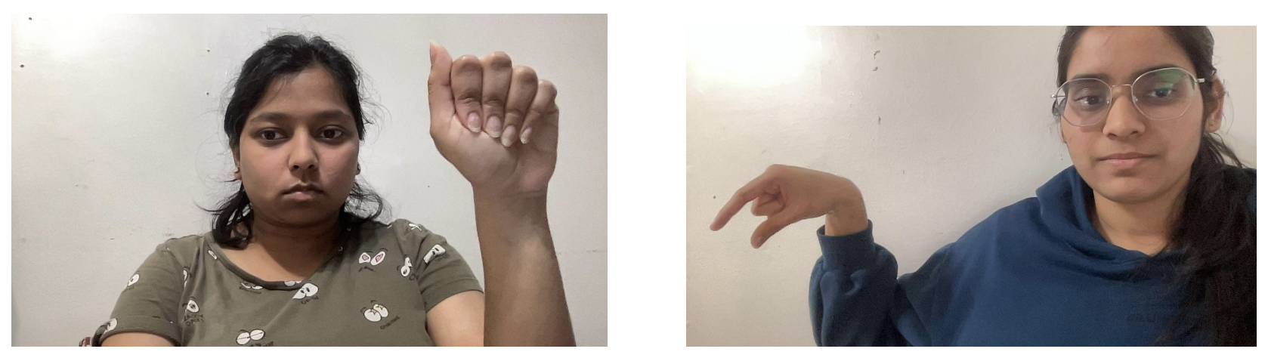

Slide 7
Data Creation and Preprocessing
These images are then converted from BGR to RGB format because MediaPipe requires RGB format.
We are using mediapipe and opencv for image preprocessing. Then we are using os and pickle libraries for directory handling and data serialization.
If exactly one hand is detected, the x and y coordinates of each landmark (21 in total) are extracted and stored in ‘data_aux’.
If the number of landmarks in data_aux is not equal to 42 we are padding it with zeros to maintain consistent feature vector lengths.

Slide 8
Model Definition and Training
Deserializing the data stored in the pickle file
the data_dict dictionary is used to laid the input and labels and then convert them to Numpy array.
Data is then divided into 80:20 ratio for training and testing
The model definition consists of :
Dense Layers : each consisting of 128, 64 and 24 neurons respectively.
Dropout Layers : dropout rate of 0.5
Parameters: trainable parameters 15,320
Output: 24 neurons as we have 24 output classes.

Slide 9
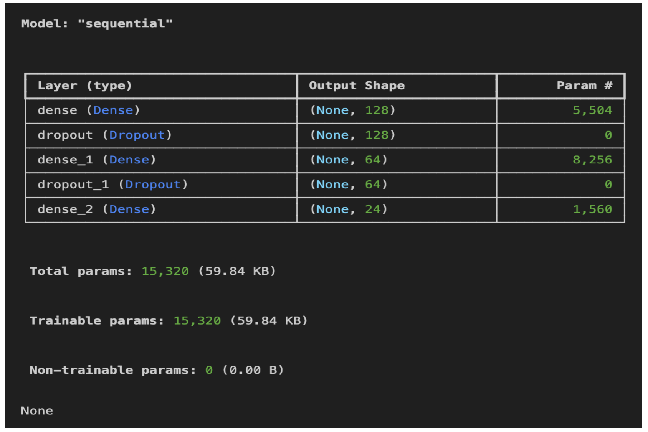

Slide 10
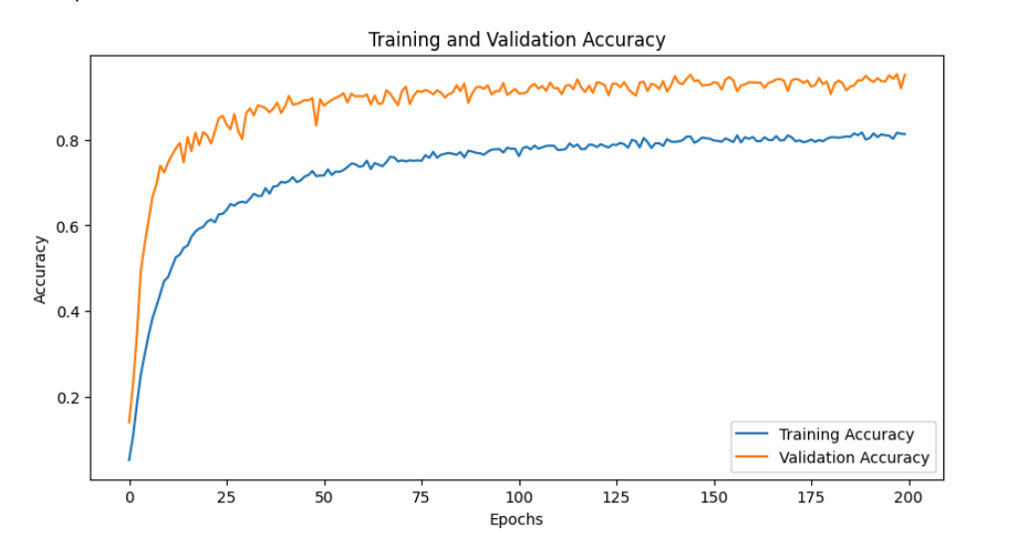
Results: Training vs Accuracy
Following is the graph which shows Training and Validation accuracy in increasing manner over 200 epochs

Slide 11
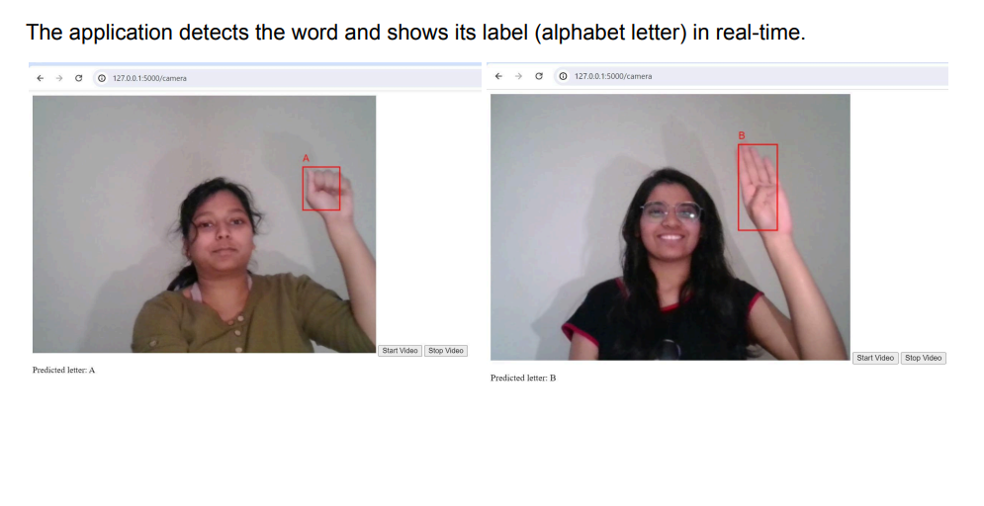
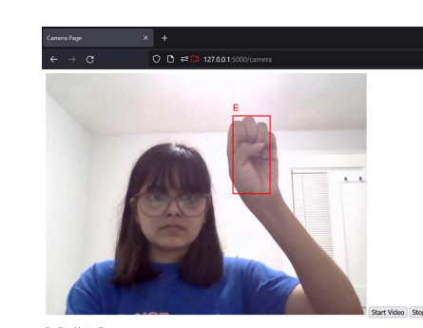
Results

Slide 12
Bonus Task: Signify Application
Developing an American Sign Language (ASL) detection and translation application using deep learning offers numerous benefits and practical applications in the real world.
Impacts of this project:
Enhanced & Inclusive Communication: the application bridges the communication gap between ASL users and those who do not know ASL
Education: In educational settings, such an application can significantly enhance the learning experience for deaf students
Social Inclusion: - Beyond functional benefits, the application promotes social inclusion, helping to normalize ASL and the participation of deaf individuals.

Slide 13
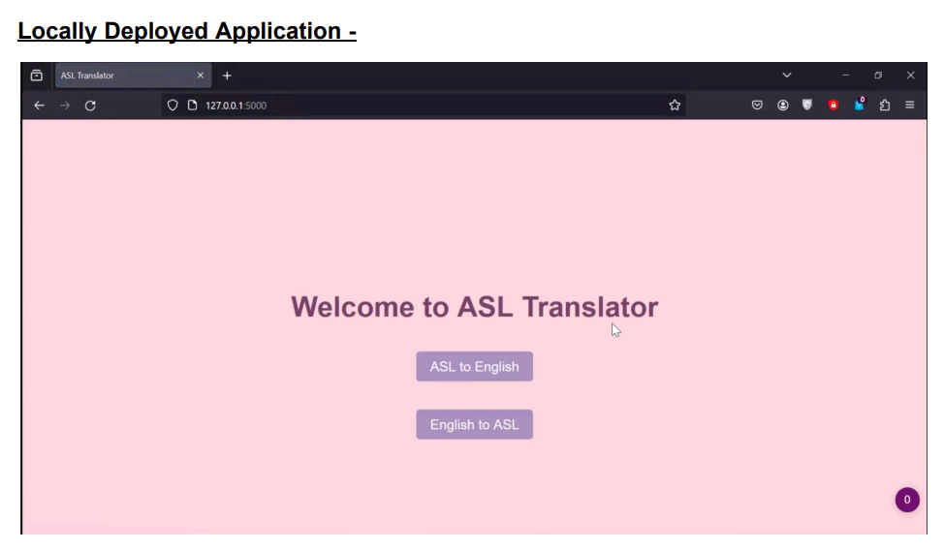
Bonus Task: Signify Application

Slide 14
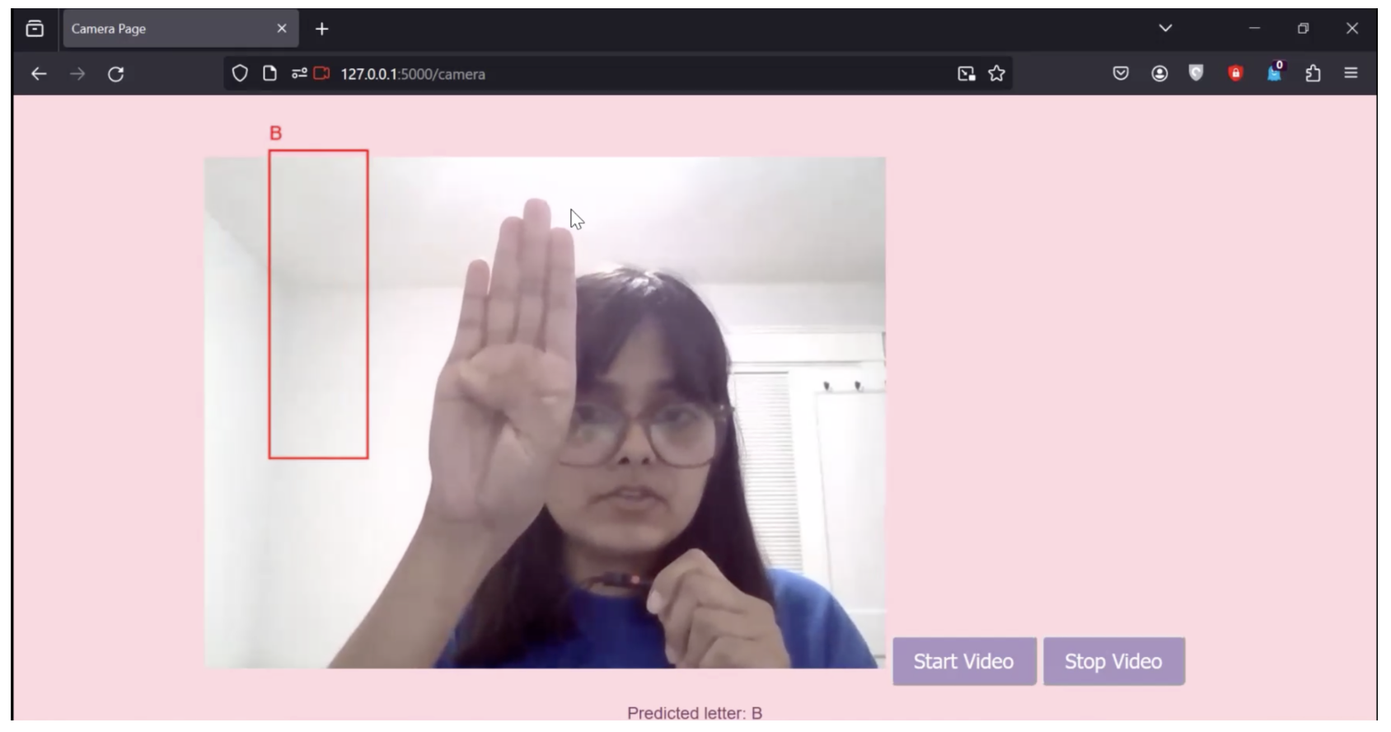

Slide 15
Thank you!

