Slide 1
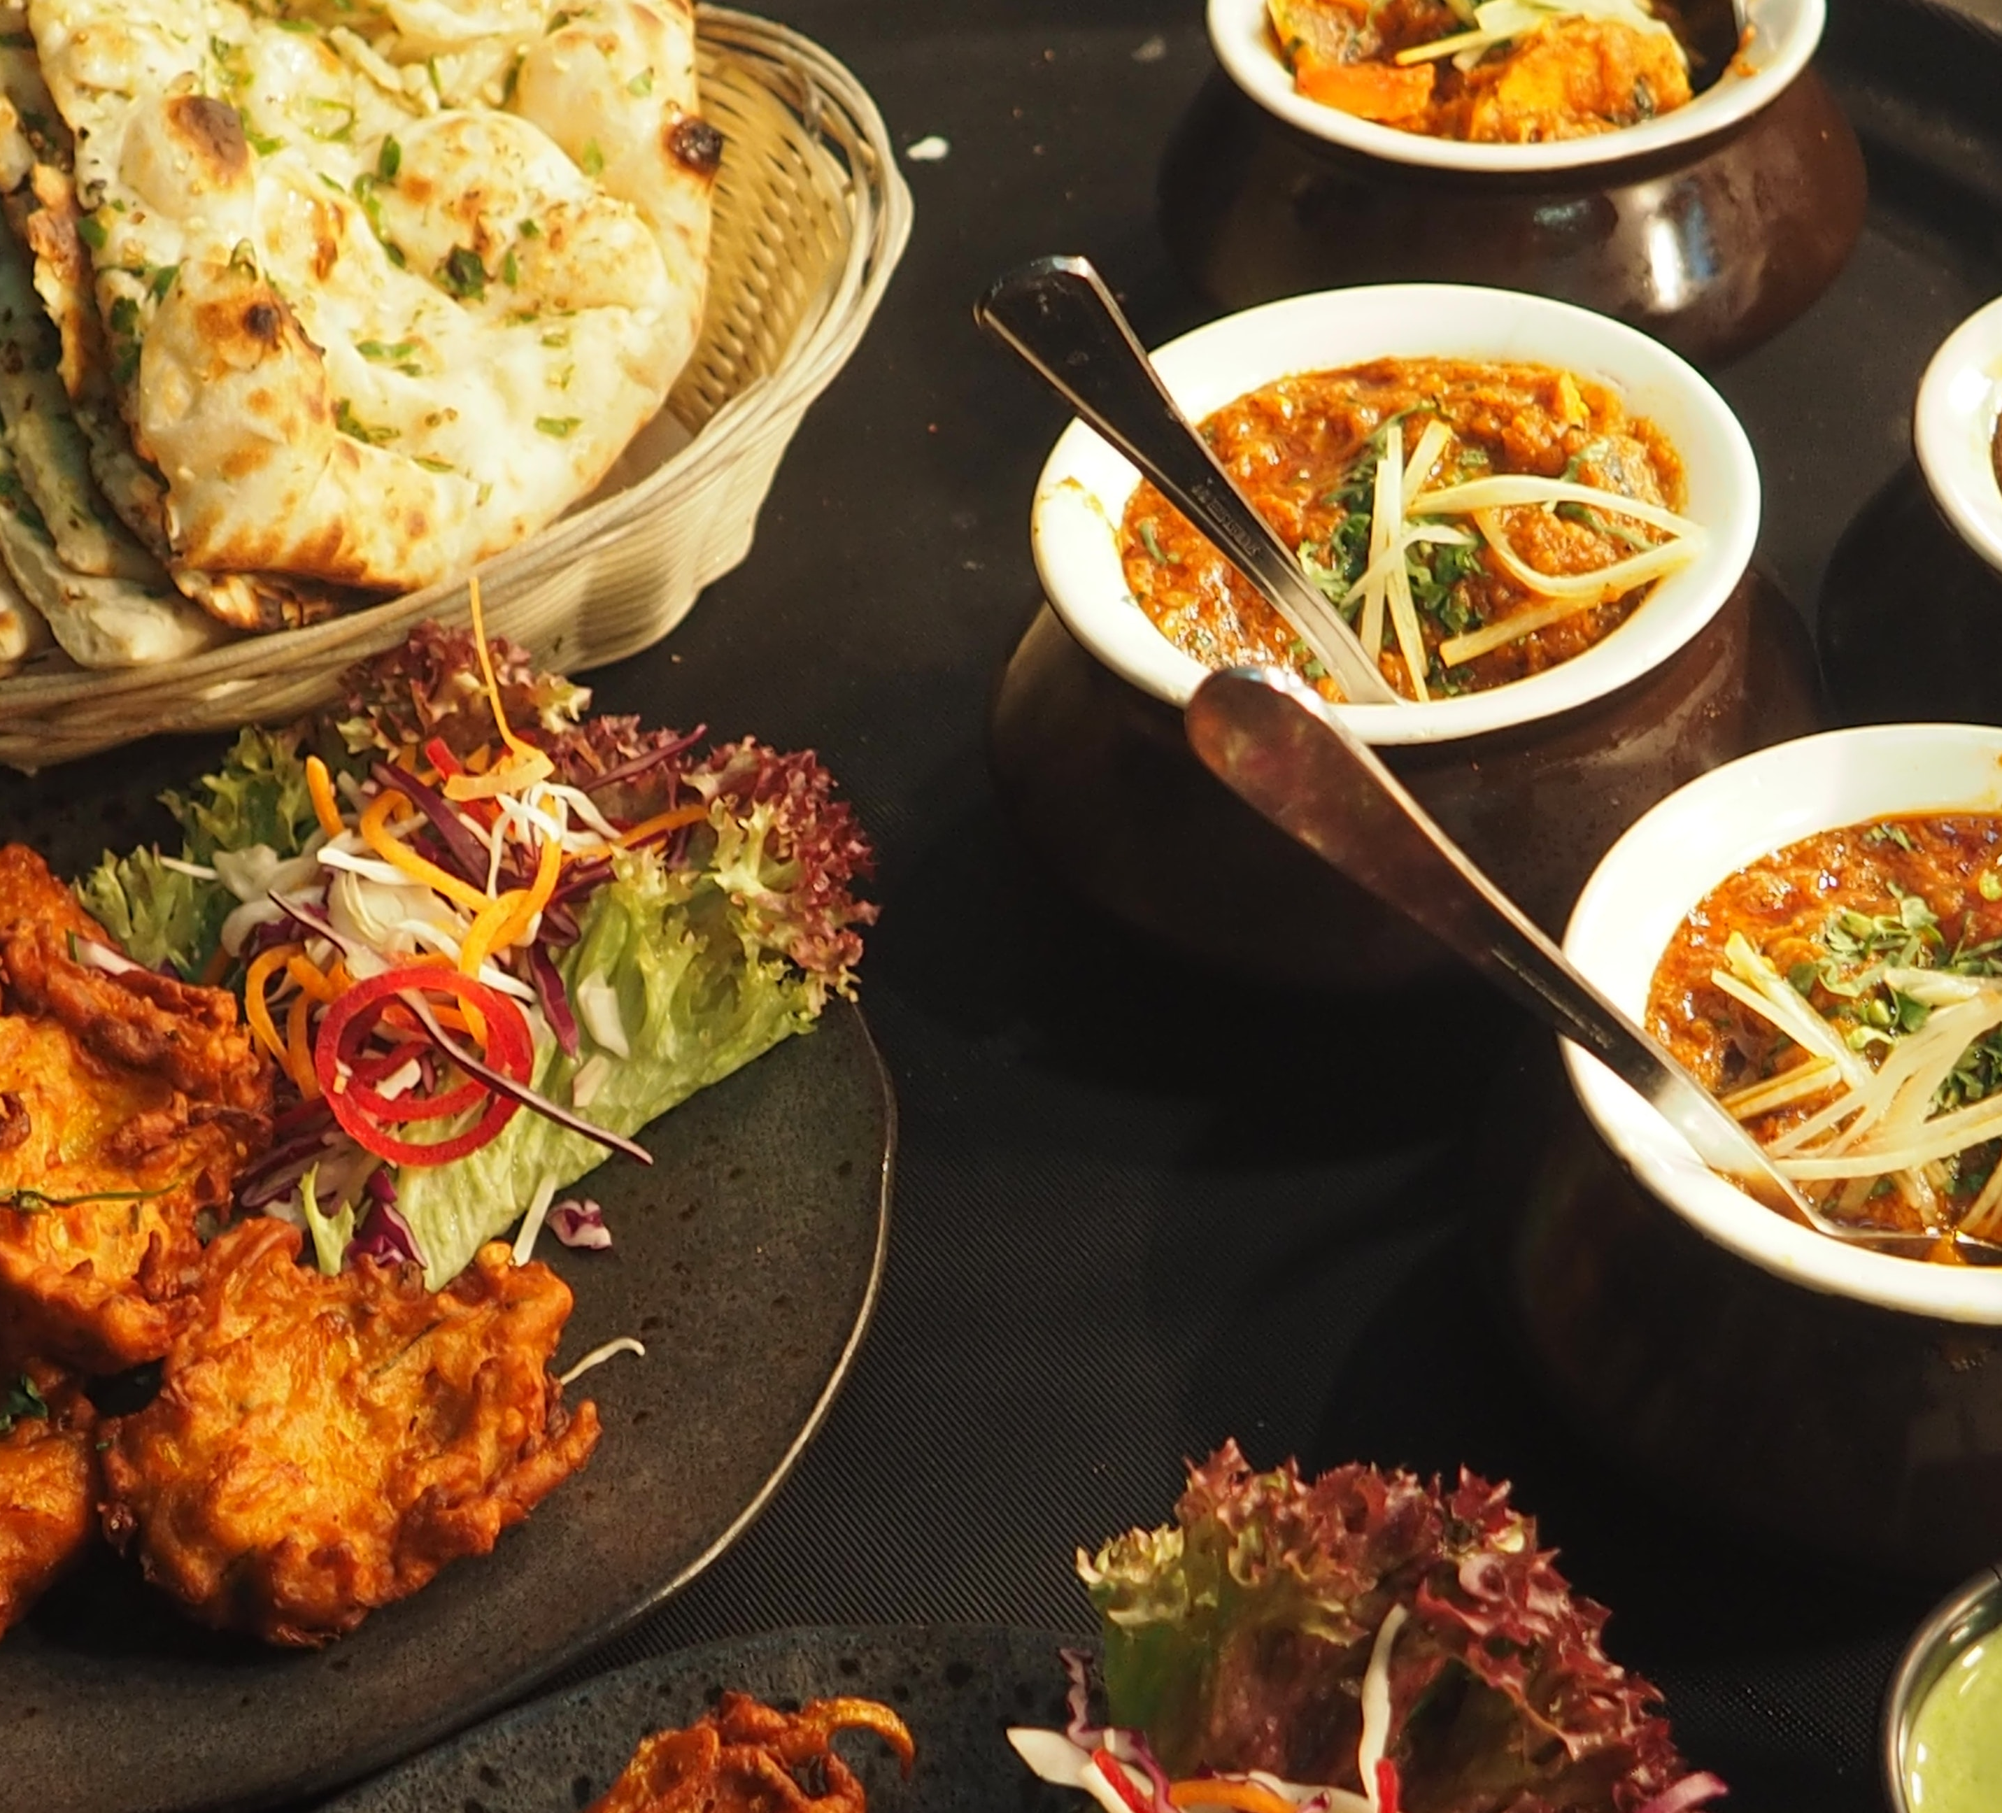

MANASI ASHOK KAMBLE
Final Project
Restaurant Management System
STU61161ca57c8c01628839077

Slide 2
Restaurant Management System

Slide 3

AGENDA
INTODUCTION
PROBLEM STATEMENT
PROJECT OVERVIEW
WHO ARE THE END USERS
SOLUTION AND ITS VALUE PROPOSITION
THE WOW IN YOU SOLUTION
THE RESULT
MEET OUR TEAM

Slide 4
INTRODUCTION
Restaurant Management System is a website designed primarily for use in the food delivery industry. This system will allow hotels and restaurants to increase scope of business by reducing the labor cost involved. The system also allows to quickly and easily manage an online menu which customers can browse and use to place orders with just few clicks. Restaurant employees then use these orders through an easy to navigate graphical interface for efficient processing.

Slide 5

PROBLEM STATEMENT
Restaurant management system basically runs between customers and management in a restaurant. the customer interacts with generally one waiter and places their order, while the waiter takes multiple customers in a day. the customer places an order with the waiter, the waiter generates an invoice with the details of the customer, their order and table number, which is sent to the kitchen. once the order is prepared the runner uses the invoice to serve the food.
The waiter usually asks again if the customers want to order anything more, this process can go on till the customer decides he does not want any more food. all the invoices generated by the customer are part of a much larger entity called order. the order is essentially the bill generated in the end by the restaurant for the customer.

Slide 6

PROJECT OVERVIEW
Develop a system that will allow customers to place their food order online and provide them with feedback as to the calorie and fat count of the meal, a generic image of the meal, a list of side dishes, main course ingredients, and cost information.

Slide 7

WHO ARE THE END USERS?
Customers

Slide 8

SOLUTION AND ITS VALUE PROPOSITION
Easy to use the food ordering system are easy to use and offers high convenience with time and effort saving for the customers. This has encouraged more users to use the mobile apps and order their favourite food online to get them delivered to their table.
5. Effective customer support with 24/7 customer support facilities, the system can offer the best customer supports, answering to their queries and assisting them in any need or complaints.

Slide 9

THE WOW IN YOUR SOLUTION
In that we have to use some languages.
MySQL - all database related developments were handled using this because development tools, and administration objects are available with this software.
HTML – Hyper Text Markup Language is used to build the base interfaces of the system
CSS – Cascading Style Sheets was used to make the system more attractive and user friendly. Php –used to build the system.
XAMPP SERVER

Slide 10
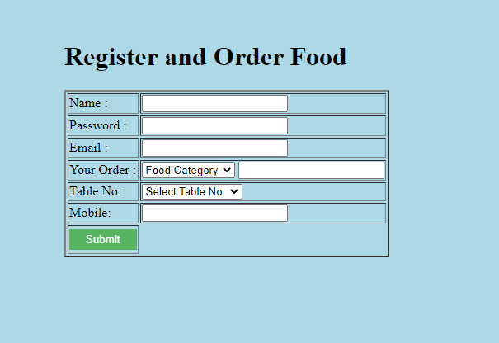
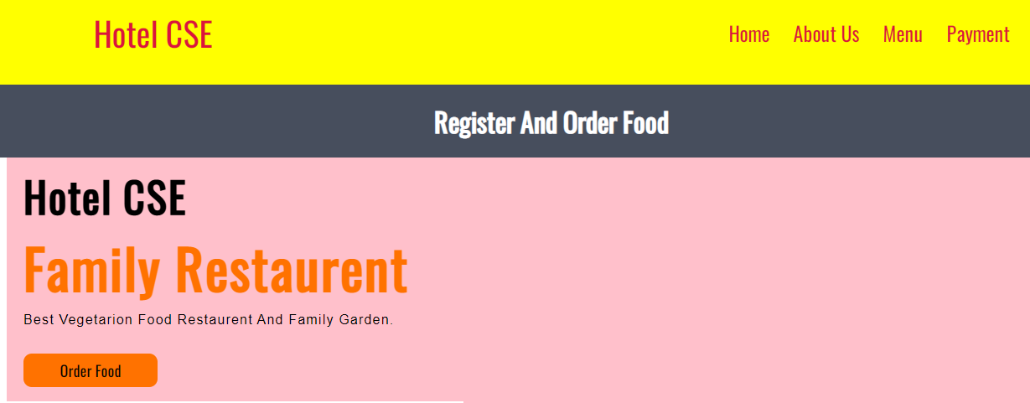
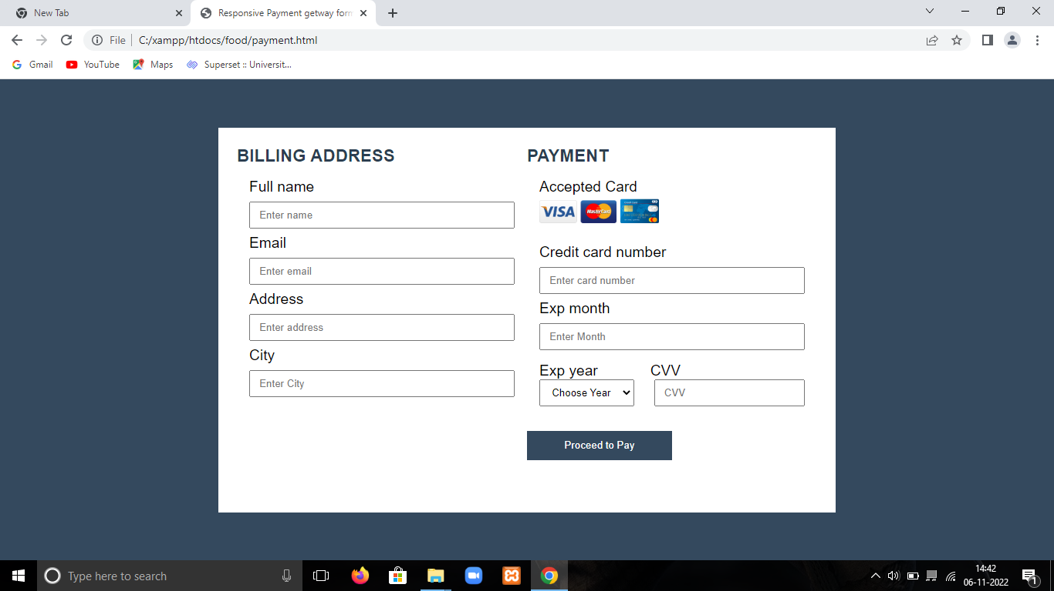
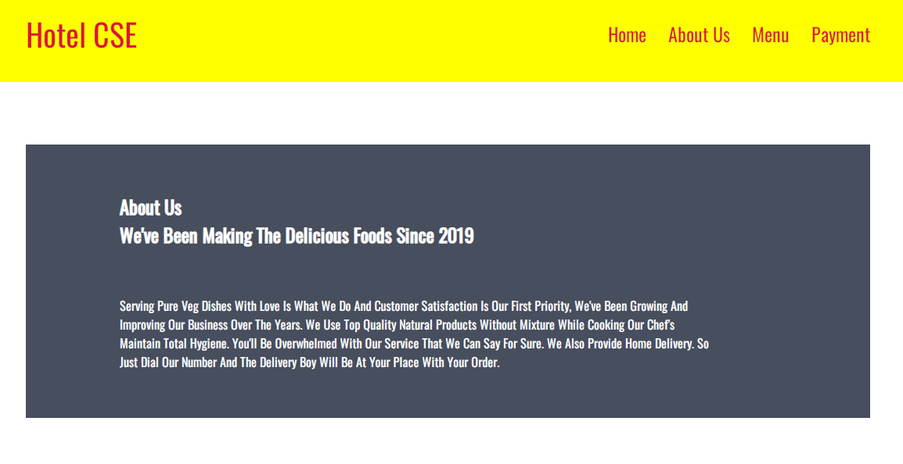
RESULTS
Demo Link

Slide 11
MEET OUR TEAM
Name: MANASI ASHOK KAMBLE
STU Id: STU61161ca57c8c01628839077
.
.

Slide 12
Thank you!

