Slide 1

Multimodal Academic Performance Prediction System
Using Text, Tabular, and Behavioral Data
Manasi Narkhede (DS24M11)
Savitribai Phule Pune University
Industry Mentor: Mr. Rithik Raj Vaishya

Slide 2
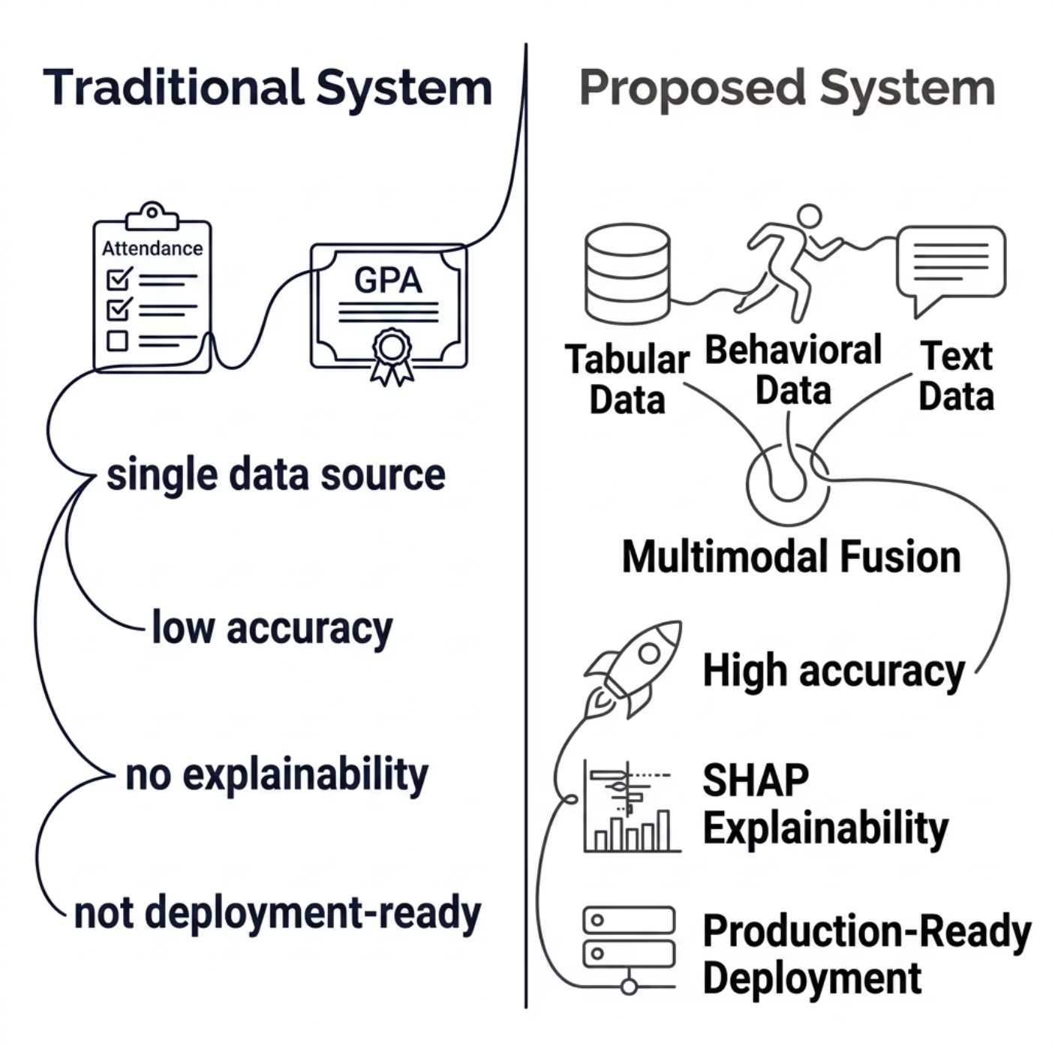


PROBLEM DEFINITION
The Challenge: Beyond GPA & Attendance
Student engagement is multidimensional — yet existing systems rely on single-dimensional indicators, lack explainability, and are not deployment-ready. Early identification of at-risk students remains a critical unmet need.
Core Research Question: How can tabular, behavioral, and textual data be combined into accurate and interpretable academic risk predictions?

Slide 3

ABSTRACT
What We Built
A production-ready multimodal prediction platform combining three ML paradigms — XGBoost, LSTM, and Transformer/BERT — through late fusion ensemble architecture, with SHAP explainability and natural language explanations, deployed via React + FastAPI + PostgreSQL on AWS.
Student Data
ML Models
Late Fusion
Dashboard
The pipeline fuses heterogeneous student data through specialized models and an explainability layer, delivering interpretable risk scores to educators in real time.

Slide 4





INTRODUCTION
Why This System Matters
Multimodal Prediction
Fuses tabular, behavioral, and textual data for richer, more accurate risk modeling than single-source approaches.
Explainable AI
SHAP-based transparency builds educator trust and supports evidence-driven, actionable interventions.
Full-Stack Deployment
React + FastAPI + PostgreSQL on AWS — production-grade, scalable, and cloud-ready from day one.
Ethical AI
Designed with fairness auditing and bias mitigation principles embedded throughout the pipeline.

Slide 5
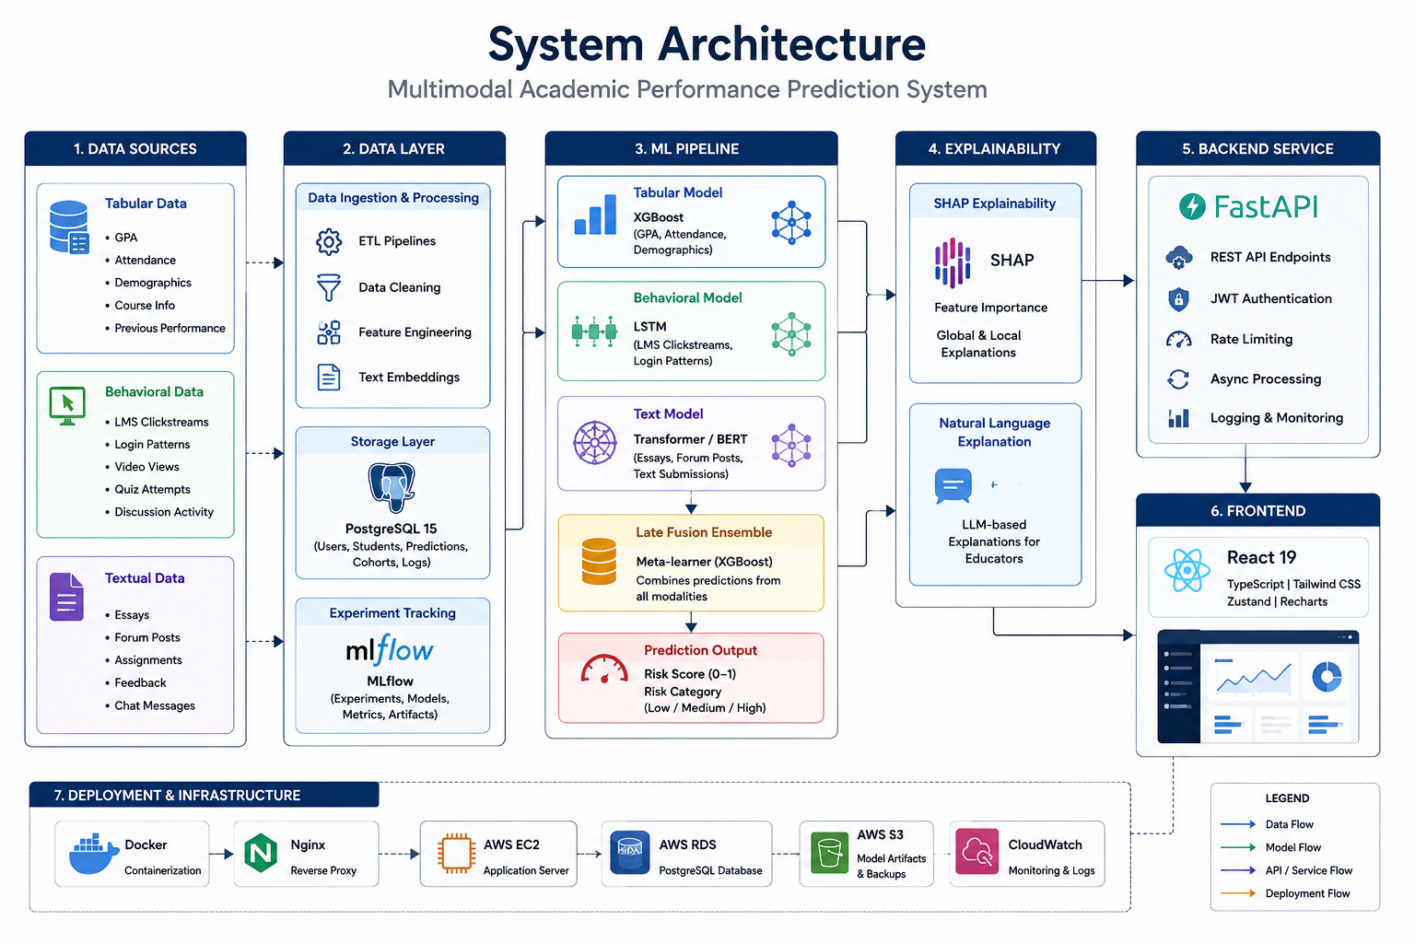
SYSTEM ARCHITECTURE
End-to-End Platform Architecture
The system follows a clean, layered architecture — from raw student data ingestion through multimodal ML processing, explainability, and cloud-hosted delivery. Each layer is independently scalable and fault-tolerant, designed for production-grade reliability on AWS infrastructure.

Slide 6
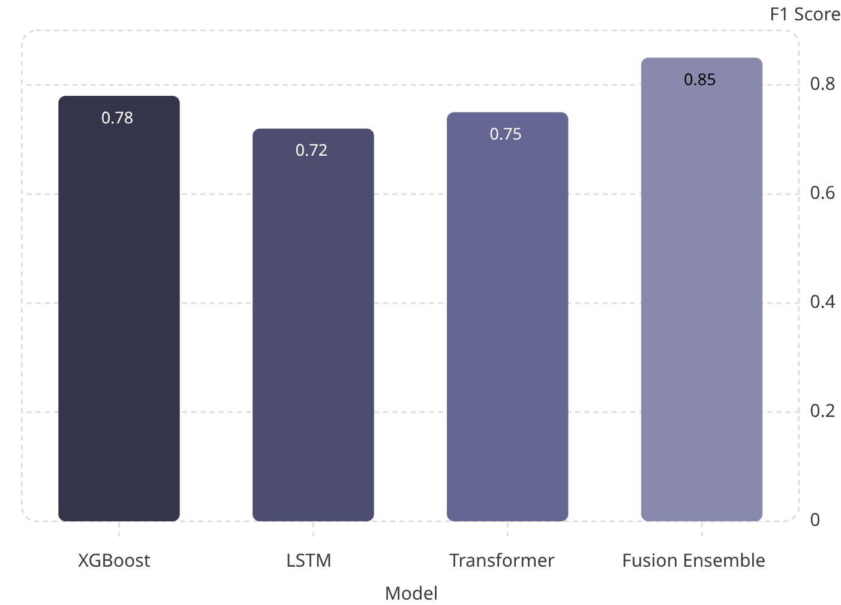

RESULTS & PERFORMANCE
Model Performance: F1 Score Comparison
Key Findings
Best Model: Fusion Ensemble
F1 = 0.85 — outperforms all individual models, validating the multimodal approach.
System Throughput
Prediction latency <500ms · API response <100ms · 100+ predictions/minute
Production-Ready
Validated under real-world load conditions on AWS cloud infrastructure.

Slide 7

LIMITATIONS
Current System Constraints
Data Dependency
Language Scope
Real-Time Processing
Requires substantial historical training data; cold-start problem for new institutions.
English-only text support; multilingual student populations not yet covered.
No live streaming pipeline; batch-oriented inference only at present.
Hardware Requirements
Fairness & Drift
GPU preferred for Transformer/BERT inference; increases deployment cost.
Fairness metrics depend on demographic data quality; periodic retraining needed for model drift.

Slide 8




FUTURE WORK
Future Modifications
Real-Time Analytics
MLOps Automation
Kafka-based streaming pipeline; live student engagement monitoring.
Automated retraining, drift detection, and CI/CD for model updates.
Mobile Platform
Federated Learning
Native mobile app for students and educators; multi-language support.
Privacy-preserving cross-institutional training; built-in fairness auditing.
Each phase builds toward a more robust, equitable, and scalable academic intelligence platform.

Slide 9
CONCLUSION
Key Takeaways
Production-Ready System
Multimodal Fusion Wins
Successfully developed and deployed a full-stack multimodal prediction platform on AWS.
Fusion ensemble (F1 = 0.85) outperforms all single-model baselines, validating the approach.
Explainable AI
Scalable & Ethical
SHAP-based transparency builds educator trust and enables actionable interventions.
Cloud-native architecture supports early intervention at institutional scale with fairness by design.

Slide 10

Thank You
We appreciate your time and interest in our Multimodal Academic Performance Prediction System. I believe this system holds significant potential to foster student success and empower educators with actionable insights.

