Slide 1

Text- To- speech
PRESENTED BY- MANASI TAYADE

Slide 2
Introduction
The text-to-speech (TTS) is the process of converting words into a vocal audio form.
The program, tool, or software takes an input text from the user, and using methods of natural language processing understands the linguistics of the language being used and performs logical inference on the text.
This processed text is passed into the next block where digital signal processing is performed on the processed text.
The text being passed is firstly pre-processed with the help of natural language processing, and then using digital signal processing is converted to speech.
Using many algorithms and transformations this processed text is finally converted into a speech format.

Slide 3
What is gTTS?
Cloud Text-to-Speech is powered by WaveNet, software created by Google's UK-based AI subsidiary DeepMind.
DeepMind's AI voice synthesis tech is notably advanced and realistic.
WaveNet uses machine learning to generate speech. It then waveforms from a database of human speech and re-creates them at a rate of 24,000 samples per second.
The end result generate speech that mimics human voices and sounds more natural, reducing the gap with human performance by 70%.
Google Cloud Text-to-Speech converts text into human-like speech in more than 180 voices across 30+ languages and variants. It applies groundbreaking research in speech synthesis (WaveNet) and Google's powerful neural networks to deliver high-fidelity audio.
The process of translating text input into audio data is called synthesis and the output of synthesis is called synthetic speech.

Slide 4
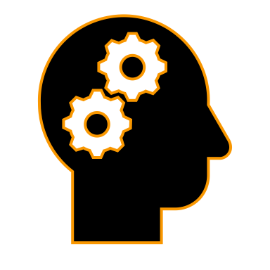
NLP
Natural Language Processing, also shortened to NLP, is a subfield of artificial intelligence (AI).
It helps machines process and understand the human language in any given context so that they automatically can carry out repetitive tasks such as machine translation, summarization, ticket classification, and more.

Slide 5
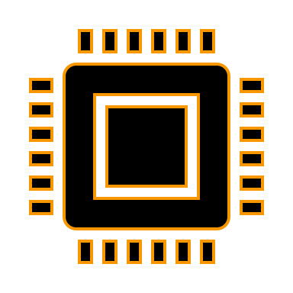
DSP
Digital Signal Processors (DSP) take real-world signals like voice, audio, video, temperature, pressure, or position that have been digitized and then mathematically manipulate them.
Signals need to be processed so that the information that they contain can be displayed, analyzed, or converted to another type of signal that may be of use.

Slide 6
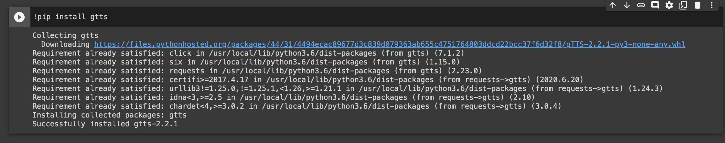
IMPLEMENTATION
STEPS TO BE FOLLOWED:
First, install gTTS library using the command:
Second, import google text to speech from gtts and audio method from IPython display class

Slide 7
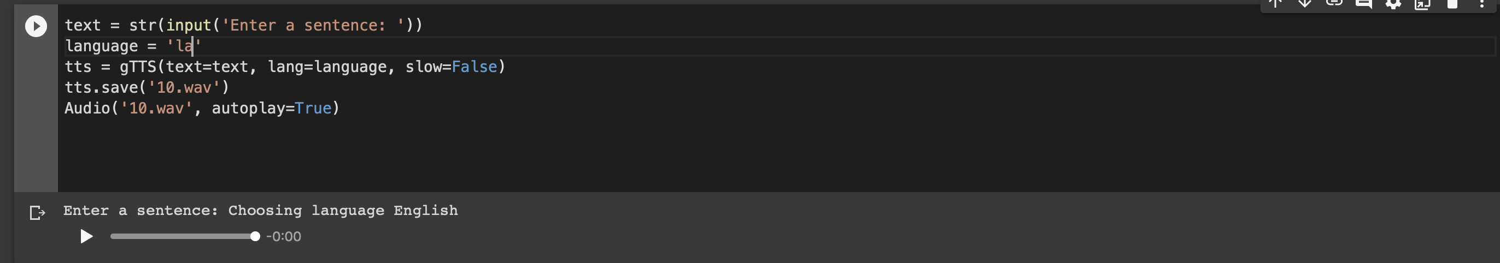
implementation
Creating a text variable which will take an input from the user and convert into audio.
gTTS supports multiple languages. Select ‘en’ for English and stored in the language variable.
Creating an object called tts and passing the text and language to the engine. Marked slow = False which tells the module that the converted audio should have a high speed.
Saving the converted audio in a .wav file named called ‘10.wav’

Slide 8
Conclusion
The gTTS module can be used extensively on other languages such as French, German, Hindi, etc.
This is extremely useful when there is a communication barrier, and the user is unable to convey his messages to people.
Text-to-speech is a great help to the visually impaired people or people with other disabilities as it can help them by assisting in the text to speech translation.
There are also many ideas possible with the gTTS module and it can be used for other languages as well.

