Slide 1


A project report
on
.
By
Manasi Samanta
Java full Stack Developer
Batch: 2020 – 5762 Center: Bangalore Sprayas
Under the guidance of ,
Cittaranjan Ghosh
Technical Trainer
EduBridge

Slide 2
Introduction
The project named “Placement Management System”, a student/company information system is a window based application , that can be accessed throughout the Organization and outside as well with proper Login provided . The project has been developed on the basis of “Placement Cell” being presently used in the Organization for storing and retrieving the information of students and companies who are registered in placement cell. The Placement Cell maintains a large database of students where in all the information of student including the personal records and the academic performance in terms of the marks and grades is stored and company information including resume of company and facilities it provide. The software retrieves this data and displays as per the user requirement .

Slide 3
Objective
I developed this project using different kind of application like Java, JSP, Servlets, Hibernate, Thymeleaf and MySQL. It’s a web-based project so I have used HTML,CSS, JavaScript and Bootstrap .
It mainly explains about various actions related to recruiter system in online. You can apply to various kind of jobs available in the portal.

Slide 4
Modules
Admin Module
Student Module
Recruiter Module
I have developed this Application in Java, JSP, Servlets , Hibernate and MySQL . It’s a web-based projects so I have used HTML, CSS, JavaScript and Bootstrap also.

Slide 5
Purpose
Admin Module
In Admin Module ,admin the manage all the portal of recruiter and student where all the details are mentioned about the jobs.
The Admin can make change in any portal because they have access to do whatever needed to change.
They can view the applied jobs, view the resume of student and also delete the category of job.

Slide 6
Student Module
In Admin Module ,admin the manage all the portal of recruiter and student where all the details are mentioned about the jobs.
The Admin can make change in any portal because they have access to do whatever needed to change.
They can view the applied jobs, view the resume of student and also delete the category of job.

Slide 7
Recruiter Module
In the recruiter module they upload various kind of jobs from different company’s.
The status of the job application can be changed by them when the candidate applied to.
The recruiter details will also be stored in the portal.

Slide 8
Software Requirements
Front end: Java/J2EE technologies (Servlet, JSP), HTML, CSS, JavaScript, Bootstrap, Hibernate.
Back end: MySQL workbench 8.0.23CE.
Middleware/Server: Apache Tomcat v8.5. IDE: Eclipse IDE for Java EE Developers.
Browser: Best result on Google Chrome
Operating System: Window 10.

Slide 9
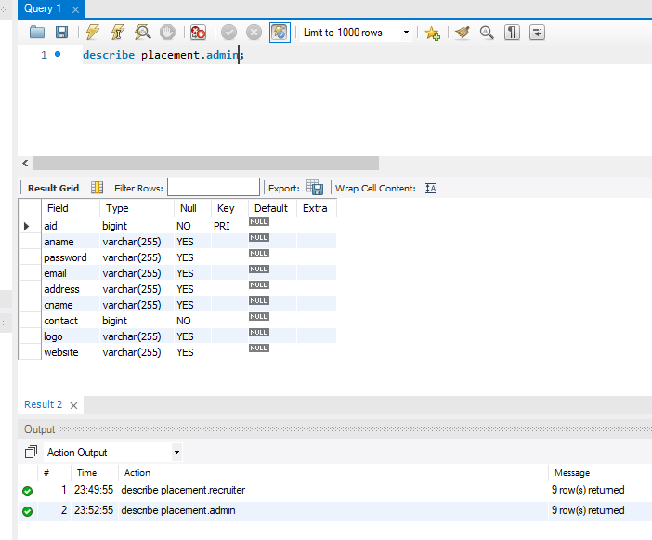
Data Dictionary SCREENSHOTS
Database table for Admin

Slide 10
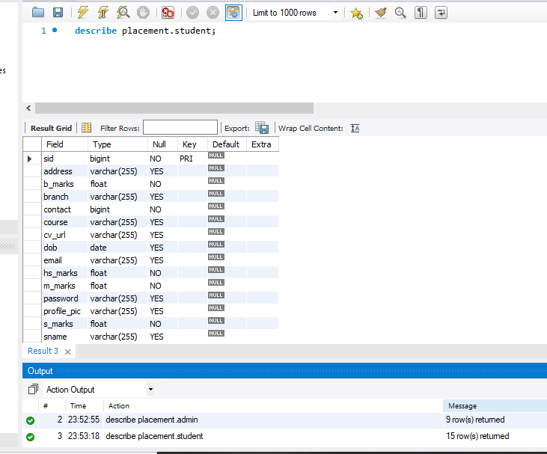
Database table for Student

Slide 11
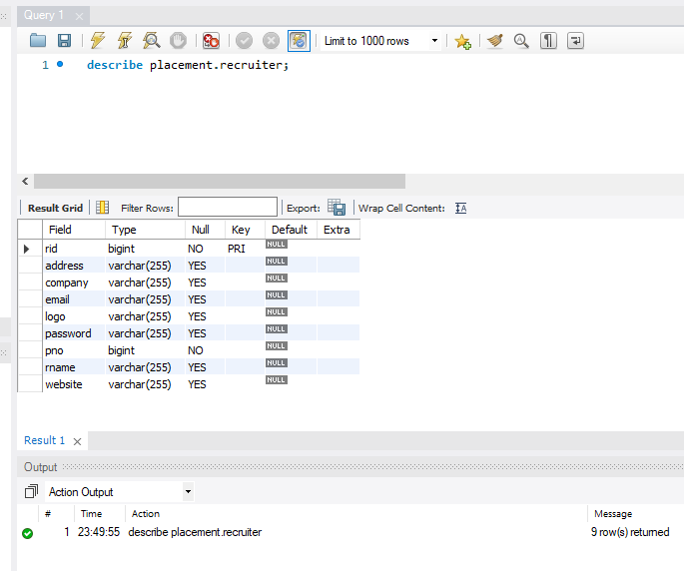
Database table for Recruiter

Slide 12
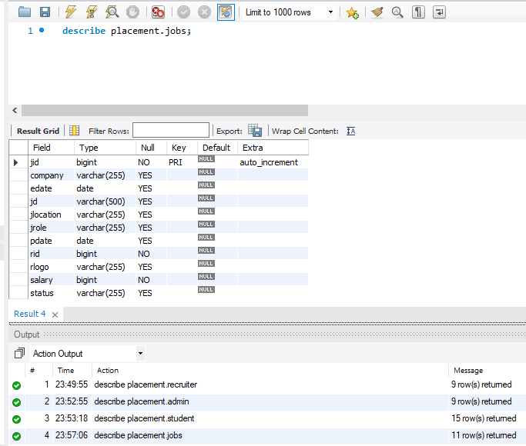
Database table for Jobs

Slide 13
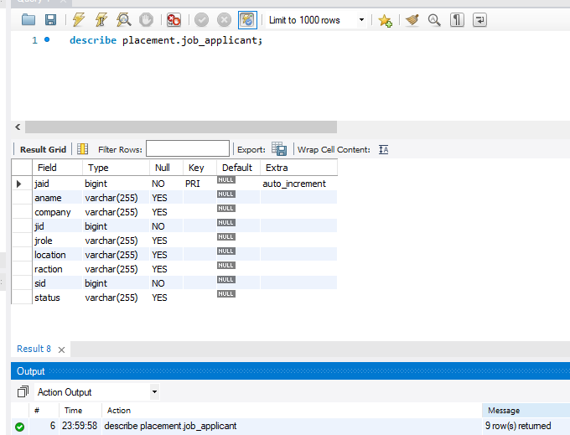
Database table for Job_Applicant

Slide 14
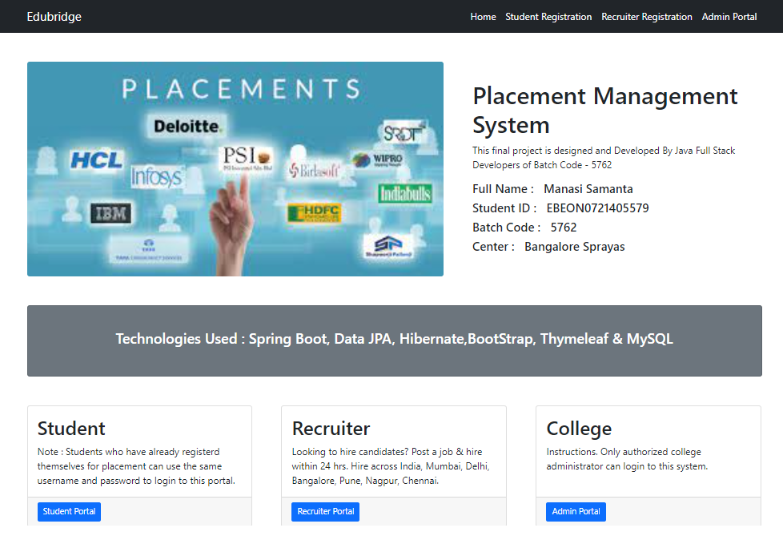
Home Page

Slide 15
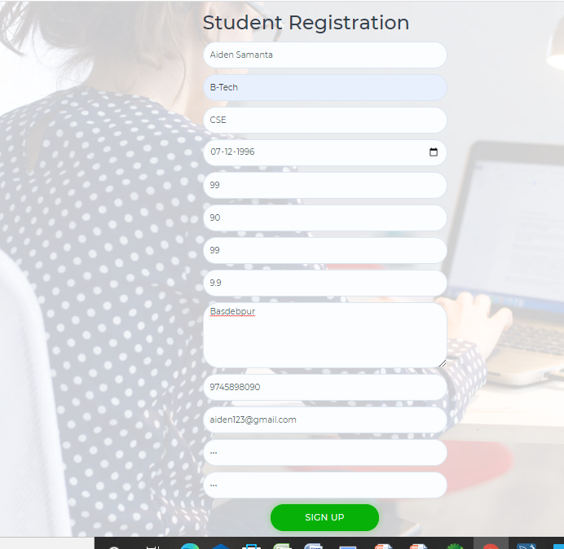
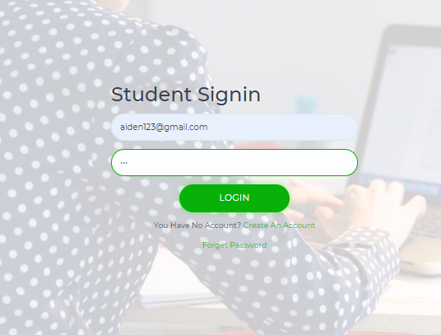
Students details page
Students Signup/Login Page

Slide 16
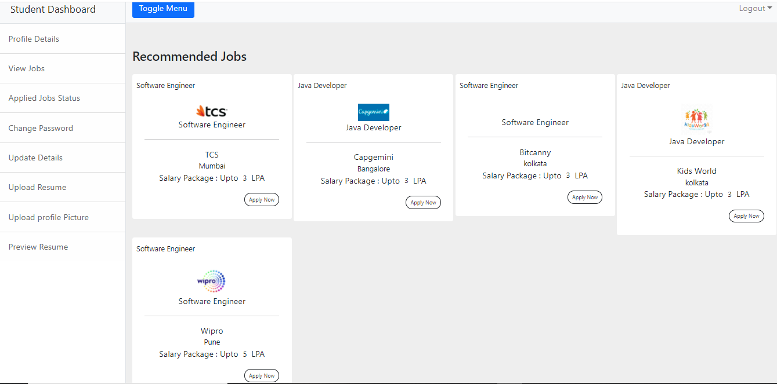
Student view jobs

Slide 17
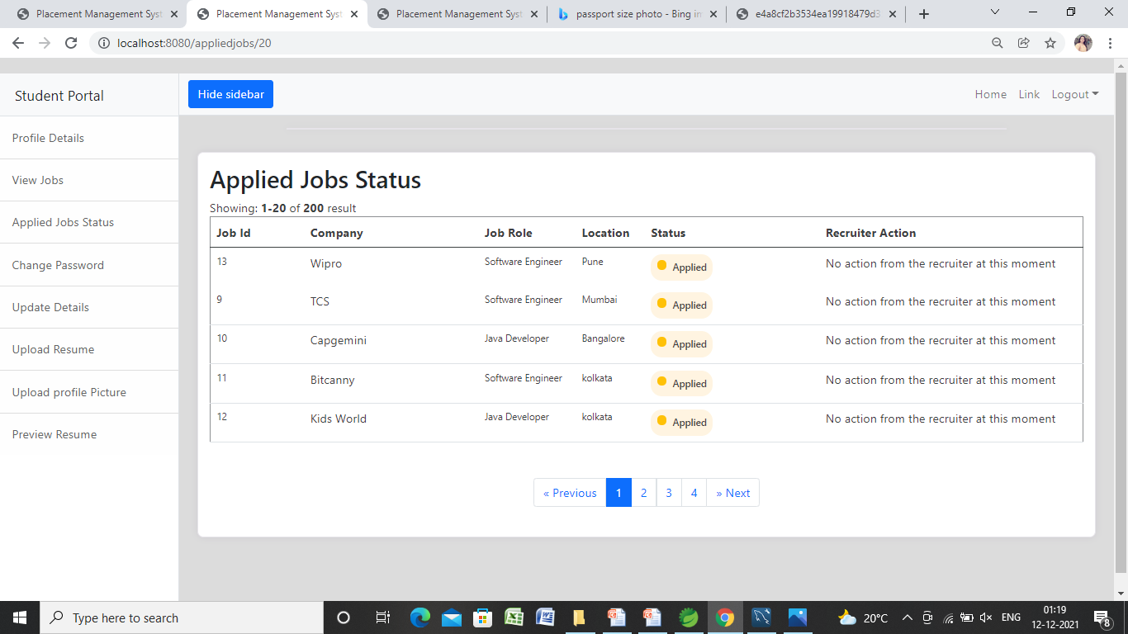
Student Applied jobs page

Slide 18
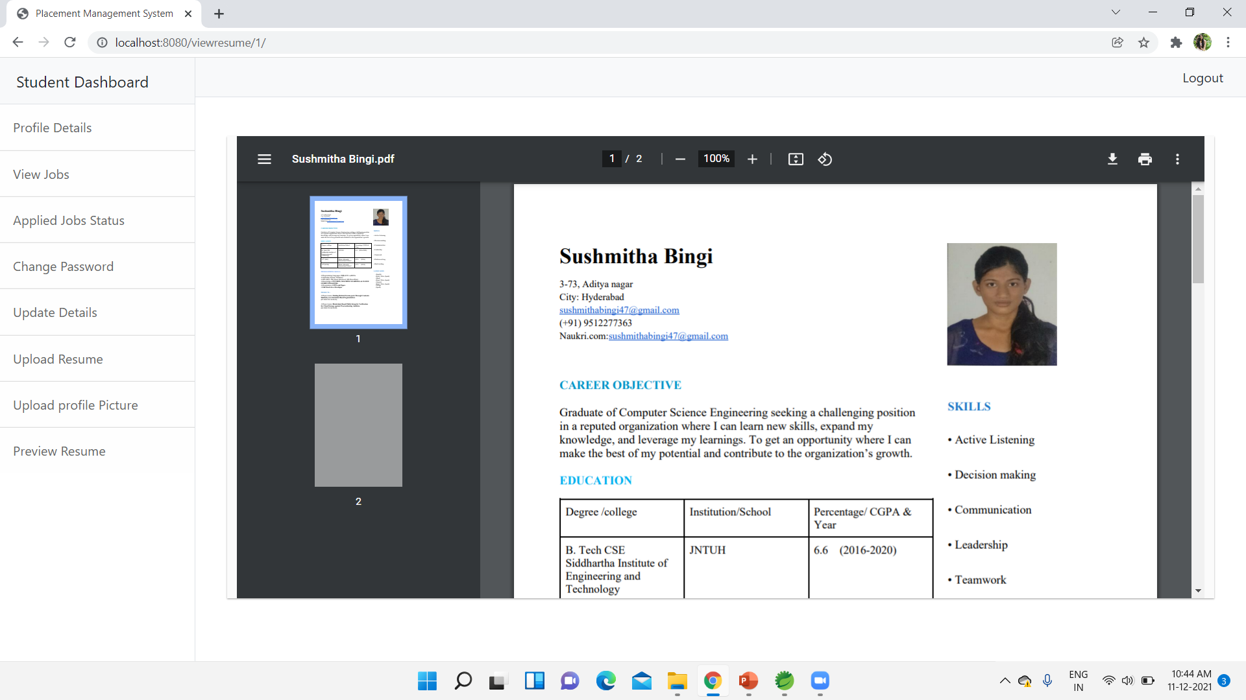
Students preview resume page

Slide 19
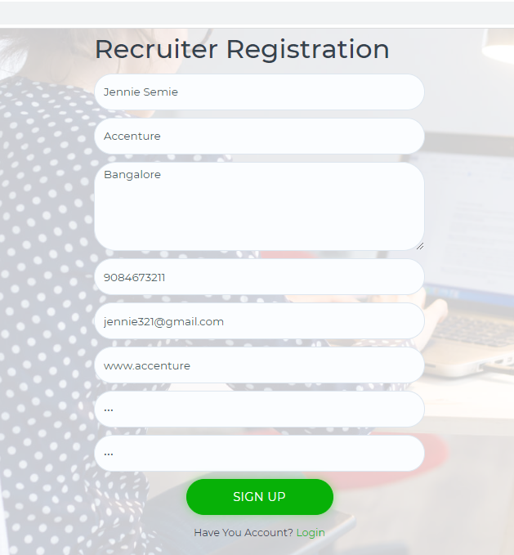
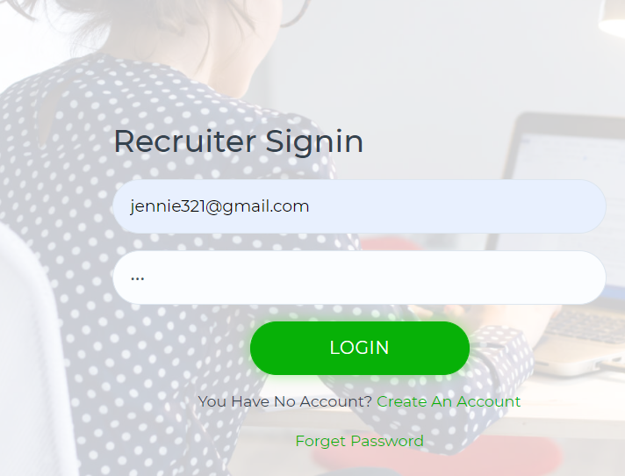
Recruiter details page
Recruiter Signup/Login Page

Slide 20
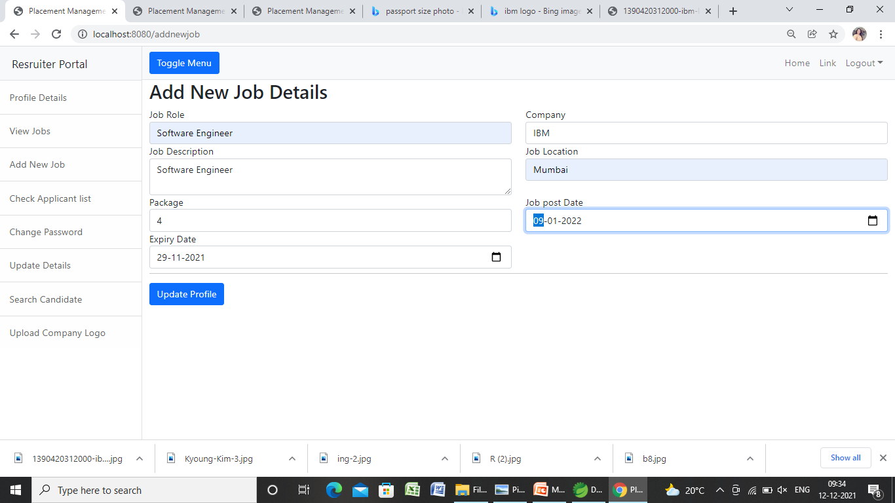
Recruiter add new job page

Slide 21
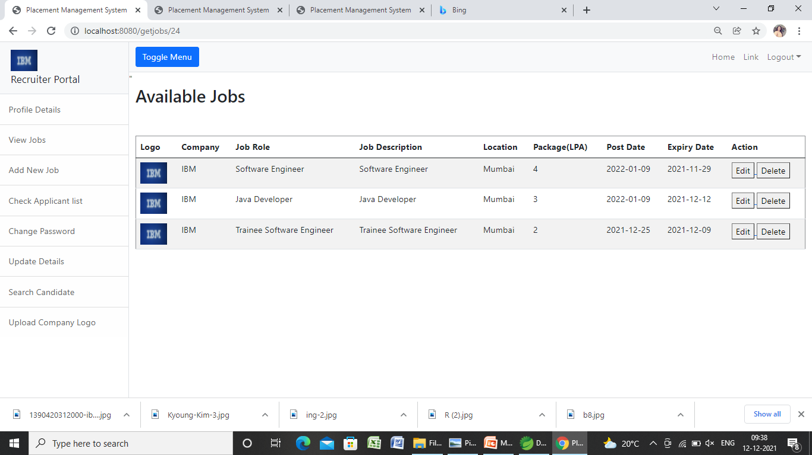
Recruiter view job page

Slide 22
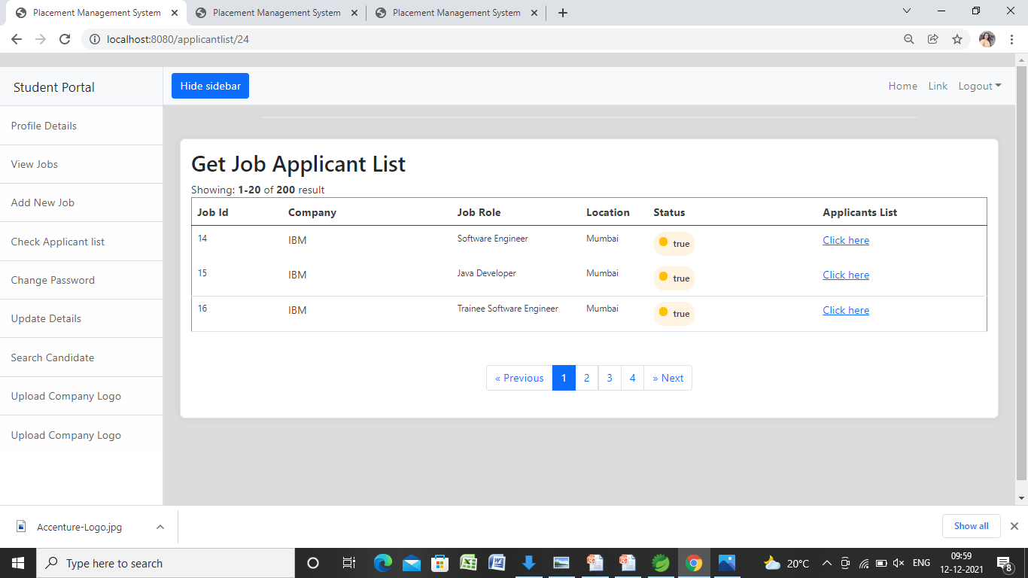
Recruiter applicant list page

Slide 23
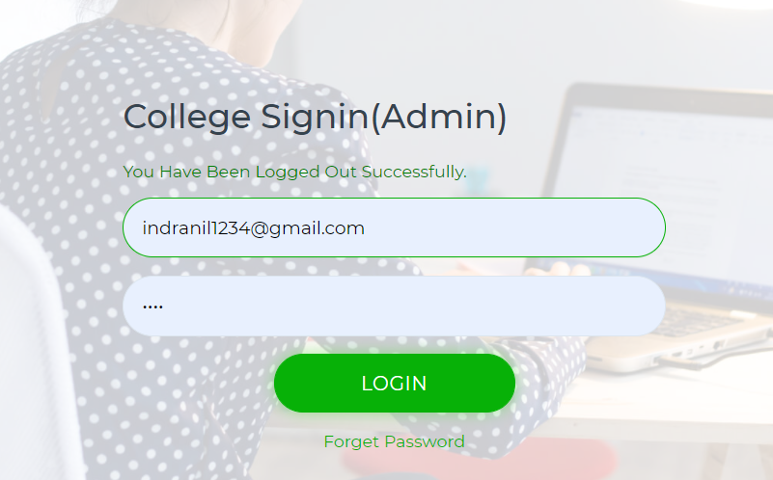
Admin manage Student page
Admin Login Page

Slide 24
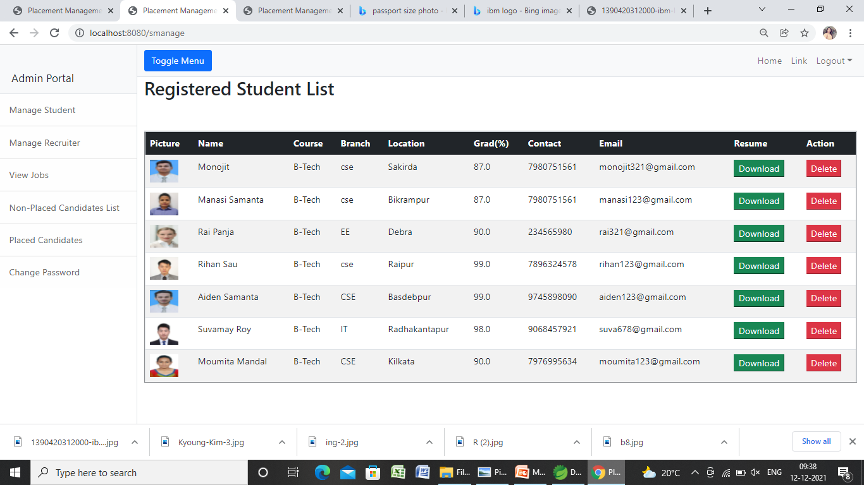
Admin manage Student page

Slide 25
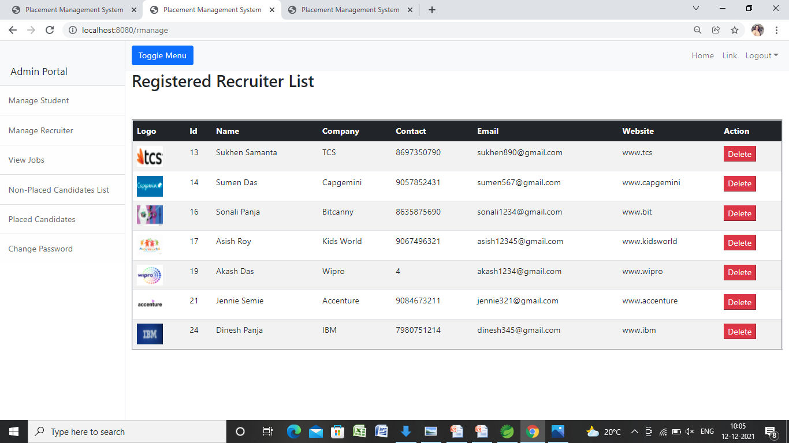
Admin manage recruiter page

Slide 26
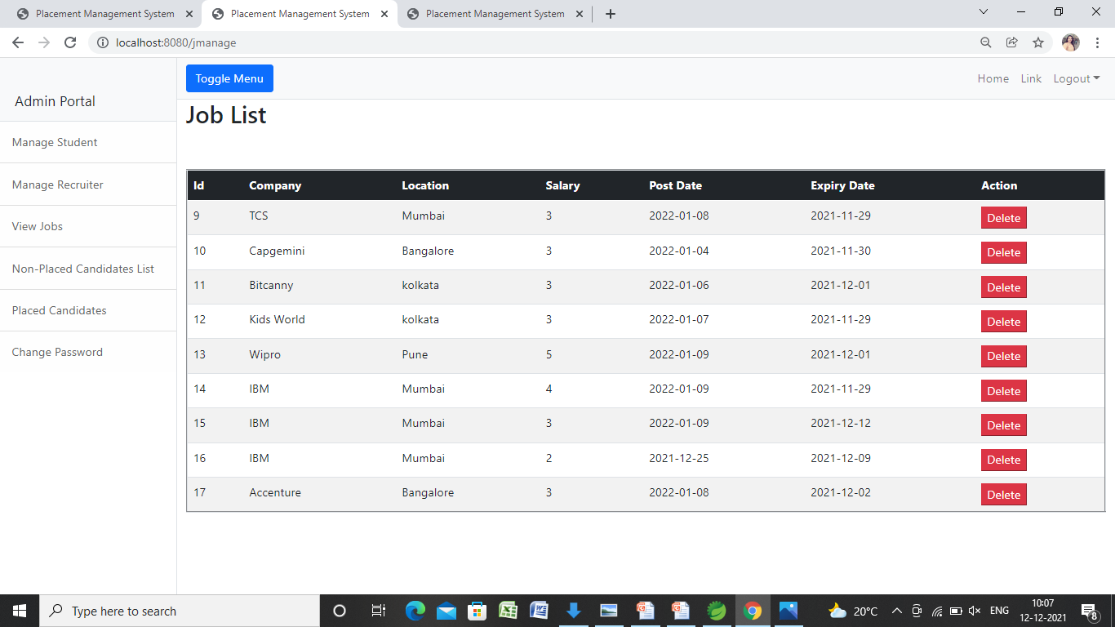
Admin manage jobs page

Slide 27
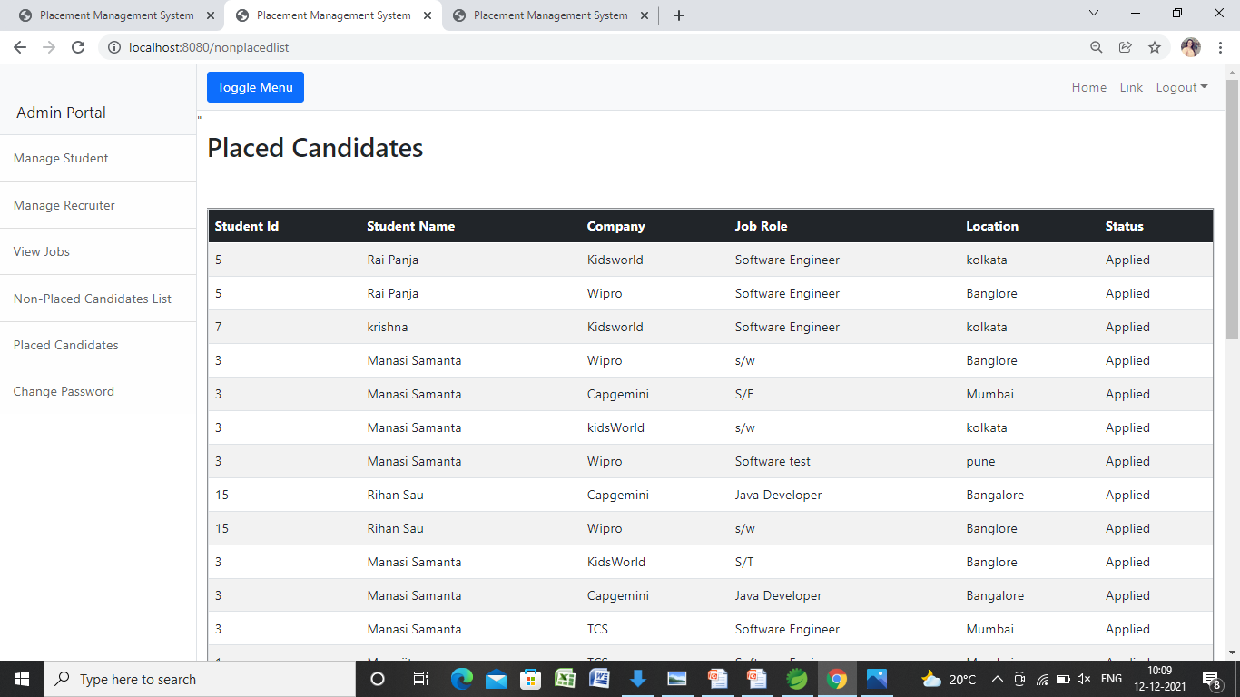
Admin non-placed candidate page

Slide 28
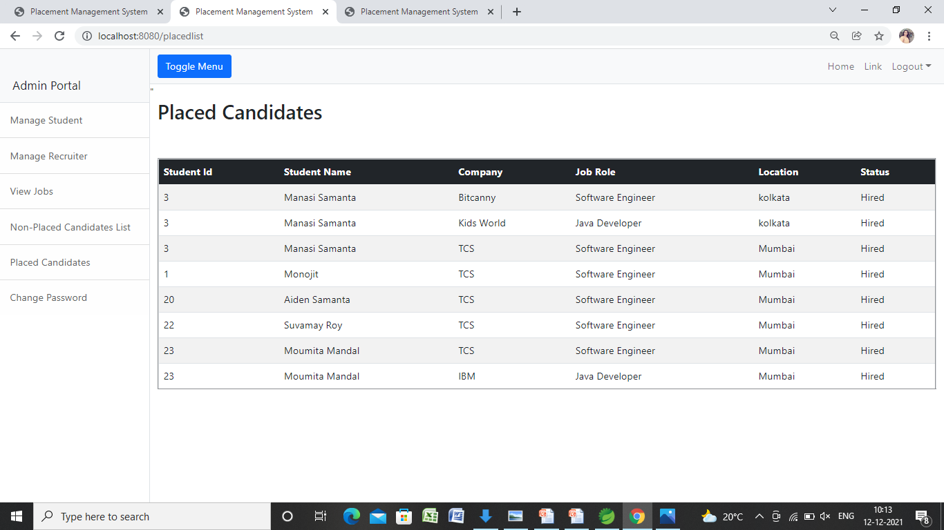
Admin placed candidate page

Slide 29
Conclusion
The Placement Management System was developed as an attempt to take a record of company and students by restricting such a large database to that of a particular class of students or company.. The System provides the facility of viewing both the personal and academic information of the student and company it can also search for eligible students and company and also insertion and deletion of records by the administrator. The GUI used for the project provide instruction and the various actions performed on button clicks or on selection of items, guide the user through a series of pages as in the Project .

Slide 30
THANK YOU!
.

